Slide 1
MESS MANAGEMENT SYSTEM
BY-ASHISH SHARMA(171B039)
ANCHIT KHARE(171B033)
DESH DEEPAK CHAUDHARY(171B045)
UNDER-
DR. PRATeeK PANDEY

Slide 2
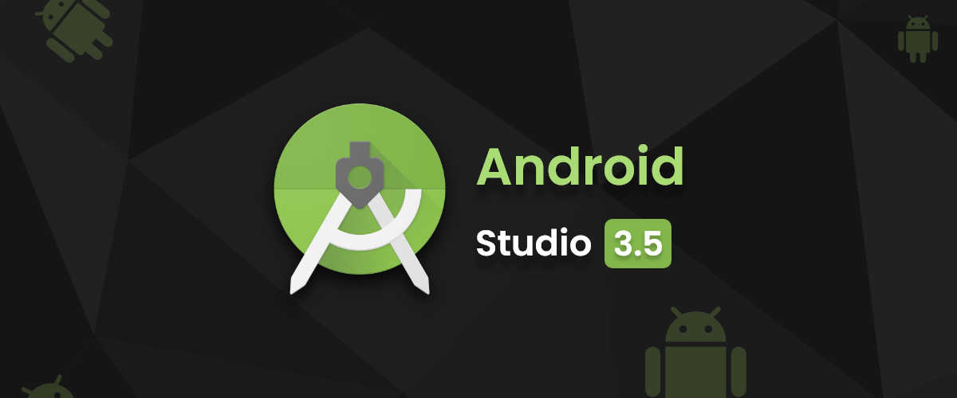
Prerequisites and Requirements
1. Android Studio
Android Studio is a development tool, used to develop Android Application.

Slide 3
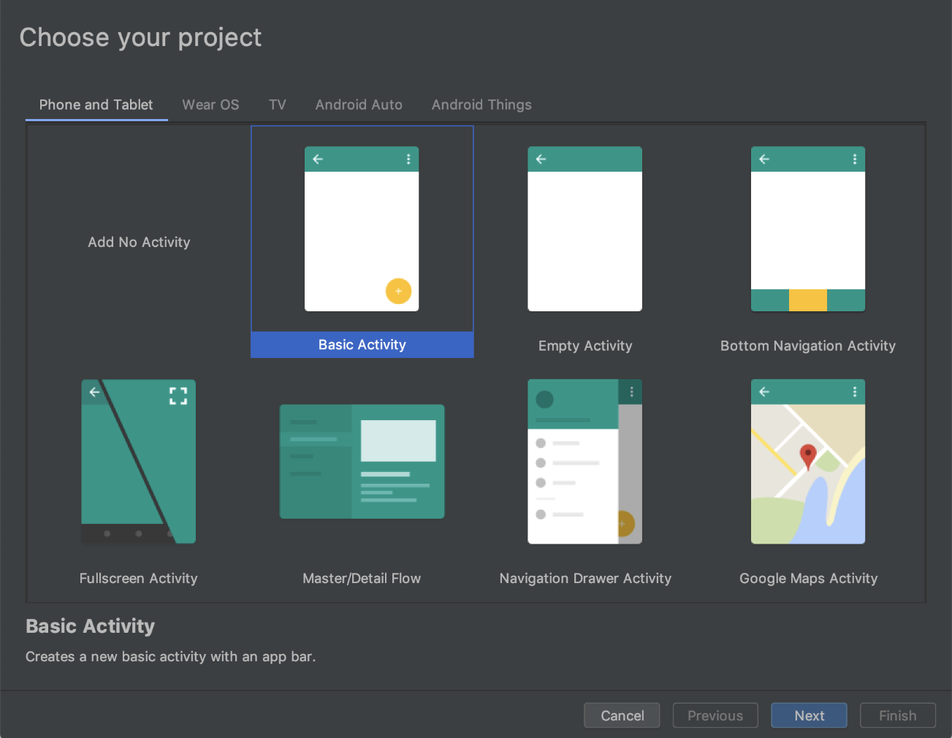
Android Studio is the official integrated development environment (IDE) for Android application development. It is based on the IntelliJ IDEA, a Java integrated development environment for software, and incorporates its code editing and developer tools.

Slide 4
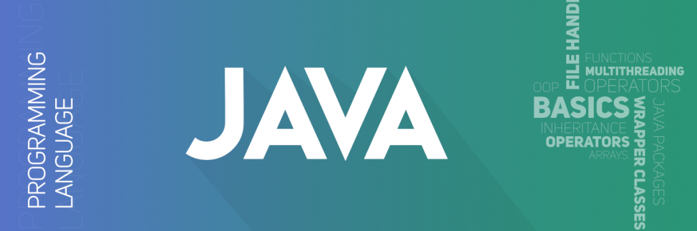
2. JAVA
Java is a widely used programming language expressly designed for use in the distributed environment of the internet. Java can be used to create complete applications that may run on a single computer or be distributed among servers and clients in a network.

Slide 5
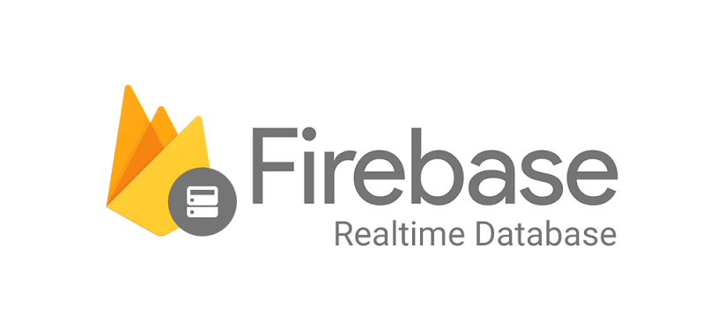
3. Firebase
The Firebase Realtime Database is a cloud-hosted NoSQL database that lets you store and sync between your users in realtime. ... When your users go offline, the Realtime Database SDKs use local cache on the device to serve and store changes. When the device comes online, the local data is automatically synchronized.

Slide 6
What is MMS?
Mess Management System: An Integrated Application for android systems which will help students to get better food than ever. By the help of MMS, students will be able to choose among different options made available by the mess in charges.
It will help in sustainable development as it will count number of students going to the mess everyday by marking their present by the application.
It will judge the overall involvement of the students towards the food prepared by the mess.

Slide 7
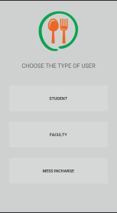
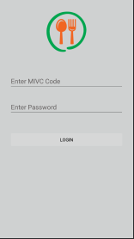
THE APPLICATION:
This will allow the user to choose between the mess incharge, Student and faculty.
Within the option of Mess Incharge, the user will be able to login by a special code that will be provided by the administrator.

Slide 8
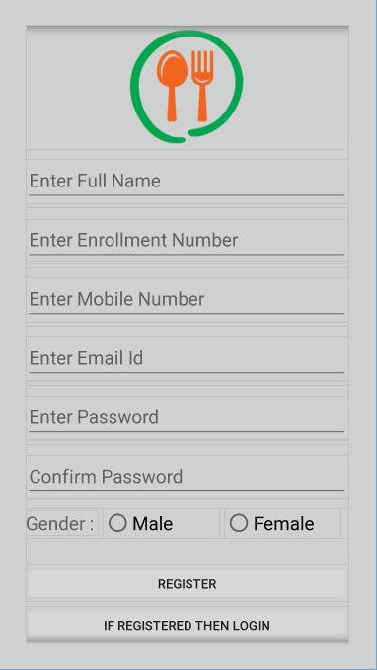
Student and Faculty view Registration Page-

Slide 9
Registration contd…
Students will register themselves in the application.
Application will take their personal details other than the official private data like the webkiosk details, this data will be transparent and will work towards the betterment of community by enhancing sustainable development and negligible wastage of food.
Students just need to register with the help of their E-mail, Phone Number, Gender, Enrolment number of college, and a new password which will lead to private login of the student and all away from personal details like password of email etc.

Slide 10
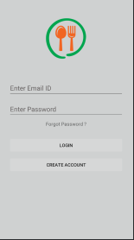
Login Page:-

Slide 11
Login contd…
By this page, students will be able to get in their application, it is a simple process which will allow students to login with the help of their Enrollment Number and the password which they opted for during the registration.

Slide 12
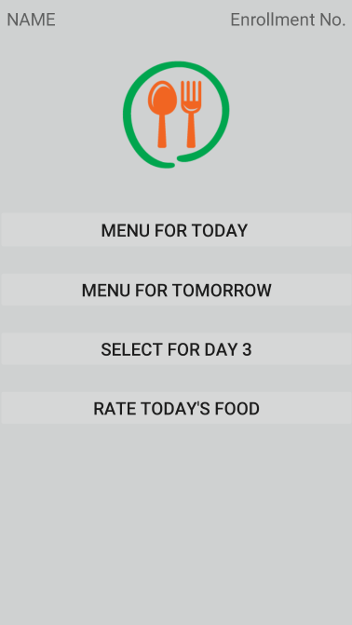
Page 1:- This page will allow the user to view the menu for the present day’s food and the menu for next day’s food. User will be able to vote for the menu for the third day from present day and can rate the quality of the food for the present day.

Slide 13
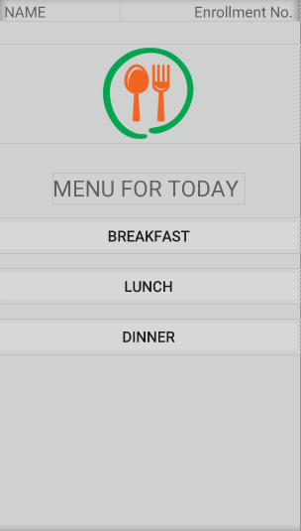
Page 2:- This page will allow the user to view the menu for present day. It will have three separate parts for the Breakfast, Lunch and Dinner It will mark the attendance for the day.

Slide 14
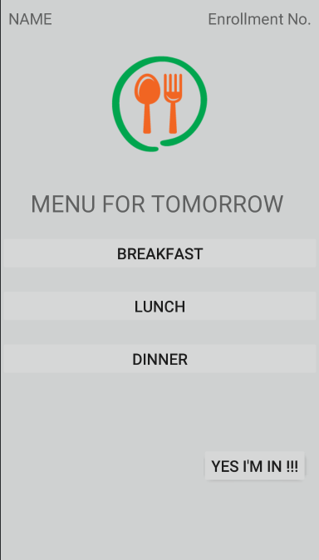
Page 3:- This page will allow the user to view the menu for next day. It will have three separate parts for the Breakfast, Lunch and Dinner It will mark the attendance for the day.

Slide 15
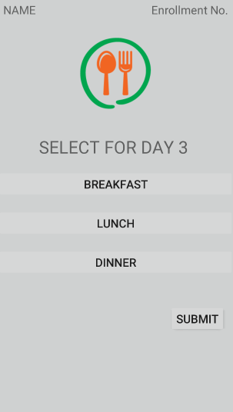
Page 4:- This page will be a polling page, which will allow students to vote for the menu for the third day for their Breakfast, Lunch and Dinner from the available choices. The polls will be then evaluated and the food in the mess will be prepared on the basis of polls.

Slide 16
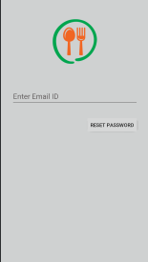
Forgot Password:
Under this page the application will
ask the user to enter its Email ID:

Slide 17
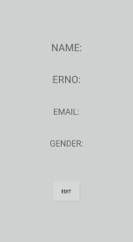
Edit Profile:
In this section of app, the user will be able to update its mobile number only, other things can not be changed.

Slide 18
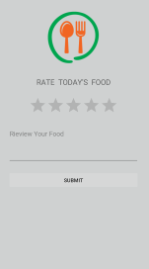
Rate Food:
User will be able to rate the food that he/she had on the same day.
Rating will be given by marking the star rating.
User will be able to write feedback.

Slide 19
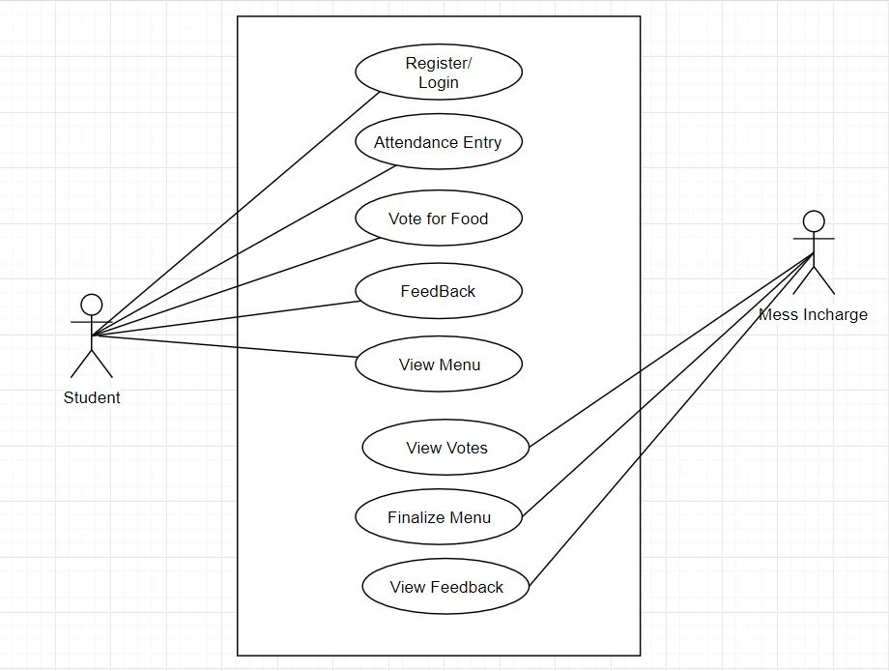
Use Case Diagram

Slide 20
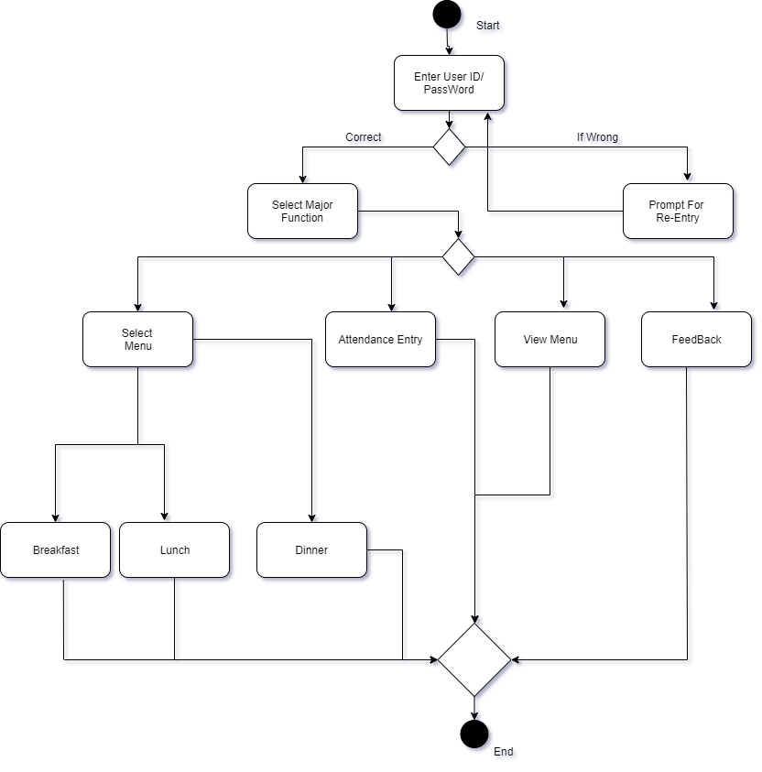
Activity Diagram- Student

Slide 21
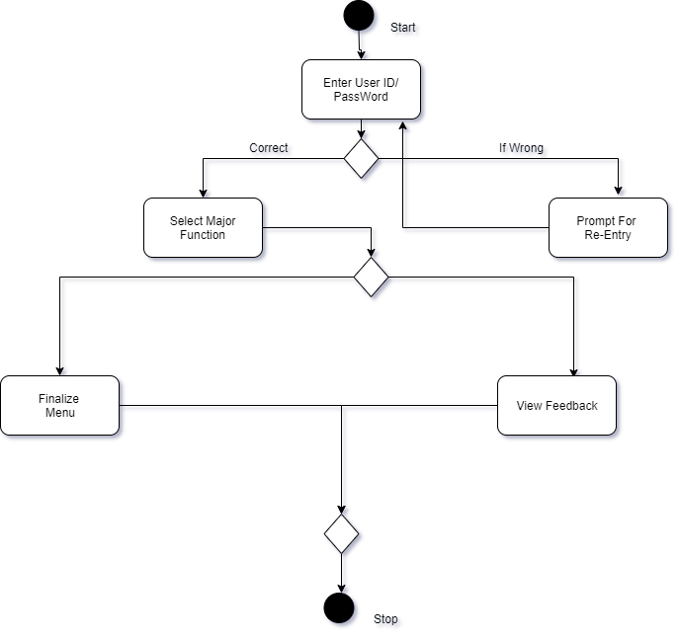
Activity Diagram- Mess In charge

Slide 22
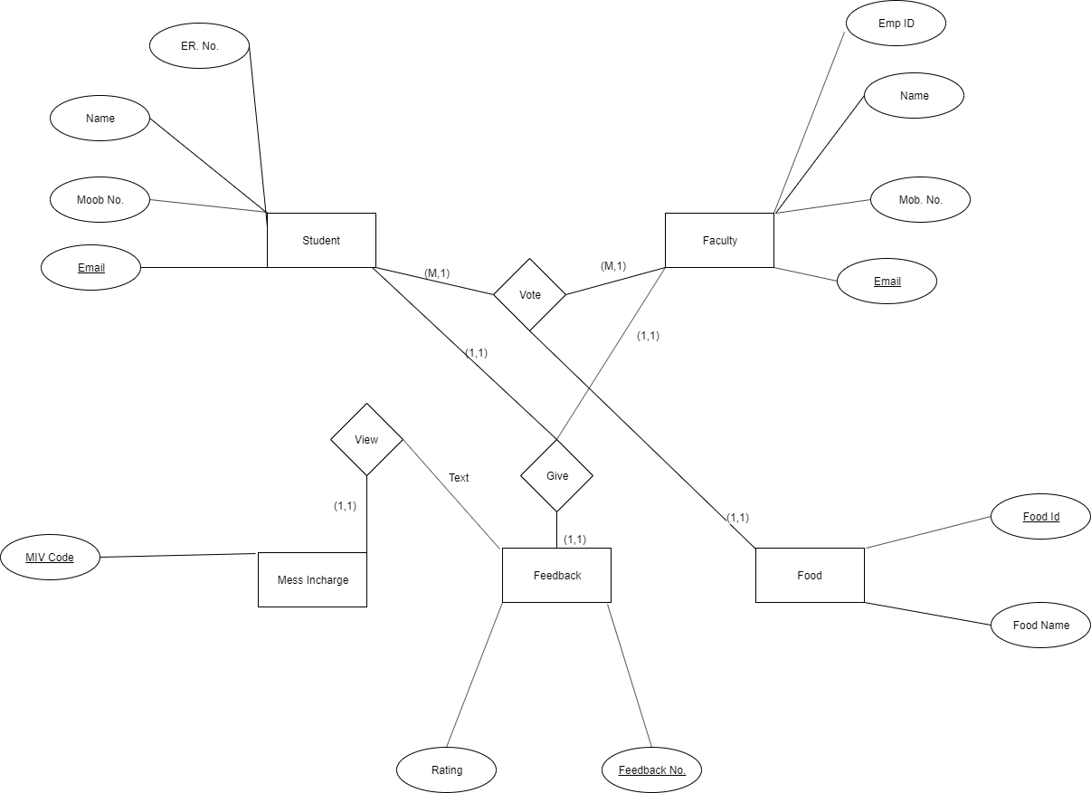
Entity – Relationship Diagram

Slide 23
Motivation
Due to excessive wastage of food, a lot of our Planet Earth’s resources are being wasted. Our project will help to monitor the wastage of food at a intermediate level as it will closely monitor the user’s activity towards the messes all around.
Our project will see the activity at our college level and it can be deployed at other places where mess system is being managed, which will help to conserve the resources at a higher level.

Slide 24
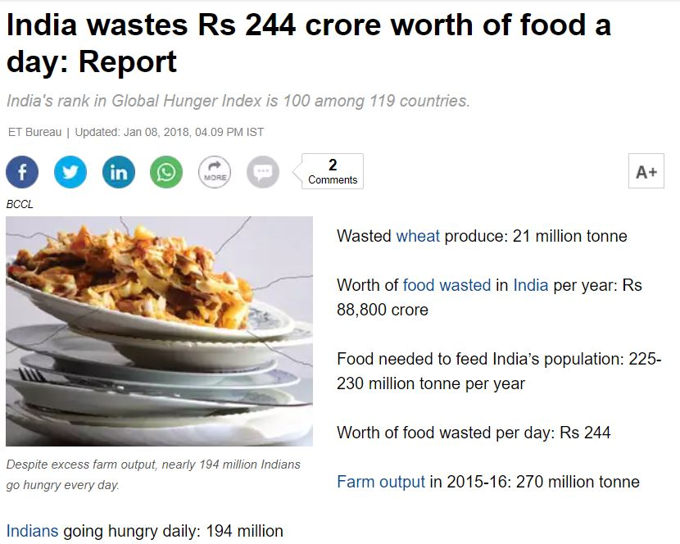
According to Economic Times-

Slide 25
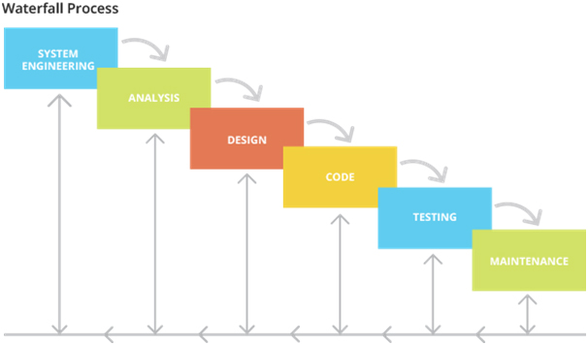
Approach towards the Project:- Modified Waterfall model

Slide 26
Modified waterfall model contd…
The modified waterfall model uses the same phases as the pure waterfall model. In response to the perceived problems with the pure waterfall model, modified waterfall model have been introduced. This enables the phases to overlap when needed.

Slide 27
After the P2 Evaluation:
We Added A couple of Hundred Lines of code to the application.
Some final touches.
Data Entries.
Connecting Our Backend to the Database.

Slide 28
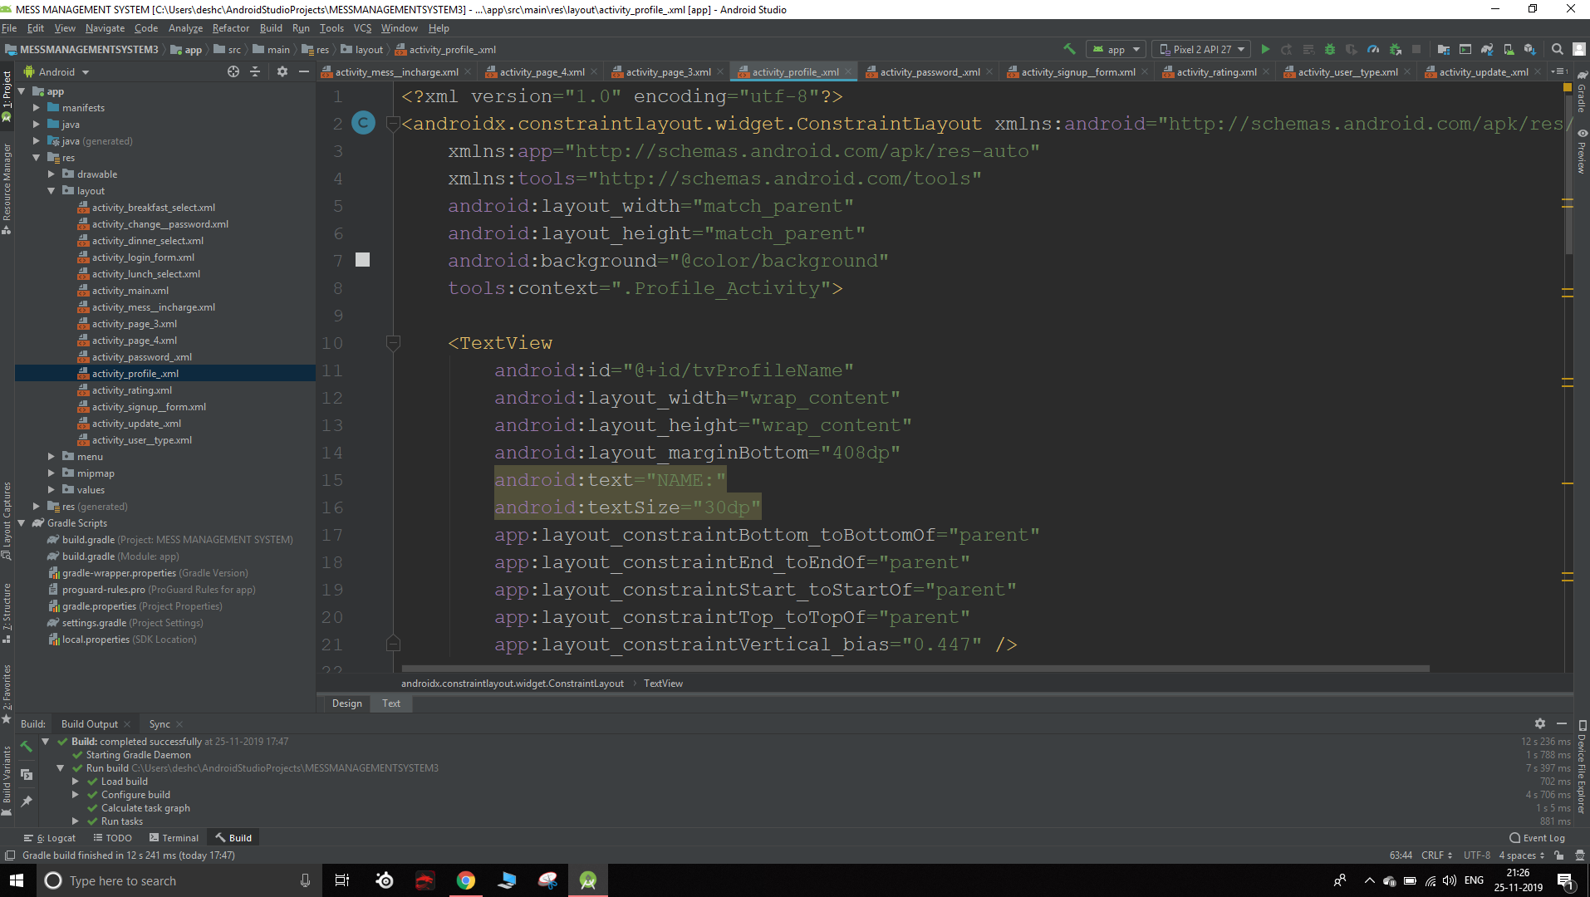

Slide 29
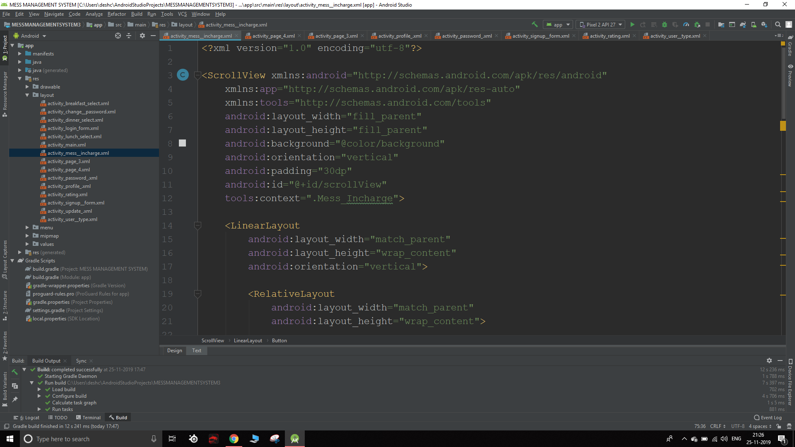
Turning our Idea to the reality.

Slide 30
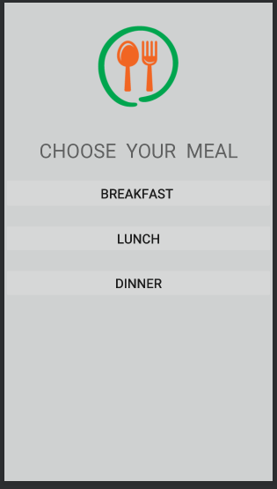
Choosing the meal for Day 3 from the given choices of food.

Slide 31
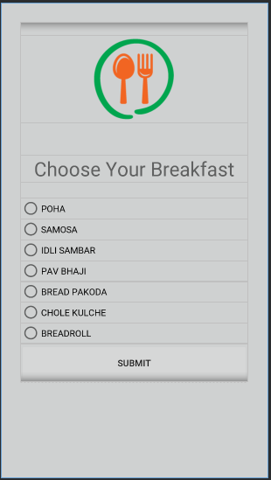
Third Day’s Breakfast Polling.

Slide 32
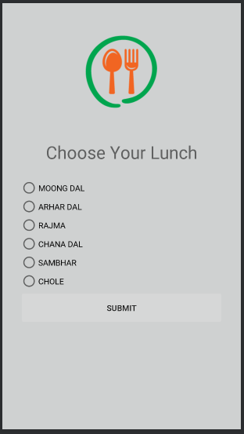
Third Day’s Lunch Polling.

Slide 33
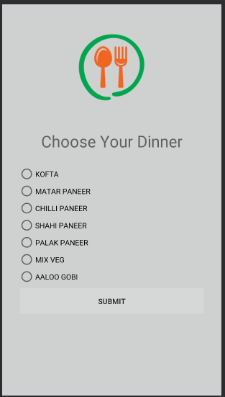
Third Day’s Dinner Polling.

Slide 34
Menu:
The above enlisted radio buttons and menu option is from the Annapurna of “Jaypee University Of Education and Technology, Guna”.
All we did is just loaded the menu options from the Mess Premises and connected the backend to the polling page.
The Dish with highest polls will be visible to the Mess Incharge.

Slide 35
Journey
We got some excellent guides and mentors who helped us throughout the making of our Application.
Each line of our code taught us something new, we got some real floor base Ideas of developing a Android Application or a project related to teamwork.
The code now finally works and it combines to form an Application with over “2500 LOC in JAVA”.

Slide 36
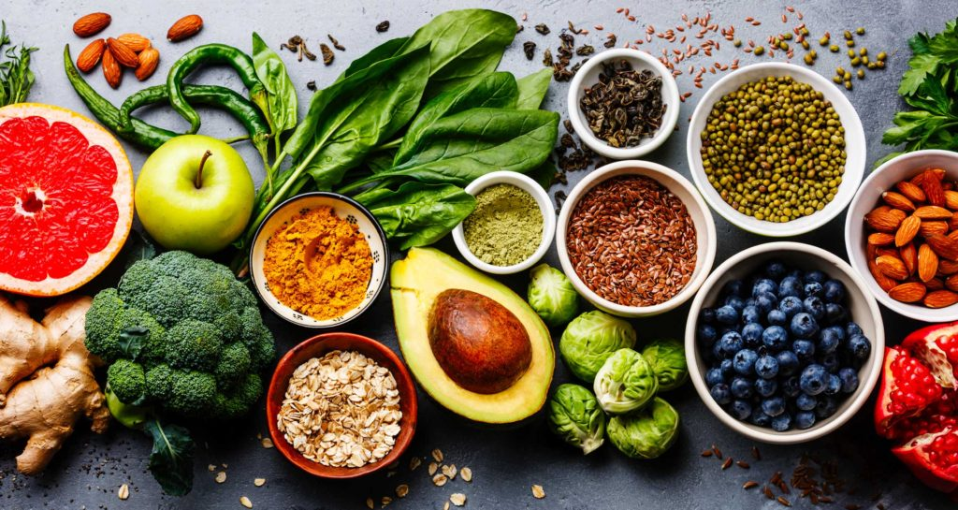
DOMAIN:- FOOD AND MANAGEMENT

Slide 37
Bibliography:
Android Studio 3.5- https://developer.android.com › docs
Java- https://docs.oracle.com › java
YouTube
Google Images

Slide 38
THANK YOU!

