Slide 1


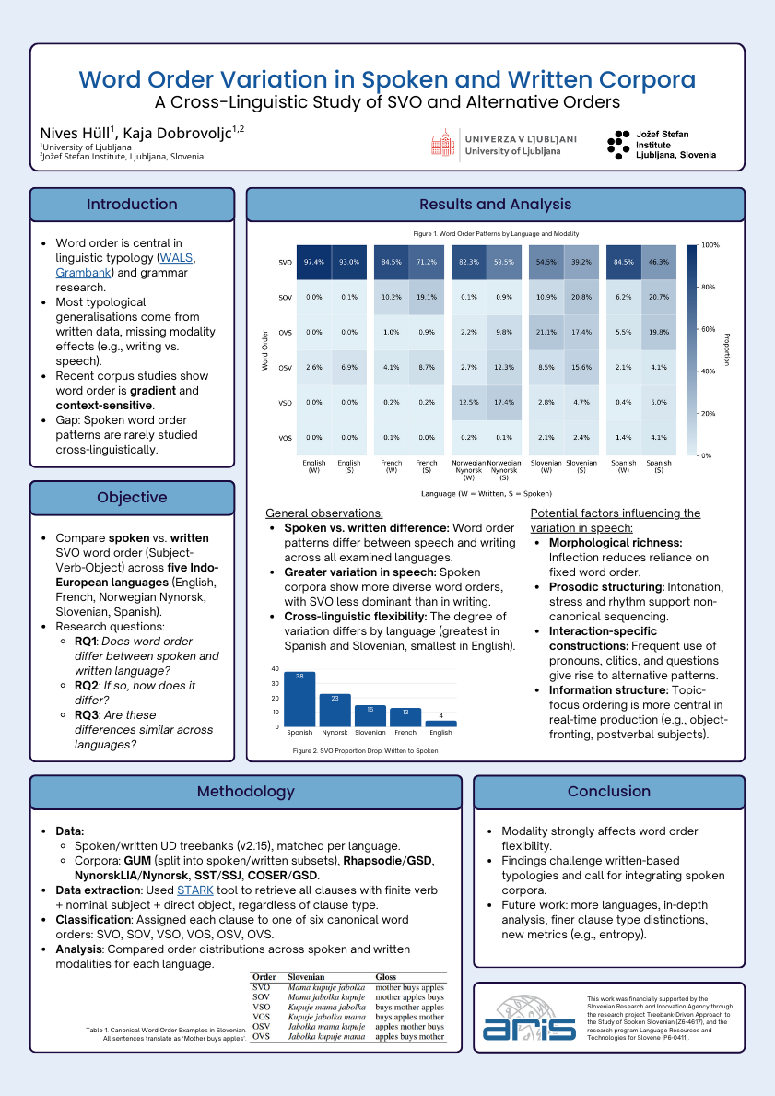
Word Order Variation in Spoken and Written Corpora A Cross-Linguistic Study of SVO and Alternative Orders
Nives Hüll, Kaja Dobrovoljc
Background:
Most word order generalizations rely on written corpora, overlooking speech.
Objective:
Compare SVO orders in spoken vs. written UD treebanks across five languages (English, French, Spanish, Slovenian, Nynorsk).
Key Observations:
Word order differs by modality.
Greater flexibility in speech, SVO less dominant.
Variation differs across languages.

