Slide 1
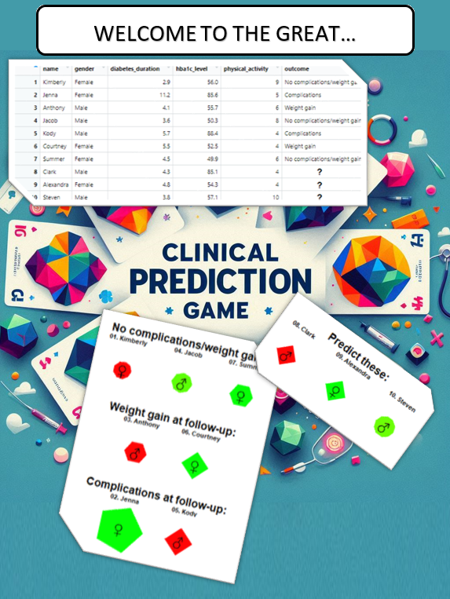

Slide 2
Scenario
You want to develop a CVD & weight gain prediction model
You went out and collected 4 variables at baseline + follow-up CVD/weight gain data
Unfortunately, your data was corrupted
Your data manager is restoring the data, but for now, variable names are blank...

Slide 3
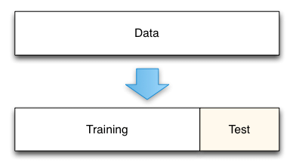
LET’S GO!
Design a classification/prediction model
Based on the available data in the ”training set” (30 cards)
Highest accuracy on the held-out test set WINS!

