Slide 1
Sales dashboard
Huma Naveed

Slide 2
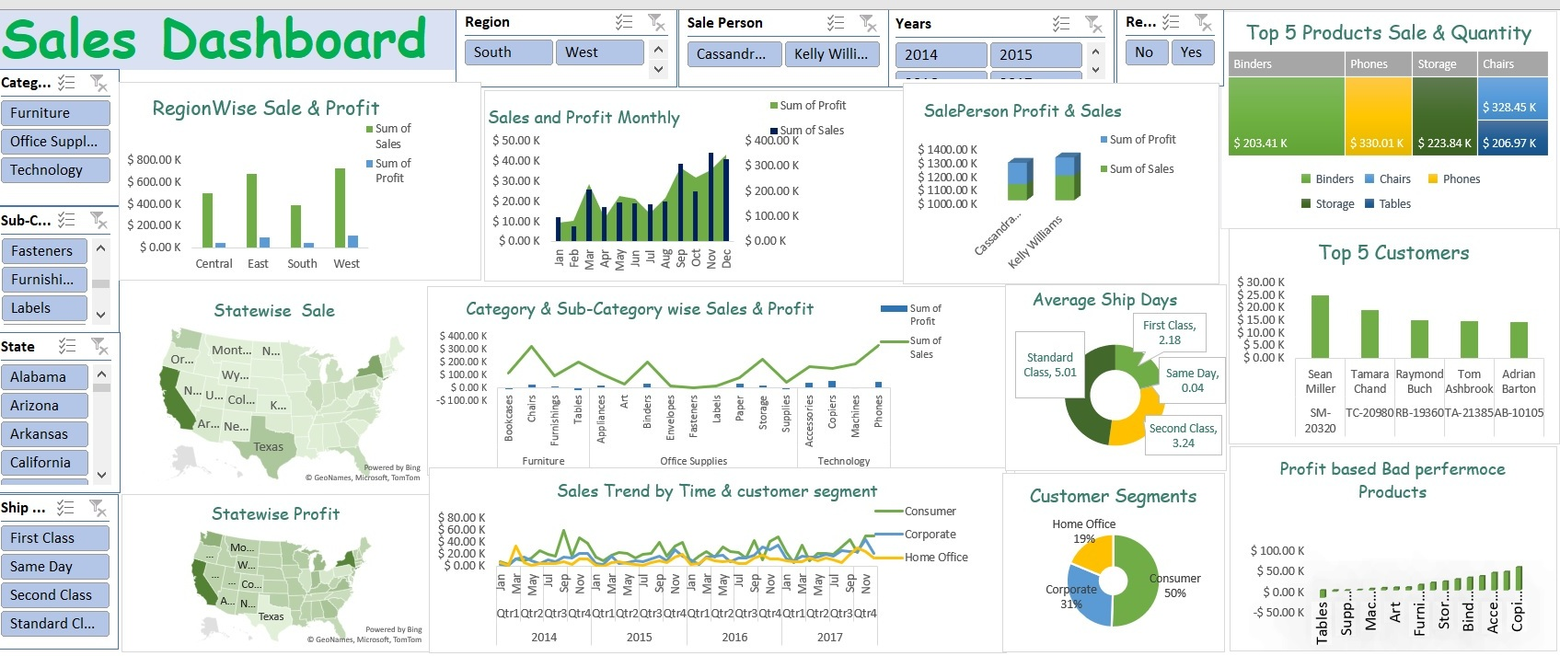

Slide 3
Data Stories
There are three stories in this data
Sales Trend
Products Associations
Customer segmentation

Slide 4
Sale trends

Slide 5
Based on sale
On basis of Sale Analysis on done on
Region wise sale and profit
State wise Sale
State wise Profit
Month-wise sale and Profit

Slide 6
Region wise sale and profit
West has highest contribution to sales and profit
South has lowest contribution to sales and profit

Slide 7
Month-wise sale and Profit
Highest sale is November
Highest profit is in December
Lowest profit is in February
Lowest sale is in February

Slide 8
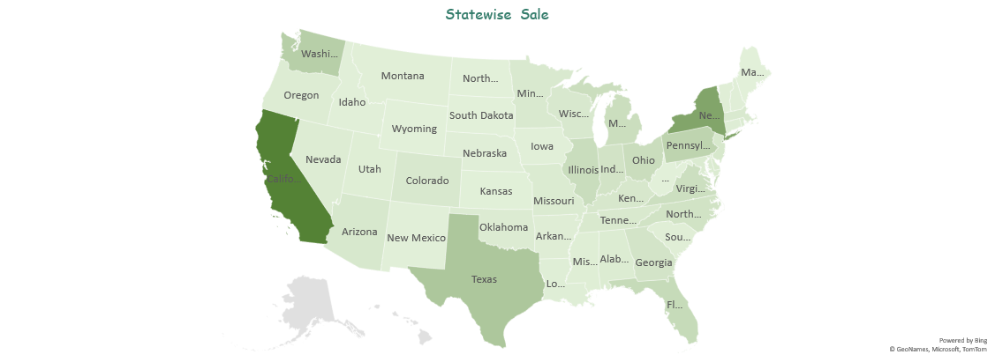
Sale on State
California has highest sale rate
North Dakota has lowest sale rate

Slide 9
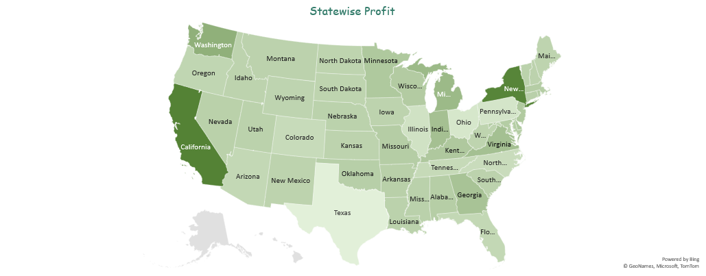
Profit on sale
California has highest profit rate
Texas has lowest profit rate

Slide 10
Product Trends

Slide 11
Category & Sub-Category wise Sales & Profit
There are three Categories
Furniture
Office supplies
Technology

Slide 12
Cont..
Furniture
Chairs and tables has good sales but Profit of table is negative
Office supplies
Binder has highest sales and profit
Supplies has lowest sales and profit
Technology
Phones has highest sales
Copies has lowest sales

Slide 13
Category & Sub-Category wise Sales & Profit

Slide 14
Customer Segmentation

Slide 15
Customer Segmentation
Highest sales are by consumers
Home office has lowest sales

Slide 16
ANALYSIS

Slide 17
Shipping days
Days taken to reach the destination after order data shows
Few order deliver on same day
First class are delivered fastest
Standard class order takes more time

Slide 18
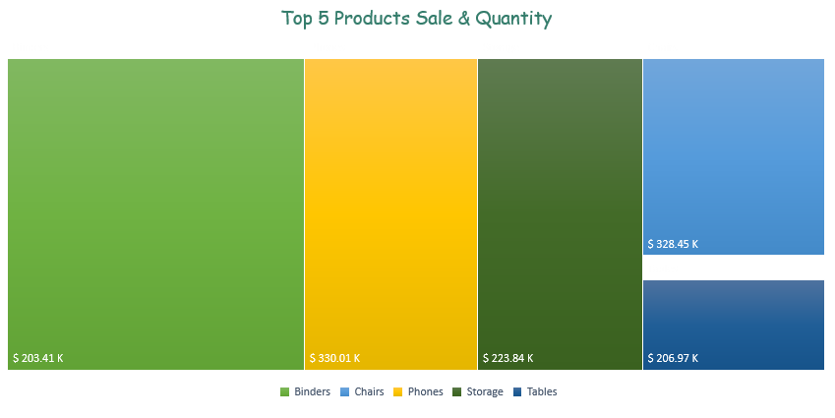
Top Products Sale & Quantity
Top 5 products bases on sales
and quantity are
Binders
Phones
Storage
Chairs
Tables

Slide 19
Top Customers

Slide 20
Bad profit products

Slide 21
Sales Trend by Time & customer segment

Slide 22
Sales person
Kelly Williams has highest sale
And profit

Slide 23
Thank-you

