Slide 1
Otolate for Odoo
Maël, Tanguy, Hugo, Cameron

Slide 2
Adherence to the theme
Office Olympics as a BeReal
Encourage participation from all team members,
Regardless of location (telework)
Energize any virtual office space

Slide 3
Features
Relevant challenges generated by an AI
Leaderboard between users
See challenges accepted by others

Slide 4





Relevant choice of technologies

Slide 5
The project aims to
Establishing a healthy competition
Bring dynamism by breaking boredom and routine
Constant team building
Challenges adapted to the professional world

Slide 6
The problem solved
Strengthen team bonds
Inspire creativity
Increase job satisfaction
Certifies less burnouts

Slide 7
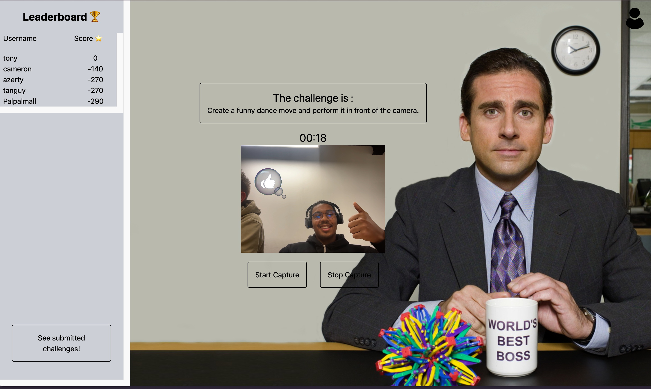
Let’s have a demo

