Slide 1

Nexus Service Marketing System
eProject · Telephone & Internet Services
Orders, feasibility, connections, postpaid billing and retail operations - one secure system for every role
[Your name] · [Batch] / [Group] · [Centre name]
Notes:
Introduce the project: an online system for Nexus Communications that replaces paper records for telephone, dial-up and broadband services. Mention the five roles and that the system covers the full journey from order to bill.

Slide 2






What we will cover
01
02
03
The challenge
Our solution
Under the hood
Why Nexus needed a system
Five roles, one database
Architecture, data and IDs
04
05
06
Business rules
The interface
Quality
Feasibility, connections, billing
3D design and dashboards
Testing and how to run it
Notes:
Walk through the agenda: the problem, the solution, the technical design, the business rules, the user interface and finally testing and how to run the system.

Slide 3




The challenge: a growing network run on paper
Records on paper
Customers, orders, connections, vendors and payments kept by hand - slip-ups and slow searches.
5
Manual feasibility
Distance and server checks tracked outside any system, so customers cannot follow their order.
roles - Admin, Accounts, Technical, Retail staff and Customers - all working from the same paper files
Hand-made bills
Plan fees, call charges, deposits, bulk discounts and 12.24% tax calculated manually every month.
Expansion to every city made the paper process impossible to scale.
Paper filing
Address proofs, forms and receipts filed by year and area in cabinets.
Notes:
Explain the existing scenario from the problem statement: everything is paper based, feasibility and billing are manual, and documents are filed by hand. With retail shops in every city this no longer scales.

Slide 4






Our solution: one system, five secure roles
Admin
Retail staff
Technical
Accounts
Customer
Cities, shops, employees, plans, stock, vendors, reports
Register customers, place orders, collect payments
Feasibility, connections, suspend and reactivate
Generate postpaid bills, record office payments
Orders, bills, dues, documents and feedback
Public visitors see plans and prices and track any order number or account ID - amounts appear only after signing in.
Notes:
Each role signs in to its own area and only sees its own functions. Passwords are hashed and every page checks the role. Visitors can still see prices and track an order.

Slide 5
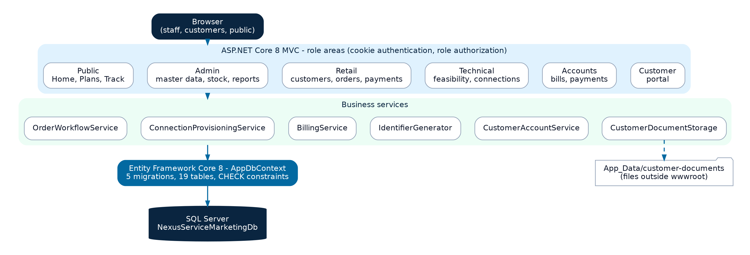



Architecture: layered and rule-driven
Role areas
Cookie login and role authorization on every controller.
Business services
Orders, provisioning and billing rules live in one place.
ASP.NET Core 8 MVC · Entity Framework Core 8 · SQL Server · Bootstrap 5
EF Core + SQL Server
Controllers only collect input and show results; every rule (IDs, feasibility, deposits, discounts, tax, payments) is enforced by a service, so all screens behave the same.
Migrations, foreign keys and CHECK constraints protect the data.
Notes:
The browser talks to role areas in ASP.NET Core MVC. Controllers call business services, and the services use Entity Framework Core to reach SQL Server. Customer documents are stored outside the public web folder.

Slide 6
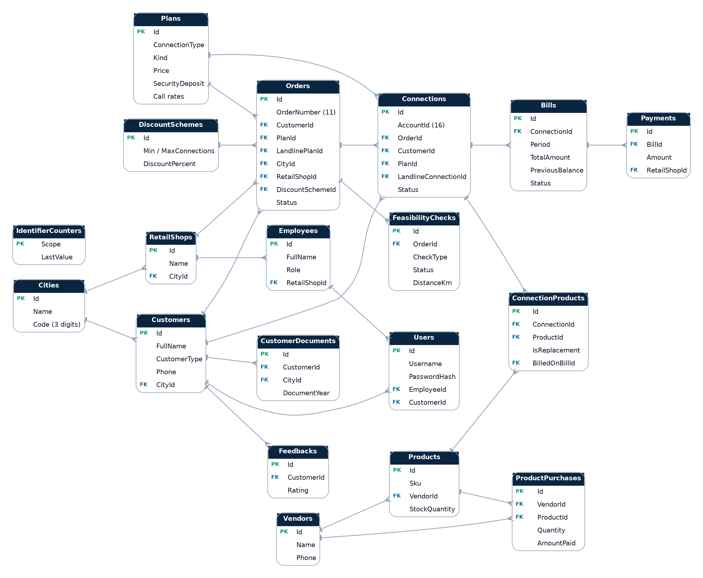
Database: 19 related tables
19
tables
customers to payments
5
migrations
repeatable schema
47
CHECK constraints
bad data cannot be saved
Notes:
The ER diagram shows the 19 tables. Orders link customers to plans and cities; connections come from orders; bills belong to connections and payments to bills. The database itself enforces the ID formats and value rules through CHECK constraints.

Slide 7
Smart identifiers, generated safely
Order number - 11 characters
D
0000000001
D = Dial-Up, B = Broadband, T = Telephone
type
10-digit serial per type
Account ID - 16 characters
B
001
000000000001
Serial counted per type and city
type
city code
12-digit serial
Notes:
Users never type these IDs. A database counter is incremented atomically, so two shops placing orders at the same moment always get different numbers. CHECK constraints reject anything that does not match the format.

Slide 8
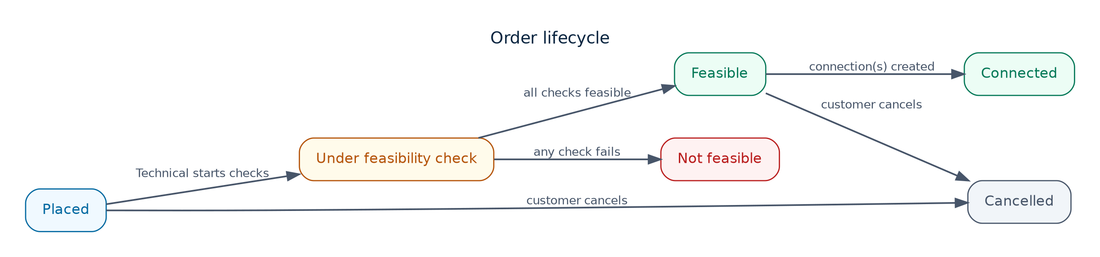



From order to connection
Order
Feasibility
Connection
Bundled line
Retail or customer; bulk band counts all the customer's connections
Landline and / or internet check: distance and server capacity
Equipment from stock, deposit after discount, account ID created
Telephone line created first, dial-up linked to it
Notes:
An order moves through feasibility to connection. If any check fails the order becomes Not feasible. A customer without a Nexus landline can apply for the telephone line and dial-up together; both checks run and the line is created first.

Slide 9
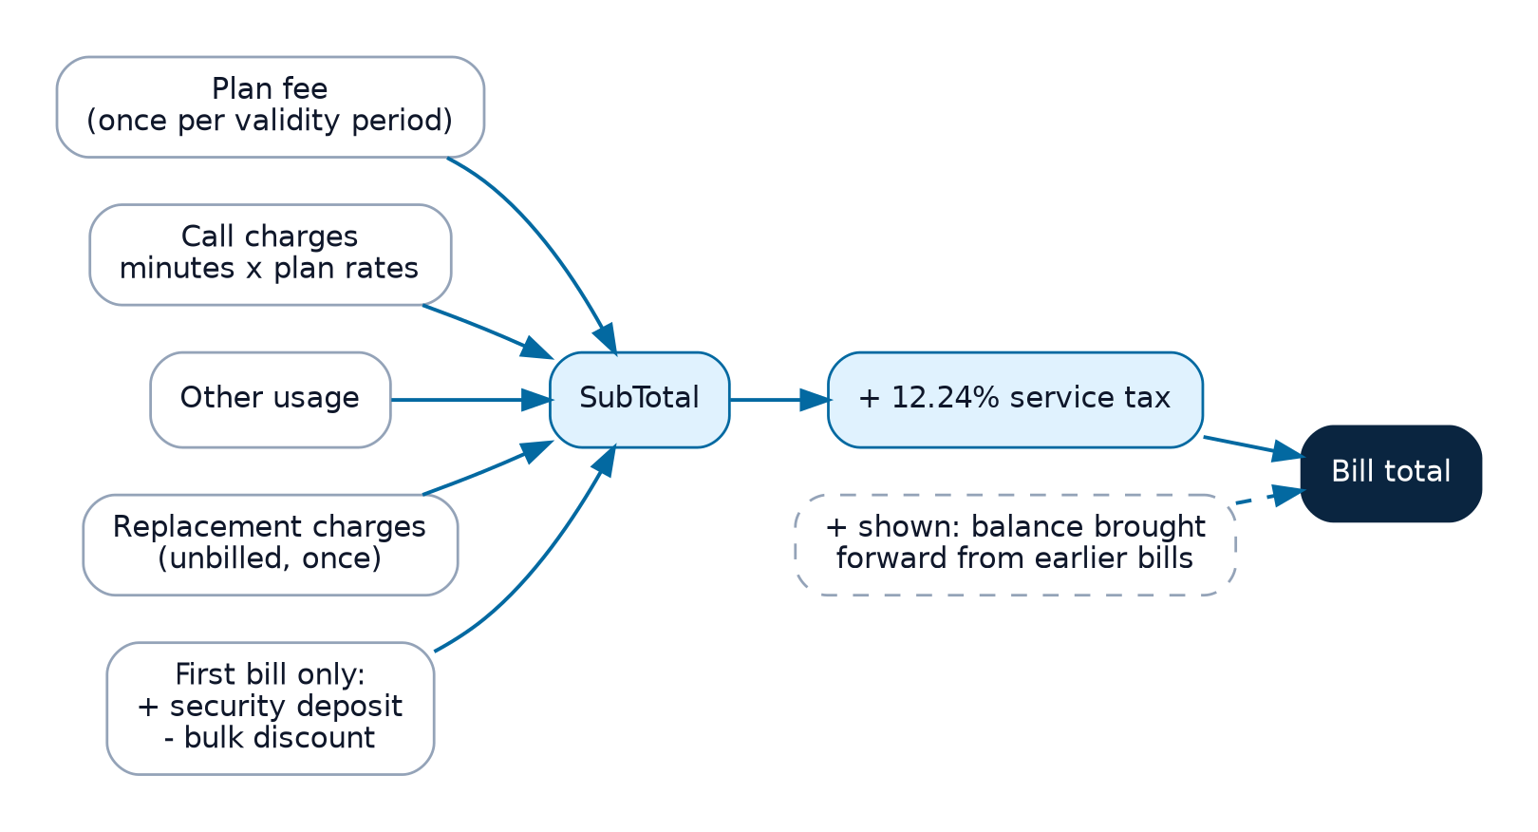

The billing engine
Worked example
Plan fee $35.00
100 local min x $0.75 $75.00
Deposit (first bill) $250.00
Service tax 12.24% $44.06
$404.06
Plan fee once per validity period
Call minutes x the plan's per-minute rates
First bill total - verified by the automated tests
Replacement charges added once, automatically
Deposit and bulk discount on the first bill
Unpaid earlier bills shown as brought forward
Notes:
Only the Accounts department generates bills. The service calculates every amount; Accounts only enters call minutes and any other usage. The worked example is one of the automated test cases.

Slide 10

Plans, deposits and bulk discounts
Dial-Up
$325
7 plans · from $50
deposit
Broadband
$500
6 plans · from $175
deposit
Landline
$250
4 plans · from $35
deposit
Notes:
The discount band depends on all the connections a customer takes, and applies to the advance and the security deposit. Deposits are refundable when a connection is closed.

Slide 11
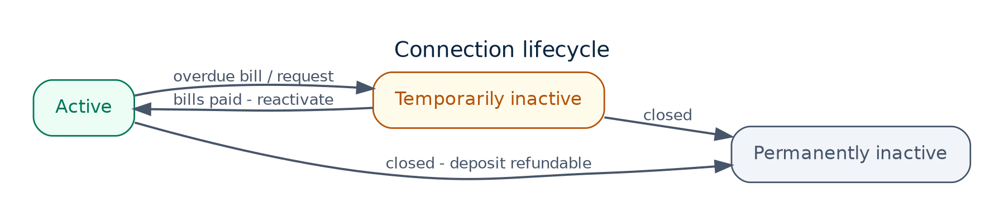
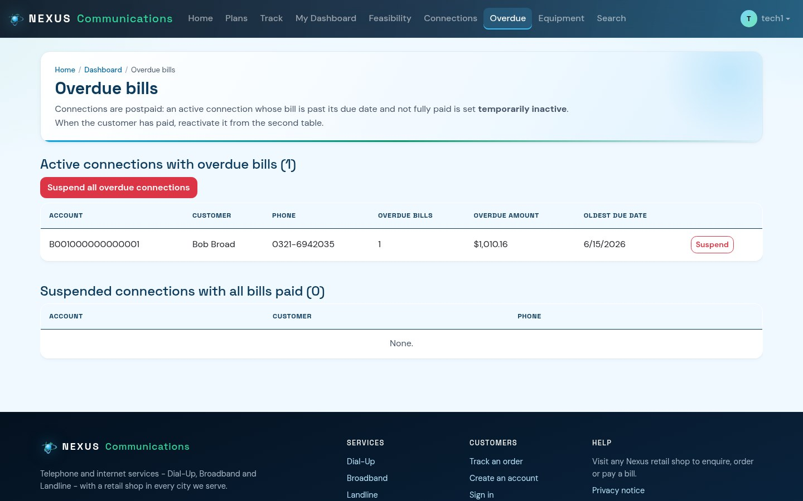
Postpaid control: unpaid bills matter
1. Overdue list
2. Suspend
3. Reactivate
Active connections with a bill past its due date and not fully paid.
One click sets one or all of them temporarily inactive.
When every bill is paid the connection is offered for reactivation.
Notes:
The specification says the connection status depends on the bill. Technical staff see every overdue connection, can suspend them, and reactivate them once the customer has paid.

Slide 12
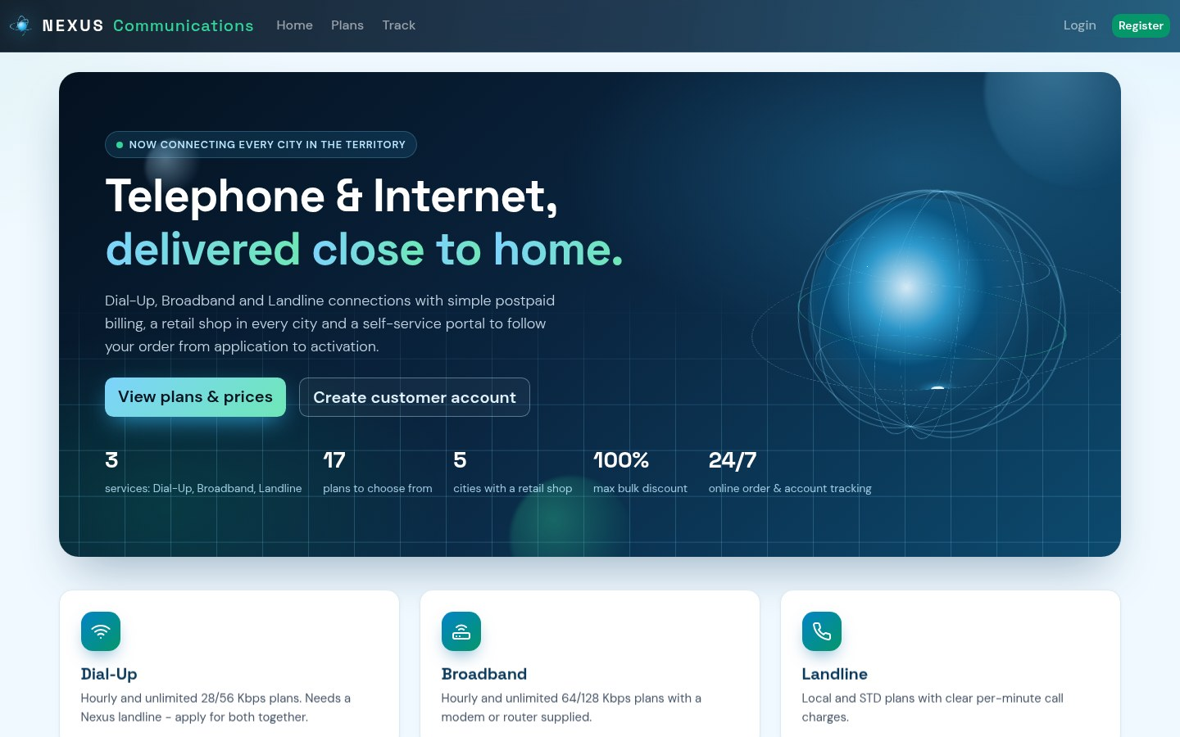





A modern interface with 3D motion
3D parallax hero
Globe, grid and glow layers follow the mouse
Tilt cards
Cards tilt toward the pointer with a light glare
Loader and reveals
Animated logo, word-by-word headlines, scroll reveals
Accessible
Reduced-motion mode, keyboard focus, 4.5:1 contrast
Responsive
Phone, tablet and desktop layouts
Notes:
The interface uses a custom design system: a 3D parallax hero, tilt cards, smooth page transitions and micro-interactions. Everything respects the reduced-motion setting and works on phones.

Slide 13
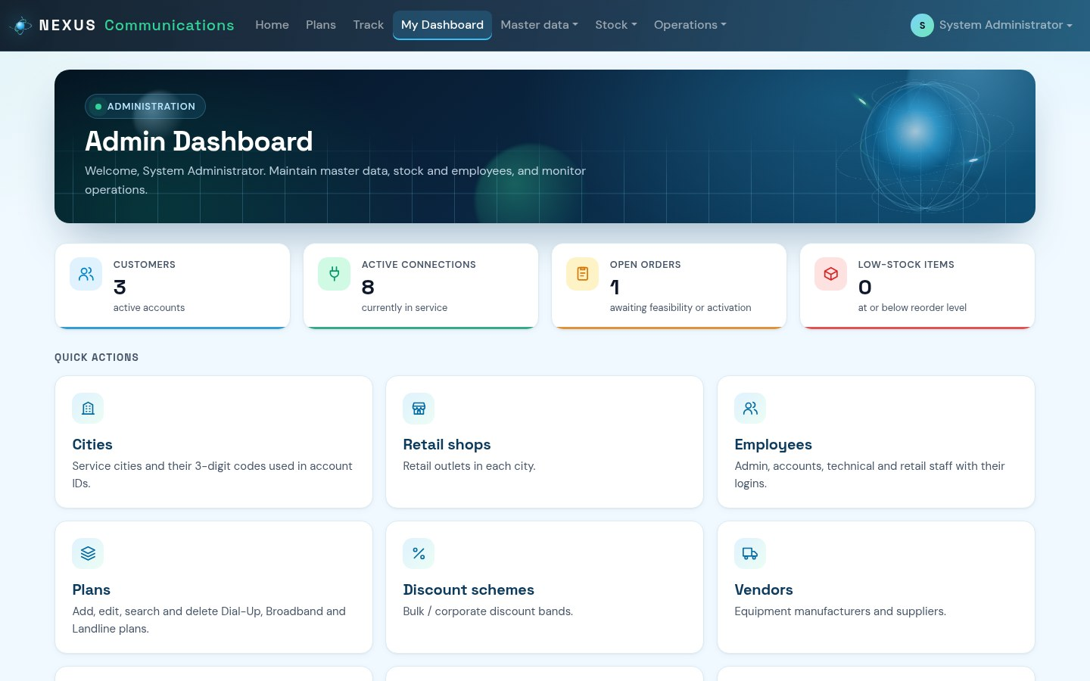
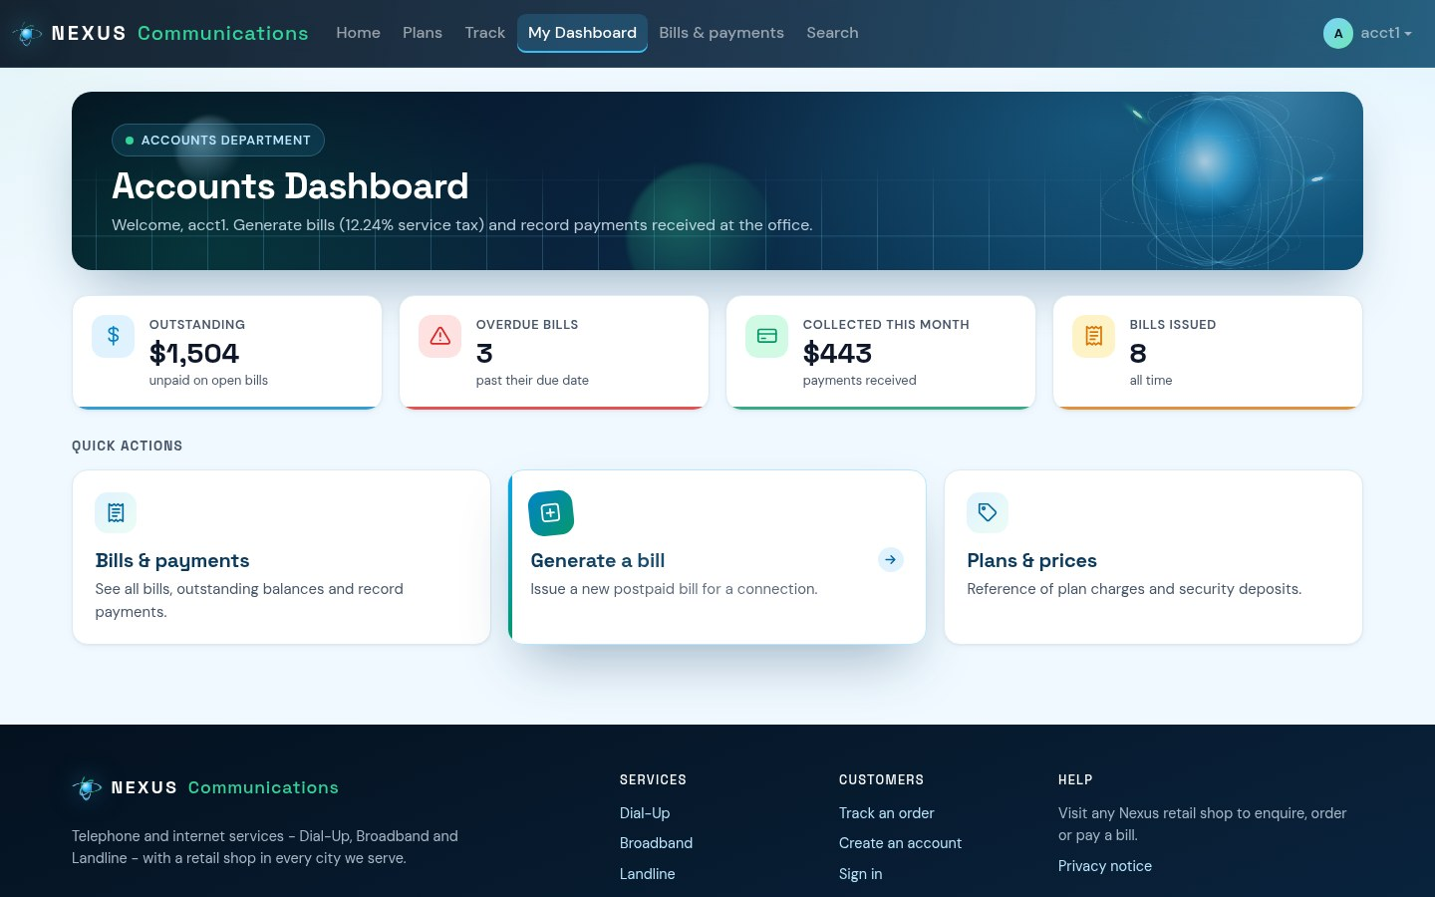
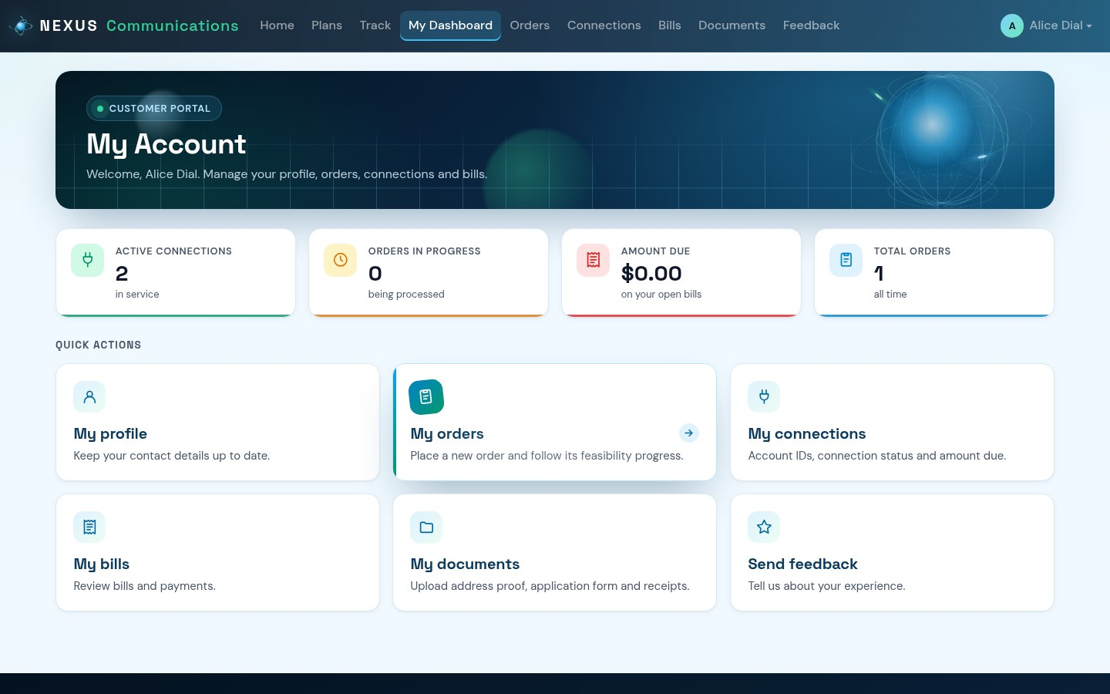
A dashboard for every role
Admin
Accounts
Customer
Live key figures on every dashboard - open orders, overdue bills, money outstanding, collections this month, low stock or the customer's own amount due - read from the database for that user only.
Notes:
Each role lands on its own dashboard with live figures and quick actions. Status values everywhere appear as coloured badges, so problems such as overdue bills stand out.

Slide 14



Quality: tested end to end
Orders and bundles
48 / 48
landline plan rules, both feasibility checks, bulk bands
Billing
automated end-to-end checks pass on SQL Server 2022
amounts, tax, plan validity, replacements, brought forward
Security
plus browser checks: no script errors, no sideways scrolling on phones, all content visible with reduced motion
role areas, shop isolation, hashed passwords
Bugs fixed
corrupted document uploads, unreachable dial-up orders
Notes:
A script drives every role through the real application and checks the database results - 48 checks, all passing. Testing also found and fixed two real bugs: uploaded documents were saved corrupted, and combined phone and dial-up orders could never be connected.

Slide 15

Running the system
1
Install the .NET 8 SDK and SQL Server Express
Demo login
Username admin
Password Admin@123
Staff and customer logins are created inside the application (Admin > Employees, Register).
2
dotnet ef database update (or run the SQL script in SSMS)
3
dotnet run - open http://localhost:5294
4
Sign in as admin, create cities, shops and staff
Notes:
Show the steps to run the system and the default admin login. Recommend changing the admin password after the first login.

Slide 16
Thank you
Questions and live demo
Nexus Service Marketing System · [Your name] · [Batch] / [Group]
Notes:
Thank the audience and offer a live demonstration of the system: place an order, run feasibility, create the connection and generate the first bill.

