Slide 1
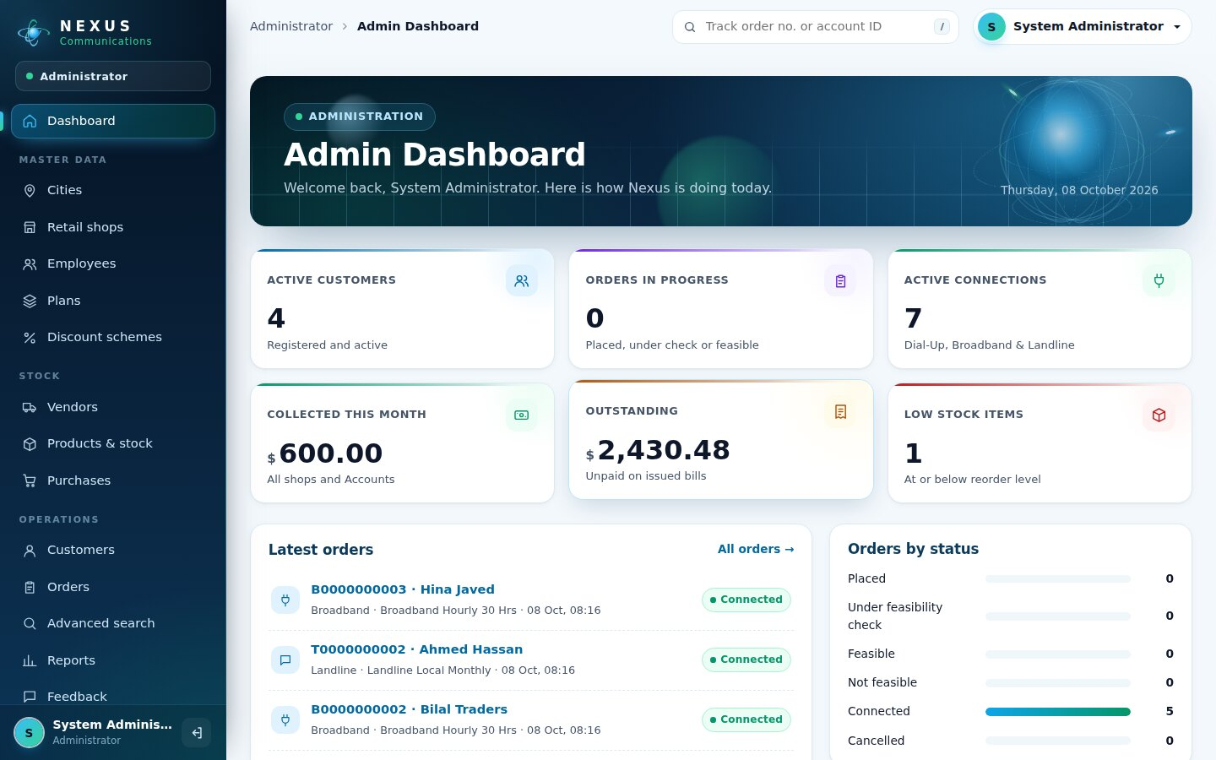
Nexus Service Marketing System
eProject · Telephone & Internet Services
Orders, feasibility, connections, equipment stock, postpaid billing and payments - one web application with a dashboard for every role.
ASP.NET Core 8 MVC
C#
EF Core 8
SQL Server
Bootstrap 5
Presented by: ______________________
Notes:
Welcome. This is the Nexus Service Marketing System, an ASP.NET Core 8 MVC application on SQL Server. It runs the whole business of a telephone and internet provider: plans, retail shops, orders, feasibility checks, connections, equipment stock, bills and payments. Every user signs in to a dashboard made for their role.

Slide 2









From paper registers to one shared system
BEFORE
WITH NEXUS
Lost and duplicated orders
No order number every department can follow
Automatic IDs
Order no. B0000000001 · account ID B001000000000001
Slow installation
Technical team waits for paperwork
Live queues
New orders appear on the Technical dashboard
Billing mistakes
Fees, discounts and 12.24 % tax done by hand
System-calculated bills
Plan fee, calls, deposit, discount, tax
No view of dues
Shops cannot see what a customer owes
Role-based access
Each role sees only its own work
Notes:
Nexus kept customers, orders, bills and stock on paper in every shop. That caused lost orders, slow installation and billing mistakes. The new system gives every order a unique number, puts it in a live queue for the technical team and calculates every bill automatically.

Slide 3




Five roles, one secure login
Administrator
Retail staff
Technical
Accounts
Customer
Cities, shops, employees
Plans and discounts
Stock, reports
Walk-in customers
Place orders
Collect payments
Feasibility checks
Create connections
Suspend overdue
Generate bills
12.24 % service tax
Record payments
Order online
Track & see dues
Documents, feedback
Visitors can also view plans and track an order or account ID without signing in.
Notes:
There are five signed-in roles and public visitors. Login is shared, and the role decides which dashboard and menu the person sees. A retail employee can never open admin pages, and a customer sees only their own orders and bills.

Slide 4





How an order becomes a paid bill
01
02
03
04
05
Order placed
Feasibility
Connection
Bill
Payment
Retail shop or customer online
Landline and / or internet check
Account ID and equipment from stock
Plan + calls + deposit - discount + 12.24 %
At a shop or at Accounts
B0000000001
Feasible
B001000000000001
$757.62
Paid
Not paid by the due date? The connection shows in Technical › Overdue, is set temporarily inactive, and is reactivated once all dues are paid.
Notes:
Every order follows the same five steps. The order number and the account ID are generated by the server in the formats the specification asks for. Accounts generates the bill with the plan fee, call charges, deposit, bulk discount and 12.24 percent service tax. If a bill is not paid in time the technical team can suspend the connection and reactivate it after payment.

Slide 5
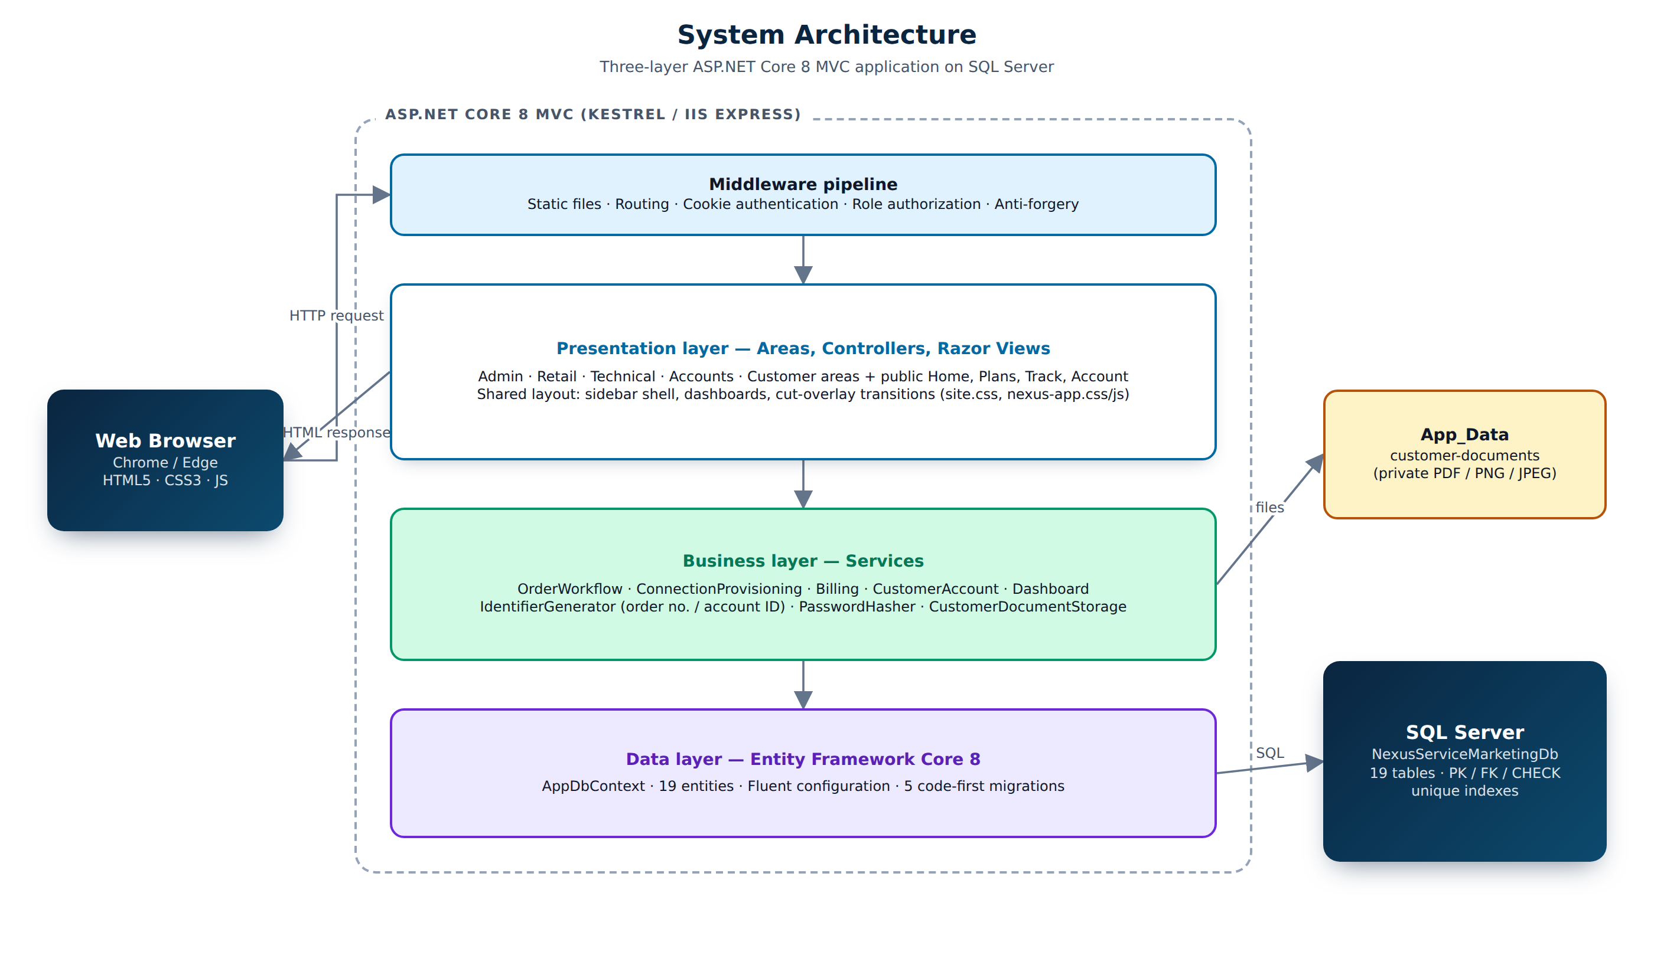
Three-layer architecture
Presentation
Areas per role, Razor views, sidebar shell, dashboards
1
Business
Order, provisioning, billing, dashboard services
2
Data
Entity Framework Core 8 and SQL Server
3
Notes:
The application has three layers. Controllers and views never touch the database; they call services that hold every business rule, and the services use Entity Framework Core to talk to SQL Server. Every area is protected by role authorization and every form by an anti-forgery token.

Slide 6
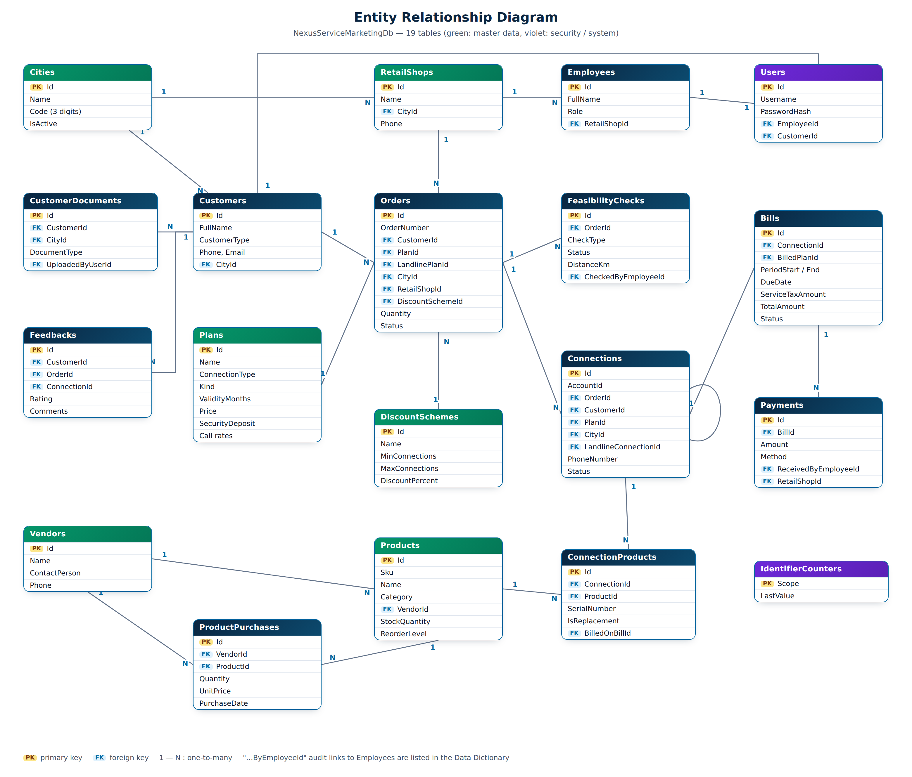
Database: 19 related tables
19
tables with primary and foreign keys
47
CHECK constraints guarding formats and amounts
5
code-first EF Core migrations
18 · 4
plans and discount bands seeded
Notes:
The database NexusServiceMarketingDb has 19 tables. Every relationship is a foreign key without cascade delete, so data in use is deactivated rather than deleted. 47 check constraints protect the order number and account ID formats, status values and amounts.

Slide 7
Business rules built into the system
12.24 %
25-100 %
Service tax
on the whole bill
Bulk discount
10-14: 25 % · 15-24: 50 % · 25-49: 75 % · 50+: 100 %
$250-$500
11 / 16
Security deposit
Landline $250 · Dial-Up $325 · Broadband $500
Characters
order number / account ID, generated by the server
Notes:
These rules come straight from the specification. Dial-up needs a Nexus landline, so a customer without one orders both together. The bulk discount uses every connection the customer takes, and it applies to the advance and the security deposit on the first bill.

Slide 8
A modern work application
VERSION 2
Sidebar shell, live dashboards, cut-overlay transitions and confirm overlays.
Notes:
Version 2 turns the staff side into a real work application.

Slide 9




A dashboard for every role
Sidebar navigation
Only the pages of your role, current page highlighted
Live figures
Orders, overdue, low stock, collections, amount due
Quick track
Type an order no. or account ID, press Enter
Responsive
Sidebar becomes a drawer on phones and tablets
Notes:
After login every user lands on a dashboard with live numbers for their job: the admin sees customers, orders, collections and low stock; technical staff see the feasibility queue and overdue connections; customers see their amount due. The top bar has a quick track box for any order number or account ID.

Slide 10

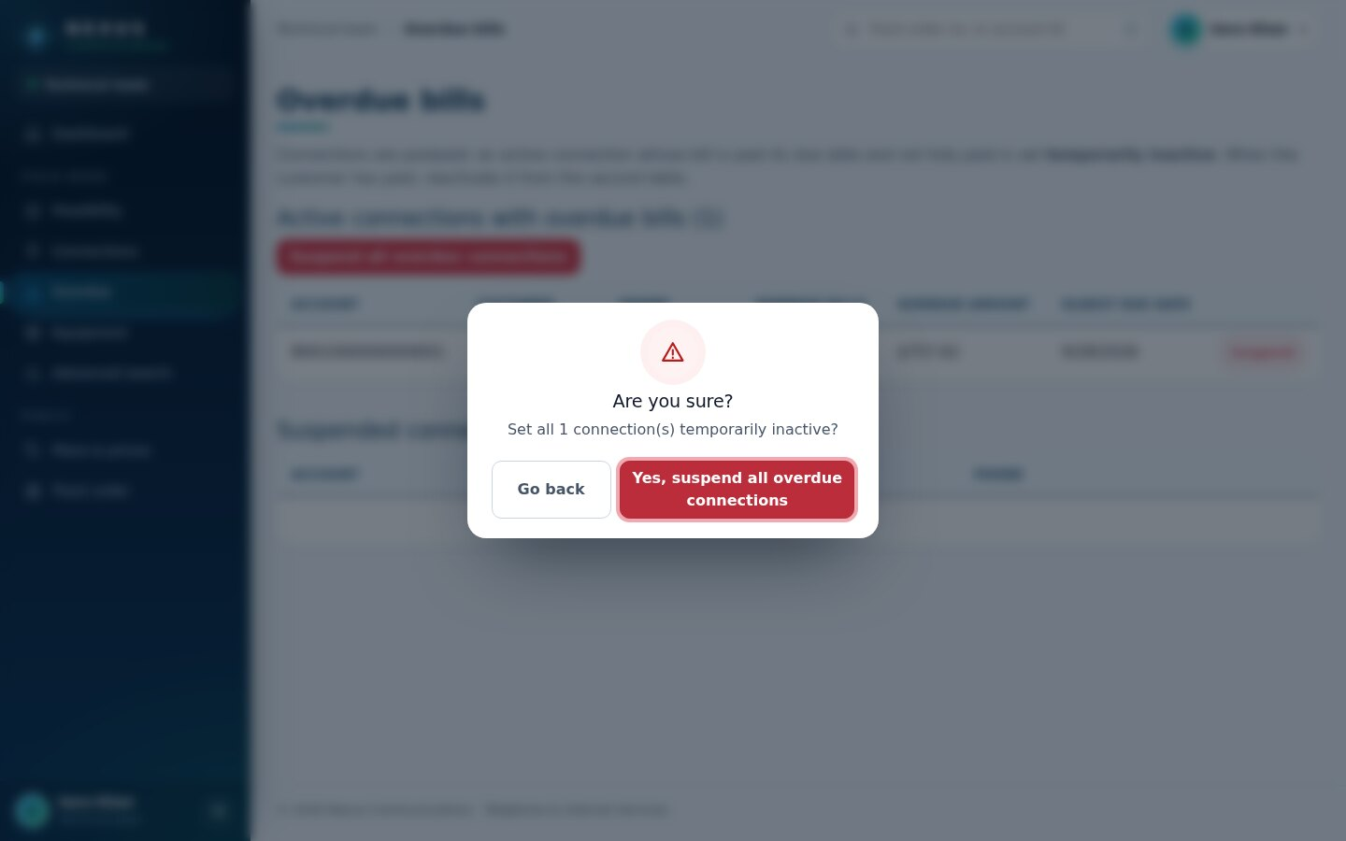
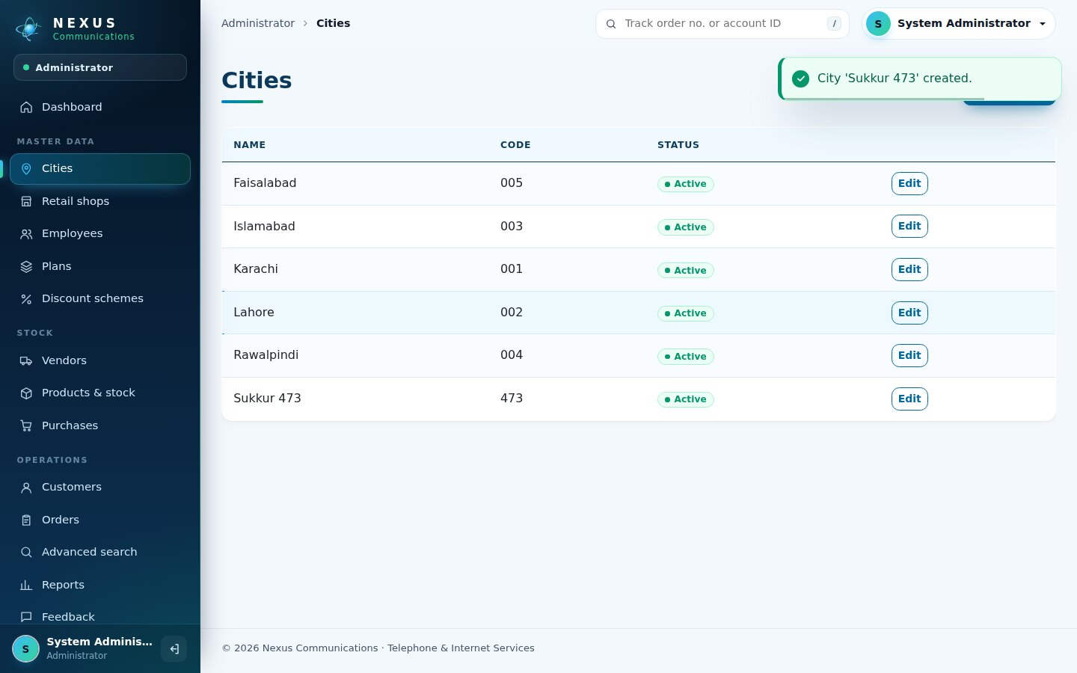
Motion that guides, not distracts
Cut-overlay transition
Angled panels sweep across between pages
Confirm overlay
Blurred overlay before Delete, Suspend, Deactivate
Success toasts
Slide in, count down, pause on hover
All motion uses transform and opacity only, and switches off for users who prefer reduced motion.
Notes:
Moving between pages plays a cut-overlay transition: three angled panels sweep across. Destructive actions open a blurred confirm overlay instead of the plain browser box, and saves show a toast. Everything turns off for users who choose reduced motion in Windows.

Slide 11
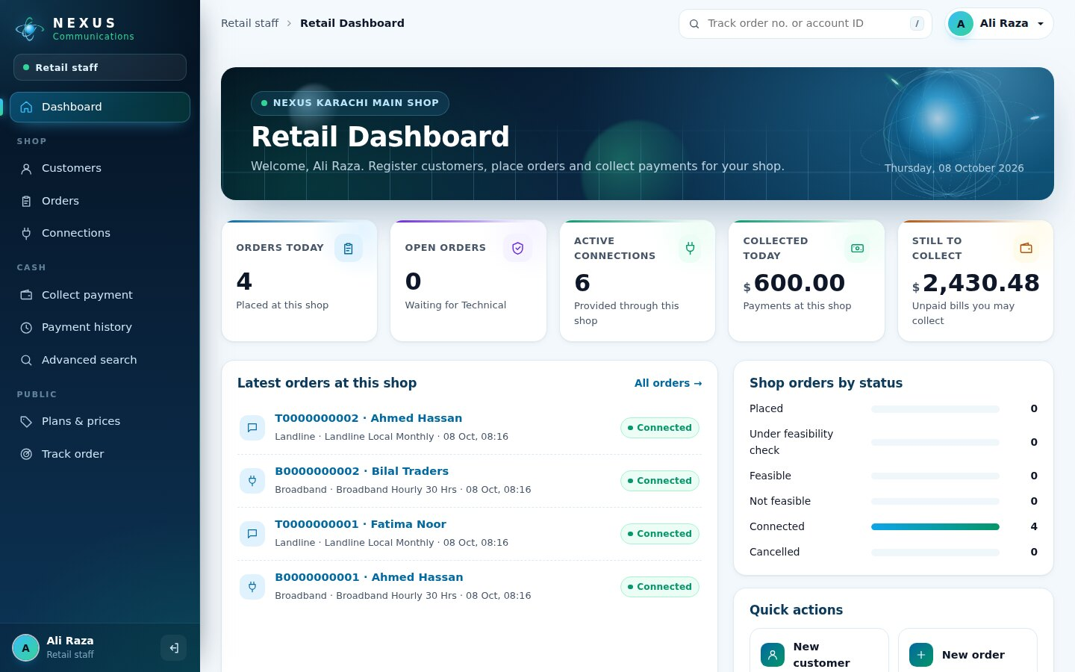
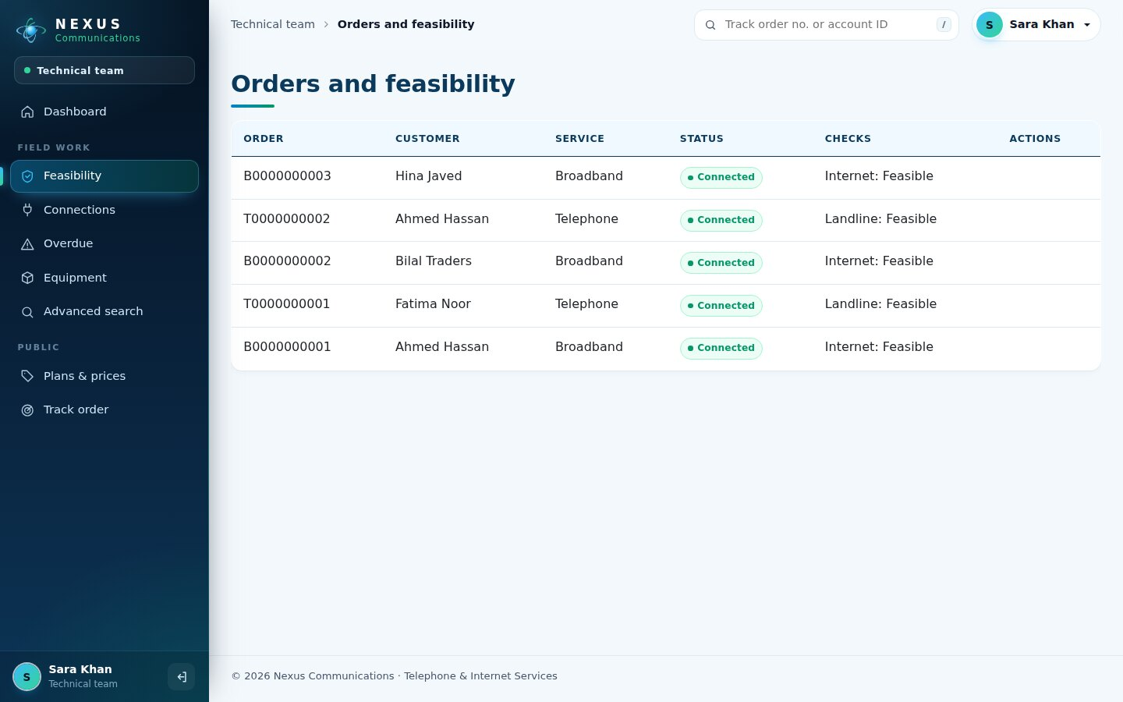
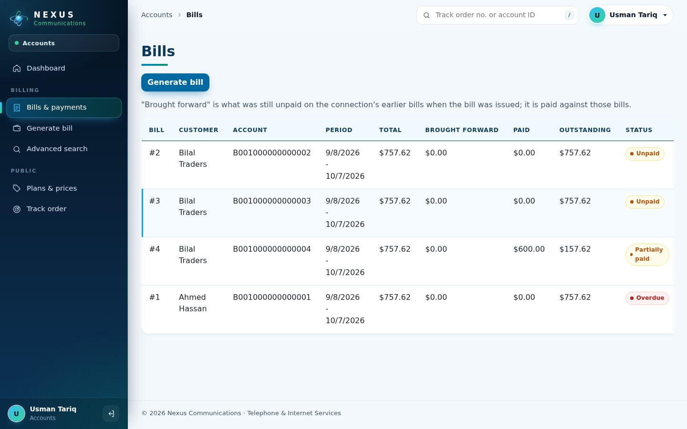
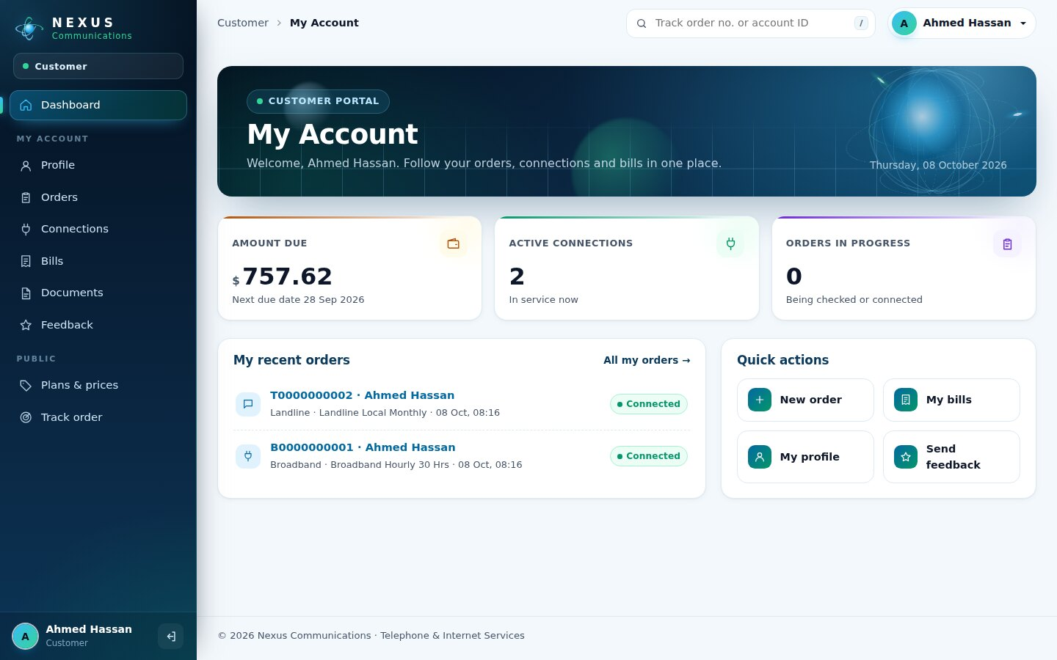
Every role has its own workspace
Retail · shop dashboard
Technical · feasibility queue
Accounts · bills and dues
Customer · amount due
Notes:
Each role works in its own area. Retail sees only its own shop, technical works the feasibility queue, accounts sees bills and dues, and the customer sees the amount due and the next due date.

Slide 12
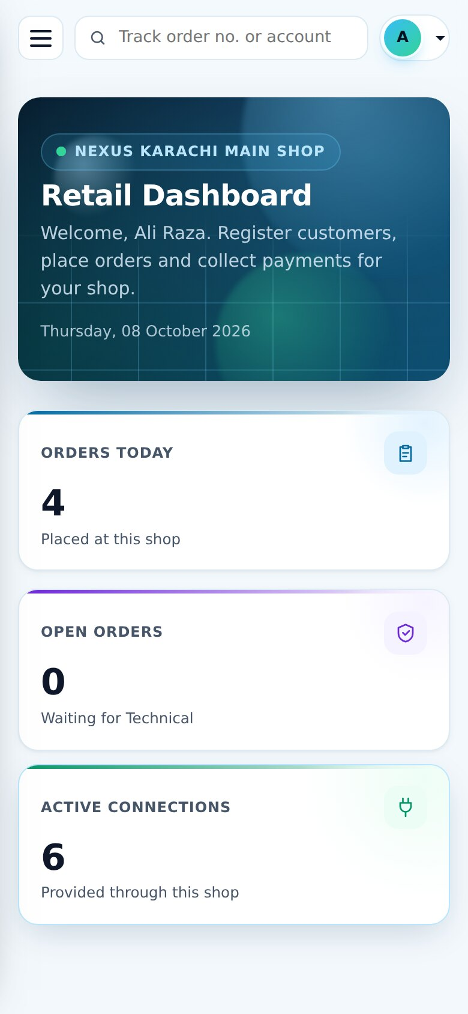
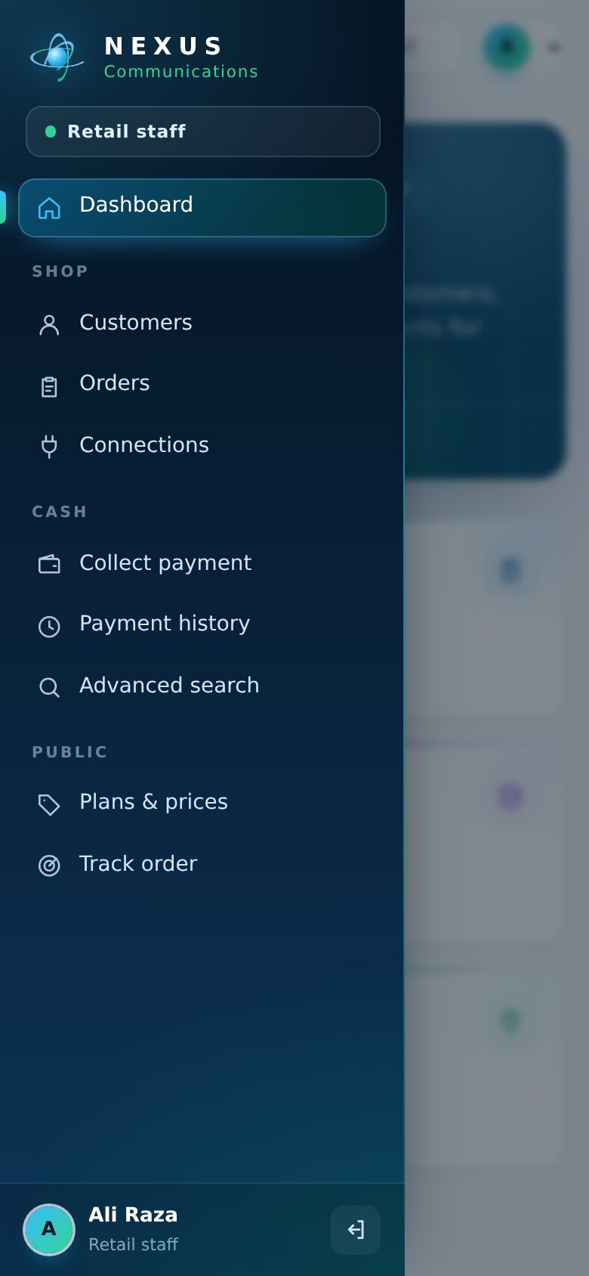
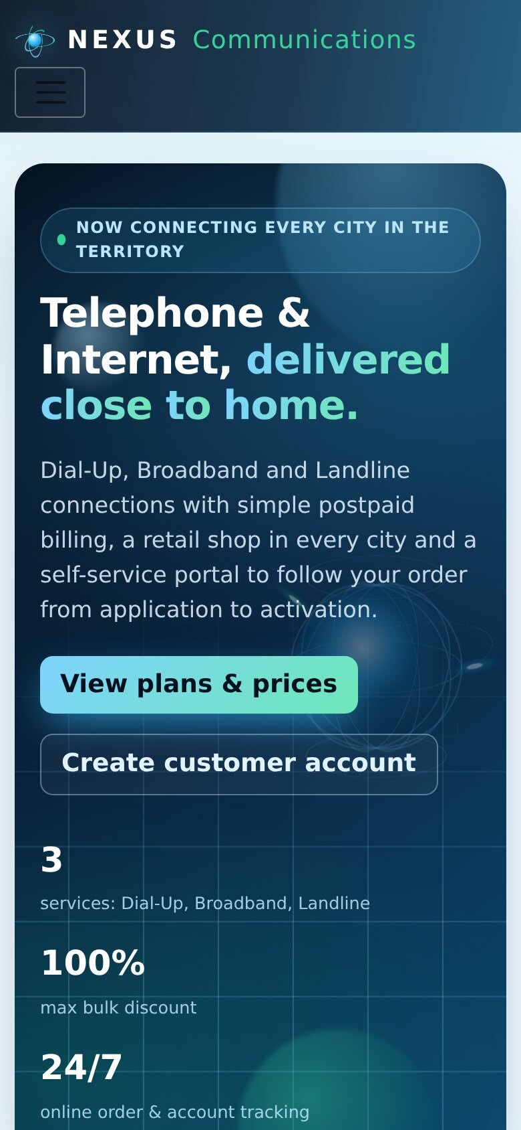
Works on phones and tablets
Retail staff often serve customers at the counter on a tablet.
Below 992 px the sidebar slides in from the menu button, cards stack and tables scroll sideways.
Notes:
The same application works on phones. The sidebar becomes a drawer, cards stack in one column and wide tables scroll sideways.

Slide 13
Tested through the real screens
24 / 24
system test cases passed on SQL Server 2022 with .NET 8
Automated browser run signs in as every role
Validation: duplicate codes, overpayment, passwords
Security: access denied, login redirect, other customers' data
Notes:
Testing used an automated browser that signs in as every role and runs the whole workflow through the real screens: 24 out of 24 system test cases passed, including validation and security checks.

Slide 14
Run it in four steps
1
Connect SQL Server
appsettings.json is already set
Server "." · login sa · password aptech
2
Create the database
19 tables, plans and discounts
dotnet ef database update
3
Start the website
or F5 in Visual Studio
dotnet run
4
Open Chrome
login admin / Admin@123
http://localhost:5294
Notes:
To run it: connect SQL Server with the sa login, run dotnet ef database update to create the database, then dotnet run and open localhost port 5294 in Chrome. The admin account is created on first start.

Slide 15
Questions?
THANK YOU
DEMO LOGINS
Admin admin / Admin@123
Retail ali.retail / Nexus@12345
Technical sara.tech / Nexus@12345
Accounts usman.accounts / Nexus@12345
Customer hina.javed / Customer@123
Nexus Service Marketing System - ASP.NET Core 8 MVC · EF Core 8 · SQL Server
Demo users are created while testing; a fresh database has only the admin.
Notes:
Thank you. I am happy to show any part of the system live. The demo logins are on the slide; a fresh database contains only the admin, who creates the employees.

