Slide 1











How To Use This Personas Template:
Slide 2 shows an example of a persona sheet. This example is your starting point for creating your own persona sheet in 4 steps:
STEP 1: right-click on the example personas sheet (slide 2), go to “layout” in the context menu, and select your favourite from the available 10 different colour themes.
STEP 2: right-click on the picture of the persona, and go to “change image” in the context menu to replace the picture with an image of your choice.
(Hint: you may use one of the images provided in the “Personas for AI” toolbox at
https://github.com/human-centered-ai-lab/PERSONAS/tree/main/Resources/Faces)
STEP 3: Modify all texts to describe your persona.
STEP 4: To adjust the skill-levels, please copy suitable skill-levels from the icons below, paste it to your persona sheet, and replace the example skill-level icons.
For visualisation of the skill-level, please copy one of these icons and paste it to your slide
This persona sheet template is made available under Creative Commons BY-NC 4.0 license
by Human-Centered AI Lab / Research and Diagnostics Institute of Pathology at Medical University Graz.
Please cite A. Holzinger, M. Kargl, B. Kipperer, P. Regitnig, M. Plass and H. Müller, "Personas for Artificial Intelligence (AI) an Open Source Toolbox", in IEEE Access, vol. 10, pp. 23732-23747, 2022, doi: 10.1109/ACCESS.2022.3154776 on use.

Slide 2
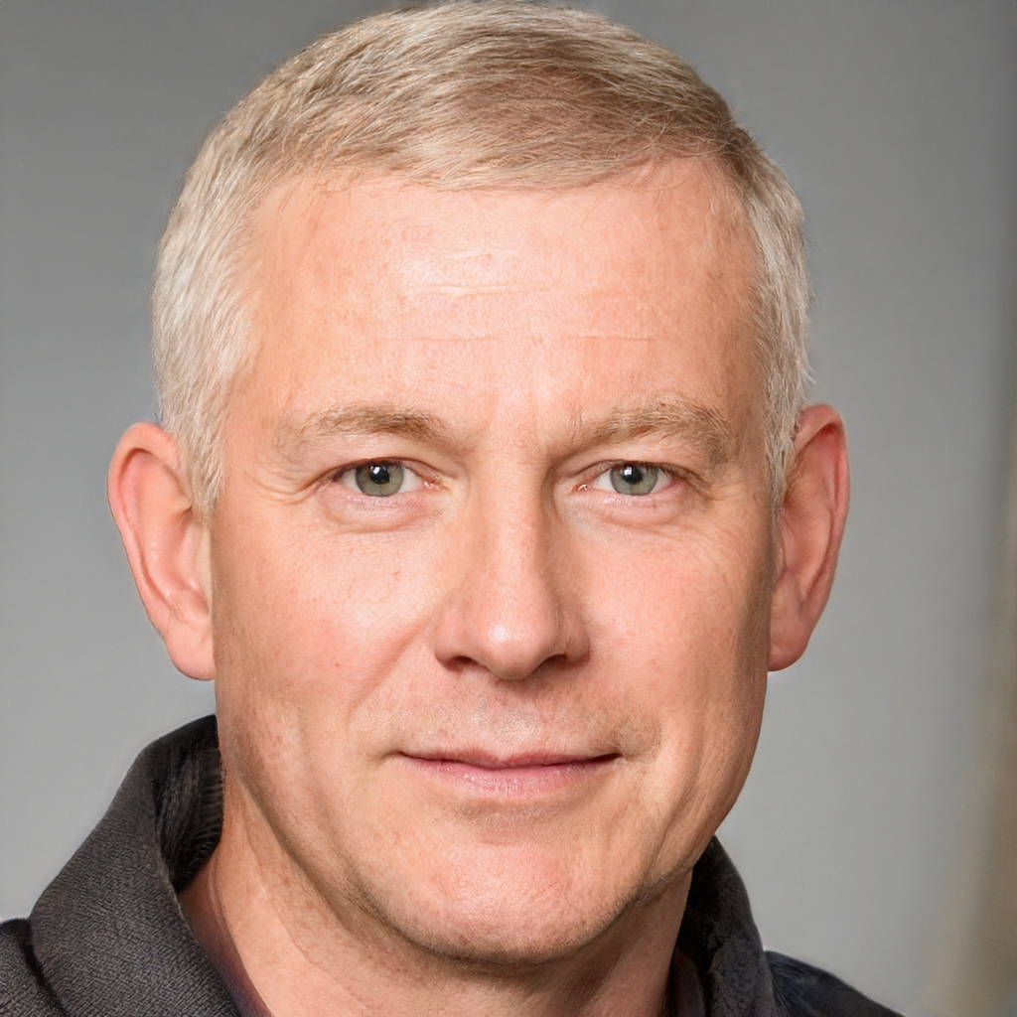
Paul PAPP Pathologist
Age: 49 * Education: Study of Medicine
Computer literacy
clinical medicine
neuropathology
clinical medicine
neuropathology
accuracy and precision
sense for details
accuracy and precision
sense for details
structured working style
conscientiousness
structured working style
conscientiousness
Medical Expertise
rejoice in his work
make correct diagnoses
working efficiently
doing his job well
responsible job
solving difficult cases
family and nature
gaining recognition for his work
Paul loves to solve tricky puzzles. In the evenings, when his two children are in bed, he enjoys the calm atmosphere where he can fully concentrate on these brainteasers. Solving logic problems has been one of his favourite hobbies since his childhood.
Paul likes it, when he can concentrate on one thing at a time. Also at work, in order to be able to do a good job, Paul tries to minimise all distractions and technical hurdles that would disturb his workflow. Therefore, he is easily upset when he feels that technologies and the technical infrastructure is slowing him down. He is glad that his workspace is in a separate room at the laboratory, where he can fully concentrate on his work.
Since more than 20 years, Paul has been working at a pathology laboratory in Austria. He is a specialist for neuropathology. His routine work comprises macropathology (cutting and grossing specimens) as well as microscopic examination of specimens in order to make diagnoses. In tumorboards, Paul discusses oncology cases with colleagues from other medical disciplines. Paul is well-known for his ability to solve difficult cases as well. He is frequently asked by pathologists from other institutes to provide a second opinion. Paul likes his job very much. However, sometimes he feels that he has got too much secondary tasks, such as administrative stuff, meetings or phone calls, which keep him from doing his main work efficiently.
Paul wants to make correct diagnoses, so that each patient can receive the right therapy. As a responsible pathologist, Paul always strives to work concentrated to avoid mistakes.
Paul thinks that in order to be useful, new technologies must integrate well with his workflows and help him to work more efficiently. Before he is willing to use a technical solution in diagnostics, he would have to be absolutely sure that this solution is trustworthy and delivers correct results.
This persona sheet template is made available under Creative Commons BY-NC 4.0 license by Human-Centered AI Lab / Research and Diagnostics Institute of Pathology at Medical University Graz.
Please cite A. Holzinger, M. Kargl, B. Kipperer, P. Regitnig, M. Plass and H. Müller, "Personas for Artificial Intelligence (AI) an Open Source Toolbox", in IEEE Access, vol. 10, pp. 23732-23747, 2022, doi: 10.1109/ACCESS.2022.3154776on use.

