Slide 1

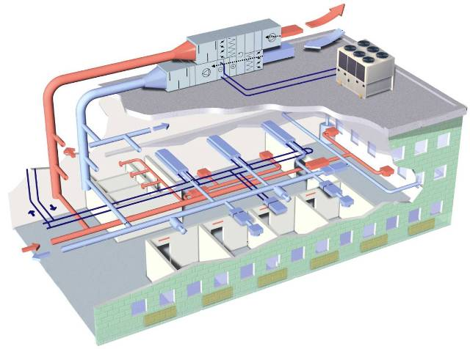
Agent-based model
Development of Personal thermal comfort profiles (Bayesian Network modeling)
Selection of
Optimized setpoints
(i.e., operational strategy)
Thermal vote
Feedback
Ask
Occupant Voting System (OVS) agent
Ask
Human agent
Controlled Environment
HVAC agent

