Slide 1
<AgencyName> Job Analysis
<insert date>

Slide 2
<Delete THIS SLIDE BEFORE PRESENTING>
TO DO BEFORE WORKSHOP
Update this presentation template with your agency details and styling.
Check that everyone has access to any technology they will need: meeting platforms.
Ensure you have the formal position description (PD) or PDs for this hiring action. The job analysis will likely document competencies more specific than the PD/
Get at least 3 resumes related to this job for competency refinement (Agency Talent Portal, LinkedIn, etc.) Aim to have 5 resumes so you have backups.
Gather example competencies and proficiencies from within the agency, OPM’s MOSAIC competencies, and the SMEQA website to leverage in drafting.
For in person workshops, bring supplies: name tags, post-it notes, sharpies, large easel-size post-it paper, dot stickers for voting. (consider coffee if early AM). You may want to print off the slides for participant reference.
Notes:
Don’t share the competencies until the team has already come up with their competencies
If the workshop is remote, you will need different tools, such as a collaboration tool for editing competencies and interview questions (nice to have but not mandatory). Consider having two mechanisms for facilitators to participate (like a phone dialed in and a computer on wifi, or a backup facilitator ready to go) so the workshop can continue if a facilitator has a power or connection glitch.
Identify and prepare 2-4 resumes for an exercise in the workshop. Resumes should be marginally strong to force discussion, and the resumes you pick should inclulde these categories: short (2 pages or less), long (over 5 pages), private sector background, public sector background. Instructions to gather resumes are here.

Slide 3
Welcome! Let’s introduce ourselves by writing a sticky:
Name
Office
Your previous experience with hiring
Group stickies together for each role in this workshop (SME, hiring manager, HR, facilitator, observer, etc)
Notes:
This can be done in person or virtually in an online stickies platform. If done in person, have attendees raise hands or do something else to make it easier to track who has been introduced and who has not.

Slide 4
Agenda for today: Tasks ⟶ Competencies ⟶ Proficiencies
Preliminaries (10 min)
Overview of the process (30 min)
Write down job tasks and group them to identify competencies (1 hr)
Discuss and define critical competencies (2 hr)
Create proficiency levels for each competency (1 hr)
Review PD and job tasks against competencies (must be “rooted in the PD”) (15 min)

Slide 5
Preliminaries: BREAKS
We will take short AM and PM breaks.
When do people want to take a lunch break?
We will end at <fill this in> PM.

Slide 6
Preliminaries: Background information sheets and confidentiality agreements
Please send your background information sheets to <fill this in>.
Please send your confidentiality agreements to <fill this in>.
Reminder: by participating in this workshop, you bar yourself from being able to apply to a future posting leveraging work done here. Please exit the workshop and contact the HR specialist if you are considering applying for this role.

Slide 7


OVERVIEW OF THE PROCESS
Standard hiring today
Cut & paste keywords
Complete a self-assessment questionnaire
Create a long “federal resume”
“I’m an expert!”
Notes:
Self-assessment questionnaires result in less-equitable hiring and less-diverse candidates. Research shows men tend to rate themselves more highly than women on these questionnaires.
Focusing on resumes can lead to even less diversity, when conscious or unconscious biases can come into play around someone’s name, where they went to school, or where they’ve worked.

Slide 8

OVERVIEW OF THE PROCESS
CONFIRM QUALS: (1 or more of the following)
Written Prompt
Resume Review
Job-Based Exercise
Structured Interview
Industry resume
Qualified
Notes:
Introducing assessments reduces unconscious bias, and allows SMEs to evaluate candidates on the quality of their work, as well as their ability to communicate the results of their work.

Slide 9
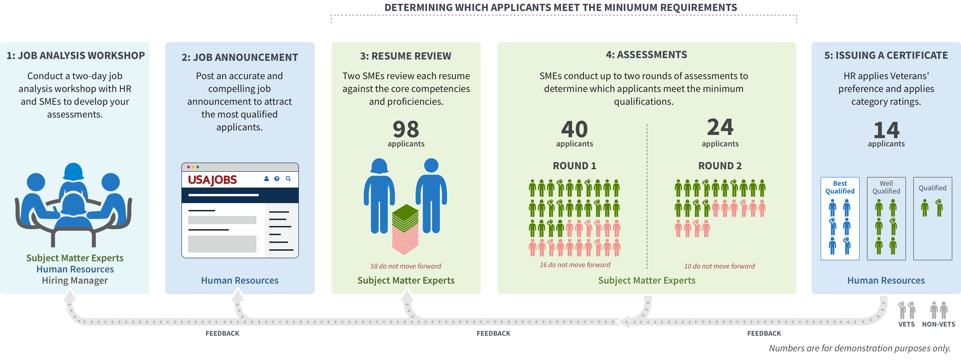
Overview of the process
Notes:
Shorter presentations (10-15 min)
During the job analysis workshop, SMEs work with HR to establish the specialized experience required for the position, which are presented as technical competencies. In practice, these technical competencies become the minimum qualification bar for the position. HR trains SMEs to assess all applicants against that bar during resume review and phone interviews. HR is responsible for the certificate, but according to the assessment strategy, they lean on SMEs’ deep technical expertise to assess applicants before they’re considered qualified. The hiring manager can be confident that any applicant, including the minimally qualified, will succeed in the role from day one.
Because SME-QA is time-intensive for SMEs, we reduced their participation burden by limiting the number of resume pages they review, including only one SME per assessment, and minimizing the length of justification for every cut. In addition, applicants who do not receive a passing score in the first interview do not proceed to the second interview.
SME-QA applies to delegated examining (though it can be applied in excepted service or direct hire situations), and veterans’ preference and category ratings still apply. However, applicants aren’t considered qualified until after they pass both interview assessments with SMEs. After the assessments are complete, HR adjudicates preference for the first time to all applicants who passed the assessment phase.
Longer presentations (1 hour)
During the job analysis workshop, SMEs work with HR to establish the specialized experience required for the position, which are presented as technical competencies. In practice, these technical competencies become the minimum qualification bar for the position. HR trains SMEs to assess all applicants against that bar during resume review and phone interviews. HR is responsible for the certificate, but according to the assessment strategy, they lean on SMEs’ deep technical expertise to assess applicants before they’re considered qualified. The hiring manager can be confident that any applicant, including the minimally qualified, will succeed in the role from day one.
Job Analysis: SMEs and hiring managers work with HR to:
Set specialized experience in the form of technical qualification criteria that will in practice become part of the minimum qualifications
Write structured interview questions to assess applicants against the defined competencies and proficiency levels
Finalize the assessment strategy
Job Announcement: Bridges a standard PD with an accurate announcement.
Represents the actual job being hired for
Is not cut and pasted from the position description
Contains only critical information with links to other items
Closes at midnight the day it hits 100 applicants so SMEs aren’t overwhelmed by too many applicants.
No occupational questionnaire to assess applicants qualifications. We don’t care how an applicant rates themselves; technical SMEs assess applicants.
Resume Review: HR only checks for eligibility requirements, SMEs check for the technical competency requirements. There are no quotas for how many applicants can move forward.
SMEs determined how many pages of each resume they would review during job analysis and documented in JOA (reduces time burden on SMEs, levels the playing field for private sector applicants).
SMEs compare resumes against the required competencies and write 1-4 sentences about why they are moving an applicant forward or cutting them.
HR reviews the justifications to make sure cuts were based on retraceable technical reasons (not to second guess SME’s technical judgement).
Applicants who pass resume review are not automatically qualified. Instead, they earn entry into a passing score examination, which is two rounds of structured interviews.
Assessments: Before beginning assessments, such as interviews, HR conducts a required 2-hour training with SMEs to practice the structured interview script.
Given the heavy time burden for participating SMEs, SME-QA uses one SME per phone interview. SMEs transcribe the applicants’ responses to the best of their ability.
HR reviews the SMEs’ analysis of the applicants’ qualifications to make sure they were only based on the required competencies and proficiency levels from job analysis.
To be considered qualified with a passing score, applicants must pass two interviews, each with a different SME, measuring the breadth of and then depth of knowledge in the required competencies.
Applicants who don’t pass the first interview can’t achieve an overall passing score, so they don’t move on to the second interview.
Certificate: For the first time, HR adjudicates veterans’ preference claims and then applies normal veterans’ preference rules, followed by category ratings.
For applicants who not only meet but exceed the qualifications, HR uses that info to put applicants into categories.
Any CPS or CP veteran who is minimally qualified will float to the top of the best qualified list. Hiring managers must consider them before any other applicant. (except for scientific or professional positions at the GS-9 level or higher).
For example:
100 people applied
HR removed 2 because they didn’t submit resumes, so SMEs reviewed 98 resumes.
SMEs interviewed 40 applicants in the first round.
Of those, SMEs interviewed 24 applicants in the second round.
Of those, SMEs considered 14 applicants qualified. Those applicants met the minimum qualifications for the job and received a passing score on both interviews.

Slide 10

Overview of the process
Job analysis provides the evidence that justifies our selection process.
Based on your expertise, we will develop competencies and proficiencies that create the qualification “bar,” then choose assessments to evaluate if someone is qualified.
Notes:
This process allows you to set the qualifications for the role you are hiring for, ensuring that you can find and hire applicants that are truly qualified
The qualifications (competencies and proficiencies) you determine today will be used during resume review and structured interviews, or other assessments
Applicants who do not receive a passing score during resume review or any assessment will not proceed
Applicants aren’t considered qualified until after they pass all assessments. Applicants that do not pass the assessments are ineligible.
After the assessments are complete, HR adjudicates veterans’ preference to all of the applicants who passed the assessment phase
We are not creating PDs (Position Descriptions) today. Job analysis is the bridge from the PD to a specific job announcement coming out of our work.

Slide 11


Overview of the process
Your participation will help us develop what it means to be qualified for this role.
SMEs like you will reference the qualifications during resume review and assessments.
Applicants who qualify through the assessments will have veterans’ preference applied and be eligible for selection.
Notes:
This process allows you to set the qualifications for the role you are hiring for, ensuring that you can find and hire applicants that are truly qualified
The qualifications (competencies and proficiencies) you determine today will be used during resume review and structured interviews, or other assessments
Applicants who do not receive a passing score during resume review or any assessment will not proceed
Applicants aren’t considered qualified until after they pass all assessments. Applicants that do not pass the assessments are ineligible.
After the assessments are complete, HR adjudicates veterans’ preference to all of the applicants who passed the assessment phase

Slide 12
Outcomes we’ll seek to achieve in this workshop
Agreement on required duties in the position from day one
3-5 core competencies and their definitions
Proficiency descriptions for each competency, including the minimum proficiency required
Materials for one or more assessment rounds
Job analysis worksheet (for hiring action case file)
SME decisions about resume review pages and requirements (see Assessment Strategy phase)
Notes:
This process allows you to set the qualifications for the role you are hiring for, ensuring that you can find and hire applicants that are truly qualified
The qualifications (competencies and proficiencies) you determine today will be used during resume review and structured interviews, or other assessments
Applicants who do not receive a passing score during resume review or any assessment will not proceed
Applicants aren’t considered qualified until after they pass all assessments. Applicants that do not pass the assessments are ineligible.
After the assessments are complete, HR adjudicates veterans’ preference to all of the applicants who passed the assessment phase

Slide 13
Job Task Exercise
We’ll now work to define the work to be performed by the people we seek to hire in this action.
Before we start, let’s make sure we’re on the same page.
What’s the name of the position we’re analyzing?
What is the grade (e.g. GS-11) being hired in this action? (Job analysis should usually focus on one or two grade levels.)
Notes:
Notes for instructor: Participants should take about 15 minutes to write down daily job tasks for the role.

Slide 14
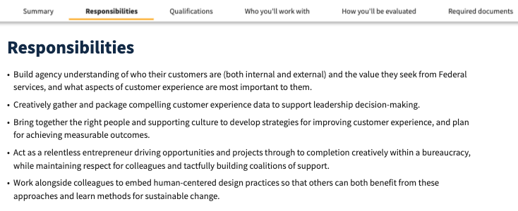
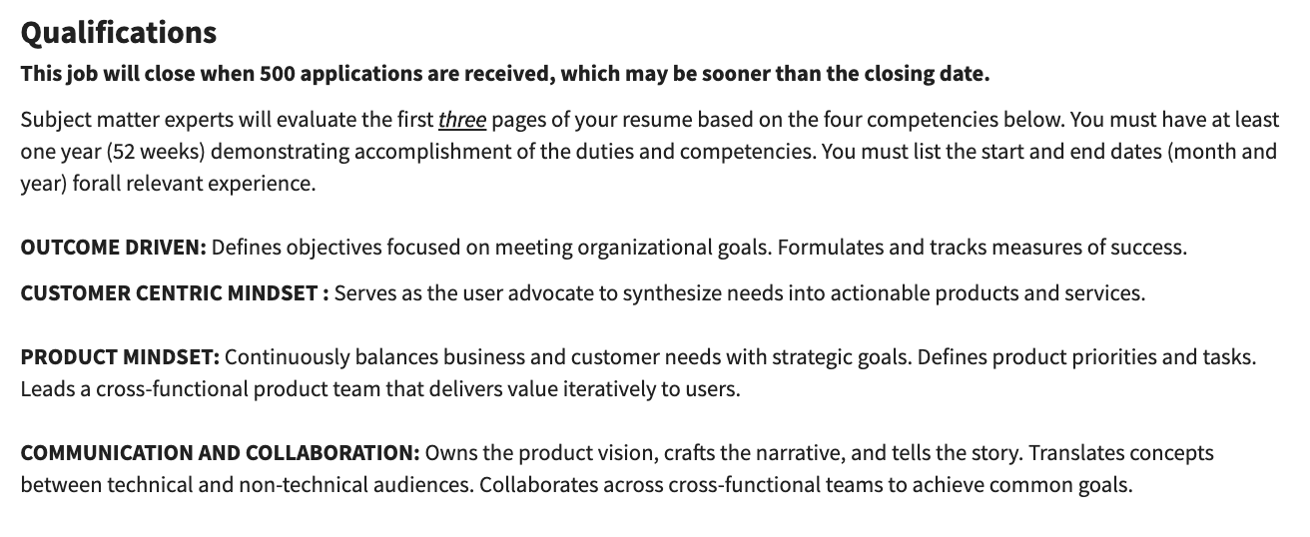
Job Task Exercise
List job tasks
Turn job tasks into competencies (specialized experience)
Notes:
In a JOA, you can see some of these in a finished version. There’s listed job tasks, defined competencies.

Slide 15
Job Task Exercise
As a group, we’re about to write down job tasks done by this position. Write one task per sticky note. Aim to write at least 10-15 tasks.
Tasks should begin with a verb, indicating an action a person in that position would actively and regularly take at the specified grade level
Be specific — think of actual tasks performed in the past month
We will analyze the tasks as a group — please work individually
If hiring for multiple grades, be sure to list any tasks specific to higher grades
Formal definition: Job tasks are observable/verifiable units of work activity to carry out functions of the job.

Slide 16

Job Task Exercise
Example tasks:
“Communicate with customers about reported issues”
“Research and resolve customer issues”
“Evaluate [XYZ] work by [ABC] contractors”
“Develop procedures for problems with [X] process”
“Interpret data to determine what helps users succeed”
“Collect website usage and performance statistics”

Slide 17
Job Task Exercise - Time to write!
Write one task per sticky note. Aim to write at least 10-15 tasks.
Tasks should begin with a verb, indicating an action a person in that position would actively and regularly take.
Be specific — think of actual tasks performed in the past month.
We will analyze the tasks as a group — please work individually
Example tasks:
“Communicate with customers about issue tickets”
“Research and resolve customer issues”
“Evaluate work by vendors”
“Develop procedures for problems with [X] process”
“Interpret data to determine what helps users succeed”
“Collect website usage and performance statistics”
Notes:
Good tasks should be:
performed as part of the job in the designated grade level
clearly and accurately written
Participants should take about 15 minutes to write down daily job tasks for the role.

Slide 18
Collection and Grouping Exercise
Now, we’ll take the tasks we wrote and group similar tasks together.
As we group, we’ll give each grouping a title representing a common skill, knowledge, or ability related to that grouping.
Don’t try to precisely wordsmith the titles yet (options are ok) – the goal is first to get groupings, which will become possible competencies.
Tasks may be copied and put into multiple groupings. If new tasks occur to you while we work, feel free to add them!
If an important skill/knowledge/ability occurs to you that doesn’t have tasks, add that now – we don’t want to miss a possible qualification need.
Notes:
Notes for facilitator:
After 10 minutes, if some folks are done, invite them to start coming up to put their tasks down while reading them aloud. If any are multiple tasks in one note, the leader should ask them to break it up into two different notes. If something is not really a task beginning with a verb, it should also be sent back.
As people come up to read and add their notes, if they’re similar to another note, they should put them close together.
Then the whole group should come up and make sure all common tasks are bunched up together.
Then the group can create a competency name that they think is covered by each common group of tasks.
Ask the SMEs if there are any EQ related competencies they think are required that are not represented by the groupings. Also ask them if there is enough technical competencies represented versus only soft competencies (leadership, collaboration, analysis, etc).

Slide 19
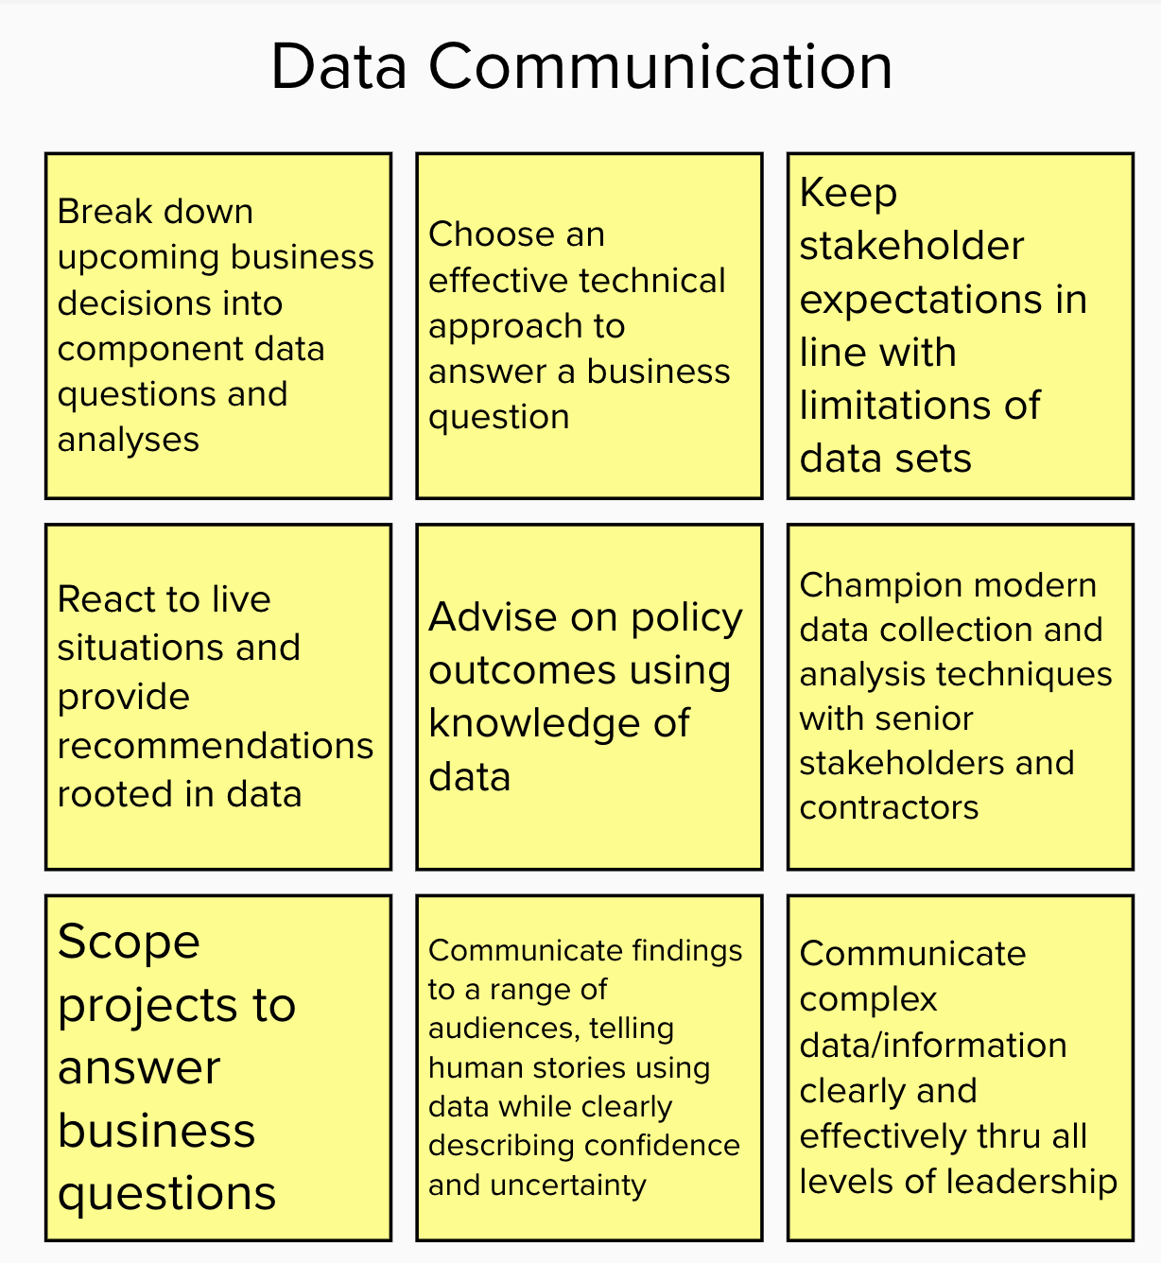
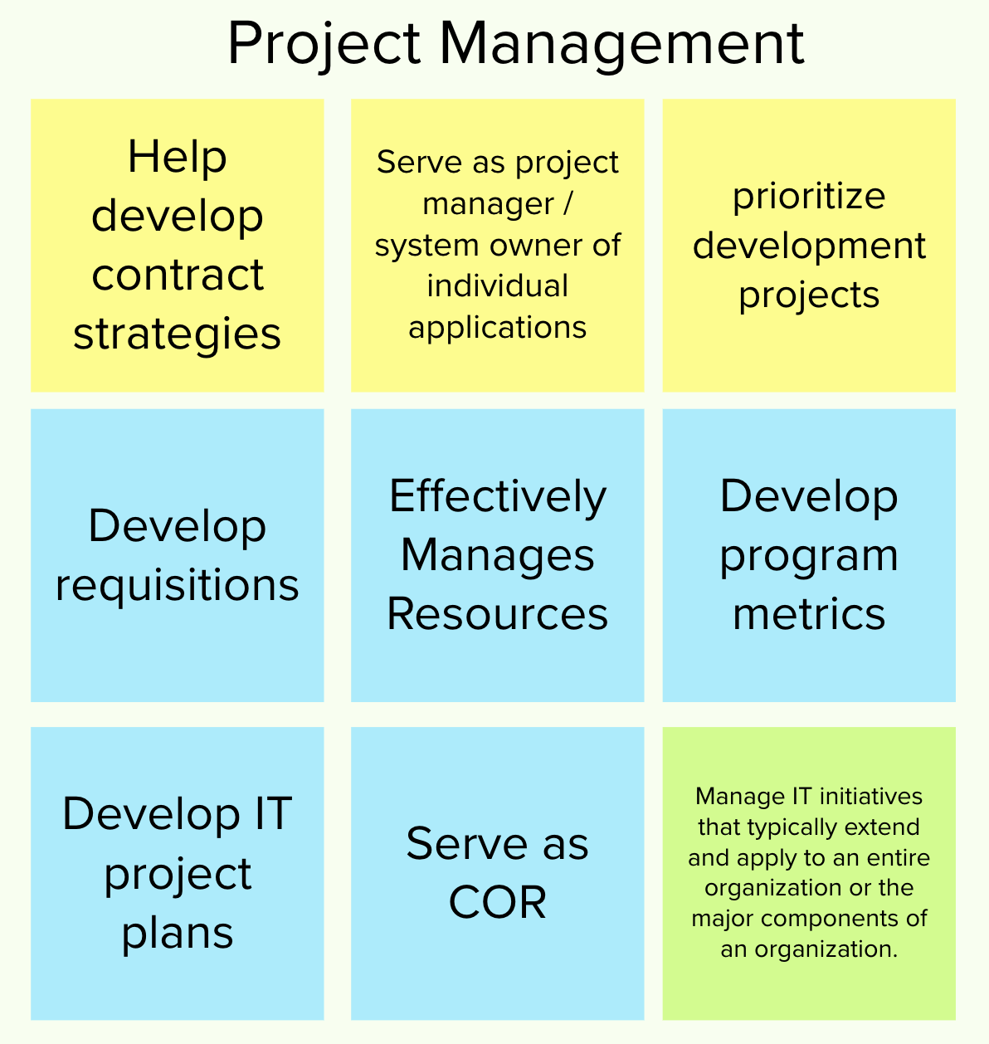
Example past Groupings below – Time to group!
Notes:
Leave this slide up as SMEs do the grouping exercise.

Slide 20
Dot Voting and discussion
Each participating gets a limited number of dots to vote for most critical competencies for this position so we can prioritize.
Goal: select 3–5 critical competencies that are both needed at entry and can disqualify an applicant from further consideration.
If competencies can be reasonably combined, consider that possibility. If they need to be separate, keep them separate. Competencies should not be redundant.
You may do single or multiple voting rounds.
Notes:
Once you have a final list, SMEs and hiring managers should independently rate each competency on how important it is (1-5) and turn those into HR. This will be evidence that competencies should or should not be mandatory.
The number of dots you give may vary based on the number of possible groupings, so that you can efficiently gather group views.
In virtual environments, votes should only be for category labels.
Under multiple voting rounds, SMEs should get many votes in an initial round – a first round with 20 groupings might offer each SME 15 votes. “final” votes should be much more narrow.

Slide 21
Now we define these critical competencies
Definition should be 1-3 sentences, not a bulleted list of job tasks.
Examples:
Collaboration - Cultivates relationships with key internal and external stakeholders. Uses negotiation skills to effectively communicate and cooperate.
Analytical Ability - Approaches problems quantitatively and displays critical thinking and problem-solving abilities. Breaks down problems into component parts. Uses key metrics to inform decisions.
Resources: OPM’s MOSAIC competencies and SMEQA examples
Notes:
Formal definition: Competencies are measurable pattern of knowledge, skills, abilities, behaviors, and other characteristics that an individual needs to do the job successfully. Competencies specify the "how" of performing job tasks.
DO NOT require agency-specific certifications, technologies, etc. that aren’t common in the private sector.
DO NOT require experience with government-only tech, this may exclude private sector applicants who could do the job well

Slide 22
Defining Competencies: shorter the better
These should be short:
You get to flesh out what it means to be proficient later.
Shorter competencies are less complex to evaluate
Definitions will go into the job announcement for applicants to see, so they should be clear to help people determine if they should apply.

Slide 23
Defining competencies – Let’s break out and write
GOOD EXAMPLE: Stakeholder Engagement – Ability to identify critical stakeholders and cultivate positive relationships through effective communications and collaboration.
BAD EXAMPLE: Stakeholder Engagement – Ability to identify critical stakeholders, cultivate positive relationships with them through effective presentations, written reports, 1:1 meetings, and group meetings. Can explain technical concepts throughout all levels of the organization. Often engages externally and internally with a wide range of stakeholders such as NGOs, educational institutions, private companies, etc.
Notes:
Reasoning: You can flesh out what it means to be proficient in the proficiencies. These should only be your definition of each competency. The shorter it is, the easier for applicants to understand in the announcement (they will see this but not the proficiencies). It will be easier for SMEs to do the assessments if these are tighter and shorter rather than encompassing multiple points.

Slide 24
Defining competencies – come back together to review
Now we’ll come back together to review work from the breakouts. Some questions we can ask while reviewing:
Is the competency required to perform the job?
Does the competency overlap with another competency?
Does the competency name or definition contain unclear/ambiguous wording that needs to be revised?
Are there any technical competencies required to perform the job that are missing from the list?
Notes:
Competencies must be clear. Avoid ambiguity.
Competencies must be verifiable on basis of resume and/or assessments.
Competencies must be attainable or realistic for the position and grade level.
Competencies must be relevant to the position and series.
Competencies must not be redundant or overlap with one another.

Slide 25
Notice: Assessment materials discussed after this point are confidential. Please sign and return the confidentiality agreement.

Slide 26
Determining Proficiency levels
Proficiencies are levels of expertise within a competency. Proficiency levels often involve these types of differences:
Complexity: The applicant can manage straightforward workflows -vs- can manage highly complex workflows.
Level of detail: The applicant can explain a general concept -vs- can discuss the concept in detail.
Scale of activity: The applicant did something at a small organization -vs- did something at a large organization.
Seniority/independence: The applicant did something as part of a group -vs- led the group that did something.
Note: Requiring particular certifications can be problematic.
Notes:
Note to facilitator: To save time, split up the participants to do work in subgroups. Levels should built upon each other and be as succinct as possible.

Slide 27
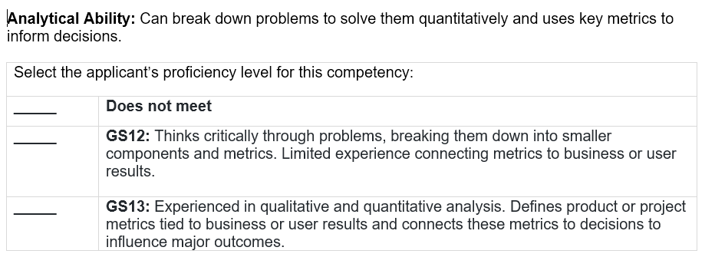
How proficiency levels are used: Assessment Review
Notes:
These are example materials.

Slide 28
Determining Proficiency levels
You can set different proficiency levels depending on how many GS levels are part of this hiring action.
Specify two levels for each GS grade being hired if you want to save time during job analysis by defining the minimum required levels: the minimum required level (“meets”) and one level above that (“exceeds”) to establish categories as required by category rating rules.
Use four levels when you may want to leverage this work for other grades in the future. The same set of competencies and proficiencies can be used for different grade levels because roles that require more seniority set the required proficiencies higher than junior roles.
Notes:
Note to facilitator: There is no “right” answer for which type of proficiencies to create. Feel free to decide in advance which type of levels the group will create.

Slide 29
Creating proficiency levels: 2 level option
Example Competency: Analytical Ability Approaches problems quantitatively and displays critical thinking and problem-solving abilities. Breaks down problems into component parts. Uses key metrics to inform decisions.
GS-13 Meets: Breaks problems down into component parts. Displays repeated experience in qualitative and quantitative analysis. Defines product or project metrics beyond the basics and ties these metrics to decisions.
GS-13 Exceeds: Brings analytical thinking to everything they do, and has a range and depth of experience doing so. Anticipates the need for metrics and analysis early in the product and project discovery and design process, and carries metrics through iterations.
Notes:
Leave this slide up as the group works, if doing 2 levels

Slide 30
Creating proficiency levels: 4 level option
Example Competency: Analytical Ability Approaches problems quantitatively and displays critical thinking and problem-solving abilities. Breaks down problems into component parts. Uses key metrics to inform decisions.
Novice: Unable to break down problems or only talks through problems at a high level. Does not make data-driven decisions. May have classroom education in analysis.
Competent: Displays some critical thinking and problem-solving abilities. May start to break a problem down in component parts, but cannot do so completely without help in some situations. Able to identify basic product or project metrics but does not fully connect these to business or user value.
Advanced (minimum for GS-13): Breaks problems down into component parts. Displays repeated experience in qualitative and quantitative analysis. Defines product or project metrics beyond the basics and ties these metrics to decisions.
Expert: Brings analytical thinking to everything they do, and has a range and depth of experience doing so. Anticipates the need for metrics and analysis early in the product and project discovery and design process, and carries metrics through iterations.
Notes:
Leave this slide up as the group works, if doing 4 levels

Slide 31
After determining how many levels to target, it’s now time to break out!
Example language demonstrating how proficiencies can “step up” in level
Novice: Applies the competency in simple situations, requiring close and extensive guidance. Has the level of experience gained in a classroom and/or experimental scenarios or as a trainee on-the-job. Aware of terminology, concepts, principles, and issues related to this competency.
Competent: Applies the competency in difficult situations, requiring occasional guidance. Able to successfully complete tasks in this competency as requested. Demonstrates understanding of terminology, concepts, principles, and issues related to this competency.
Advanced: Applies the competency in considerably difficult situations, generally requiring little or no guidance. Recognized within immediate organization as “a person to ask” when difficult questions arise regarding this skill. Demonstrates broad understanding of terminology, concepts, principles, and issues related to this competency.
Expert: Applies the competency in exceptionally difficult situations, serving as a key resource and advising others. Demonstrates comprehensive, expert understanding of terminology, concepts, principles, and issues related to this competency.
Notes:
Note to facilitator: To save time, split up the participants to do work in subgroups. Levels should built upon each other and be as succinct as possible.

Slide 32
decide required proficiency levels (4 level option)
After defining competencies and proficiency levels, select the required proficiency level to qualify for the grade. Applicants will need a year’s worth of experience at the chosen proficiency level to qualify.
The same set of competencies can be used for multiple grades. Select proficiency levels for each grade you are hiring.
Job analysis should typically focus on no more than two grade levels. Jobs at other levels (e.g. entry level positions) may require slightly different competencies.
Use this slide only if using four proficiency levels
Notes:
Note to facilitator: To save time, split up the participants to do work in subgroups. Levels should built upon each other and be as succinct as possible.

Slide 33
Review PD against job tasks and competencies
The workshop (or a breakout) should confirm that the competencies and proficiencies do not contradict the PD for the position, or identify any required edits to the PD based on updated job analysis.
Job analysis is frequently more specific than the language on PDs.
Notes:
Note to facilitator: To save time, split up the participants to do work in subgroups. Levels should built upon each other and be as succinct as possible.

Slide 34
End of Competencies/Proficiencies

Slide 35
This is often the break point between two workshop “days” – move the welcome back slides based on your expected schedule.
TO DO BEFORE NEXT ACTIVITIES
Combine competencies and proficiencies into a single document.
HR should have been drafting a JOA with competency names and definitions, the most critical job tasks from the job task exercise, and other materials for the team to review during a break.
Reminder: Pull at least 3 resumes related to this job for test resume review (Agency Talent Portal, LinkedIn, etc.) Aim to have 5 resumes so you have backup options.

Slide 36
Start of Test Resume Review & Assessment Activities

Slide 37
Welcome back!

Slide 38
Recap: Overview of the process
Notes:
Thank you for joining us on Day 2! I want to take a couple of minutes to ground folks on where we are. Here’s the process we walked through yesterday for how the SMEQA process works.
First, you develop the materials from the overall Job Analysis Workshop. Then the job announcement is posted and applicants apply. Once applicants apply, then SMEs will review applicants through resume review and assessments. Only after this assessment are veteran preference requirements applied and the cert(s) created. This better ensures certification of qualified candidates.
Today, as you know, we are in the middle of completing the Job Analysis Workshop. Yesterday we wrote the competencies and proficiency levels. These will be used for everything we do today: seeing how they work with reviewing resumes and creating assessment materials. As a reminder, SMEs will be reviewing resumes and conducting the assessments. The materials you create are used by both HR and SMEs in the hiring process. [Open couple of minutes for questions]

Slide 39
Agenda for this segment: REVIEW JOA ⟶ Write questions
Review the draft JOA (30 min)
Refine competencies and proficiency levels through resume review (1 hr)
Learn about and write assessment questions (2 hrs)
Present questions and answers for refinement and feedback (2 hr)
Plan schedule of SME training, resume reviews, and interviews (15 min)
Preview of future activities: refine questions via mock interviews

Slide 40
Review draft job announcement
Notes:
Skip if this isn’t prepared!
SMEs should verify job tasks and summary section.

Slide 41
Now, we’ll test the competencies and proficiencies through test resume review. The facilitator team will collect responses privately.
Notes:
The group will check its work to date
Use 4-5 sample resumes you prepared ahead of time, but timebox to 1 hour and expect to only get through 2-3 resumes. All SMEs should work through resumes in the same order.
Goals:
Give SMEs 10 minutes to look at the first resume and then have them write down if they think it's a pass or fail against the required proficiencies and why.
Give them 5 minutes to discuss the differences,
Ask them if they want to change the proficiency level or tweak the wording of the levels based on this practice.
Repeat for all required proficiencies
This goal is not to calibrate SMEs (though this will help with calibration) but to refine the competencies and proficiency levels.

Slide 42
Testing competencies and proficiencies via Resume review
Now, we’ll test the competencies and proficiencies through test resume review. SMEs should work through resumes in the same order (e.g. everyone starts with resume X, then moves to resume Y, etc etc).
The facilitator team will privately collect/display responses via private post-its, DMs/e-mail, or another mechanism such as the below table:
 | First Competency | Second Competency | Third…
Resume A | SME 1’s review of resume A for the first competency e.g. “Meets GS-12 level from experience at XYZ corp” SME 2’s review of resume A for the first competency e.g. “Does not meet; experience is vague” SME 3’s review of resume A for the first competency, etc | SME 1’s review of resume A for the second competency e.g. “Fail. Missing required elements like [ABC].” […] | […]
Resume B | SME 1’s review of resume B for the first competency SME 2’s review of resume B for the first competency […] | [...] | […]
Resume C | […] |  | […]

Slide 43
Upcoming activities
Decide resume length/recency and what materials will be required to apply
Determine assessments and assessment materials
Test all materials and iterate

Slide 44
Resume review and requirements – time to discuss
Given your experience practicing resume review:
Decide: is there recency relevance for any of the competencies?
Decide: what page limit (e.g. 2-3 pages starting with job experience section) will you set for resume review and announce on the JOA?
Determine: are all competencies required or should some be optional for resume review? (additionally, some specific components of proficiencies may not appropriate to find in resume review)
Determine: should a prior work sample to be reviewed alongside applicant resumes?
Notes:
Recency requirements are only allowed for job series where standards change frequently (such as IT).
Figure out how many pages of job experience is sufficient to make a determination. We know from analysis that 50+ page resumes pass at the same rate as 2 page resumes.
It’s OK to decide not all competencies are required to appear in a resume, but this must be decided ahead of time in the assessment strategy
Requiring a work sample helps to ensure that applicants are responsive to the job announcement. You may only request a work sample or portfolio at the time of application if applicants can be reasonably expected to already have one relevant to this role.

Slide 45
Discussing Assessment Types
Based on your competencies, we’ll determine the tentative plan for assessments that will determine whether an applicant possesses the required specialized experience
Assessment must test applicants in different ways so you can legally eliminate unqualified applicants after each assessment round. Each assessment does not have to evaluate every competency.
The next few slides will cover some but not all assessments options available.
Notes:
If you want to ask applicants to complete an assessment before resume review, you must ask applicants in the occupational questionnaire if they they have the specialized experience.
You may want to use content at https://smeqa.usds.gov/hiring-phases/job-analysis/creating-assessments-from-competencies/ in your workshop to determine the best assessments for this action.

Slide 46
Discussing Assessment Types
Work Sample
+ You’d ask applicants to provide a sample of past work at the time of application, such as a portfolio submitted along with a resume
+ Can help screen out unqualified applicants before a more time-consuming assessment.
Notes:
Trying to discover applicant’s ability to apply their experience in a new situation
“and can you give an example of when you did this in the past”
Be intentional about the kinds of questions there can be
Wording of the hypothetical questions is very tricky – it can be confusing to the applicants, difficult to “set the scene” so it makes sense for them
Strike the balance between the two question types
If you want to ask applicants to complete an assessment before resume review, you must ask applicants in the occupational questionnaire if they think they have the specialized experience.

Slide 47
Discussing Assessment Types
USA Hire Behavioral / Monster Behavioral Assessment
+ Not focused on specialized technical competencies
+ Some USAHire assessments have a cut score
+ Generally takes 90 minutes (up to 3 hours)
USA Hire Standard Assessment Sample Items
USA Hire Series/Competency Lookup Tool
USA Hire Decision Tree Guidance
Notes:
Trying to discover applicant’s ability to apply their experience in a new situation
“and can you give an example of when you did this in the past”
Be intentional about the kinds of questions there can be
Wording of the hypothetical questions is very tricky – it can be confusing to the applicants, difficult to “set the scene” so it makes sense for them
Strike the balance between the two question types
If you want to ask applicants to complete an assessment before resume review, you must ask applicants in the occupational questionnaire if they think they have the specialized experience.
USA Hire resource center: https://help.usastaffing.gov/ResourceCenter/index.php/USA_Hire_Resource_Center

Slide 48
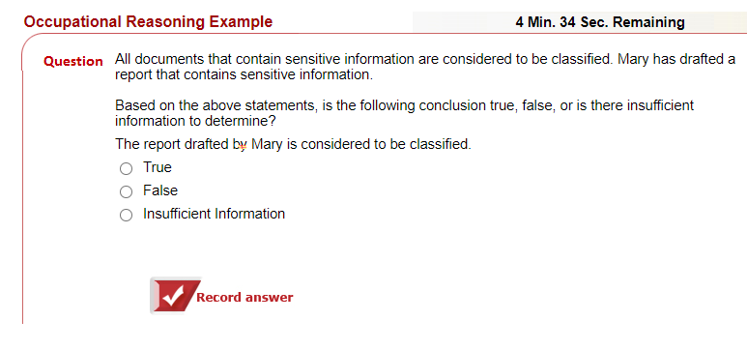
Notes:
Sample USAHire content

Slide 49
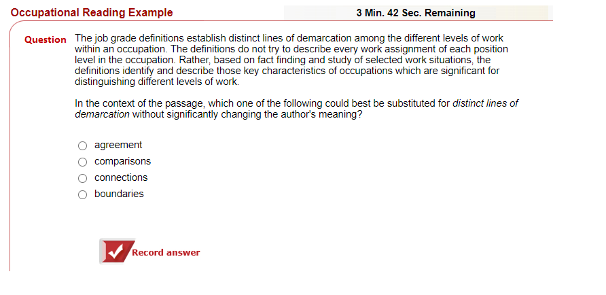

Slide 50
Discussing Assessment Types
Written Prompt
+ Period of time allowed can range from an hour (applicants preschedule an assessment block) to a week (take-home style)
+ Generally faster for SMEs to review than an structured interview.
+ Example: pose a scenario, ask how applicants would react to the scenario, try to solve the problem, or focus their next analysis
+ Need to determine page / word count limit
Notes:
Marci

Slide 51
Discussing Assessment Types
Structured Phone Interview
+ SMEs interview applicants 1:1 or in panels
+ Interviews follow a strict script in the assessment portion (there may be an untimed Q&A for applicants to ask about working in government)
+ Generally time consuming to conduct and review
+ Some platforms offer asynchronous interviews (where applicants record answers to recorded prompts for later review by SMEs)
Notes:
Trying to discover applicant’s ability to apply their experience in a new situation
“and can you give an example of when you did this in the past”
Be intentional about the kinds of questions there can be
Wording of the hypothetical questions is very tricky – it can be confusing to the applicants, difficult to “set the scene” so it makes sense for them
Strike the balance between the two question types
If you want to ask applicants to complete an assessment before resume review, you must ask applicants in the occupational questionnaire if they think they have the specialized experience.

Slide 52
Determine Assessment Types – time to discuss
What will be the assessment strategy? One round? Two rounds?
What type of assessment will be used in a round?
Structured interviews (used in every SMEQA action to date)
Written assessments
Work samples
USA Hire Behavioral / Monster Behavioral Assessments
Reminder: Assessments must test applicants in different ways so you can legally eliminate unqualified applicants after each assessment round. Each assessment does not have to evaluate every competency.
Notes:
If you want to ask applicants to complete an assessment before resume review, you must ask applicants in the occupational questionnaire if they they have the specialized experience.
You may want to use content at https://smeqa.usds.gov/hiring-phases/job-analysis/creating-assessments-from-competencies/ in your workshop to determine the best assessments for this action.

Slide 53
Determining structured interview Questions
Example question types for structured interviews:
Past experience: “Tell me about a time…”
Hypothetical situation: “Imagine we have a problem with…”
Questions can have three components:
Main prompt (mandatory)
Follow-up prompts (mandatory if not answered in initial response)
Probing questions (optional; useful if applicants are brief in their responses)
Notes:
Note to facilitator: This slide is only needed if the group decides to use a structured interview.
Trying to discover applicant’s ability to apply their experience in a new situation
“and can you give an example of when you did this in the past”
Be intentional about the kinds of questions there can be
Wording of the hypothetical questions is very tricky – it can be confusing to the applicants, difficult to “set the scene” so it makes sense for them
Strike the balance between the two question types

Slide 54
Breadth questions
Depth questions
The first interview tests the applicant’s breadth of experience across the competencies.
Breadth questions tend to take 5-10 minutes for an applicant to answer.
Breadth questions test if an applicant has experience, knowledge, or exposure to a general topic.
Breadth: Limit follow up questions to basic probe questions (i.e., “What was your role?” or “Can you tell me more?”)
The second interview tests the applicant’s depth of knowledge across the competencies.
Depth questions can take up to 10-15 minutes for an applicant to answer.
Depth questions test how an applicant reacts and responds to changes in the presented situation.
Depth: Mandated follow up questions that probe deeper (i.e., “Now imagine...” or “Tell me about a time you've experienced that hypothetical in real life.”).
Relevant only if doing two structured interview assessments
Notes:
Use this slide to explain how two structured interviews can be different (allowing applicants to be failed between the interviews). Only needed if doing two interviews. The questions types are relevant even if doing just one interview.

Slide 55
Example Question without follow-ups – Stakeholder Engagement Competency
Question: Imagine you will be attending a chief executive briefing along with a number of senior leaders from your organization. These senior leaders have more experience and tenure in the organization than you have. In addition, they hold a view that is in conflict with yours. You need the chief executive to adopt your view. How would you prepare for this meeting?
Notes:
This is a “breadth” question (useful if doing two structured interviews)

Slide 56
Example Question with follow-ups – Stakeholder Engagement Competency
Same question: Imagine you will be attending a chief executive briefing along with a number of senior leaders from your organization. These senior leaders have more experience and tenure in the organization than you have. In addition, they hold a view that is in conflict with yours. You need the chief executive to adopt your view. How would you prepare for this meeting?
Required follow-up questions:
If the meeting does not result in the outcome you had hoped for, what do you do next?
Imagine the meeting did result in the outcome you hoped for, but the other senior leaders left the meeting with remaining concerns. Would you take any additional action with those stakeholders?
Tell us about a time when you experienced a situation where you needed to convince a chief executive of something despite the other leaders who did not feel the same way. What was the outcome and what would you do differently next time?
Notes:
This is a “depth” question (useful if doing two structured interviews)

Slide 57
More example Questions Prompts
Past experience:
“Tell me about a time when….”
“What’s an example of you effectively using...”
”What was your most challenging project….”
Hypothetical situation: “Imagine we have a problem with…”
“How would you go about addressing an issue with…”
“What are some strategies you would use if….”
Notes:
To help spur groups to create questions.

Slide 58
Questions to Avoid
Brain teasers or puzzles: These create stress for the applicant and don't test their skills.
Self-assessing strengths and weaknesses: These create disingenuous answers that don't relate to competencies.
Questions about an applicant’s future goals (e.g. “Where do you want to be in five years?”): These don't test competencies and can reveal inappropriate information that introduces bias.

Slide 59
Time to break out
Based on the types of assessments you will use in this action, the group will break out one or multiple times to draft and review possible assessment material.
You may leverage past assessments if relevant to your competencies/proficiencies
Examples:
“Tell me about a time when….”
“What’s an example of you effectively using...”
“What was your most challenging project….”
“Imagine we have a problem with…”
“How would you go about addressing an issue with…”

Slide 60
Review job announcement draft and diiscuss recruitment strategy (HR sets up the draft JOA for SME review at this time)
Notes:
The group will check its work to date
Use 4-5 sample resumes you prepared ahead of time, but timebox to 1 hour and expect to only get through 2-3 resumes.
Goals:
Give SMEs 10 minutes to look at the first resume and then have them write down if they think it's a pass or fail against the required proficiencies and why.
Give them 5 minutes to discuss the differences,
Ask them if they want to change the proficiency level or tweak the wording of the levels based on this practice.
Repeat for all required proficiencies
This goal is not to calibrate SMEs (though this will help with calibration) but to refine the competencies and proficiency levels.

Slide 61
Testing Draft Assessments
Assessments should be tested with SMEs who didn’t draft them
In testing, check:
If the questions are understood as intended by the drafter
If the questions solicit responses that apply to all relevant competencies and proficiency levels (applicants should not be penalized if they fully respond to the question but lack an element for evaluating against a “best qualified” proficiency level)
That all relevant follow-up/probing questions are documented

Slide 62
Test the material on each other
Notes:
We’ve spent several days creating these materials. Thank you for your time and expertise! We’d love to take a group photo!

Slide 63
Next Steps
Customize this slide with information on what will come next. Steps could include:
Finalizing job analysis documents
JOA posting timeline
Likely timeline for resume review or other SME activities

Slide 64
The End

Slide 65
Example Breadth Question – Modern Architecture Competency
Question: You’re brought in to an existing project with a three-tier web site: A web server front-end, an application server, and a database. Each is on its own single separate machine. We want to upgrade the database without taking the site down for “scheduled maintenance.” How can we do this?
Acceptable probe follow-up questions:
How does this affect the application server?
What happens next?
Notes:
Only for technical job analysis

Slide 66
Example Depth Question – Modern Architecture Competency
Same question: You’re brought in to an existing project with a three-tier web site: A web server front-end, an application server, and a database. Each is on its own single separate machine. We want to upgrade the database without taking the site down for “scheduled maintenance.” How can we do this?
Added depth follow-up questions:
Before we made changes, the first request from a user took 1 second and subsequent requests took 100 milliseconds. We added a bunch of new application server instances behind a round-robin load balancer, and now many requests take 1 second. What’s going on?
All of our load balancers do round-robin. What should the health checks in front of the front-end HTTP server test for?

