Slide 1
FOR TRAINING FACILITATORS (delete before presenting)
While preparing, finalize your resume review method (i.e. online tool, 1-4 sentences, competency checklist) and reflect that in the slides
Replace all ____ with content specific to your agency/posting
Ensure your examples are relevant to the SMEs/posting
PREPARE THE FOLLOWING AHEAD OF TIME FOR EACH ATTENDEE:
3-4 sample resumes (should be relevant to the job you’re hiring for)
Copy of competencies and proficiency levels from Job Analysis
SME paperwork for anyone without that

Slide 2
SME Training: Resume Review
<date>
***CONFIDENTIAL – DO NOT SHARE***

Slide 3
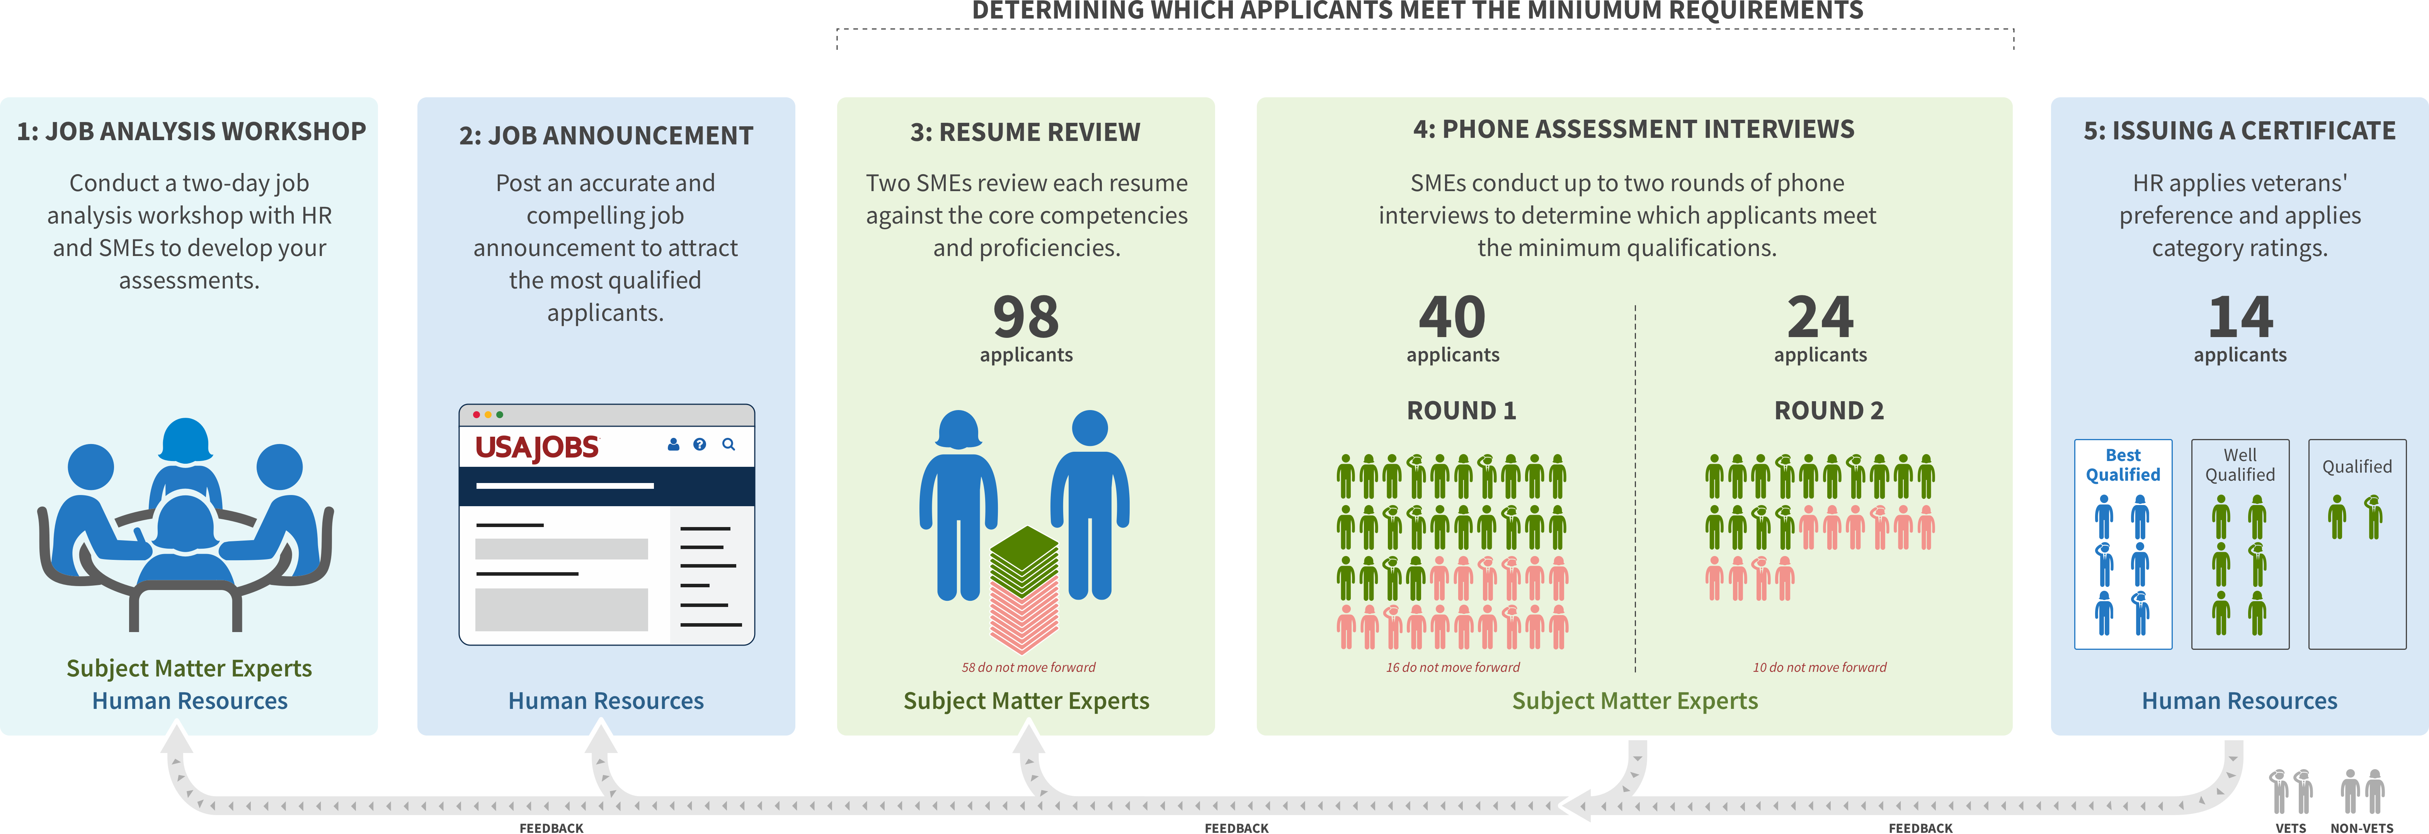
Multi-Hurdle SME Assessment Process
WE ARE HERE
<fill this in>
?
?
?
Replace the number in the third box with the actual number of applications you receive (or an estimate) then delete this box
YOU
Notes:
Reminder of the overall hiring process and where we are now
Job analysis workshop and Job Announcement already done
We are now preparing for Resume Review stage
Two SMEs will independently review each remaining applicant’s resume to determine whether they adequately reflect the core competencies and proficiencies to warrant the first of two phone assessment interviews.
If applicants move on from the resume review stage, they will each have up to 2 phone interviews

Slide 4
Agenda for this session
Refresh competencies and proficiencies
Resume review process/tool demo
Writing justifications
Learn basic principles behind the merit system and about preventing bias
Practice resume review
Reminder: Turn in filled out SME paperwork (e.g. info forms, confidentiality agreements) to _____ if you have not done so

Slide 5
Time considerations
Two SMEs who will review every resume on the worklist
If two reviewers disagree, the resume will be assigned to a third SME for a tiebreaker
Review should take 5-10 minutes and will get progressively easier
We recommend 1 hour blocks of review time, with breaks in between. Put these blocks on your work calendar and silence notifications so that you can work productively
You will have five business days to complete your share of reviews
Replace the time estimate to review a resume using the time it took during job analysis to test the proficiencies.
Notes:
Please refrain from multi-tasking during review time.
Focus should be on the qualifications review.
Allow extra time in the beginning to learn the qualifications process.
Reviews will get easier as you work through the list.

Slide 6
What to look for during resume review
Add specific page count being reviewed
Look at the first <X> pages of work experience only.* (might not be first pages).
Verify at least a year of relevant job experience.
Look for evidence of the required competencies at the proficiency level specified. Be rigorous.
Do not make a determination based on anything other than the competencies/proficiencies.
Do not look for specific keywords.
Do not reject for overqualification.
Notes:
Certain resumes might have a header on the first page due to formatting. Three pages start with the listed job experience.
SMEs should not consider an applicant’s vet status at all, positively or negatively. Only the applicant’s competencies are to be evaluated.

Slide 7
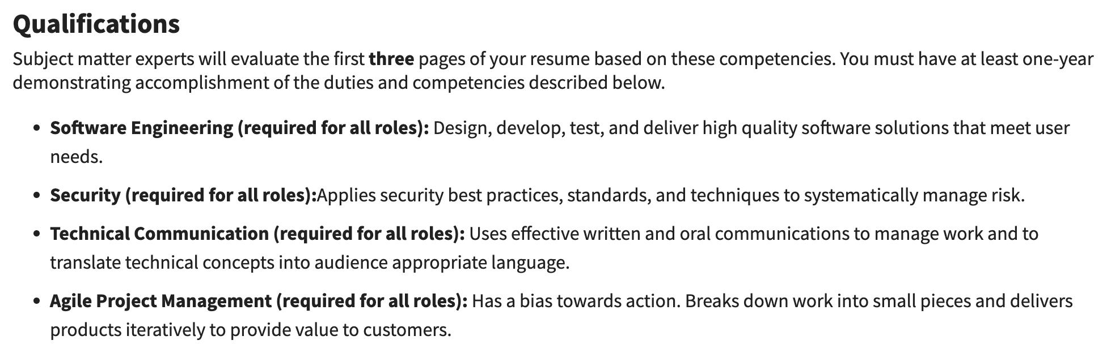
What was on the job announcement?
Replace with a screenshot and link of your job announcement
https://www.usajobs.gov/job/65502310 (also post in chat)
Notes:
Post link to the USAJOBS link in the chat

Slide 8
Review competencies and proficiencies 20 minutes All SMEs should review the materials for five minutes, followed by 15 minutes of discussion.
Notes:
If the SMEs want, they can make the proficiencies OR statements.

Slide 9
Demo of resume review process and tool 10 minutes
Notes:
Show the tool you will use for resume review and how to input results.
If using a tool, ensure that the SMEs have a technical point of contact if they hit a bug.

Slide 10
Within first ___ pages of job experience, Assess the following
Competency or Requirement | Proficiency Level or Duration Required | Met or Not Met
Adaptive Leadership and Resiliency | Familiar
Customer Experience (CX) Strategy | Familiar
Customer Experience (CX) Implementation | Familiar
Design Practices | Familiar
Relevant job experience | At least 1 year (by closing date of announcement).
Only needed if you ARE NOT using the SMEQA resume review tool
To move an applicant forward, the resume must reflect ALL of these.
Notes:
Job experience must be at least one year (52 weeks) by the closing date of the job announcement.
Full time status. Part time pro-rated.

Slide 11
Within first ___ pages of job experience, Assess the following
Competency or Requirement | Proficiency Level or Duration Required | Met or Not Met
{CORE-COMPETENCY-1} | {PROFICIENCY-LEVEL-1}
{CORE-COMPETENCY-2} | {PROFICIENCY-LEVEL-2}
{CORE-COMPETENCY-3} | {PROFICIENCY-LEVEL-3}
{CORE-COMPETENCY-4} | {PROFICIENCY-LEVEL-4}
Relevant job experience | At least 1 year
Only needed if you ARE NOT using the SMEQA resume review tool
One core competency not met. No need to assess for additional competencies.
Notes:
NOTE: Replace all {VARIABLE} data items on this slide with the details the team has agreed upon. There may be fewer/more competencies, customize this table as needed.
If an applicant does not meet one requirement, there’s no need to continue evaluating for remaining ones
By definition, applicants must meet ALL minimum qualifications to move forward

Slide 12
Written statements
When failing on a proficiency, name why the proficiency isn’t met and provide enough detail to retrace the decision later.
Your justification must be rooted in that specific competency or proficiency.
If you make an logical inference as part of your finding, positive or negative, record it.
Sometimes, the reason is that there is no evidence of the competency. There’s no additional detail needed in that case.
Notes:
Important to cite the technical reason why the specific competency wasn’t met.
Refrain from searching using keywords. Look for evidence of competencies and proficiency levels.

Slide 13
Elements of a good “MOVES FORWARD” statement: Start with decision
“Move Forward:
These slides are only needed if the SMEs are writing “move forward” justifications from scratch.
Notes:
Start your note with your move forward/do not move forward determination

Slide 14
Elements of a good “MOVES FORWARD” statement: mention that Core competencies/proficiency levels are met
“Move Forward: Core competency proficiency levels adequately reflected.
These slides are only needed if the SMEs are writing “move forward” justifications from scratch.
Notes:
Then state if the core competency and required proficiency level is met

Slide 15
Elements of a good “MOVES FORWARD” statement: mention if Core competencies/proficiency levels are met
“Move Forward: Core competency proficiency levels adequately reflected. Meets communications/collaboration because she implemented a company-wide program that had success results and metrics.
These slides are only needed if the SMEs are writing “move forward” justifications from scratch.
Notes:
Cite the competency and note the decision: [decision] ([role]) - [competency] was/was not met. [reason]

Slide 16
Elements of a good “MOVES FORWARD” statement: mention if they have 1 year relevant experience
“Move Forward: Core competency proficiency levels adequately reflected. Meets communications/collaboration because she implemented a company-wide program that had success results and metrics. One year relevant experience.”
These slides are only needed if the SMEs are writing “move forward” justifications from scratch.
Notes:
Make sure and note the 1 year experience requirement

Slide 17
If you are using a different tool for resume review ”moves forward” statements, add instructions here
Notes:
Make sure and note the 1 year experience requirement

Slide 18
“DOES NOT MOVE FORWARD” STATEMENTS: GOOD EXAMPLES
“Though Eugene’s resume shows 43 years experience as an IT Specialist, his resume shows minimal experience delivering products to production. His proficiency is below what is required for the position.”
“Kevin’s resume does not show the communications/collaboration competency at the level required for this position because it contains significant spelling and grammatical errors.”
Notes:
This applicant does not move forward despite many decades of experience because the required proficiency level was not evidenced.

Slide 19
“DOES NOT MOVE FORWARD” STATEMENTS: BAD EXAMPLES
“This applicant is overqualified and will not accept the position.”
“This applicant does not meet requirements because they’ve changed between positions so much they probably have a personality problem.”
“This applicant is not qualified because she has no experience in this agency.” [agency knowledge is not a required competency]
Notes:
Each of these are invalid reasons to reject a resume and will require another SME to do a brand new review of that resume.

Slide 20
Prohibited Personnel Practices 5 U.S.C. 2302(b)
Giving an unauthorized preference or advantage to improve or injure the prospects of any particular person for employment (also, don’t promise anyone they’re going to get this job--you don’t know that!)
Engaging in nepotism
Discriminating (including discrimination based on marital status and political affiliation)
Considering employment based on factors other than personal knowledge or records of job-related abilities
Influencing any person to withdraw from job competition
Notes:
Reminder of relevant legal requirements around personnel practices

Slide 21
Guidance on Personal Relationships with Applicants
Recuse if:
You have a personal relationship with the applicant outside of work, whether or not the relationship is known to others.
There is any appearance of bias from you toward the applicant, such as when it’s well known that you and the applicant have regular disagreements, or that you and the applicant have a unique bond.
Attending happy hours together is fine.
Notes:
Guidance from SMEQA website:
It’s common for SMEs participating in a hiring action to know applicants. SMEs may review people they know, supervise, and work with, such as contract professionals or fellow public servants, except in these cases:
The SME has a personal relationship with the applicant outside of work, whether or not the relationship is known to others.
There is any appearance of bias from the SME toward the applicant, such as when it’s well known that the SME and applicant have regular disagreements, or that the SME and the applicant have a unique bond.
In general, if the SME and the applicant have occasionally attended the same office happy hour, there is no conflict. However, if the SME and applicant regularly socialize together outside of work, the SME should recuse themselves

Slide 22
Correcting for unconscious bias
Notes:
Full slides on unconscious bias are at the end of the presentation in an appendix

Slide 23
We all have biases that can have profound effects on our ability to hire the best team.

Slide 24
1/ Don’t look up candidates
2/ Question your assumptions 3/ Use competencies/proficiency levels
4/ Look at how you describe people
Notes:
For #4, “assertive” vs “bossy”

Slide 25
Resume Review Practice Session 90 minutes You will have ten minutes to review each resume and write a decision and justification statement. Share your work with the facilitator by ____
Determine how you want to practice: should SMEs review many resumes before
Notes:
We are going to do 10 min per resume and 10 min for review of each resume tomorrow so in 1 hour hopefully we get through 3 of them
PREPARE AHEAD OF TIME – 1 PRINTED COPY OF EACH PER ATTENDEE
3-4 sample resumes (should be relevant to the job you’re hiring for)
Copy of competencies and proficiency levels doc that the team created in Job Analysis Workshop
For each sample resume:
Review first 2-3 pages (or whatever the team decided) silently for about 5 minutes until everyone has completed writing their review statement
Read aloud each statement
Discuss as a team after all statements are read aloud
Should take 15-20 minutes per resume
This exercise is intended to calibrate all SMEs so they agree on how strict/lenient they want to be with each competency.
Calibration as an SME resume reviewing team is vital to ensure as much consistency as possible across the competencies and proficiency levels.
SMEs must set the bar high for the assessment

Slide 26
Your login.gov account
Go to secure.login.gov and create a new account with the e-mail address you are using for your SME work. (not a personal address, like you might used for USAJOBS)
You will need to set up two factor authentication.
If you already have an account, log in now to verify its working!
Only needed if you are using USA Staffing to view resumes or the SMEQA resume review tool

Slide 27
Batch download demo 5 minutes During your review, if you have a problem with USA Staffing/Monster, reach out to _____
Put in a point of contact for USAStaffing/Monster issues
Notes:
If the SMEs want, they can make the proficiencies OR statements.

Slide 28
Logistics
Resume review will start _____
You are expected to review at least ____ resumes (based on the total number of applicants)
Resume review must be complete by _____
Go over needed SME Confidentiality Statements or Background forms.
Holding calendar availability for the next stages after resume review
First assessments: ____; second assessment: ___
Update these dates to be specific to your hiring action
Notes:
Fill in your team’s dates on this slide
Typically this slide sparks a discussion among the team as to who’s on vacation, who cannot make the proposed times, etc.
For each SME who cannot participate in the allotted time, the time-to-hire gets that much longer, and that’s another SME who must fill in

Slide 29
The End

Slide 30
Appendix: Correcting for unconscious bias
Notes:
Some slides are earlier in the presentation

Slide 31
We all have biases that can have profound effects on our ability to hire the best team.

Slide 32
“Job applicants with white names needed to send about 10 resumes to get one callback; those with African-American names needed to send around 15 resumes to get one callback.”
— National Bureau of Economic Research

Slide 33
Unconscious bias doesn’t mean we’re bad people. All humans are biased.

Slide 34
But we have to recognize our bias and correct for it.

Slide 35
1/ Don’t look up candidates
2/ Question your assumptions 3/ Use competencies/proficiency levels
4/ Look at how you describe people

Slide 36
1/ Don’t look up candidates
Looking at a candidate’s internet presence can lead you to make conclusions about them before you even meet them!
Don’t search for candidates online. Instead, use the application materials provided.

Slide 37
2/ Question your assumptions
Society has taught us to assume that certain people (like women, people of color, people with disabilities, etc.) are less capable than others. When considering candidates from under-estimated backgrounds, check your thinking about qualification.
Ask yourself: am I reading this person's qualifications the same as if they were white, male, etc?

Slide 38
3/ Use the competencies and proficiency levels
Using the guides consistently helps us assess candidates more fairly, because we’ve had time to write down what we’re looking for in an answer before we look at their application. That means that the bar we’re holding a candidate to isn’t a moving target based on our perception of them.
Make sure to double check your reviews against the pre-established qualifications.

Slide 39
4/ Look at how you describe people
We have been taught to use words like “aggressive” or “competitive” to describe men, and words like “supportive” or “nurturing” to describe women. Similarly, we’re taught to react differently to the exact same behavior depending on who we’re reacting to. Is someone “assertive” or “overbearing”? Are they “bossy” or “a leader”?
To counter this effect, ask yourself “Is how I’m describing this candidate colored by their demography?”

