Slide 1
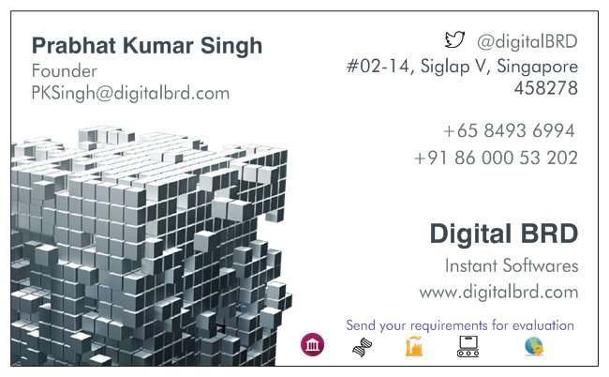

Slide 3










Prabhat Kumar Singh
@digitalbrd
Founder
#02-14, Siglap V, Singapore, 458278
PkSingh@digitalbrd.com
+65 8493 6994
+91 86 000 53 202
Digital BRD
Get Instant Softwares
www.digitalbrd.com
Send your business requirements for free consultation

Slide 4

Prabhat Kumar Singh
@digitalbrd
Founder
#02-14, Siglap V, Singapore, 458278
PkSingh@digitalbrd.com
+65 8493 6994
+91 86 000 53 202
Digital BRD
Get Instant Softwares
www.digitalbrd.com
Send your business requirements for free consultation

Slide 5

Prabhat Kumar Singh
@digitalbrd
Founder
#02-14, Siglap V, Singapore, 458278
PkSingh@digitalbrd.com
+65 8493 6994
+91 86 000 53 202
Digital BRD
Get Instant Softwares
www.digitalbrd.com
Send your business requirements for free consultation

Slide 6


Prabhat Kumar Singh
@digitalbrd
Founder
#02-14, Siglap V, Singapore, 458278
PkSingh@digitalbrd.com
+65 8493 6994
+91 86 000 53 202
Digital BRD
Get Instant Softwares
www.digitalbrd.com
Send your business requirements for free consultation

