Slide 1
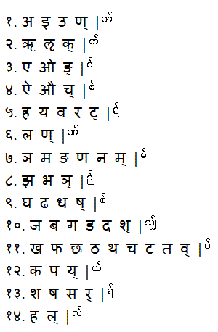
14 = 4 + 10
4 := vowels
10 := consonants
?
act
p³ :
Expr, Jump, Loop
An accounting system 1. Name of product 2. Quantity of Purchase 3. Taxes is x% 4. Discount is y% 5. Discount is before tax or after tax? 6. Only one product or multiple? 7. What is final payable amount

