Slide 1
Digital

Slide 2
Current Players
Name | Rank* | Cognitive Ranking | Price
my-invenio.com | 7
intellilink.com | 6
blueprism.com | 2
automationanywhere.com | 1
redwood.com | 8
Ipsoft | 9
UiPath | 3 |  | $120
Infosys - AssistEdge | 4
HCL Toscana | 5
Talking | 10
* Market Cap As of 12 October 2016

Slide 3
New Ideation Playgrounds
pr.ai
irpanetwork.com

Slide 4

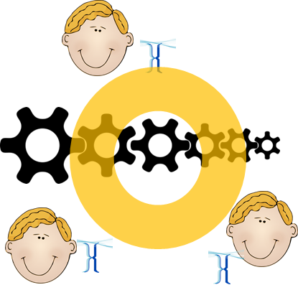







Cognitive
Human Talk
Automate
Autonomation
Connect to other bots
Windows Objects
Supervise
Learn & Replicate
Staff assistant
chatbots
Workflows are basic functional block.
Robust
Flexible
Evolving
Dynamics
Continuous Automation
Fast
Pattern Discovery
Demand Driven Connections
Visit http://Talking.im for more
Talking connects Everything

Slide 5
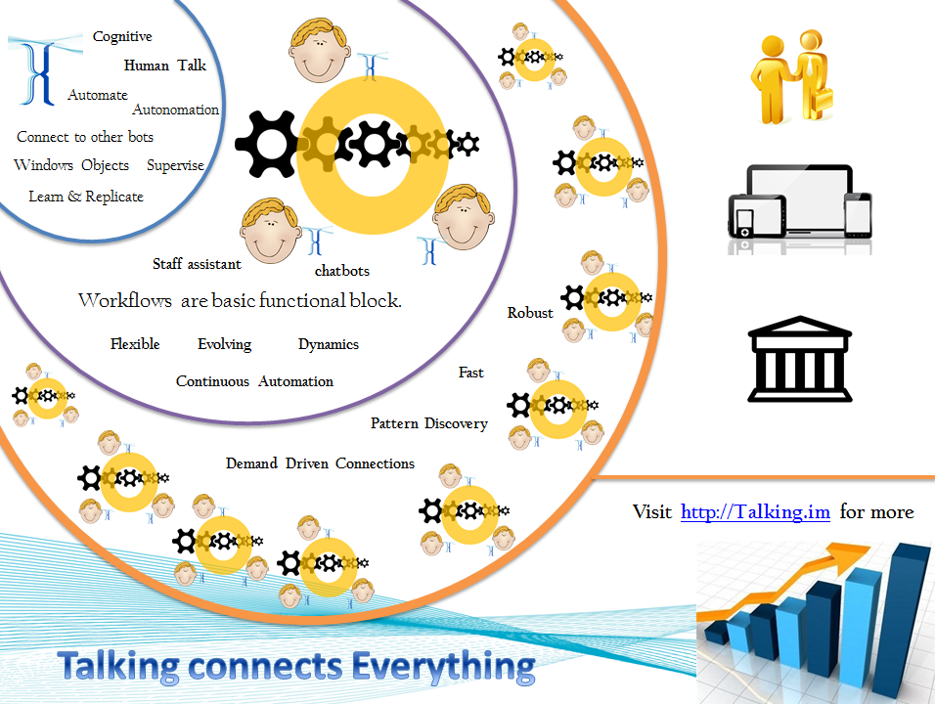

Slide 6
Robotics Feasibility Assessment
Download Self Assessment Spreadsheet http://Talking.in
Send your questions Talk@Talking.im

Slide 7
