Slide 1
Earthquake Monitor
Real-Time Seismic Data Pipeline

Slide 2
Project Purpose
Why was this system built?
Earthquakes happen continuously worldwide. The goal of this project is to capture every seismic event in real time, enrich it with contextual data, and make the results explorable through an interactive dashboard.
Monitor
Enrich the event with other information
Analyse
Visualise
Receive live earthquake events the moment they are detected
Compute related parameters
Present all data in an
- population data
interactive web dashboard
- historical seismic activity
per event and per country
- nearby infrastructure
in a structured warehouse

Slide 3
Data Sources
External APIs called per earthquake event
EMSC WebSocket
USGS Earthquake API
WorldPop API
European-Mediterranean Seismic Centre
US Geological Survey
worldpop.org
• Live seismic event stream (WebSocket)
• Historical M4.0+ earthquakes since 2014
• Population density around the epicenter
• Magnitude, coordinates, timestamp
• Within 100 km radius of epicenter
• data from 2020
• Persistent connection — events pushed in real time
• Used to assess regional seismic risk
• Indicates how many people are affected
Overpass API
Nominatim API
OpenStreetMap infrastructure data
OpenStreetMap reverse geocoding
• Hospitals, police stations, aerodromes
• Converts coordinates to place names
• Within a defined radius
• Returns country, state, settlement
• Indicates emergency response capacity
• Human-readable location labelling

Slide 4
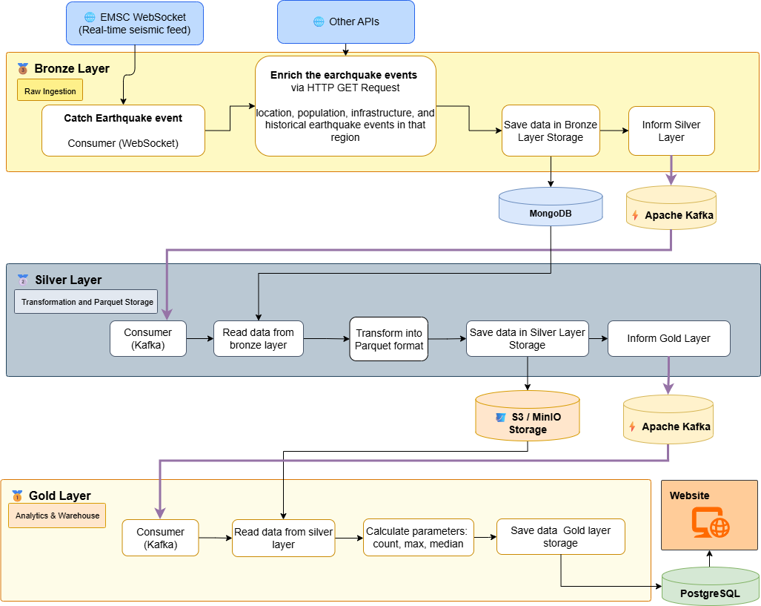
System Architecture
Medallion Pattern
Data flows through three quality
layers before reaching the dashboard

Slide 5
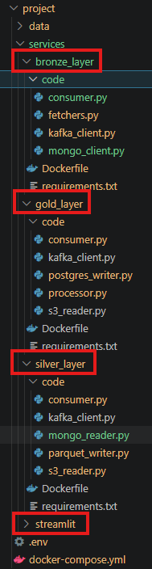
Software Architecture

Slide 6
Technologies Used
Full stack overview
Event Streaming
Object Storage
Data Formats
• Apache Kafka (Confluent CP 7.5.3)
• Bronze-Layer: MongoDB – raw data, json objects
• Silver-Layer: MinIO — S3-compatible storage (Parquet)
• JSON — raw bronze event storage
• Zookeeper (cluster coordination)
• Apache Parquet — columnar silver storage
• PyArrow + pandas for Parquet I/O
• Accessed via boto3 / AWS SDK
Data Warehouse
Dashboard
Infrastructure
• PostgreSQL 16
• Access with psycopg2-binary
• Streamlit 1.35
• Docker & Docker Compose
• Plotly (data visualization in maps)
• pandas

Slide 7
Streamlit Dashboard
4 interactive tabs
Tab 1
Tab 2
Last 24 h — Top 10
All Earthquakes
• Shows the 10 strongest earthquakes from the last 24 hours.
• Shows every earthquake event with interactive filters
Tab 3
Tab 4
Country Overview
Historically Strongest
• Shows statistics per-country
• Shows events where the surrounding region has the strongest historical earthquake record (magnitude > 4.0)

Slide 8
Next Steps?
• CI/CD for the Cloud
• Time-consuming generation of reports via jobs

Slide 9
Thank you for your attention
Q&A

