Slide 1



AWS Breaking Barriers Challenge

Slide 2
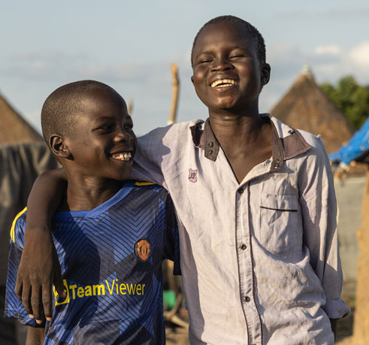
About the HLA
As the department focused on localisation at Save the Children UK, our mission is to inspire a movement for locally led humanitarian action
Our purpose is to work with local actors and organisations to provide tailored resilience and crisis response support that addresses their specific needs.
We focus on nurturing and empowering local leaders, driving collective action through our networks, thought leadership and research, and convening local voices, creating opportunities for change and collaboration

Slide 3

Our Digital Platforms
We believe that digital technology can help us enhance and extend the reach of our work, enabling us to support more vulnerable adults and children worldwide.
Powered by a catalogue of hundreds of courses in multiple languages, the Kaya learning management system has provided over one million users with free humanitarian learning.
Our platform and digital expertise are also enabling organisations around the world to have the tools and resources to be more effective, agile, and holistic in their approach to saving lives and safeguarding livelihoods.

Slide 4
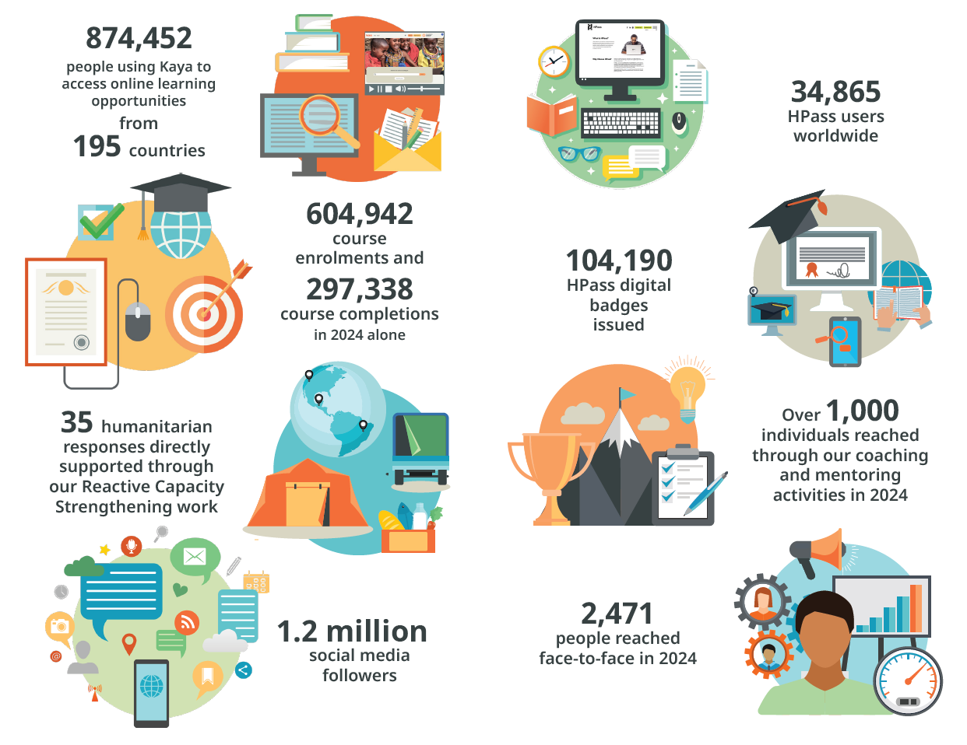
Our Impact in 2024

Slide 5
Challenge Statement
There is currently no way to connect learning to real-world action. Learners complete training but struggle to find relevant jobs, mentoring, or volunteering opportunities, while local organisations cannot easily identify qualified individuals.
How can we utilise artificial intelligence and our learner database to enable the rapid recruitment of qualified specialists for a humanitarian response?

Slide 6
Hackathon Briefs
Brief 1
Build a proof-of-concept matching algorithm that connects learner profiles to opportunities using synthetic data.
Brief 2
Build an interface for organisations to submit job/opportunity descriptions, with automated feature extraction and normalisation to a standardised glossary.

