Slide 1
Day Two Review
HILT 2018

Slide 2
Python
What are some of the data types?
What is a variable?
What is a method?
Why Python? Why not?

Slide 3
Python
What is an operator?
What is the Python interpreter? Is it awesome?
How do you assign a variable?
What is Duck Typing?
What is a list?
What is a dictionary?

Slide 4
Python
What’s the difference between a list and a dictionary?
How do you step over a collection?
How do you print something to the console?

Slide 5
Python
How do you run a command-line program?
What is an argument?
What is a conditional statement?

Slide 6
Python
What was the hardest thing you did yesterday?
What was the easiest?

Slide 7
Plan
Keep going!
But we take requests! In particular, top choices from the poll were…
student projects
useful libraries
how to work with data and these tools

Slide 8
Plan Cont.
Today:
Finish out concepts II.
Hand wave at concepts III.
Start working through a case study together.

Slide 9
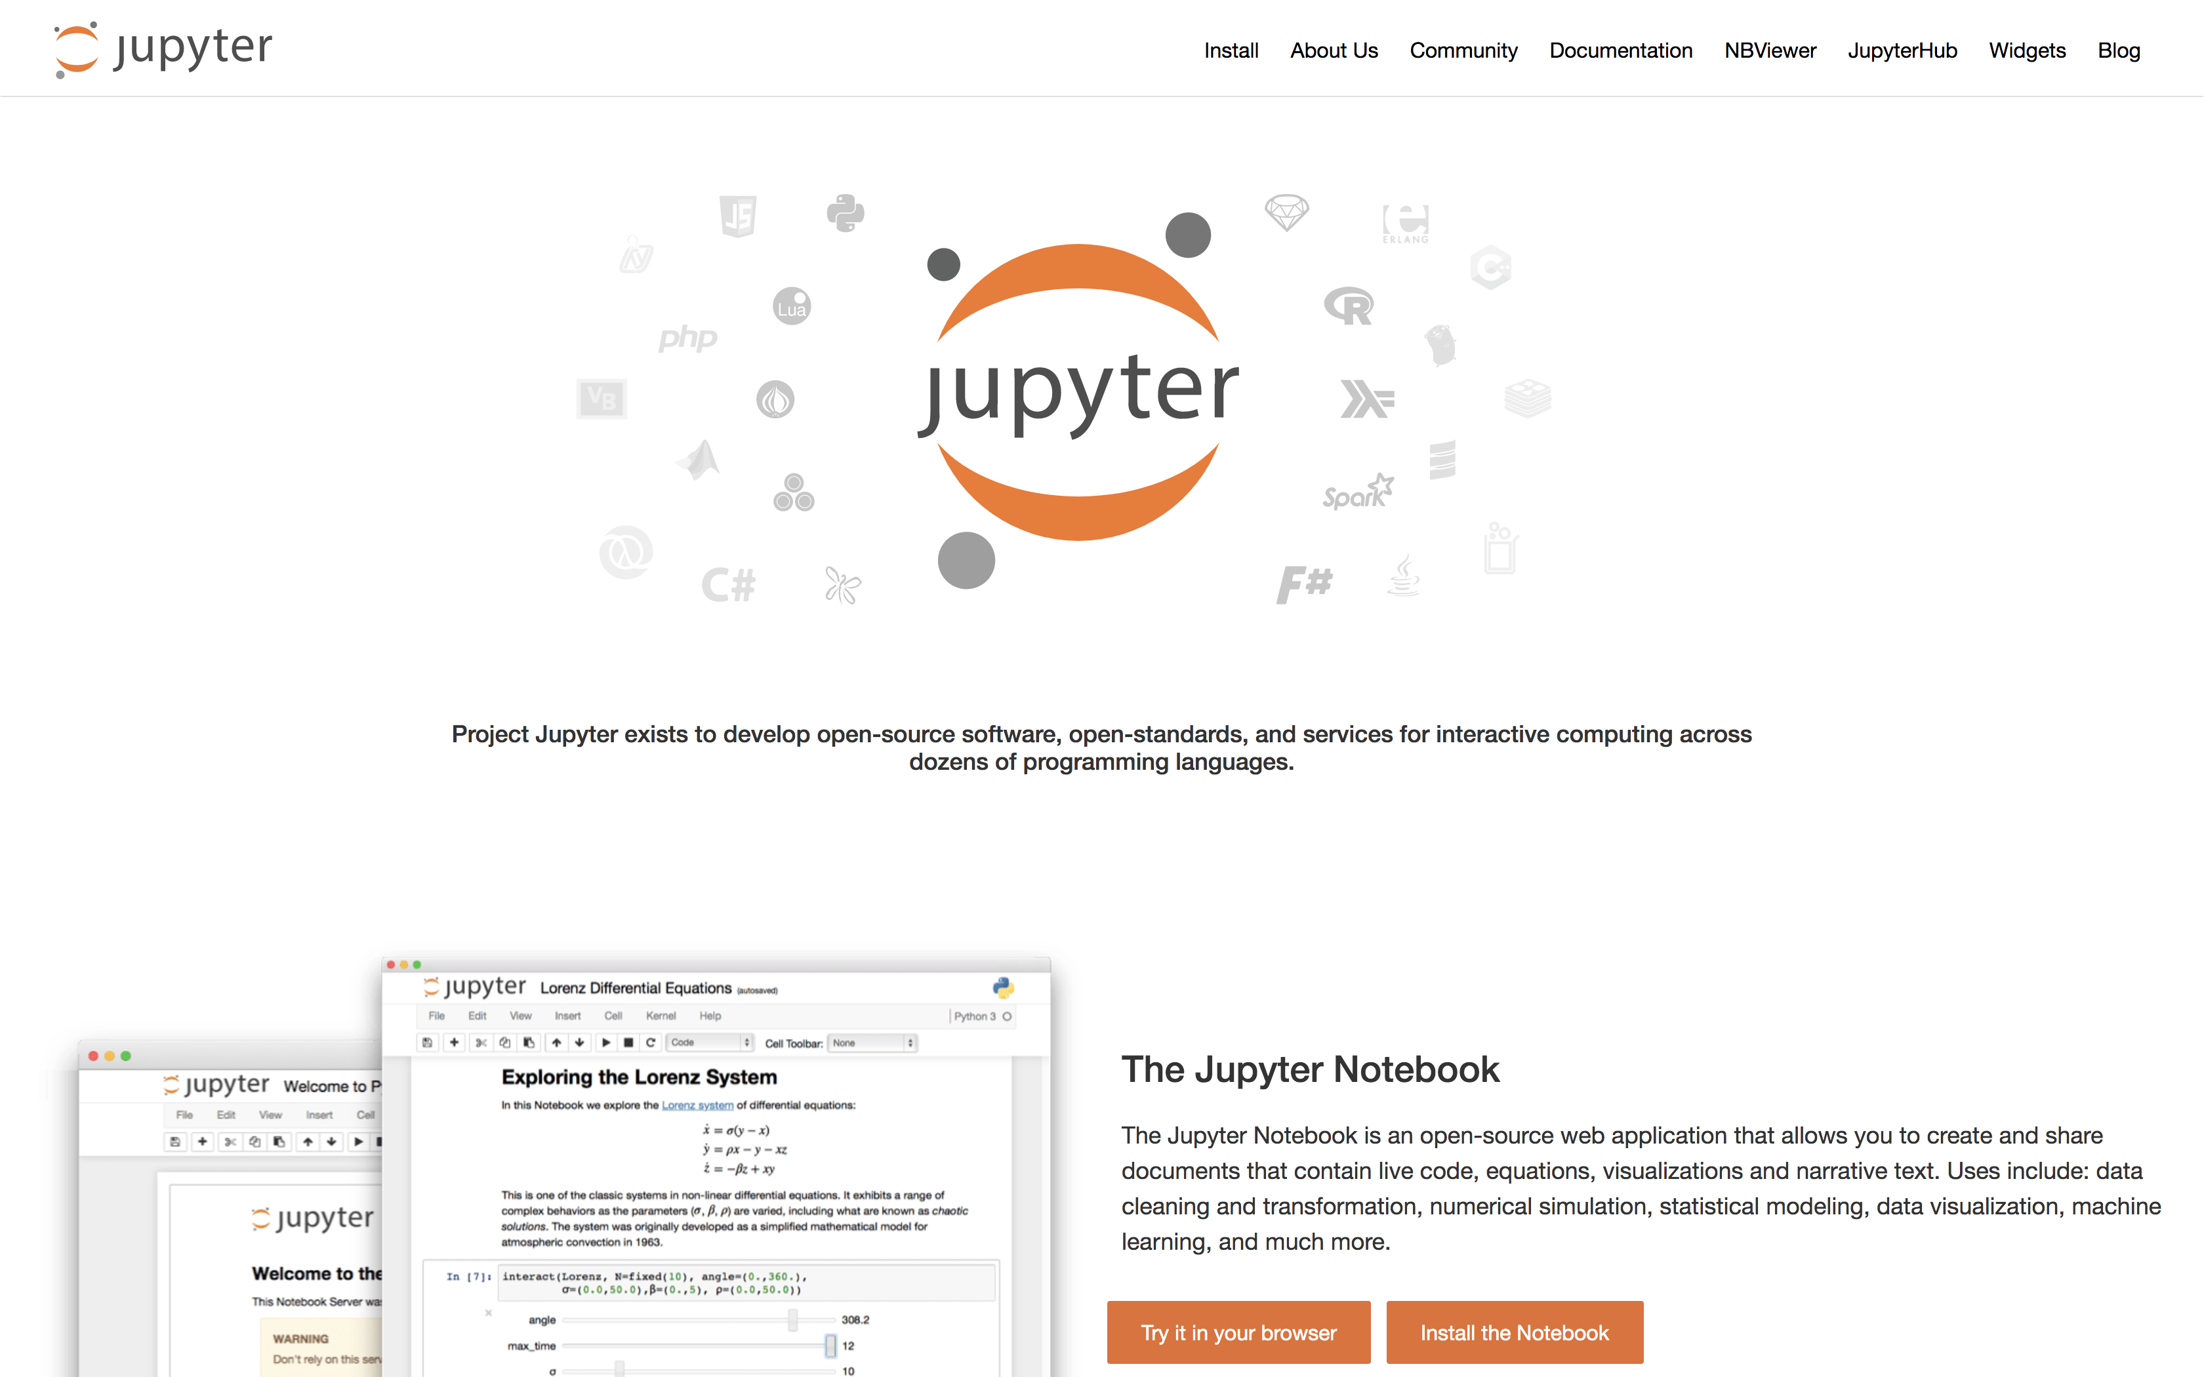
Case Studies

Slide 10
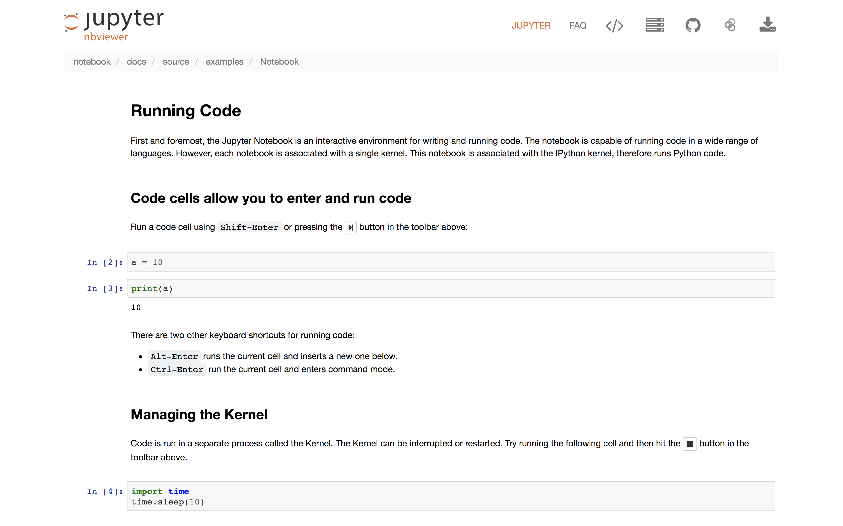
Jupyter Notesbooks Cont.

Slide 11
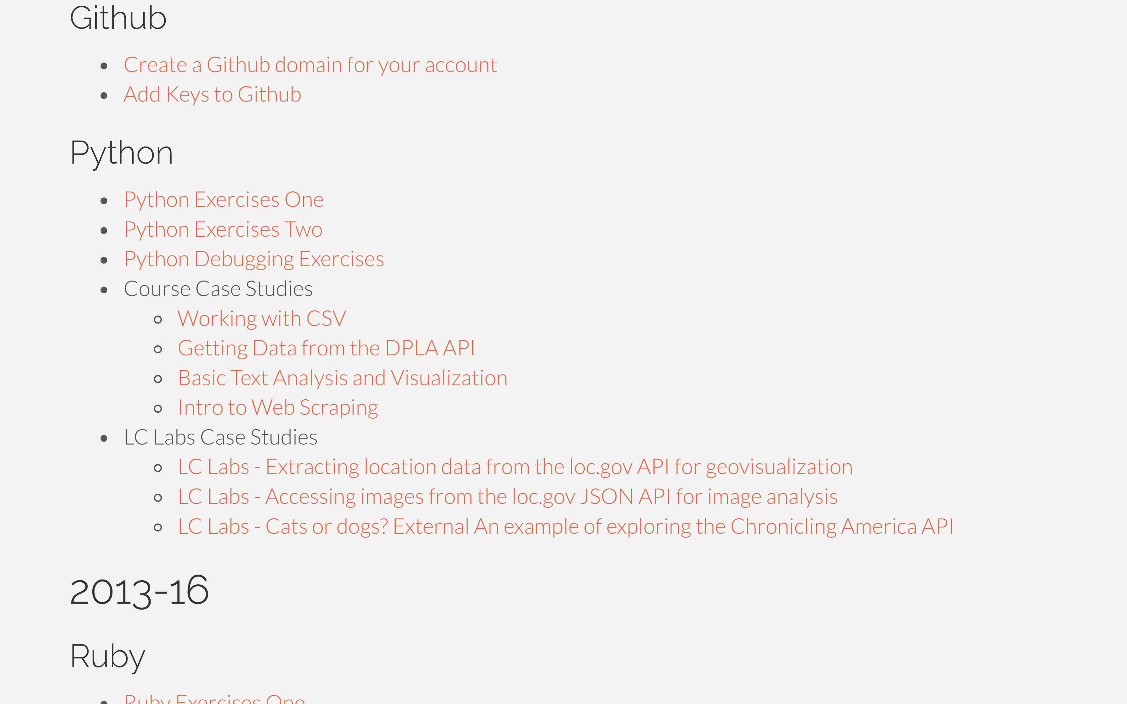
Transitioning to Independent Work
In the real world, you're often working from examples.
This is an opportunity to try that with some support!
Pick one relevant to your interests. If you have an idea for a project that you'd rather work on we can help you get started on that too.

Slide 12
Plan Cont.
All slides (incl. Concepts III) on the website.
Also have some exercises up there.
Reinforcement is important!

Slide 13
Show and Tell
Start thinking about it...

