Slide 1
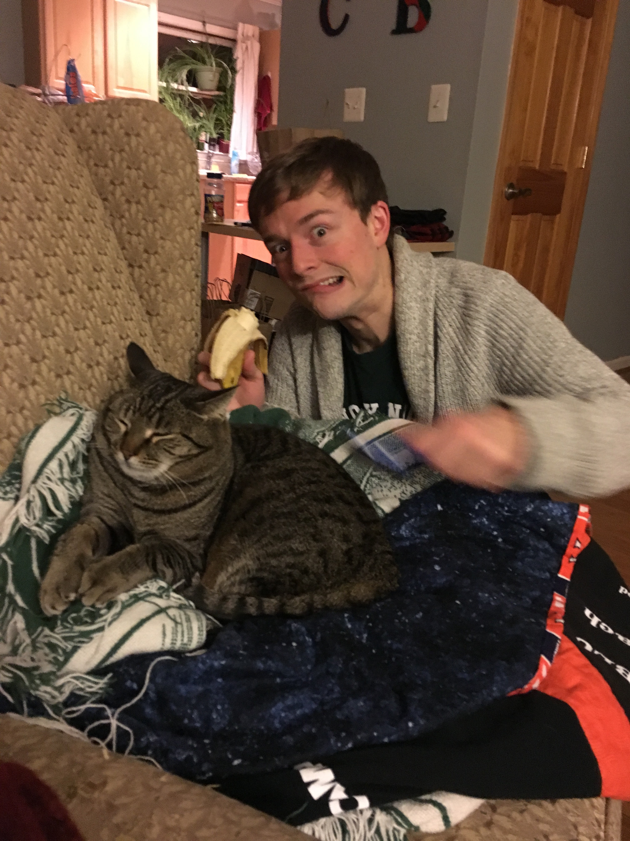
Day Three Review
HILT 2017

Slide 2
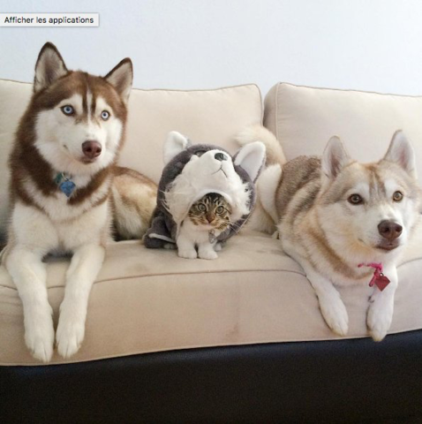
Impostor Syndrome

Slide 3
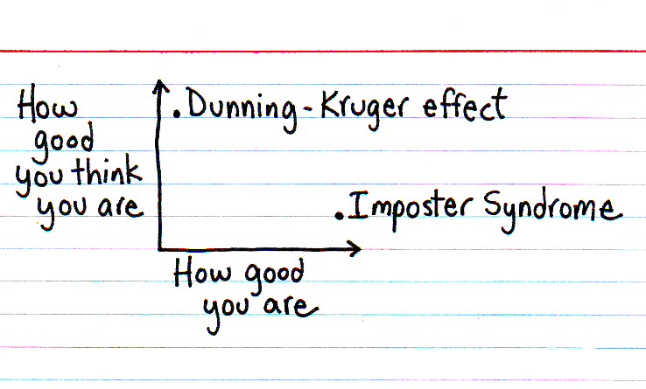

Slide 4
Dunning-Kruger Effect
Cognitive bias of unskilled individuals suffering from illusory superiority
Rate their ability much higher than accurate

Slide 5
Impostor Syndrome
Your accomplishments are undeserved, invalid, you in some way not earned
(not a descriptive slide)

Slide 6
Reading
Tanya X Short, “Overcoming Impostor’s Syndrome” http://www.gamasutra.com/blogs/TanyaXShort/20140716/220938/Overcoming_Impostors_Syndrome.php

Slide 7
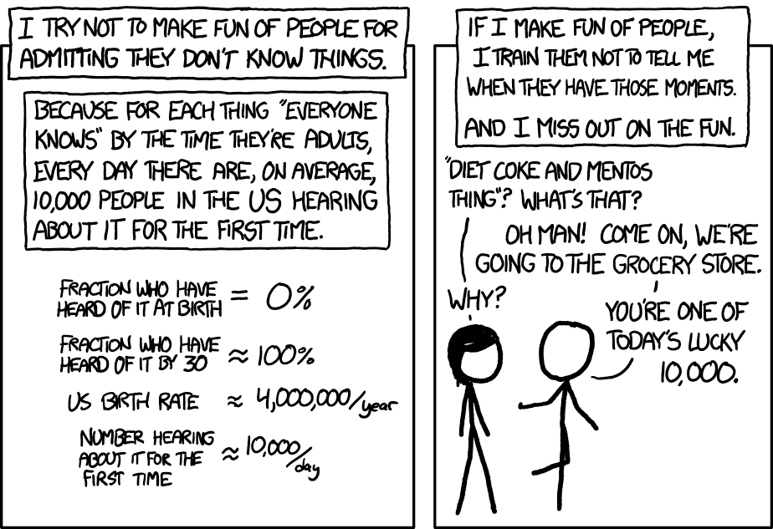
Notes:
PAY IT FORWARD

Slide 8
Today (at show and tell)
We need to fill up 5 minutes…

Slide 9
The plan…
Work through Python in practice
Give some real-world examples of using Python
Discuss anything you want

Slide 10
Approaches
“Pair programming”: work with the person next to you. One type, the other says what to do
Do it by yourself
Pretend you’re doing it, but really read your email and surf Facebook

Slide 11
When to Scrape?
Ask:
Will they just give me the data?
Do they have an API I can use instead?
Do the have a terms of service I can see?
Would I have to log in?
Can the URLs be worked around in Python?
Is it worth it?

Slide 12
How to start?
To find code, google
python3 library “thing I want to do” “object of study”
Ex:
python3 library for analyzing images
python3 library for getting proper nouns from strings
Look on github
Look at the documentation

Slide 13
How to start?
Find projects similar to yours
Is their code on github?
Does their about page describe what they did?
Can you ask them?
Look at resources that exist online
programminghistorian.org
nltk.org/book
Blogs! walshbr.com, scholarslab.org

Slide 14
How to teach?
Big Resources
https://jitp.commons.gc.cuny.edu/
http://codingpedagogy.net/index.html
hybridpedagogy.org
“Beyond Buttonology” – Russell and Hensley
https://crln.acrl.org/index.php/crlnews/article/view/16833/18427
Blogs!
walshbr.com
scholarslab.org

