Slide 1
Digital humanities programming - Now with 50% more Python!
HILT 2019

Slide 2
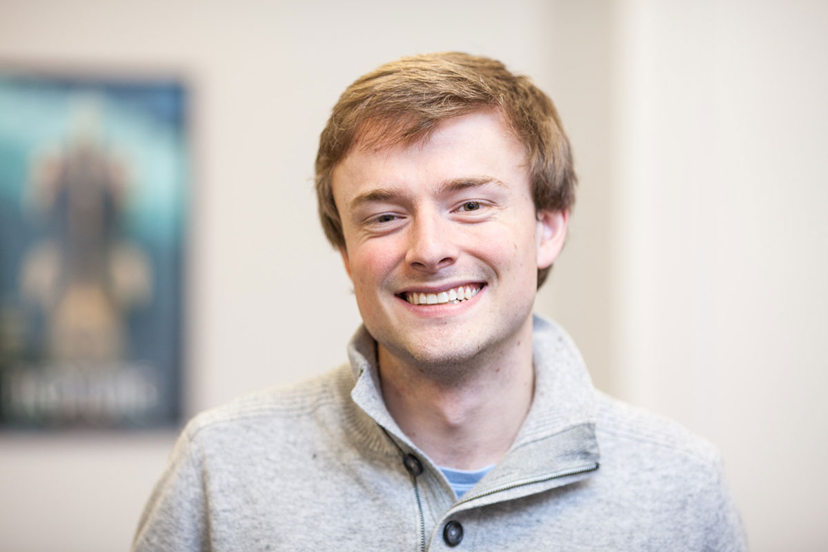
GitHub: walshbr
@walshbr

Slide 3

GitHub: reedeth
@reedeth

Slide 4
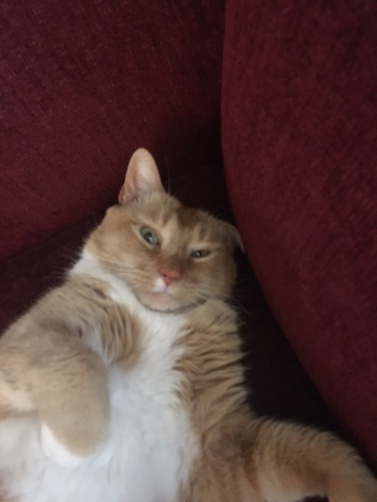
GitHub: @tony
@thecat

Slide 5
Week’s Trajectory
Introduce the command line
Introduce source code management
Introduce programming concepts w/ Python
Apply Python to real-life DH situations

Slide 6
Pedagogical Approach
A mix!
Some programming together
Some talking over slides
Some independent work
Collaboration is encouraged!
Notes:
To be frank the course title is a pedagogical intervention – trying to get a particular audience in the room.
Hope is that the course will give you a way in, help you get started and help you apply these things to your real life.

Slide 7
What to expect
Lots of hands-on activities
Lots of new concepts
Humorous pictures
Your brain will hurt at some point

Slide 8
Ground Rules
Asking questions is a “super power”
If you need a mental (or other break), take one
Writing software is a collaborative endeavor

Slide 9
Post-it Notes
All have three colors: Green, Red, White
Green: things are good
Red: need help
White: Done
Green and (especially) white offer help to red
Credit to Miriam Posner and Deb Verhoeven

Slide 10
slack
hilt-institute.slack.com
Another avenue for asking for help and sharing
/giphy word

Slide 11
Code of conduct
We are dedicated to creating a safe, respectful, and collegial learning environment for the benefit of everyone who attends.

Slide 12
Other Important Stuff
Coffee
Lunch
Supper

Slide 13
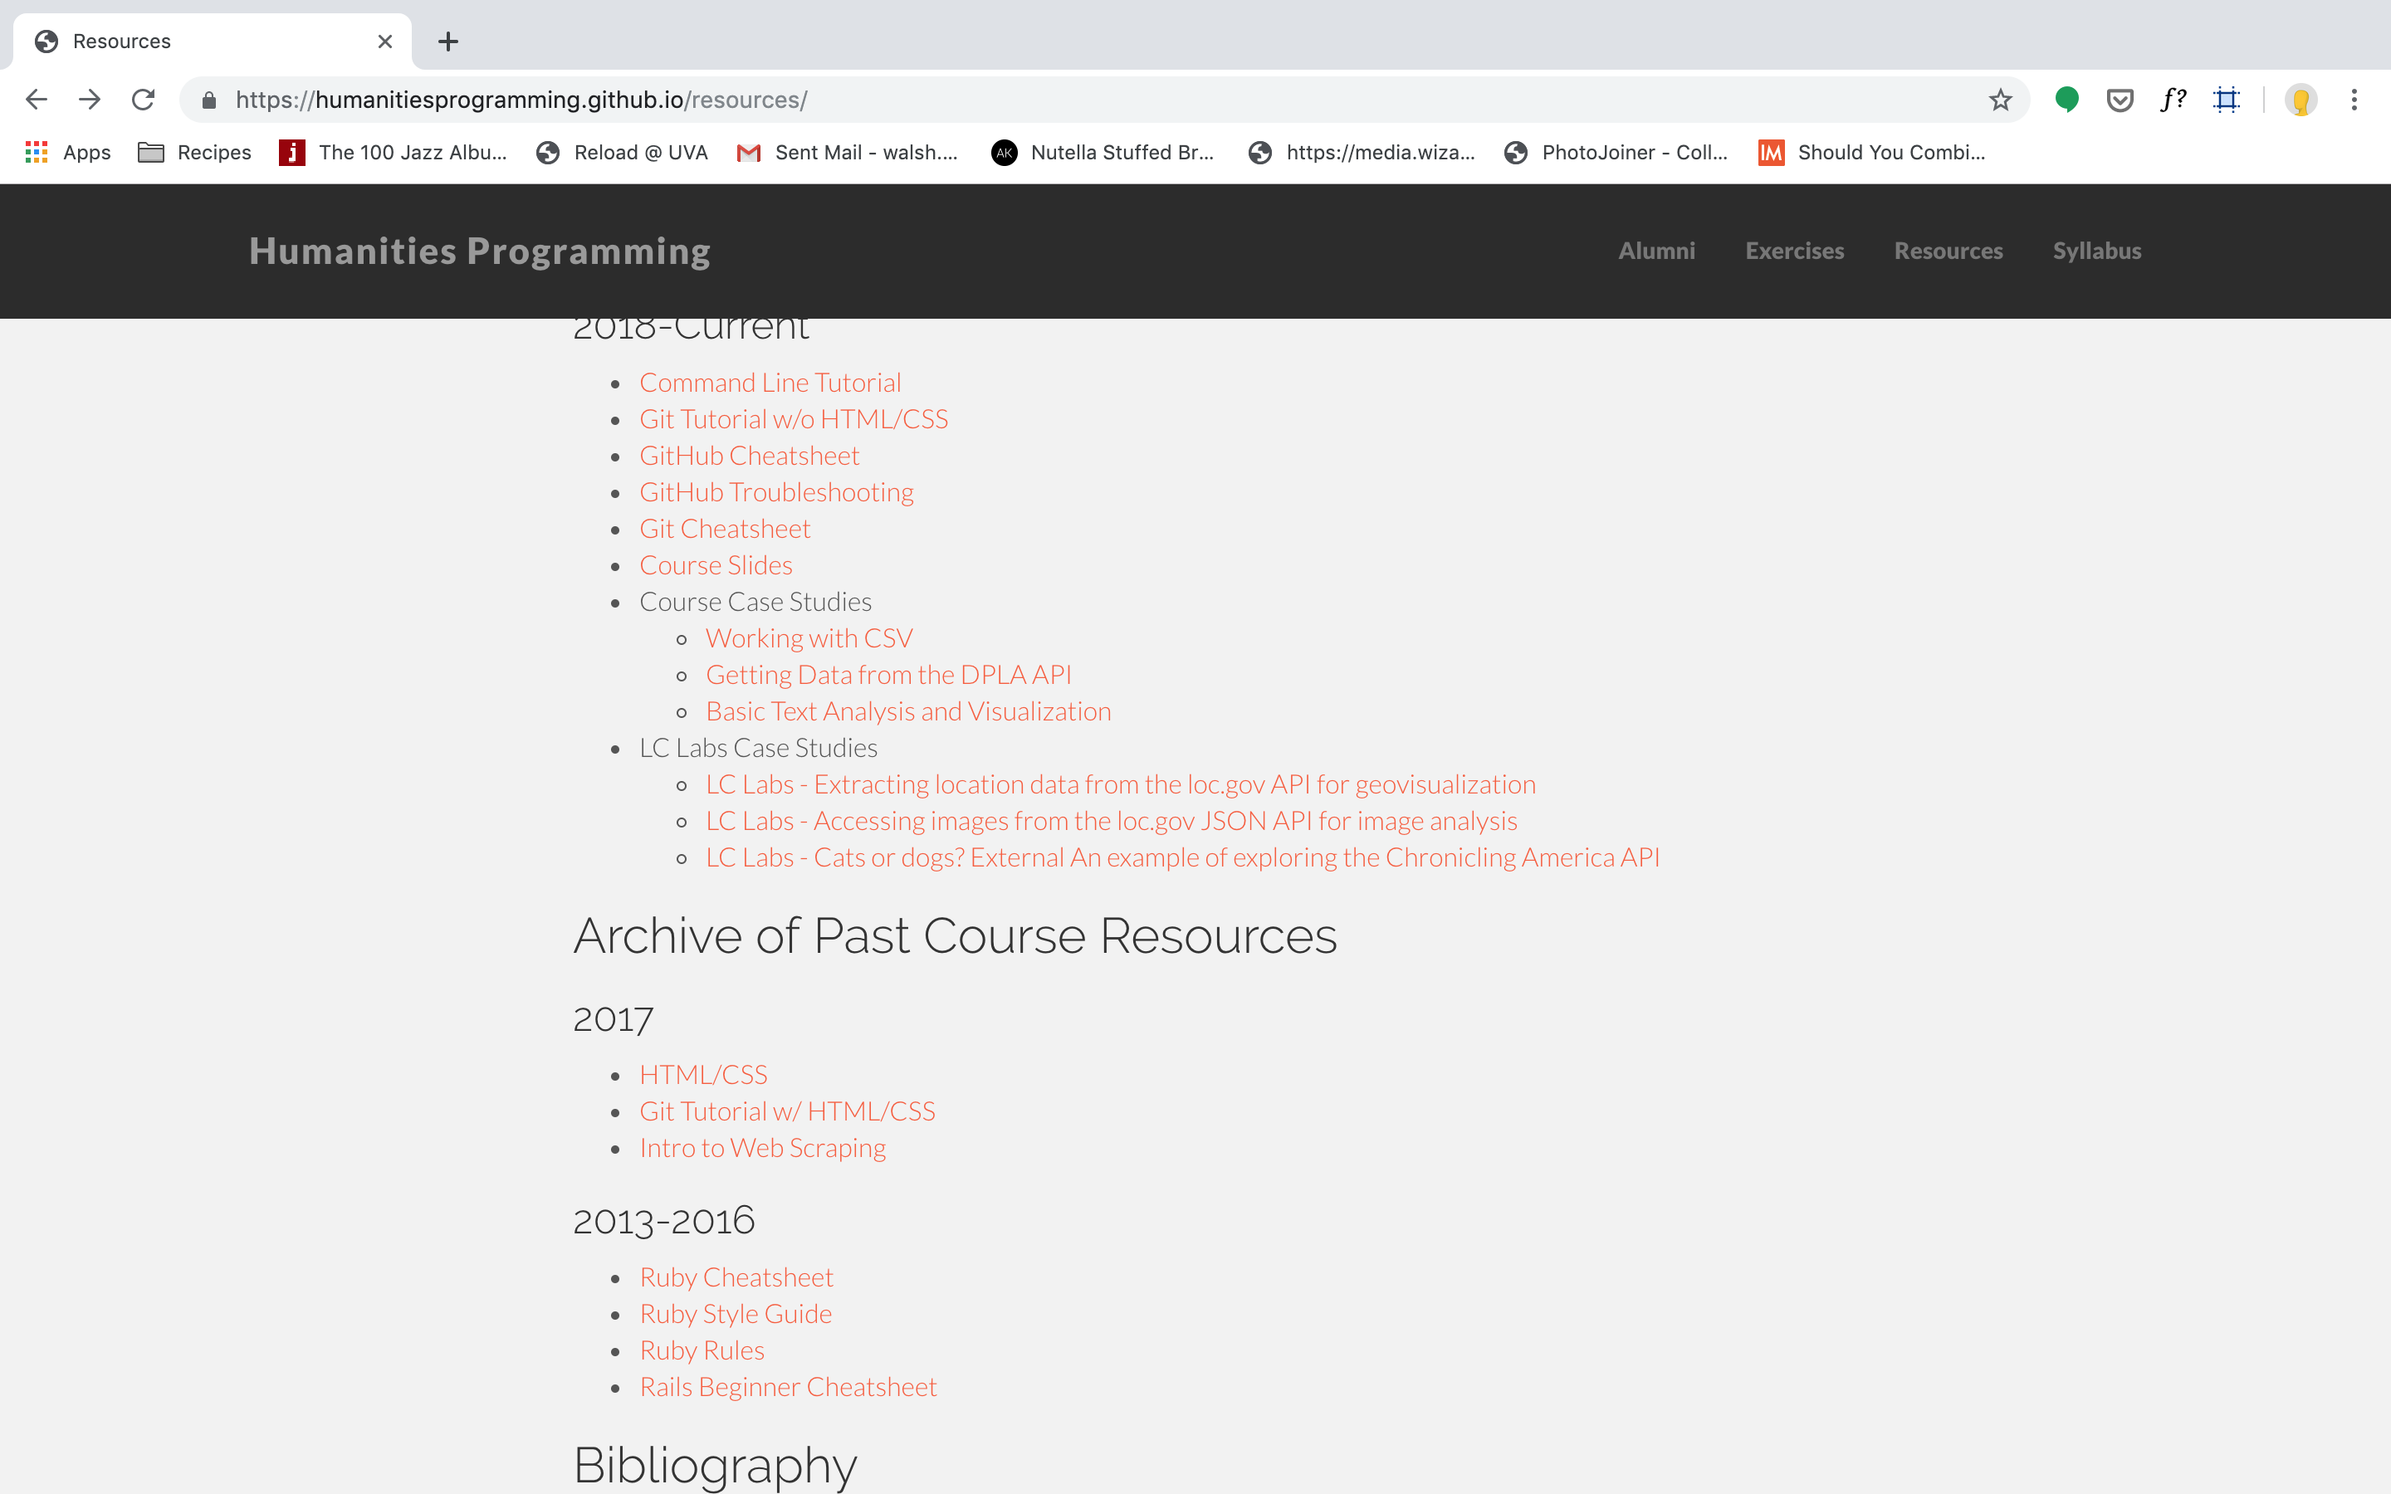
Slides
https://humanitiesprogramming.github.io/resources/

Slide 14
Note on Powerpoint
Autocorrect is a nightmare for code
Be very wary of copying and pasting from the slide decks if you're following along.
And also the odd human error might pop in.
Everything will be fine – that's why we have post-its!

Slide 15
Introductions
What is your name?
What institution are you from?
What is your background with programming/tech/DH?
What is one thing you want to learn this week?

