Slide 1
Digital humanities programming - Now with Python!
HILT 2017

Slide 2
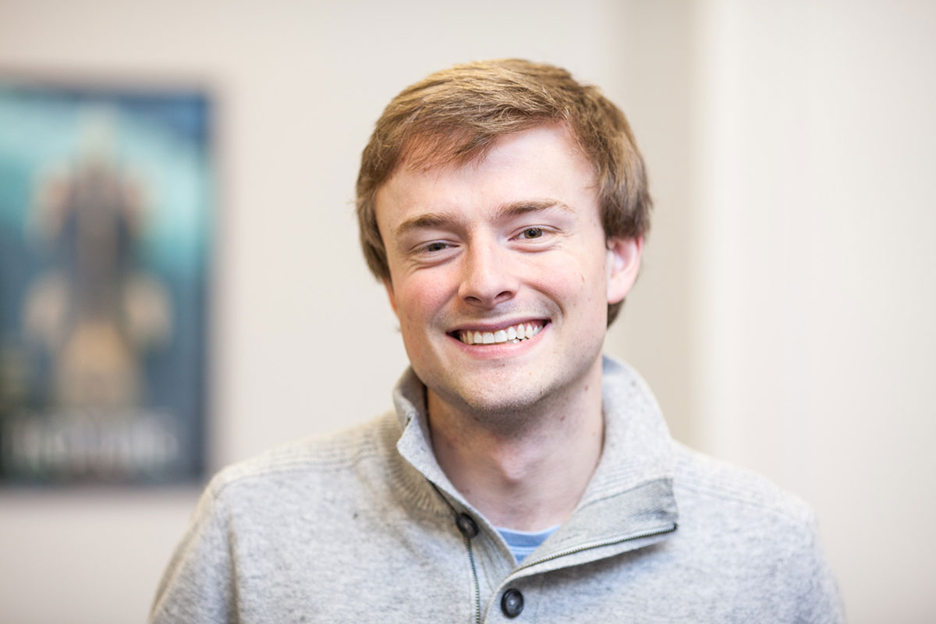
GitHub: walshbr
@walshbr

Slide 3

GitHub: reedeth
@reedeth

Slide 4
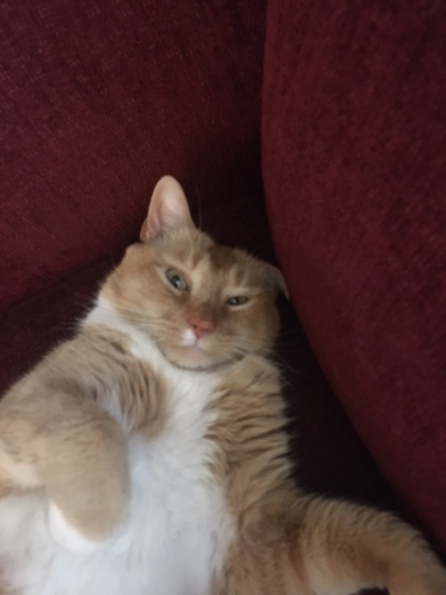
GitHub: @tony
@thecat

Slide 5
Week’s Trajectory
Introduce the command line
Introduce source code management
Review basics of HTML
Introduce programming concepts w/ Python
Apply Python to real-life DH situations

Slide 6
What to expect
Lots of hands-on activities
Lots of new concepts
Humorous pictures
Your brain will hurt at some point

Slide 7
No Seriously…
Take a walk
Browse reddit (/r/aww)
Play a game…Brandon loves icebreakers

Slide 8
Ground Rules
Asking questions is a “super power”
If you need a mental (or other break), take one
Writing software is a collaborative endeavor

Slide 9
Post-it Notes
All have three colors: Green, Red, White
Green: things are good
Red: need help
White: Done
Green and (especially) white offer help to red
Credit to Miriam Posner and Deb Verhoeven

Slide 10
slack
hilt-institute.slack.com
Another avenue for asking for help and sharing
/giphy word

Slide 11
Code of conduct
We are dedicated to creating a safe, respectful, and collegial learning environment for the benefit of everyone who attends.

Slide 12
Other Important Stuff
Coffee
Lunch
Supper

Slide 13
Introductions
What is your name?
What institution are you from?
What is your background with programming/tech/DH?
What is one thing you want to learn this week?

Slide 14
Changes to the course
Ruby swapped for Python
Enforces good style and practices
Rails swapped for working with data
More likely to be immediately useful for you
Targeted towards clearer audience (hopefully)

Slide 15
Virtual Box – Linux/Mint
UT is a Windows campus
We're running a virtual box so everyone has the same OS.
Functionally, your computer is pretending to be a different computer. Just need to know how to get to it.
Will be very similar to a Mac. Windows would be different.
We can get things running on your computer throughout the week if you reach out to Brandon

