Slide 1
Day Two Review
HILT 2015

Slide 2
Ruby
What are some of the data types?
What is a variable?
What is a method?
Who created Ruby?
What happens if you use PHP in a project?

Slide 3
Ruby
What is an operator?
What is irb? Is it awesome?
How do you assign a variable?
What is Duck Typing?
What is an array?
What is a hash?

Slide 4
Ruby
What’s the difference between a hash and array?
How do you step over a collection?
What is a splat?
How do you print something to the console?

Slide 5
Ruby
How do you run a command-line program?
What is ARGV?
What is a conditional statement?

Slide 6
Ruby
What was the hardest thing you did yesterday?
What was the easiest?

Slide 7
Methods
def method_name()
end
All methods start with a def and must have an end.

Slide 8
Methods
def method_name()
end
method_name()
-nothing happens when you declare a method.
- you have to call it later to execute it.

Slide 9
Methods
def method_name(a_local_variable)
a_local_variable exists here!
end
method_name(example_method)
a_local_variable does not exist here
Variable scope – only exist in certain places

Slide 10
Methods
def method_name(a_local_variable)
a_local_variable exists here!
end
method_name(example_variable)
Here, example_method gets passed to the function method_name. for the scope of that function, a_local_variable is set equal to example_method

Slide 11
Methods
def method_name(a_local_variable)
puts “a thing”
end
method_name(example_method)

Slide 12
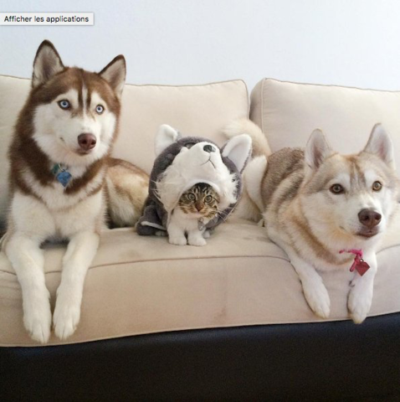
Impostor Syndrome

Slide 13
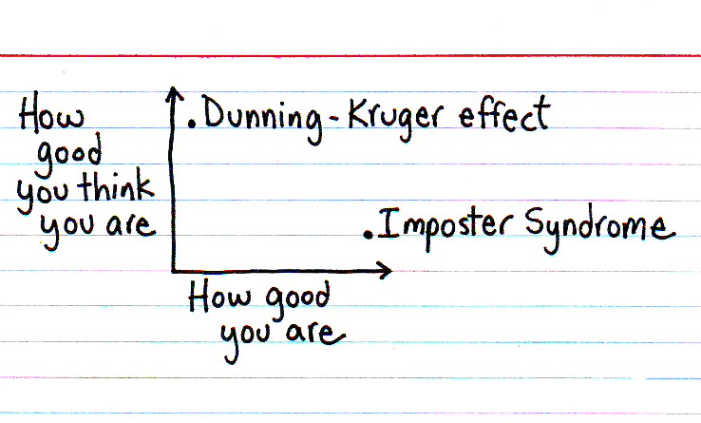

Slide 14
Dunning-Kruger Effect
Cognitive bias of unskilled individuals suffering from illusory superiority
Rate their ability much higher than accurate

Slide 15
Impostor Syndrome
Your accomplishments are undeserved, invalid, you in some way not earned
(not a descriptive slide)

Slide 16
Reading
Tanya X Short, “Overcoming Impostor’s Syndrome” http://www.gamasutra.com/blogs/TanyaXShort/20140716/220938/Overcoming_Impostors_Syndrome.php

Slide 17
Plan
Introduce OOP concepts
Start Rails

Slide 18
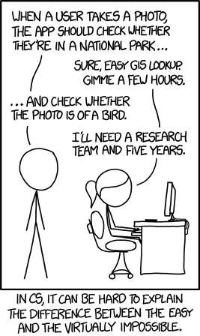

Slide 19
Show and Tell
Start thinking about it...

