Slide 1
Digital humanities programming
HILT 2016

Slide 2

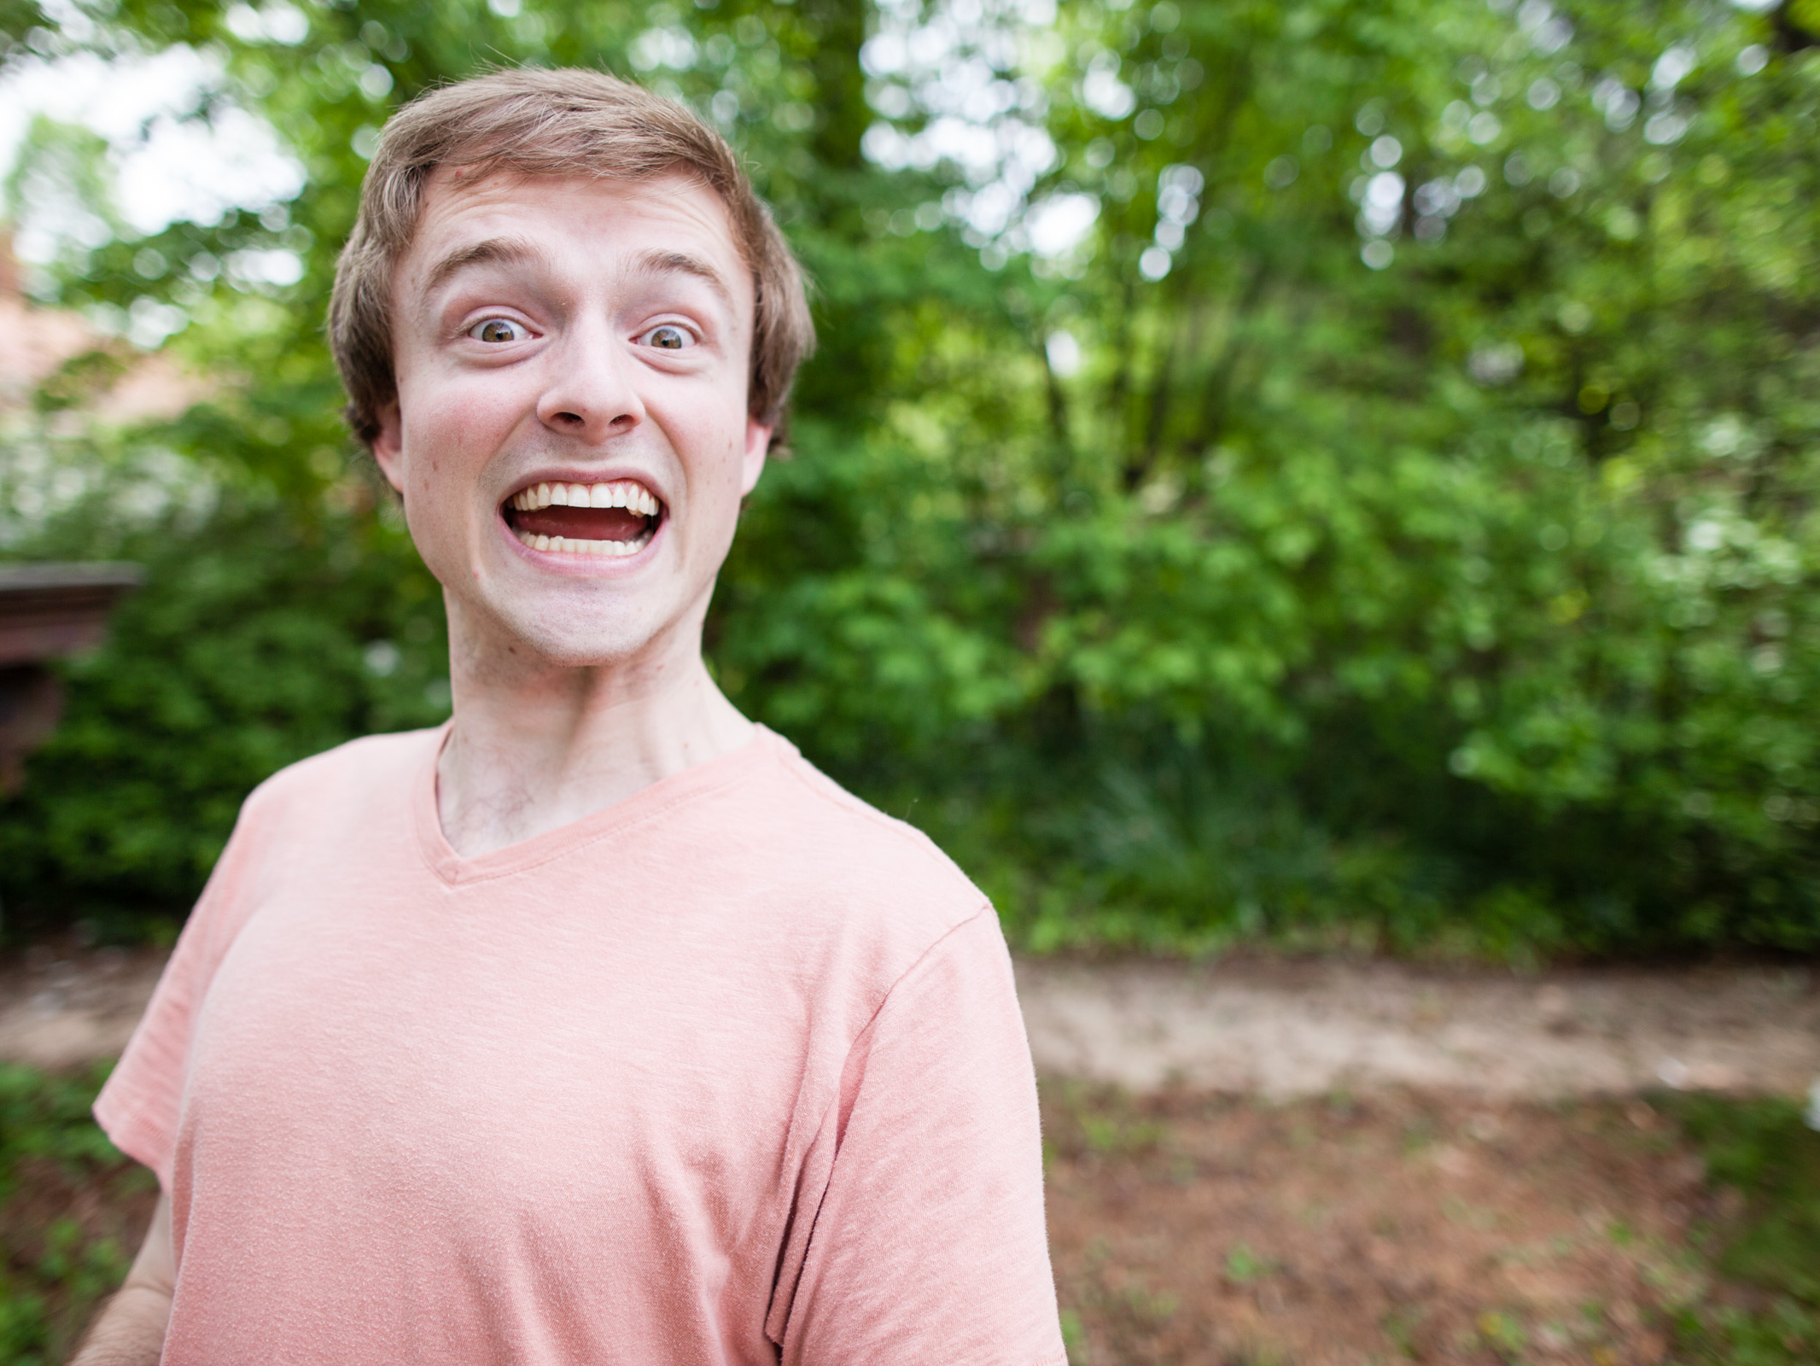
GitHub: bmw9t
@walshbr

Slide 3

GitHub: reedeth
@reedeth

Slide 4
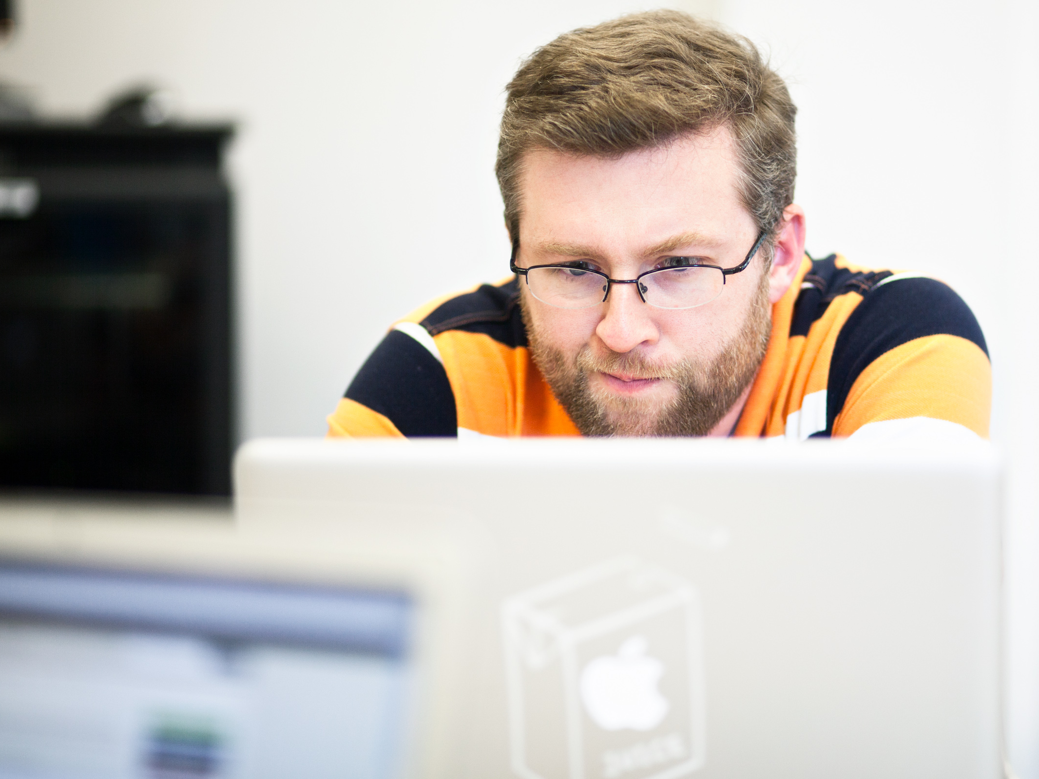
GitHub: waynegraham
@wayne_graham

Slide 5
Week’s Trajectory
Introduce the command line
Introduce source code management
Review basics of HTML
Introduce programming concepts
Build, and deploy, a Ruby on Rails application

Slide 6
What to expect
Lots of hands-on activities
Lots of new concepts
Humorous pictures
Your brain will hurt at some point

Slide 7
No Seriously…
Take a walk
Browse reddit (/r/aww)
Play a game…Hearthstone anyone?

Slide 8
Ground Rules
Asking questions is a “super power”
If you need a mental (or other break), take one
Writing software is a collaborative endeavor

Slide 9
Post-it Notes
All have three colors: Green, Red, White
Green: things are good
Red: need help
White: Done
Green and (especially) white offer help to red
Credit to Miriam Posner

Slide 10
slack
hum-programming.slack.com
Another avenue for asking for help and sharing
/giphy word

Slide 11
Code of conduct
We are dedicated to creating a safe, respectful, and collegial learning environment for the benefit of everyone who attends.

Slide 12
Other Important Stuff
Coffee
Lunch
Supper

Slide 13
Introductions
What is your name?
What institution are you from?
What is one thing you want to learn this week?
What is one wild prediction about the best possible outcome?

