Slide 1
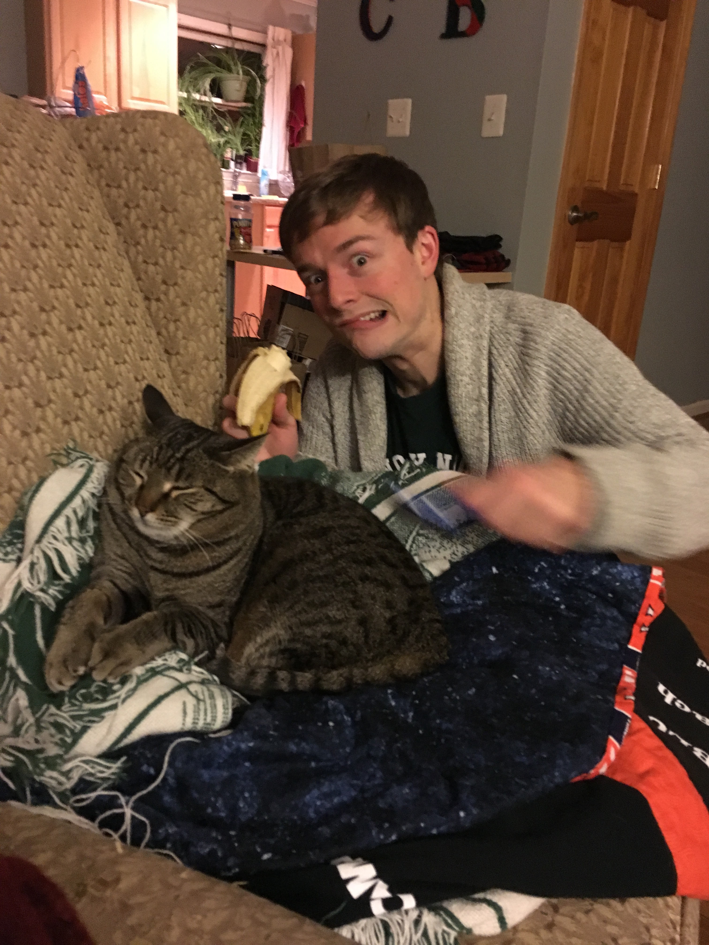
Day Three Review
HILT 2017

Slide 2
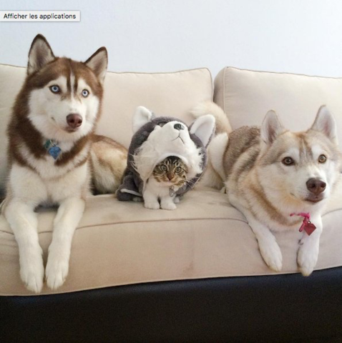
Impostor Syndrome

Slide 3
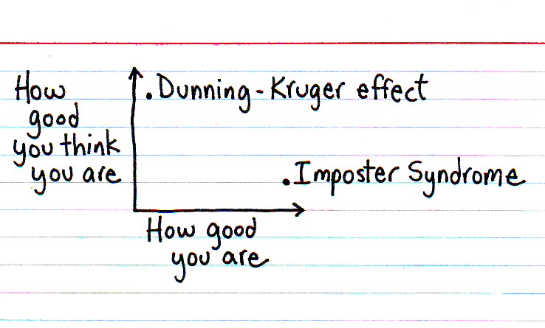

Slide 4
Dunning-Kruger Effect
Cognitive bias of unskilled individuals suffering from illusory superiority
Rate their ability much higher than accurate

Slide 5
Impostor Syndrome
Your accomplishments are undeserved, invalid, you in some way not earned
(not a descriptive slide)

Slide 6
Reading
Tanya X Short, “Overcoming Impostor’s Syndrome” http://www.gamasutra.com/blogs/TanyaXShort/20140716/220938/Overcoming_Impostors_Syndrome.php

Slide 7
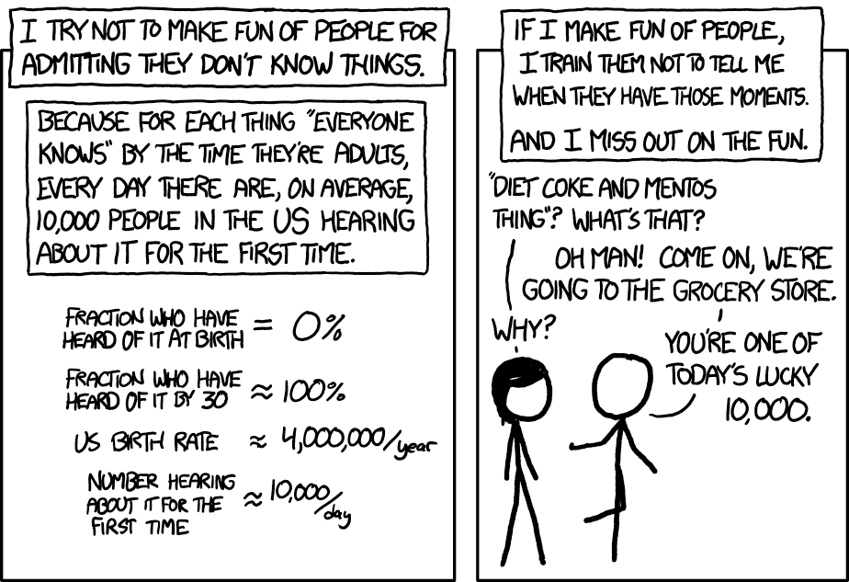
Notes:
PAY IT FORWARD

Slide 8
Today (at show and tell)
We need to fill up 5 minutes…

Slide 9
The plan…
Work through Python in practice
Give some real-world examples of using Python
Discuss anything you want
Install on your own laptops

Slide 10
Approaches
“Pair programming”: work with the person next to you. One type, the other says what to do
Do it by yourself
Pretend you’re doing it, but really read your email and surf Facebook

