Slide 1
Digital humanities programming - Now with Python!
HILT 2017

Slide 2
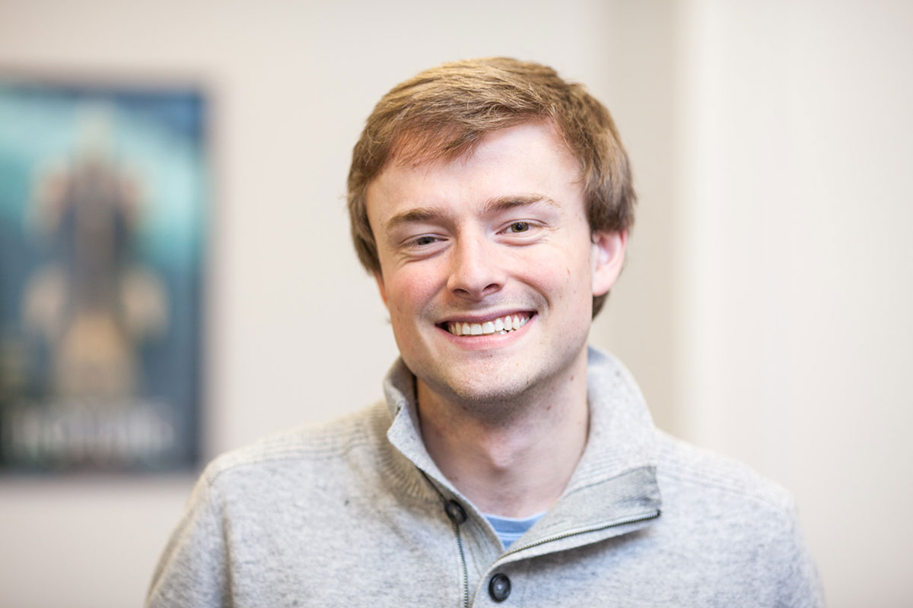
GitHub: walshbr
@walshbr

Slide 3

GitHub: reedeth
@reedeth

Slide 4
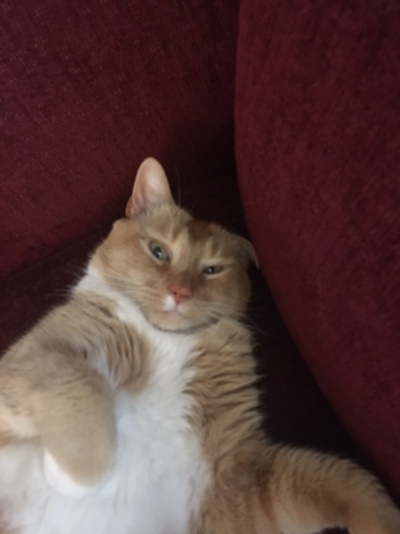
GitHub: @tony
@thecat

Slide 5
Week’s Trajectory
Introduce the command line
Introduce source code management
Introduce programming concepts w/ Python
Apply Python to real-life DH situations

Slide 6
Pedagogical Approach
A mix of approaches!
Some programming together
Some talking over slides
Some independent work
Collaboration is encouraged!

Slide 7
What to expect
Lots of hands-on activities
Lots of new concepts
Humorous pictures
Your brain will hurt at some point

Slide 8
No Seriously…
Take a walk
Browse reddit (/r/aww)
Play a game…Brandon loves icebreakers

Slide 9
Ground Rules
Asking questions is a “super power”
If you need a mental (or other break), take one
Writing software is a collaborative endeavor

Slide 10
Post-it Notes
All have three colors: Green, Red, White
Green: things are good
Red: need help
White: Done
Green and (especially) white offer help to red
Credit to Miriam Posner and Deb Verhoeven

Slide 11
slack
hilt-institute.slack.com
Another avenue for asking for help and sharing
/giphy word

Slide 12
Code of conduct
We are dedicated to creating a safe, respectful, and collegial learning environment for the benefit of everyone who attends.

Slide 13
Other Important Stuff
Coffee
Lunch
Supper

Slide 14
Changes to the course
Ruby swapped for Python
Enforces good style and practices
Rails swapped for working with data
More likely to be immediately useful for you
Targeted towards clearer audience (hopefully)

Slide 15
Introductions
What is your name?
What institution are you from?
What is your background with programming/tech/DH?
What is one thing you want to learn this week?

