Slide 1
Day One Review
HILT 2016

Slide 2
Command Line
How do you know where you are?
How do you make a new folder?
How do you move in to a directory?
How do you see all the files in a directory?
How do you look up what a command does?

Slide 3
Git
How do you create a git repository?
What is the git workflow we kept going over?
What is GitHub?
What is the relationship between git and GitHub?
How do you know if your code got to github?

Slide 4


Slide 5
GitHub & Passwords
Uses advanced ssh keys
No passwords!
Need an identity

Slide 6
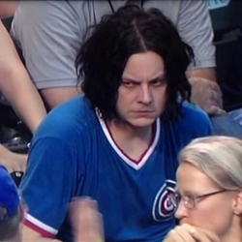
GitHub & Passwords

Slide 7
git config for Github Config
$ mkdir –p ~/bin
$ ln -s “/Applications/Sublime Text 2.app/Contents/SharedSupport/bin/subl” ~/bin/s
$ echo “PATH=~/bin:$PATH” >> ~/.bash_profile
$ source ~/.bash_profile

Slide 8
Github Config
$ git config --global user.name “Your Name”
$ git config --global user.email “you@place.edu”
$ git config --global core.editor s
$ git config --list

