Slide 1
Day Two Review
HILT 2015

Slide 2
Ruby
What are some of the data types?
What is a variable?
What is a method?
Who created Ruby?
What happens if you use PHP in a project?

Slide 3
Ruby
What is an operator?
What is irb? Is it awesome?
How do you assign a variable?
What is Duck Typing?
What is an array?
What is a hash?

Slide 4
Ruby
What’s the difference between a hash and array?
How do you step over a collection?
What is a splat?
How do you print something to the console?

Slide 5
Ruby
How do you run a command-line program?
What is ARGV?
What is a conditional statement?
What is a weeping angel?

Slide 6
Ruby
What was the hardest thing you did yesterday?
What was the easiest?

Slide 7
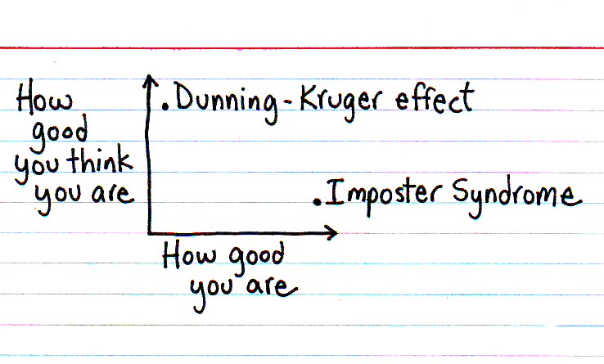

Slide 8
Dunning-Kruger Effect
Cognitive bias of unskilled individuals suffering from illusory superiority
Rate their ability much higher than accurate

Slide 9
Impostor Syndrome
Your accomplishments are undeserved, invalid, you in some way not earned

Slide 10
Reading
Tanya X Short, “Overcoming Impostor’s Syndrome” http://www.gamasutra.com/blogs/TanyaXShort/20140716/220938/Overcoming_Impostors_Syndrome.php

Slide 11
Plan
Do some “fun” debugging exercises
Introduce OOP concepts
Introduce some design concepts
Maybe start Rails?

Slide 12
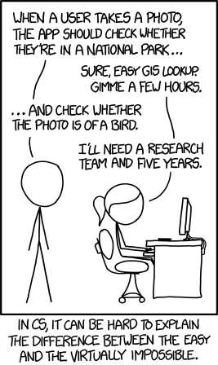

Slide 13
Show and Tell
Start thinking about it...

