Slide 1
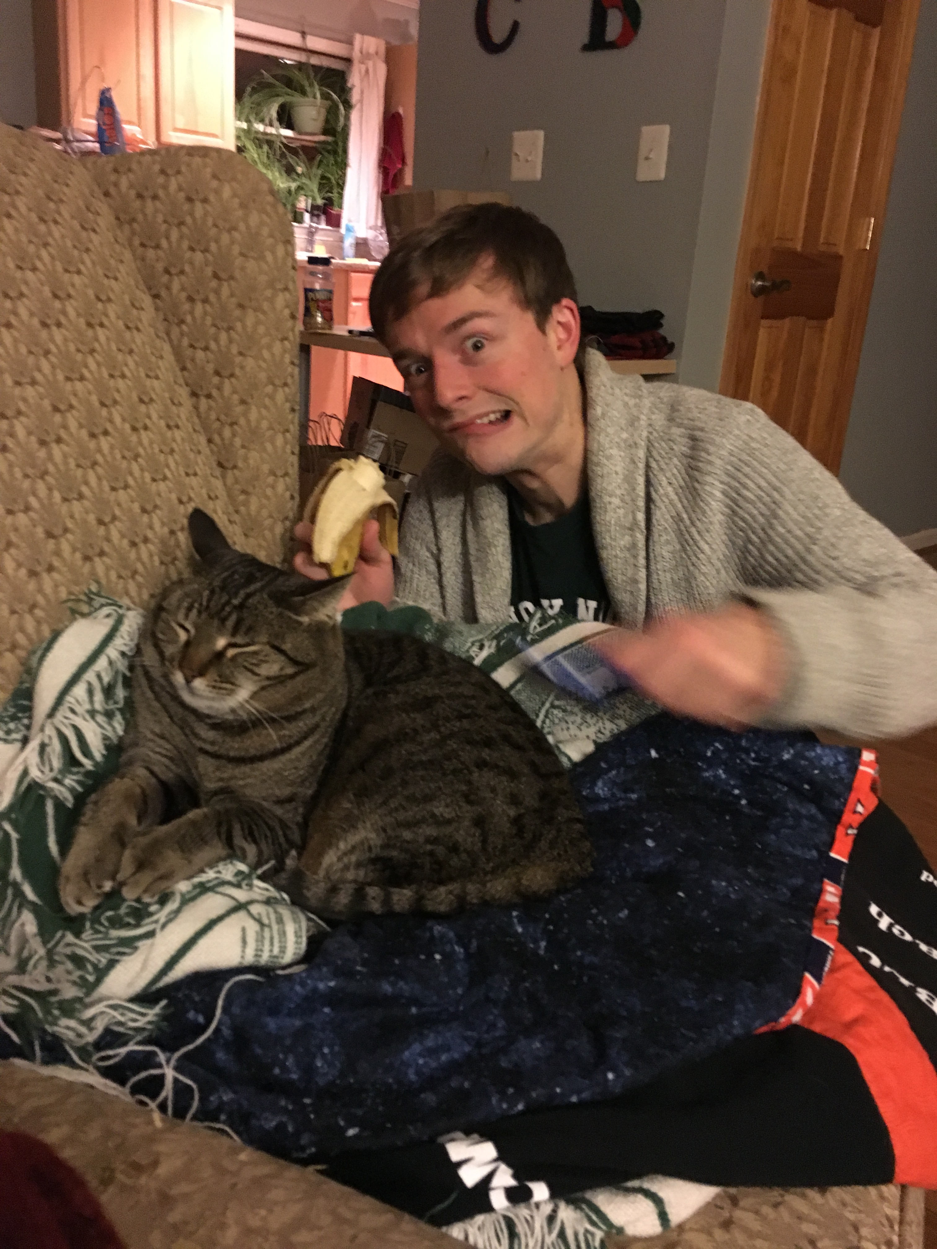
Day Three Review
HILT 2017

Slide 2
Methods
def method_name(a_local_variable):
a_local_variable exists here!
method_name(example_variable)
Here, example_method gets passed to the function method_name. for the scope of that function, a_local_variable is set equal to example_method

Slide 3
Methods
def method_name(a_local_variable):
print(“a thing”)
method_name(example_method)

Slide 4
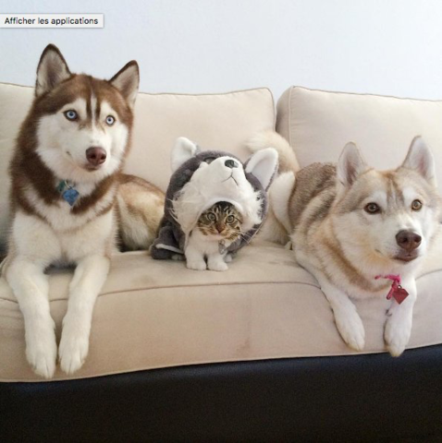
Impostor Syndrome

Slide 5
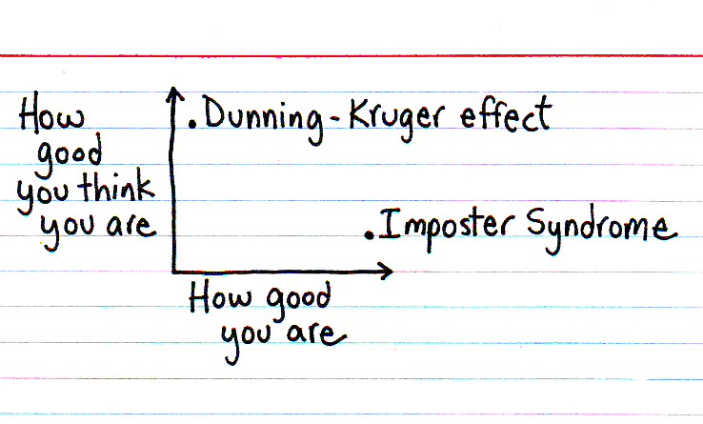

Slide 6
Dunning-Kruger Effect
Cognitive bias of unskilled individuals suffering from illusory superiority
Rate their ability much higher than accurate

Slide 7
Impostor Syndrome
Your accomplishments are undeserved, invalid, you in some way not earned
(not a descriptive slide)

Slide 8
Reading
Tanya X Short, “Overcoming Impostor’s Syndrome” http://www.gamasutra.com/blogs/TanyaXShort/20140716/220938/Overcoming_Impostors_Syndrome.php

Slide 9
Today (at show and tell)
We need to fill up 5 minutes…

Slide 10
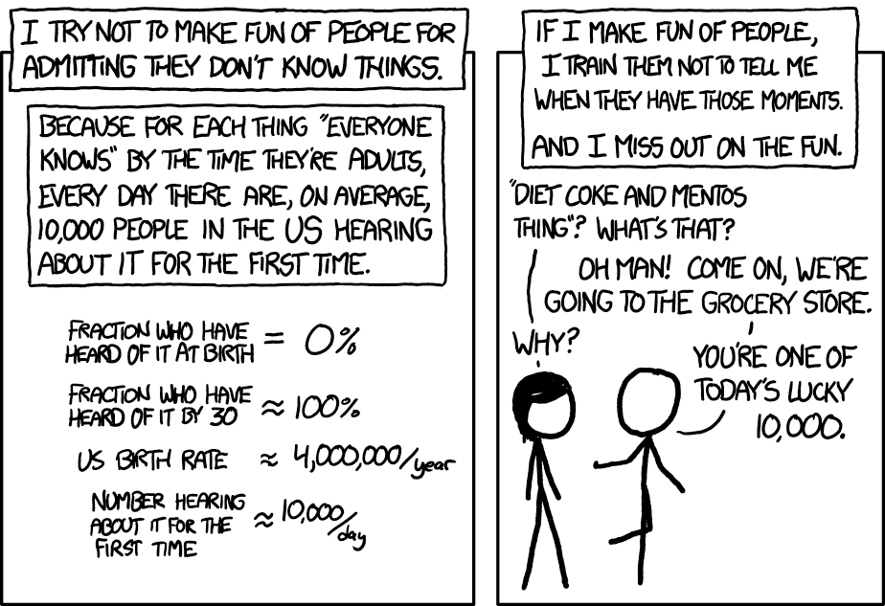

Slide 11
The plan…
Work through Python in practice
Give some real-world examples of using Python
Discuss anything you want
Install on your own laptops

Slide 12
Approaches
“Pair programming”: work with the person next to you. One type, the other says what to do
Do it by yourself
Pretend you’re doing it, but really read your email and surf Facebook

