Slide 1
Day Two Review
HILT 2017

Slide 2
Python
What are some of the data types?
What is a variable?
What is a method?
Why Python? Why not?
What happens if you use PHP in a project?

Slide 3
Python
What is an operator?
What is the Python interpreter? Is it awesome?
How do you assign a variable?
What is Duck Typing?
What is a list?
What is a dictionary?

Slide 4
Python
What’s the difference between a list and a dictionary?
How do you step over a collection?
How do you print something to the console?

Slide 5
Python
How do you run a command-line program?
What is an argument?
What is a conditional statement?

Slide 6
Python
What was the hardest thing you did yesterday?
What was the easiest?

Slide 7
Methods
def method_name():
# what the method does!
All methods start with a def.

Slide 8
Methods
def method_name():
…
…
method_name()
-nothing happens when you declare a method.
- you have to call it later to execute it.

Slide 9
Methods
def method_name(a_local_variable):
a_local_variable exists here!
method_name(example_method)
a_local_variable does not exist here
Variable scope – only exist in certain places

Slide 10
Methods
def method_name(a_local_variable):
a_local_variable exists here!
method_name(example_variable)
Here, example_method gets passed to the function method_name. for the scope of that function, a_local_variable is set equal to example_method

Slide 11
Methods
def method_name(a_local_variable):
print(“a thing”)
method_name(example_method)

Slide 12
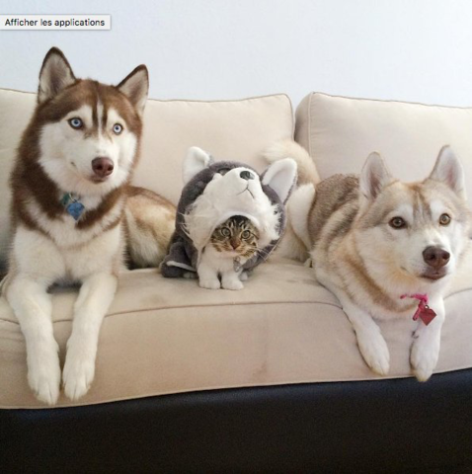
Impostor Syndrome

Slide 13
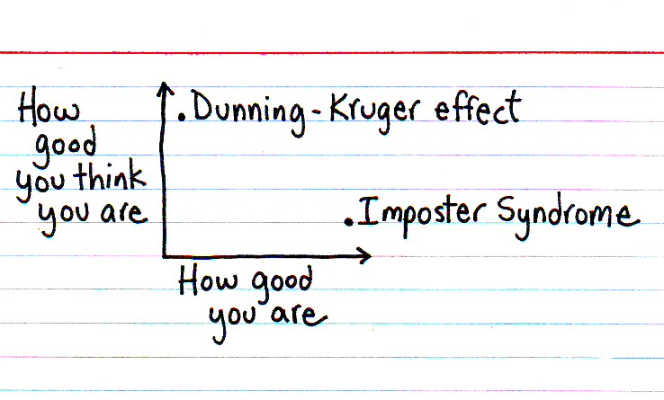

Slide 14
Dunning-Kruger Effect
Cognitive bias of unskilled individuals suffering from illusory superiority
Rate their ability much higher than accurate

Slide 15
Impostor Syndrome
Your accomplishments are undeserved, invalid, you in some way not earned
(not a descriptive slide)

Slide 16
Reading
Tanya X Short, “Overcoming Impostor’s Syndrome” http://www.gamasutra.com/blogs/TanyaXShort/20140716/220938/Overcoming_Impostors_Syndrome.php

Slide 17
Plan
Keep going!
But we take requests!

Slide 18
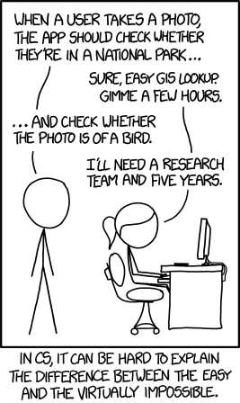

Slide 19
Show and Tell
Start thinking about it...

