Slide 1
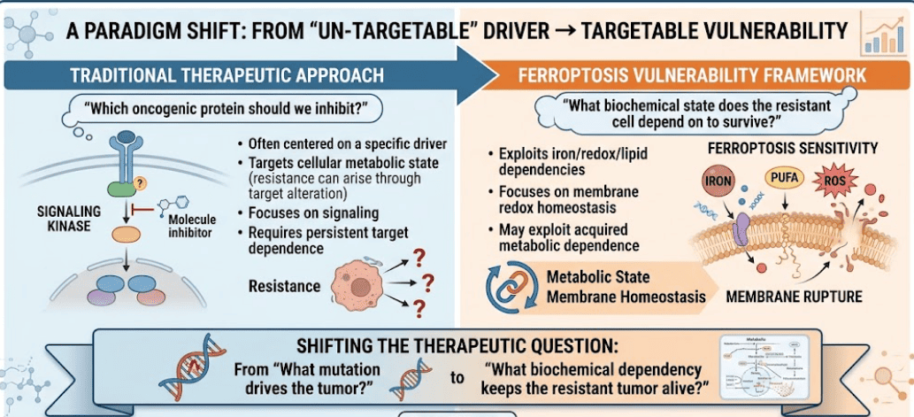


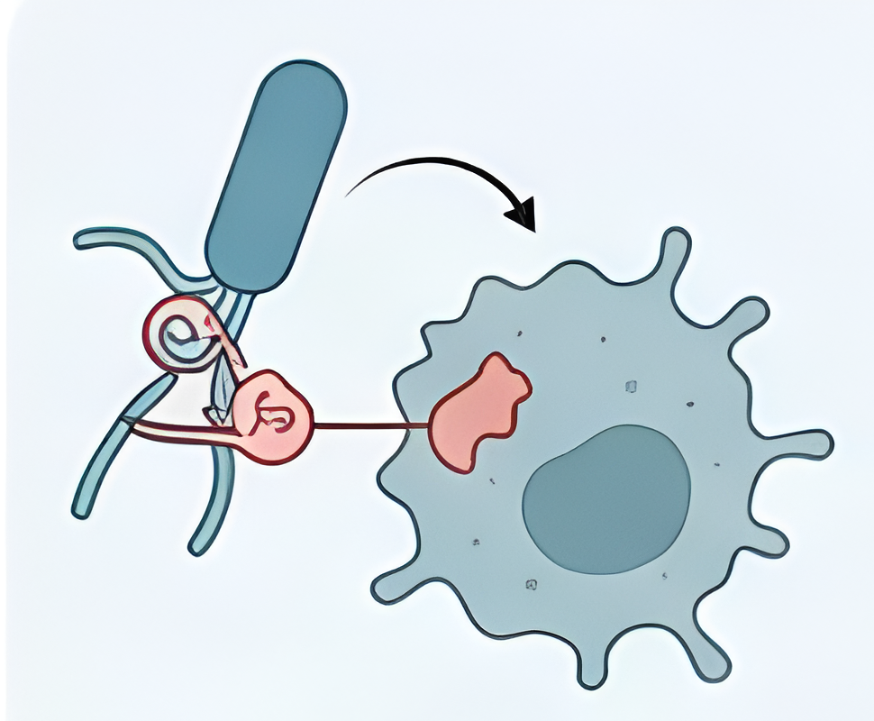
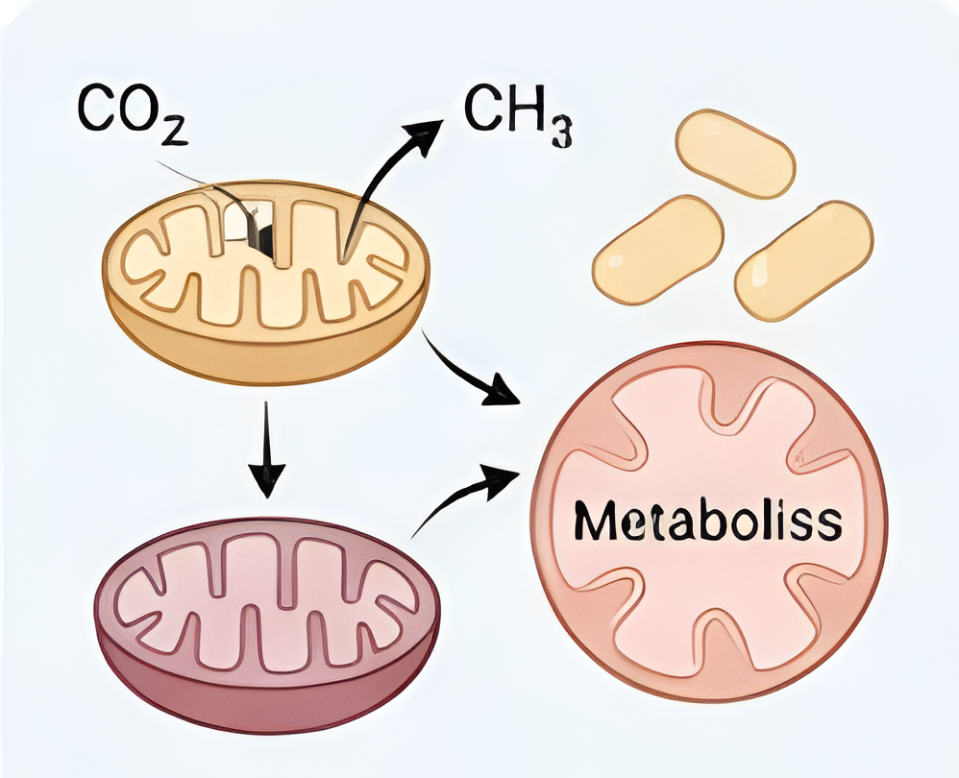
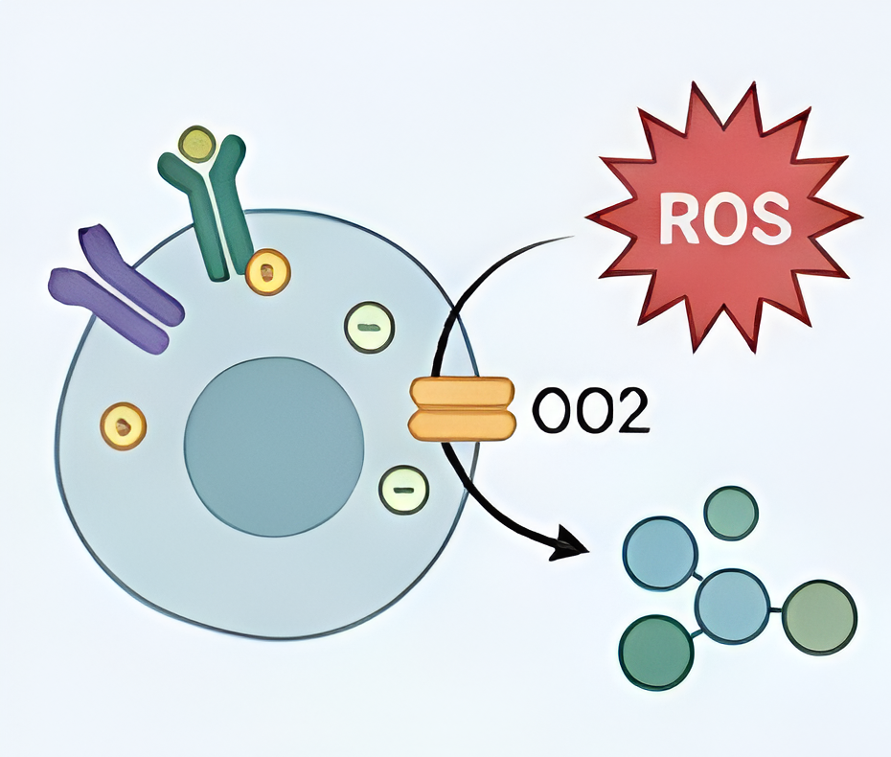
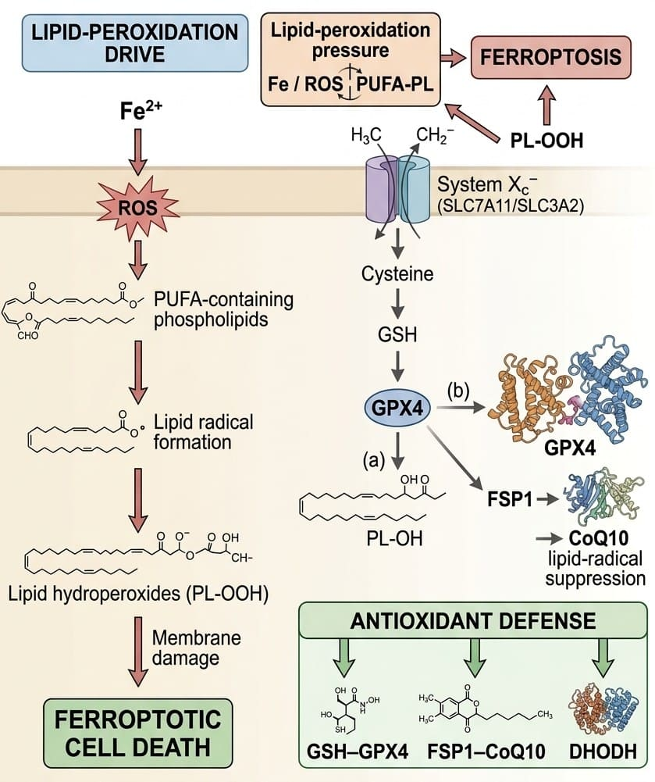
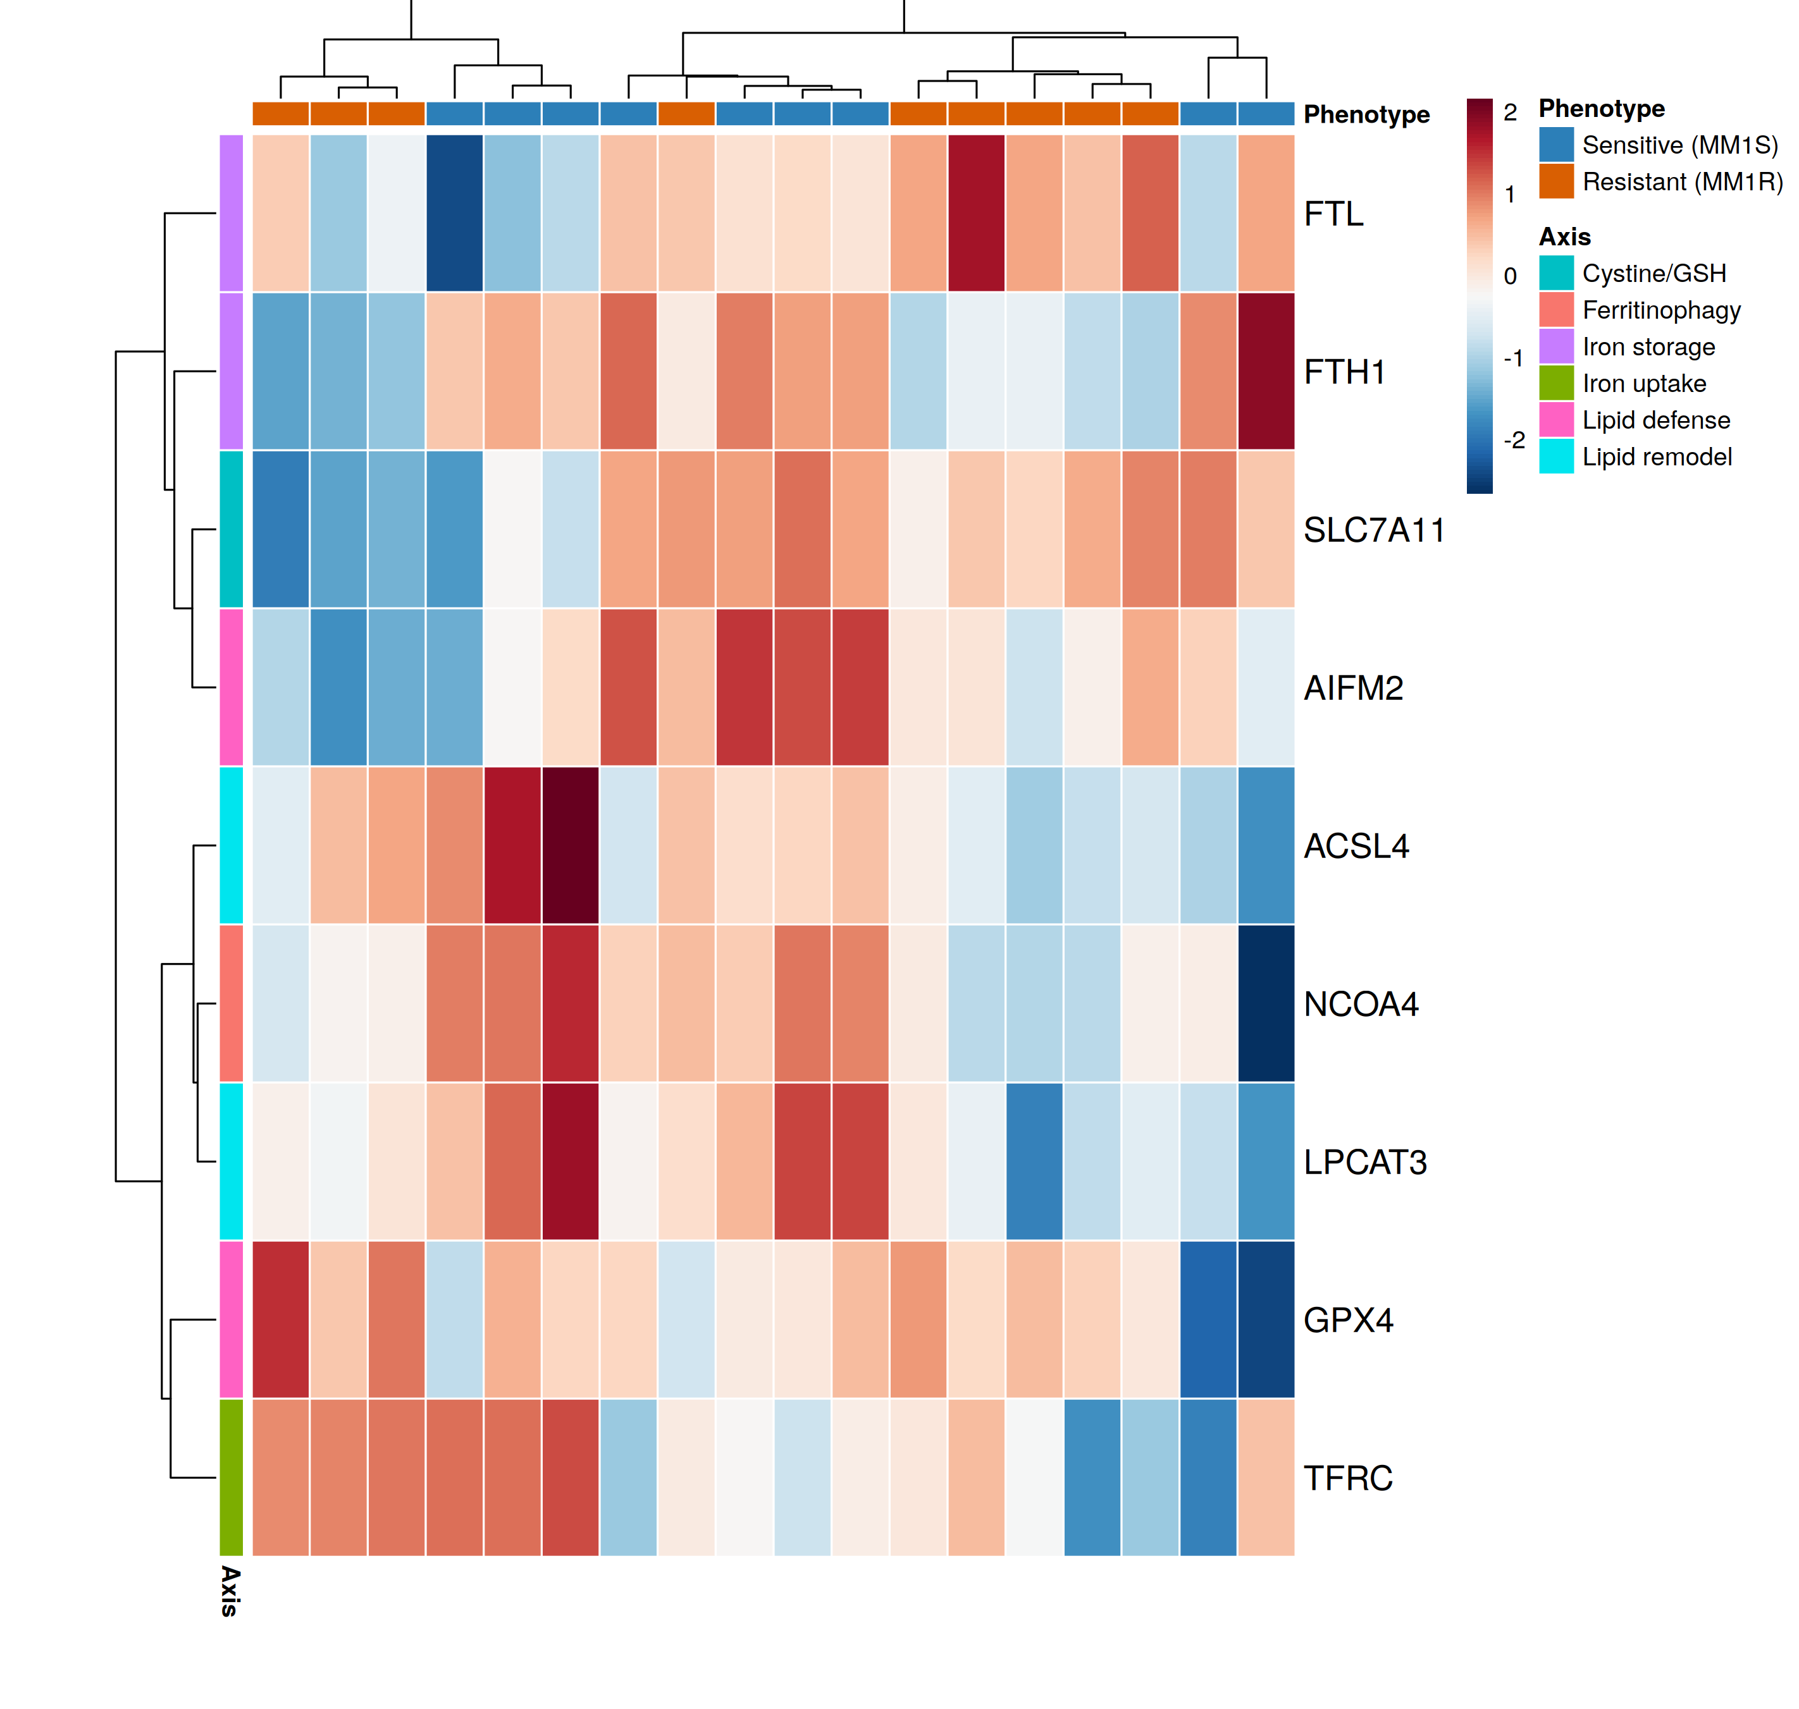
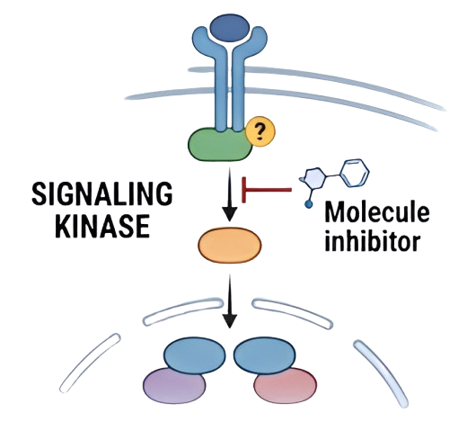
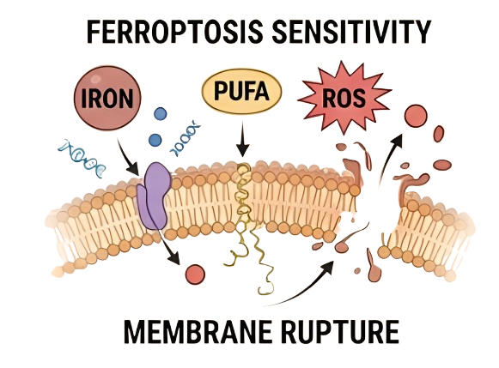
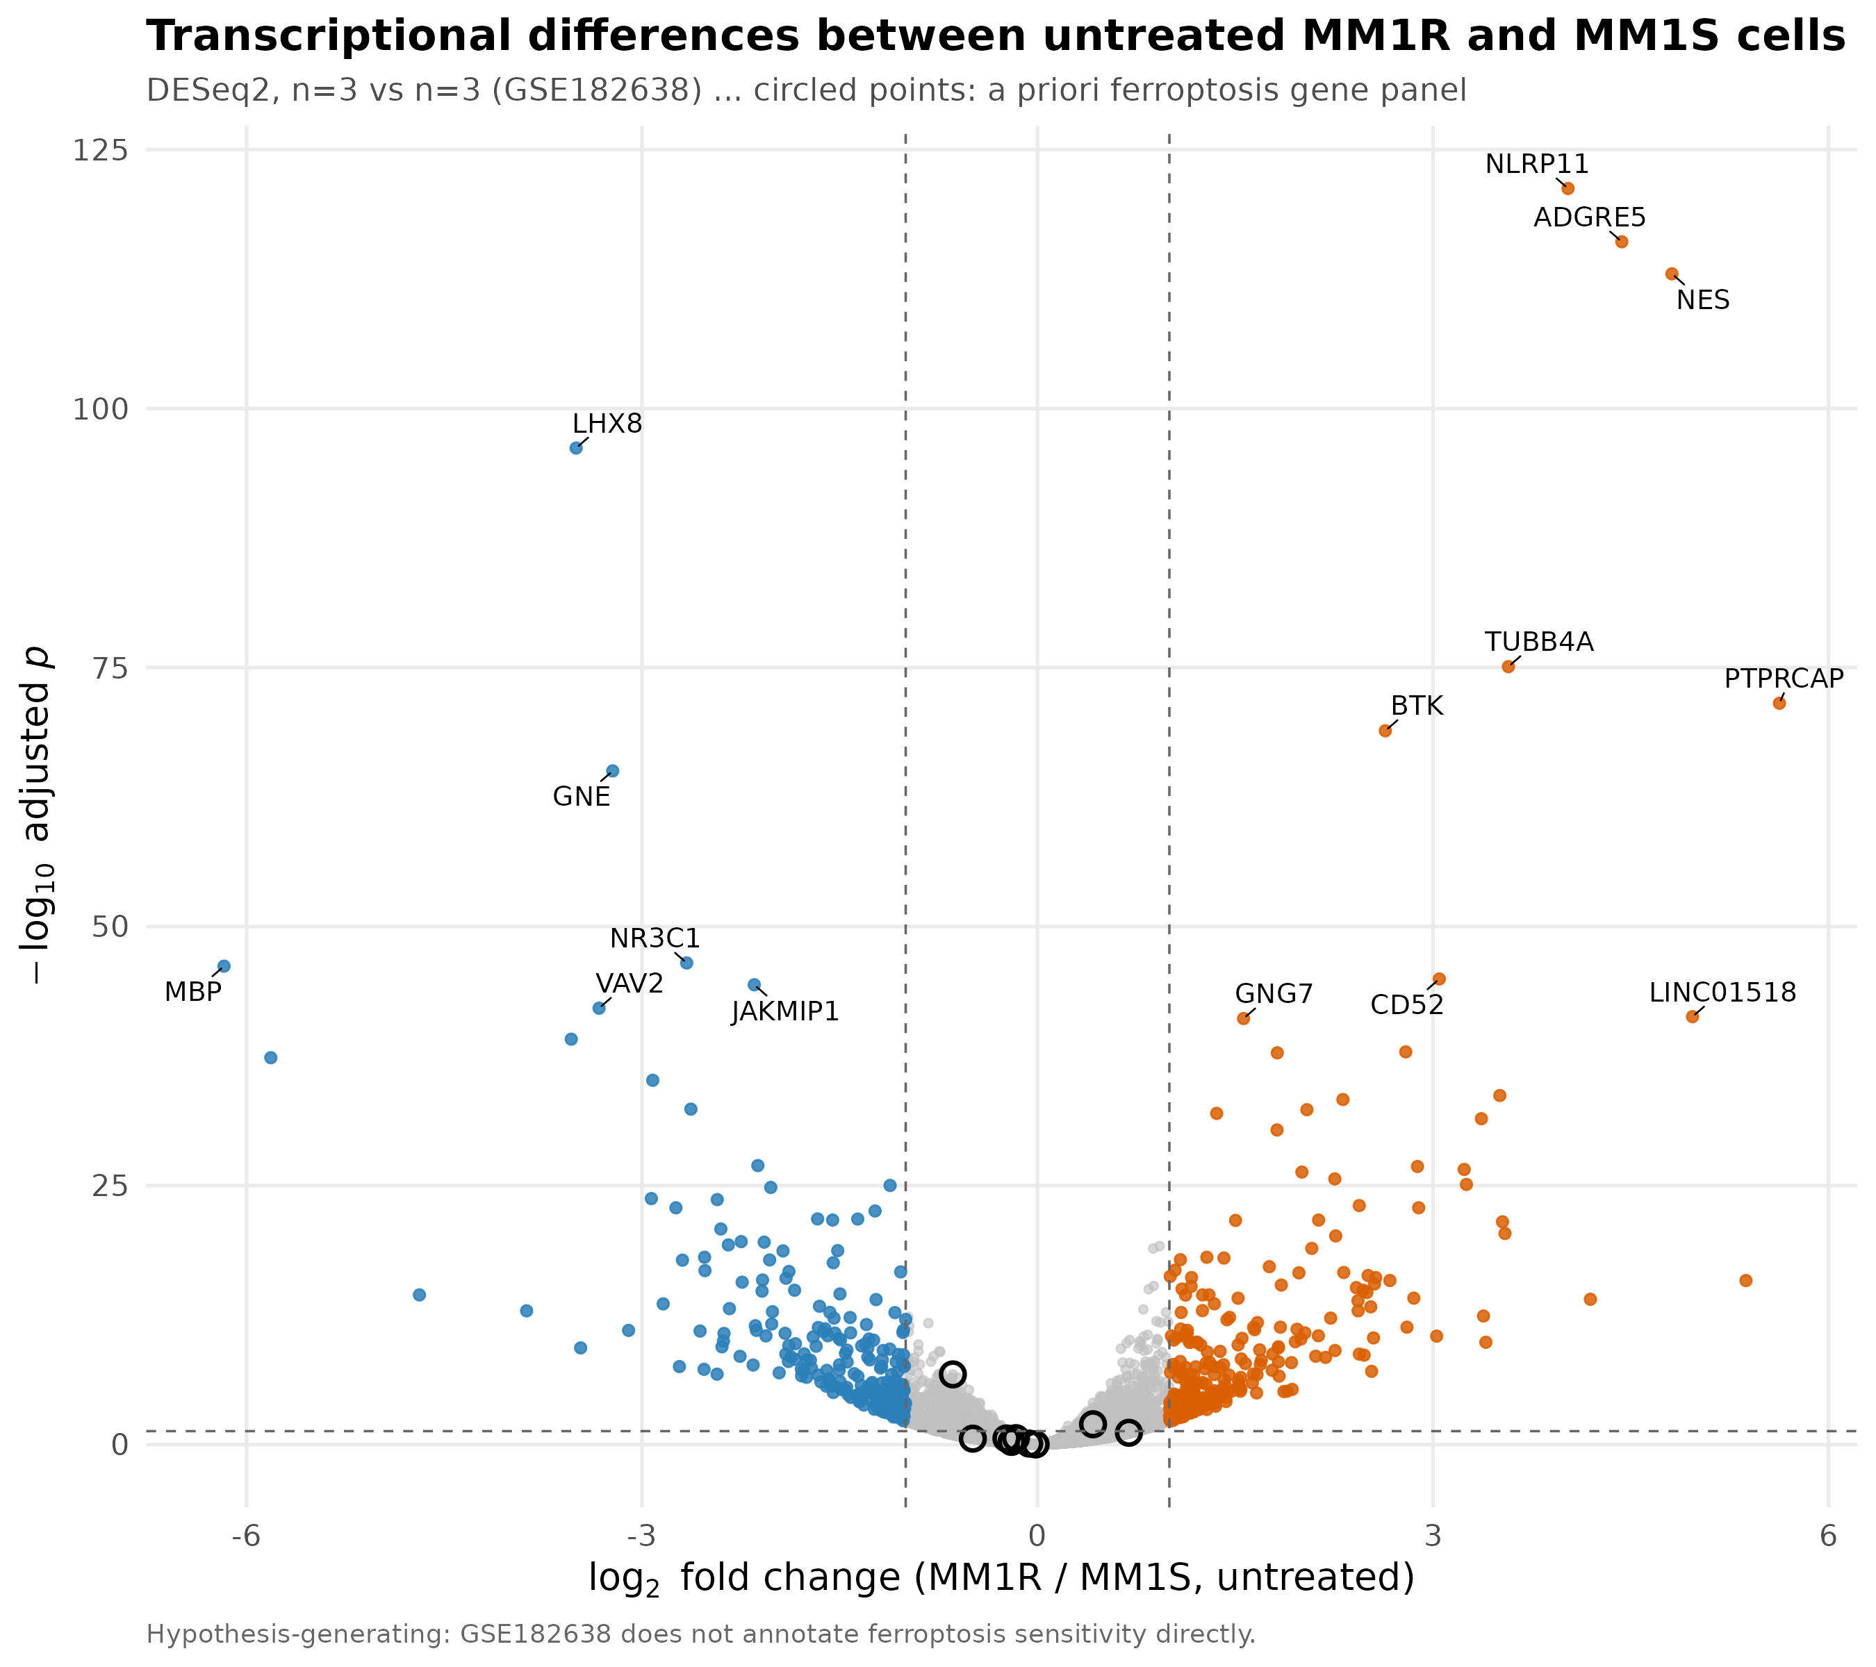
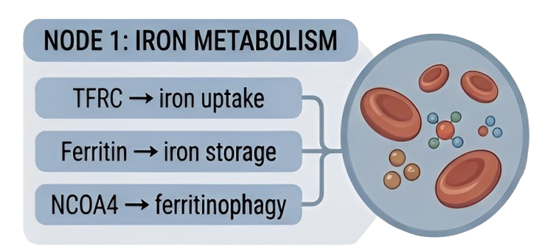
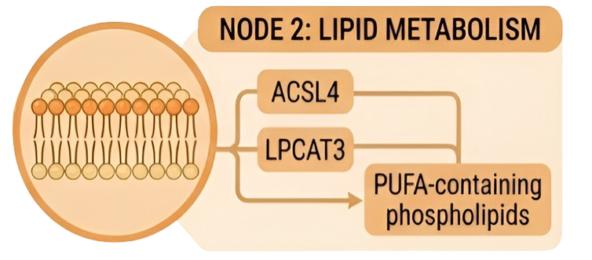
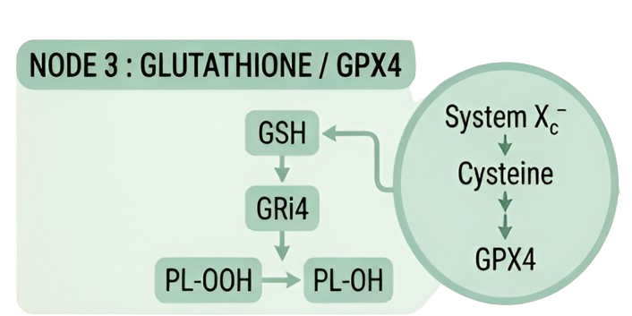
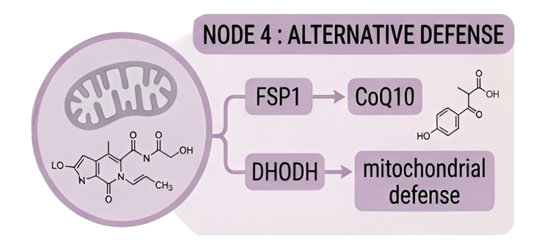
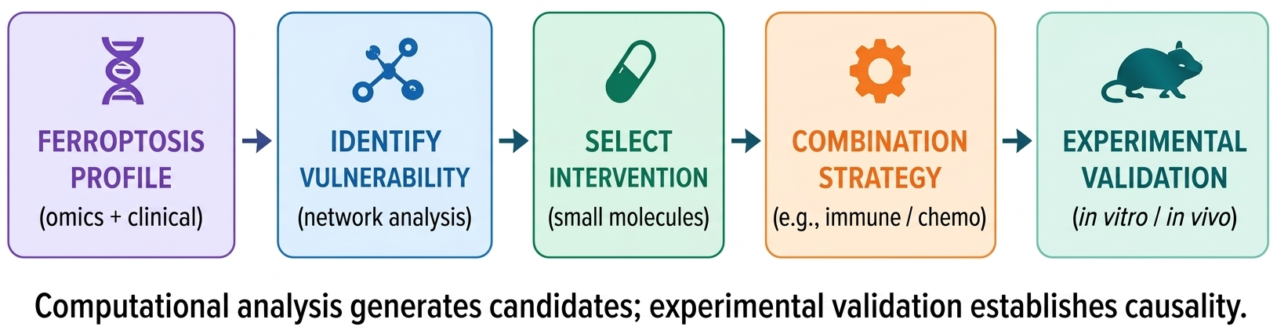
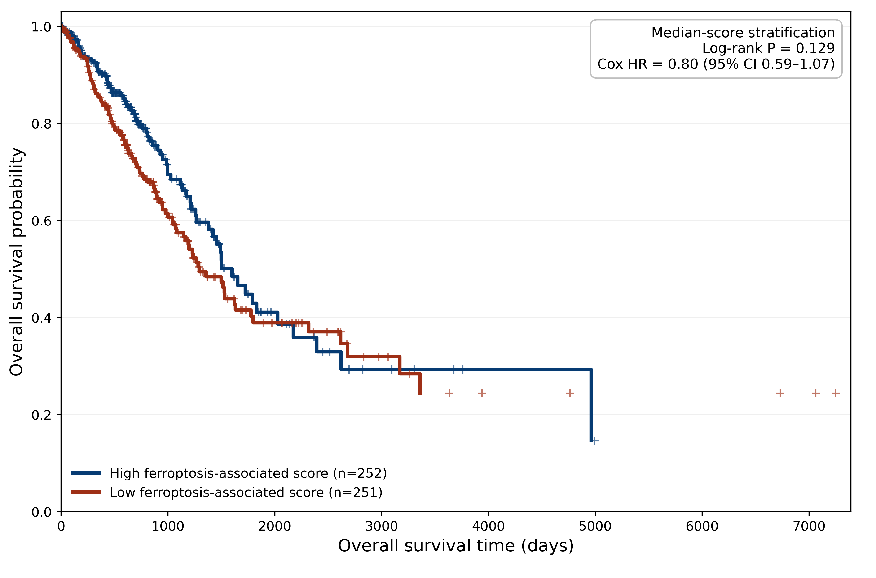


TARGETING THE UN-TARGETABLE :
A Ferroptotic Approach to Refractory Cancers
INSTITUTION
LOGO
Exploiting iron, lipid-peroxidation and antioxidant dependencies to identify vulnerabilities in therapy-resistant tumors
Humayra kabir Ahona · Sanjida Rahman Muntaha
Department of Biochemistry | | University of Chittagong
LITERATURE SYNTHESIS • PUBLIC-DATA ANALYSIS • COMPUTATIONAL HYPOTHESIS GENERATION
THE CENTRAL HYPOTHESIS : Refractory cancers may acquire or retain dependencies on iron metabolism, lipid remodeling and antioxidant defense. Ferroptosis exploits these vulnerabilities by overwhelming the cellular capacity to detoxify phospholipid peroxides.
THERAPEUTIC RESISTANCE → METABOLIC / REDOX ADAPTATION → IRON + PUFA-LIPID DEPENDENCY → ANTIOXIDANT DEFENSE BECOMES CRITICAL → FERROPTOTIC VULNERABILITY → POTENTIAL THERAPUTIC OPPORTUNITY
1. THE PROBLEM
4. FERROPTOSIS BIOCHEMISTRY
6. PUBLIC DATA ANALYSIS
WHY DO REFRACTORY CANCERS REMAIN DIFFICULT TO TARGET?
THE BIOCHEMICAL ENGINE OF FERROPTOSIS
Ferroptosis-associated transcriptional landscape
GSE182638 : MM1R (Glucocorticoid-resistant) vs MM1S (Glucocorticoid-sensitive)
01: TARGET ALTERATION
Mutations, pathway rewiring and loss of dependence on the original therapeutic target can reduce treatment efficacy.
02: METABOLIC PLASTICITY
Resistant cells can remodel glucose, lipid, amino-acid and antioxidant metabolism to maintain survival under therapeutic stress.
03: REDOX ADAPTATION
Enhanced ROS-buffering capacity can protect cancer cells from oxidative damage.
Resistance to one mechanism may expose dependence on another survival system.
2. WHY FERROPTOSIS ?
FROM “UN-TARGETABLE” DRIVER → TARGETABLE VULNERABILITY
TRADITIONAL THARAPUTIC APPROACH
FERROPTOSIS VULNERABILITY FREAMEWORK
Often centered on
a specific driver
Focuses on signaling
Requires persistent target dependence
Exploits iron/redox/lipid dependencies
Focuses on membrane redox homeostasis
Targets cellular metabolic state
Ferroptotic susceptibility = Lipid peroxidation pressure balanced against antioxidant defenses.
DIFFERENTIAL EXPRESSION BETWEEN MM1R & MM1S CELLs
DESeq2, n=3 vs n=3 (GSE182638) || circled points: A priori ferroptosis gene panel
[Literature-derived mechanistic synthesis]
06 COMPUTATIONAL ANALYSIS
3. LITERATURE EVIDENCE
5. WHERE CAN WE TARGET ?
PUBLIC CANCER DATA
FERROPTOSIS AS A MULTI-NODE TARGETING NETWORK
QC & PREPROCESSING
Fe
IRON
Iron availability contributes to oxidative presuuure.
SENSITIVE vs RESISTANT
LIPIDS
PUFA containing phospholipids influence peroxidation susceptibility..
FERROPTOSIS GENE SET
FERROPTOSIS
ENRICHMENT / SIGNATURE
CLINICAL ASSOCIATION
ANTIOXIDANT DEFENSE
GPX4 and alternative defense pathways regulate ferroptotic sensitivity.
CANDIDATE VULNERABILITY
Proposed public-dataset analysis; computational result only if actually executed.
[ Raw data were obtained from TCGA-LUAD (Cancer
Genome Atlas Research Network, 2014) and processed
using custom R scripts ]
8. PROPOSED THERAPEUTIC FRAMEWORK
7. FERROPTOSIS SIGNATURE & SURVIVAL
Ferroptosis-associated molecular state and overall survival
[ TCGA-LUAD ]
overall survival probability
9. CONCLUSION
overall survival probability
THREE TAKE-HOME MESSAGES
RESISTANCE CAN CREATE DEPENDENCIES
FERROPTOSIS EXPLOITS REDOX-LIPID VULNERABILITY
BIOMARKERS MAY ENABLE PRECISION TARGETING
References :
1. Cancer Genome Atlas Research Network. Nature. 2014;511:543–550. doi:10.1038/nature13385.
2. Zhou N, Bao J. Database (Oxford). 2020;2020:baaa021. doi:10.1093/database/baaa021.
3. Greenstein S, et al. Exp Hematol. 2003;31:271–282. doi:10.1016/S0301-472X(03)00023-7.
4. Author-generated R analysis & visualizations; reproducible code: GitHub — github.com/humayrakabir-ahona/poster-presentation-data

