Slide 1
Data Communication & Networking- Forouzan (4th Edition)
Chapter-4
Digital Transmission

Slide 2
List of Topics
Analog to Digital Conversion
Modulation
PCM
Sampling Theorem Math Example
Delta Modulation
Adaptive Delta Modulation
Quantization Error
Transmission Modes
Parallel Transmission
Serial Transmission
Asynchronous Transmission
Synchronous Transmission

Slide 3
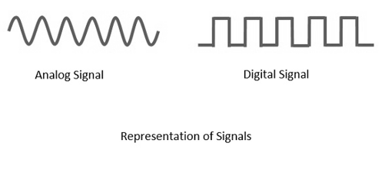
Analog to Digital Conversion
The conventional methods of communication used analog signals for long distance communications, which suffer from many losses such as distortion, interference, and other losses including security breach.
In order to overcome these problems, the signals are digitized using different techniques. The digitized signals allow the communication to be more clear and accurate without losses.
The following figure indicates the difference between analog and digital signals. The digital signals consist of 1s and 0s which indicate High and Low values respectively.

Slide 4
Modulation
Modulation is the process of varying one or more parameters of a carrier signal in accordance with the instantaneous values of the message signal.
The message signal is the signal which is being transmitted for communication and the carrier signal is a high frequency signal which has no data, but is used for long distance transmission.
There are many modulation techniques, which are classified according to the type of modulation employed. Of them all, the digital modulation technique used is Pulse Code Modulation (PCM).

Slide 5
Pulse Code Modulation
Pulse code modulation is essentially analog to digital conversion of a signal where the information contained is represented by digital words in a serial bit stream.
To do it following steps are taken:
Sampling (Analog signal to PAM signal)
Quantization (PAM signal to Quantized signal)
Encoding (Quantized signal to bit of stream)
In sampling, analog signal is sampled every Ts, where Ts is the sample interval. Sampling can be done through ideal, natural or flat-top sampling. The most common sampling method is sample and hold.
Quantization is second step. The result of sampling is a series of pulses with amplitude values between maximum and minimum amplitude values.

Slide 6
Pulse Code Modulation (Cont.)
Low Pass Filter:
This filter eliminates the high frequency components present in the input analog signal which is greater than the highest frequency of the message signal, to avoid aliasing of the message signal.
Sampler:
This is the technique which helps to collect the sample data at instantaneous values of message signal, so as to reconstruct the original signal. The sampling rate must be greater than twice the highest frequency component W of the message signal, in accordance with the sampling theorem.
Quantizer/ Quantization:
Quantizing is a process of reducing the excessive bits and confining the data. The sampled output when given to Quantizer, reduces the redundant bits and compresses the value.
Encoder/ Encoding:
The digitization of analog signal is done by the encoder. It designates each quantized level by a binary code. The sampling done here is the sample-and-hold process. These three sections LPF, Sampler, and Quantizer will act as an analog to digital converter.

Slide 7

PCM (Cont.)

Slide 8
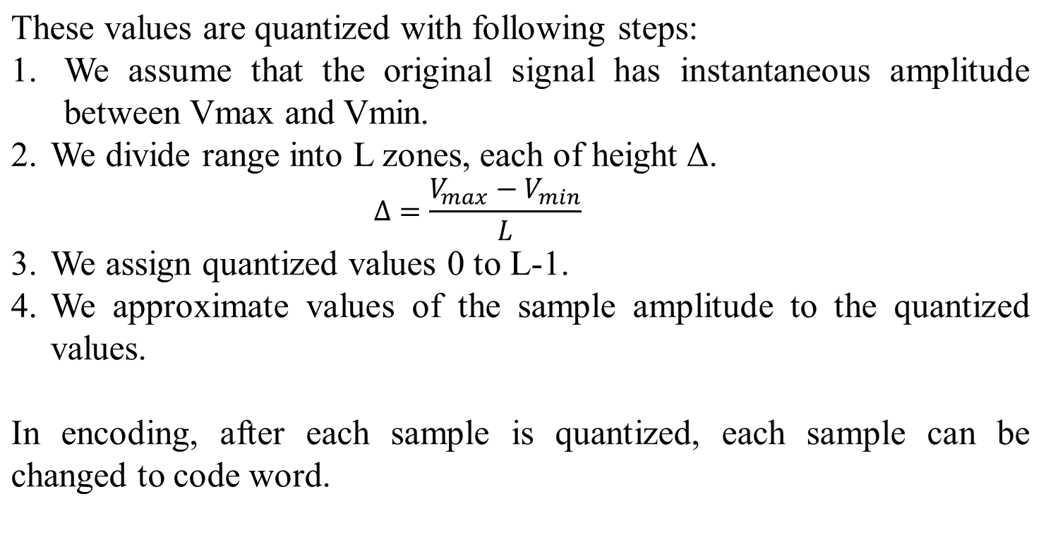
Pulse Code Modulation (Cont.)

Slide 9

Quantization & Encoding Samples

Slide 10
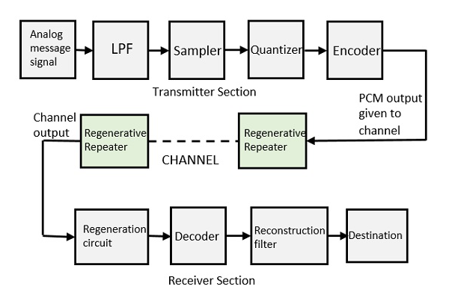
Pulse Code Modulation (Cont.)

Slide 11
Purpose of PAM
The amplitude modulation is used to describe the conversion of the analog signal to a pulse type signal in which the amplitude of the pulse denotes the analog information. The purpose of PAM is to provide another waveform that looks like pulses, yet contains the information that was present in the analog waveform.

Slide 12
Quantization Error
As quantization is an approximation process, so error occurs in the whole process.
The input values to the quantizer are the real values and the output values are the approximated values. The output values are chosen to be the middle value in the zone.
The quantization error changes the signal-to-noise ratio of the signal, which in turn reduces the upper limit capacity according to Shannon.

Slide 13
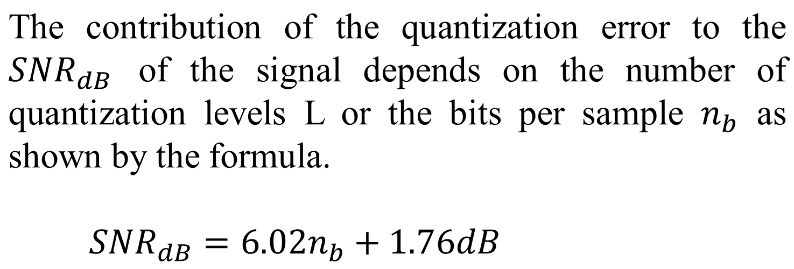
Quantization Error (Cont.)

Slide 14
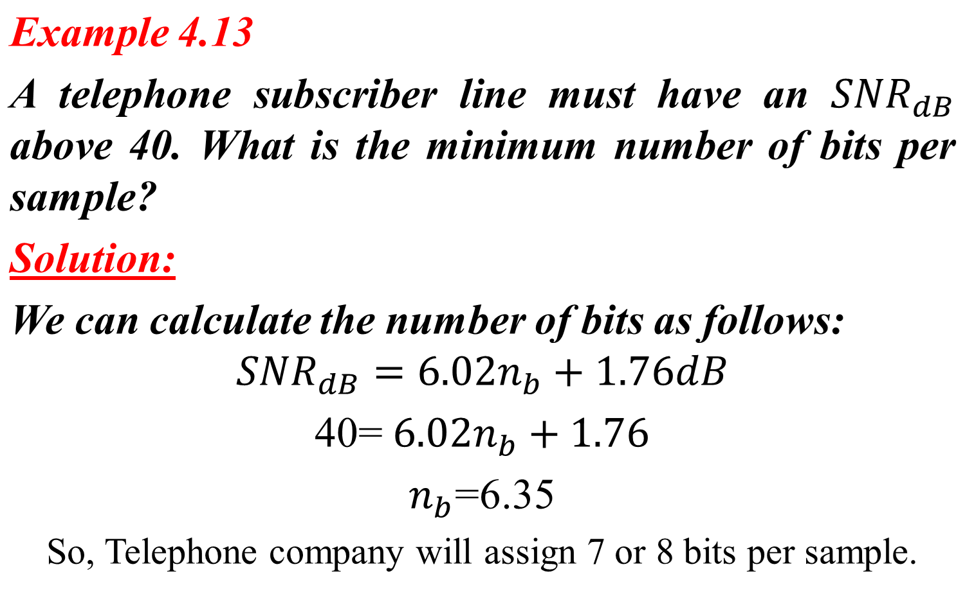
Quantization Error Math

Slide 15

Note
According to the Nyquist theorem, the sampling rate must be
at least 2 times the highest frequency contained in the signal.

Slide 16

Sampling Math
Example 4.14
We want to digitize the human voice. What is the bit rate, assuming 256 Levels, 8 bits per sample?
Solution:
The human voice normally contains frequencies from 0 to 4000 Hz. So the sampling rate and bit rate are calculated as follows:

Slide 17
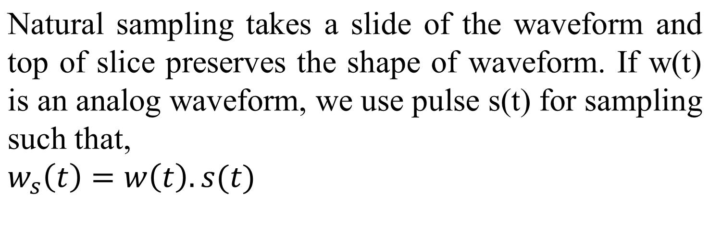
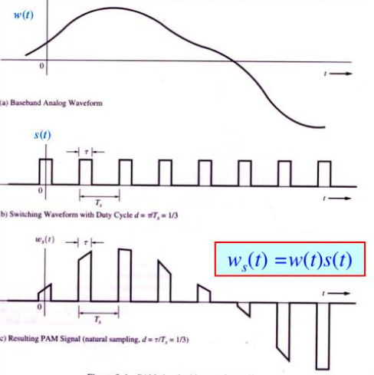
Natural Sampling

Slide 18

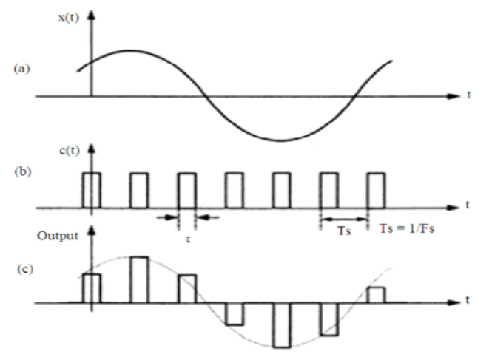
Flat-Top Sampling
In flat-top sampling, a signal is multiplied with impulse train. It uses sample and hold operation with that circuit. We get flat-top samples that do not preserve original shape of waveform.
The duration of each sample is T and the sampling rate is:

Slide 19
Delta Modulation
The type of modulation, where the sampling rate is much higher and in which the step size after quantization is of a smaller value Δ, such a modulation is termed as delta modulation.
Properties of Delta Modulation:
An over-sampled input is taken to make full use of the signal correlation.
The quantization design is simple.
The input sequence is much higher than the Nyquist rate.
The quality is moderate.
The design of the modulator and the demodulator is simple.
The stair-case approximation of output waveform.
The step-size is very small, i.e., Δ or delta.
The bit rate can be decided by the user.
This involves simpler implementation.

Slide 20
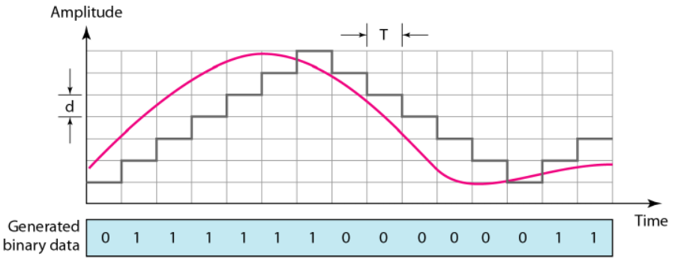
Delta Modulation (Cont.)
PCM is a very complex technique. Other techniques have been developed to reduce the complexity of PCM. The simplest is delta modulation. PCM finds the value of the signal amplitude for each sample; DM finds the change from the previous sample. Note that there are no code words here; bits are sent one after another.
Figure: The process of delta modulation.

Slide 21
Delta Modulation (Cont.)
Modulator:
The modulator is used at the sender site to create a stream of bits from an analog signal. The process records the small positive or negative changes, called delta ẟ. If the delta is positive, the process records a 1; if it is negative, the process records a 0. However, the process needs a base against which the analog signal is compared. The modulator builds a second signal that resembles a staircase. Finding the change is then reduced to comparing the input signal with the gradually made staircase signal.
The modulator, at each sampling interval, compares the value of the analog signal with the last value of the staircase signal. If the amplitude of the analog signal is larger, the next bit in the digital data is 1; otherwise, it is 0. The output of the comparator, however, also makes the staircase itself. If the next bit is 1, the staircase maker moves the last point of the staircase signal 0 up; it the next bit is 0, it moves it 0 down. Note that we need a delay unit to hold the staircase function for a period between two comparisons.

Slide 22
Delta Modulation (Cont.)
In delta modulation, the analog input signal is approximated by a staircase function that moves up or down by a fixed step size Δ at each sampling interval. The difference between the current sample and the previous one is sent as a 1 or 0:
If the signal increases, a 1 is transmitted.
If the signal decreases, a 0 is transmitted.

Slide 23
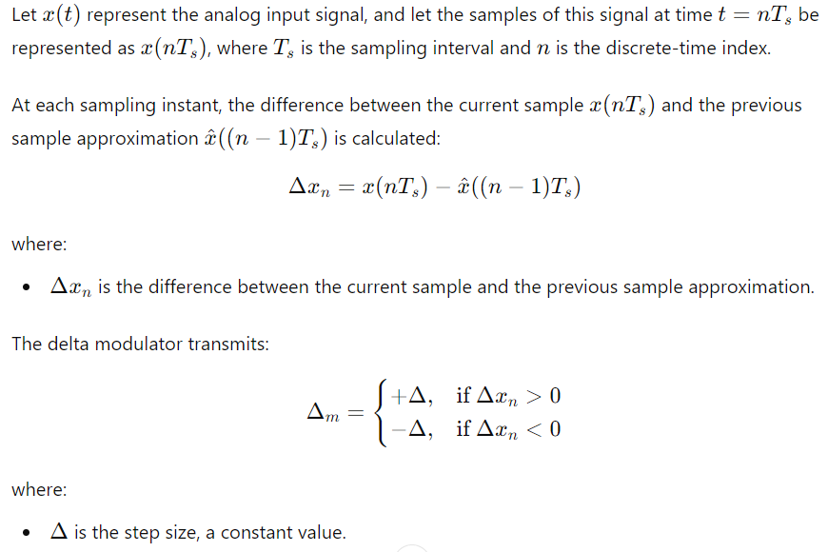
Delta Modulation (Cont.)

Slide 24
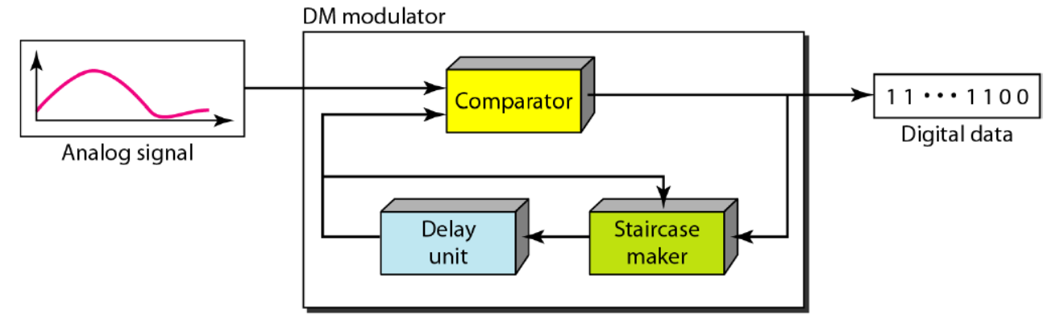
Delta Modulation (Cont.)
Modulator:
Figure: Delta modulation circuit

Slide 25
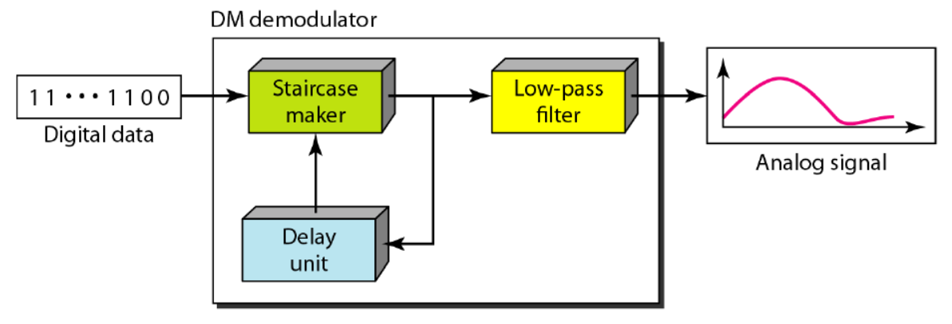
Delta Modulation (Cont.)
Demodulator:
The demodulator takes the digital data and, using the staircase maker and the delay unit, creates the analog signal. The created analog signal, however, needs to pass through a low-pass filter for smoothing.
Figure: Delta modulation demodulator circuit

Slide 26
Errors in Delta Modulation
There are two types of error in DM.
Slope Overhead or Overload.
Granular Noise

Slide 27
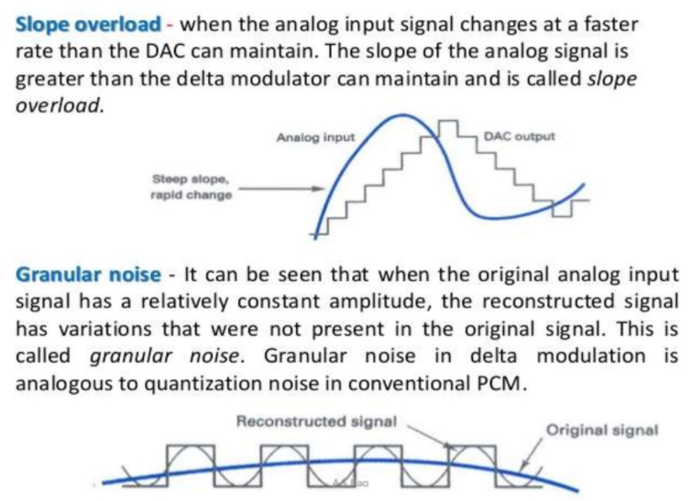
Errors in Delta Modulation (Cont.)

Slide 28
Quantization Error
It is obvious that DM is not perfect. Quantization error is always introduced in the process. The quantization error of DM, however, is much less than that for PCM.

Slide 29
Transmission Modes

Slide 30
Transmission Modes
The transmission of binary data across a link can be accomplished in either parallel or serial mode. In parallel mode, multiple bits are sent with each clock tick. In serial mode, 1 bit is sent with each clock tick. While there is only one way to send parallel data.
There are two subclasses of serial transmission: asynchronous, synchronous.

Slide 31
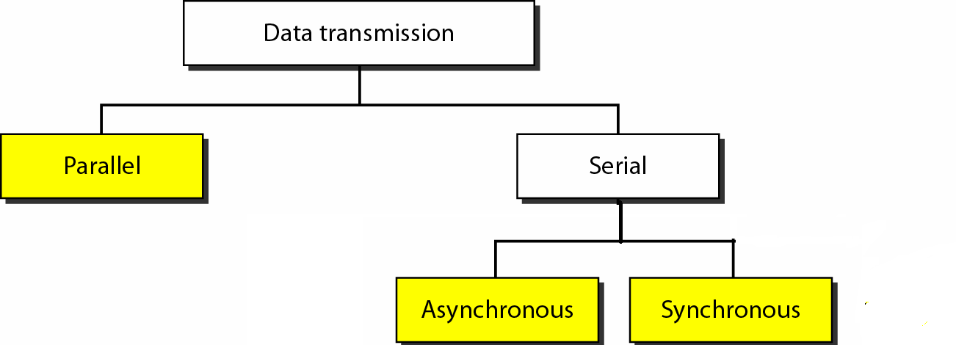

Slide 32
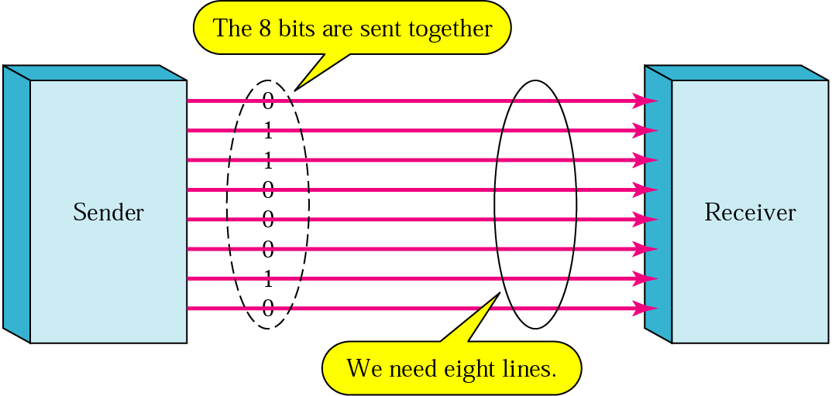
Parallel Transmission

Slide 33
Parallel Transmission (Cont.)
Binary data, consisting of 1’s and 0’s, may be organized into groups of n bits each.
Computers produce and consume data in groups of bits much as we conceive of and use spoken language in the form of words rather than letters. By grouping, we can send data n bits at a time instead of 1. This is called parallel transmission. The mechanism for parallel transmission is a conceptually simple one: Use n wires to send n bits at one time. That way each bit has its own wire, and all n bits of one group can be transmitted with each clock tick from one device to another. Figure shows how parallel transmission works for n =8. Typically, the eight wires are bundled in a cable with a connector at each end. The advantage of parallel transmission is speed. All else being equal, parallel transmission can increase the transfer speed by a factor of n over serial transmission. But there is a significant disadvantage: cost. Parallel transmission requires n communication lines (wires in the example) just to transmit the data stream. Because this is expensive, parallel transmission is usually limited to short distances.

Slide 34
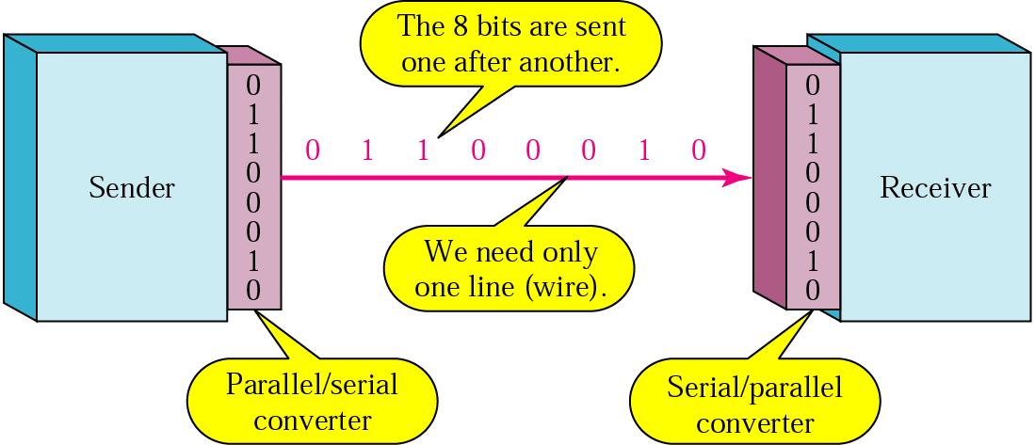
Serial Transmission

Slide 35
Serial Transmission (Cont.)
In serial transmission one bit follows another, so we need only one communication channel rather than n to transmit data between two communicating devices. The advantage of serial over parallel transmission is that with only one communication channel, serial transmission reduces the cost of transmission over parallel by roughly a factor of n.
Since communication within devices is parallel, conversion devices are required at the interface between the sender and the line (parallel-to-serial) and between the line and the receiver (serial-to-parallel).
Serial transmission occurs in one of three ways: asynchronous, synchronous, and isochronous.

Slide 36

Asynchronous Transmission

Slide 37
Asynchronous Transmission (Cont.)
Asynchronous transmission is so named because the timing of a signal is unimportant. Instead, information is received and translated by agreed upon patterns. As long as those patterns are followed, the receiving device can retrieve the information without regard to the rhythm in which it is sent. Patterns are based on grouping the bit stream into bytes. Each group, usually 8 bits, is sent along the link as a unit.
To alert the receiver to the arrival of a new group, therefore, an extra bit is added to the beginning of each byte. This bit, usually a 0, is called the start bit. To let the receiver know that the byte is finished, 1 or more additional bits are appended to the end of the byte. These bits, usually 1’s are called stop bits. By this method, each byte is increased in size to at least 10 bits, of which 8 bits is information and 2 bits or more are signals to the receiver. In addition, the transmission of each byte may then be followed by a gap of varying duration. This gap can be represented either by an idle channel or by a stream of additional stop bits.

Slide 38
Note
In asynchronous transmission, we send 1 start bit (0) at the beginning and 1 or more stop bits (1s) at the end of each byte. There may be a gap between
each byte.

Slide 39
Note
Asynchronous here means “asynchronous at the byte level,”
but the bits are still synchronized;
their durations are the same.

Slide 40
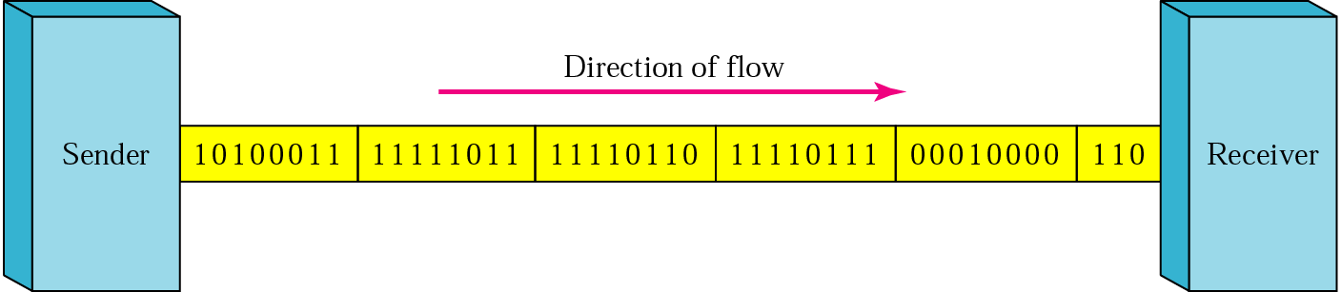
Synchronous Transmission

Slide 41
Synchronous Transmission (Cont.)
In synchronous transmission, the bit stream is combined into longer "frames," which may contain multiple bytes. Each byte, however, is introduced onto the transmission link without a gap between it and the next one. It is left to the receiver to separate the bit stream into bytes for decoding purposes. In other words, data are transmitted as an unbroken string of 1’s and 0’s, and the receiver separates that string into the bytes, or characters, it needs to reconstruct the information.
Figure 4.35 gives a schematic illustration of synchronous transmission. We have drawn in the divisions between bytes. In reality, those divisions do not exist; the sender puts its data onto the line as one long string. If the sender wishes to send data in separate bursts, the gaps between bursts must be filled with a special sequence of 0’s and 1’s that means idle. The receiver counts the bits as they arrive and groups them in 8-bit units.

Slide 42
Synchronous Transmission (Cont.)
The advantage of synchronous transmission is speed. With no extra bits or gaps to introduce at the sending end and remove at the receiving end, and, by extension, with fewer bits to move across the link, synchronous transmission is faster than asynchronous transmission. For this reason, it is more useful for high-speed applications such as the transmission of data from one computer to another. Byte synchronization is accomplished in the data link layer.
We need to emphasize one point here. Although there is no gap between characters in synchronous serial transmission, there may be uneven gaps between frames.

Slide 43
Note
In synchronous transmission, we send bits one after another without start or stop bits or gaps. It is the responsibility of the receiver to group the bits.

Slide 44
Readings
Chapter 4 (B.A Forouzan)
  Section 4.1, 4.2, 4.3

Slide 45


