Slide 1

Chapter 3
Data and Signals
Copyright © The McGraw-Hill Companies, Inc. Permission required for reproduction or display.

Slide 2
Data and Signals
Data are entities that convey meaning (computer file, music on CD, results from a blood gas analysis machine)
Signals are the electric or electromagnetic encoding of data (telephone conversation, web page download)
Computer networks and data/voice communication systems transmit signals
Data and signals can be analog or digital – this can be misleading – let’s talk more about this
TDC 361

Slide 3
Analog vs. Digital Signals
Signals can be interpreted as either analog or digital
In reality, all signals are analog
Analog signals are continuous, non-discrete
Digital signals are non-continuous, discrete
Digital signals lend themselves more nicely to noise reduction techniques

Slide 4
Analog vs. Digital Signals
There are actually multiple “kinds” of digital signals
Discrete square waveforms found in digital systems such as LANs (see an example on the next slide)
Digital logic voltage levels (a binary 0 is 0 to 2 volts; a binary 1 is 4 to 6 volts)
Analog signals which can only be interpreted in a finite number of ways (modulation techniques such as QAM-16)

Slide 5
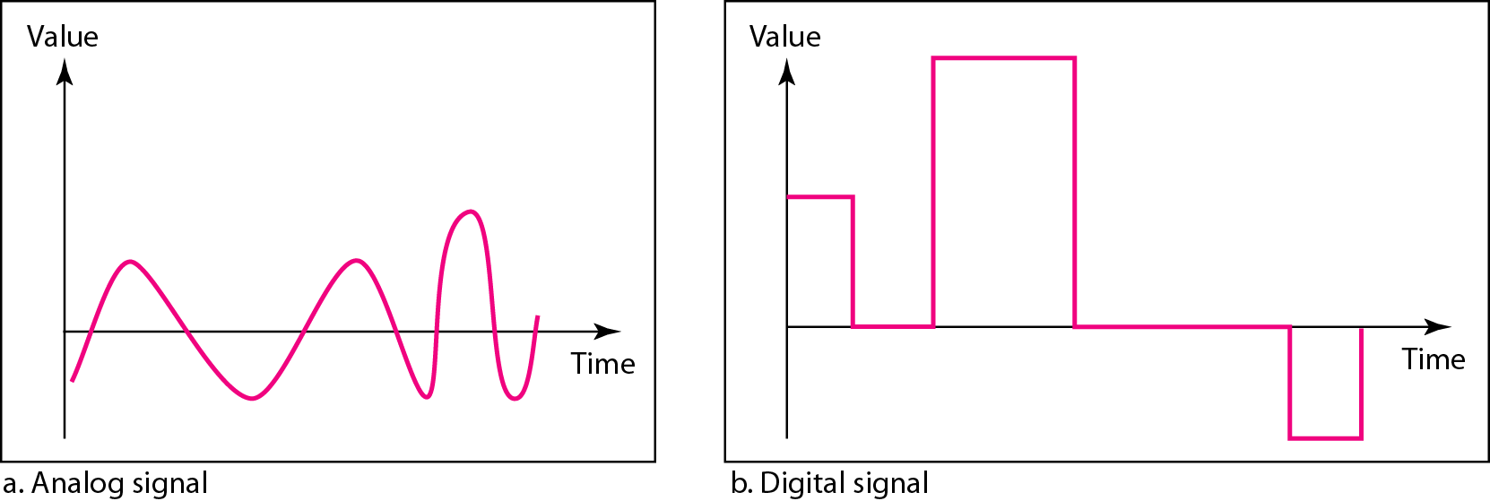
Figure 3.1 Comparison of analog and digital signals

Slide 6
Time domain concepts
Continuous signal
Infinite number of points at any given time
Discrete signal
Finite number of points at any given time; maintains a constant level then changes to another constant level. So time is discrete but amplitude is continuous.
Periodic signal
Pattern repeated over time
Aperiodic (non-periodic) signal
Pattern not repeated over time

Slide 7
Time domain concepts
In data communications, we commonly use periodic analog signals and nonperiodic digital signals.
Periodic analog signals can be classified as simple or composite.
A simple periodic analog signal, a sine wave, cannot be decomposed into simpler signals.
A composite periodic analog signal is composed of multiple sine waves.

Slide 8
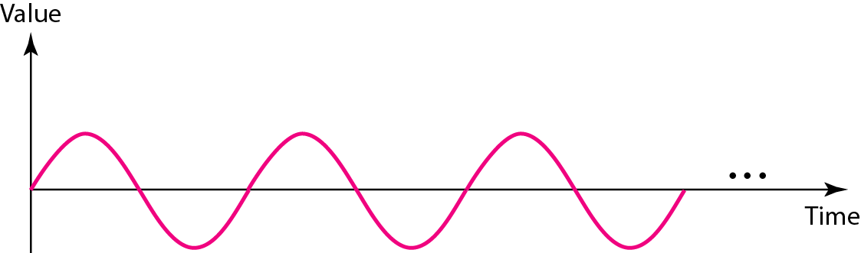
Figure 3.2 A sine wave

Slide 9
Signal Properties
All signals are composed of three properties:
Amplitude
Frequency
Phase

Slide 10
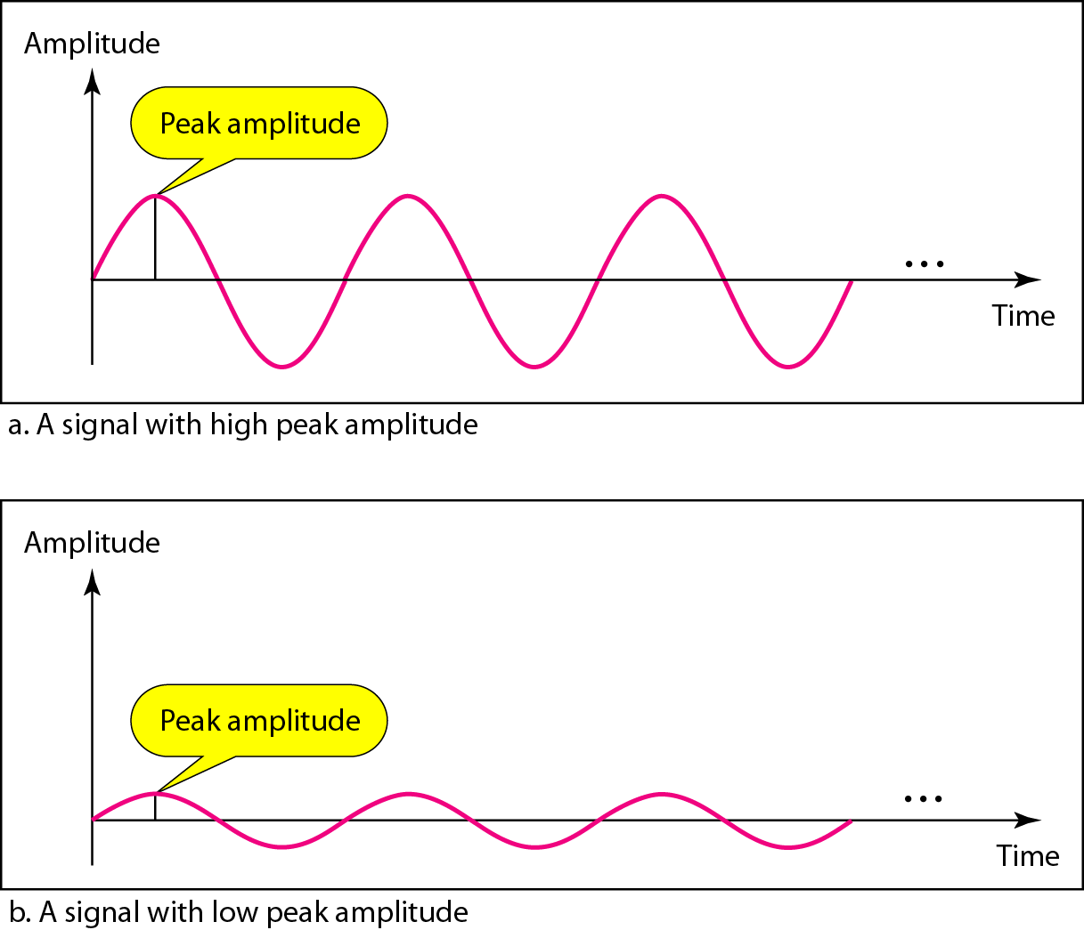
Figure 3.3 Two signals with the same phase and frequency, but different amplitudes

Slide 11


Note
Frequency and period are the inverse of each other.

Slide 12
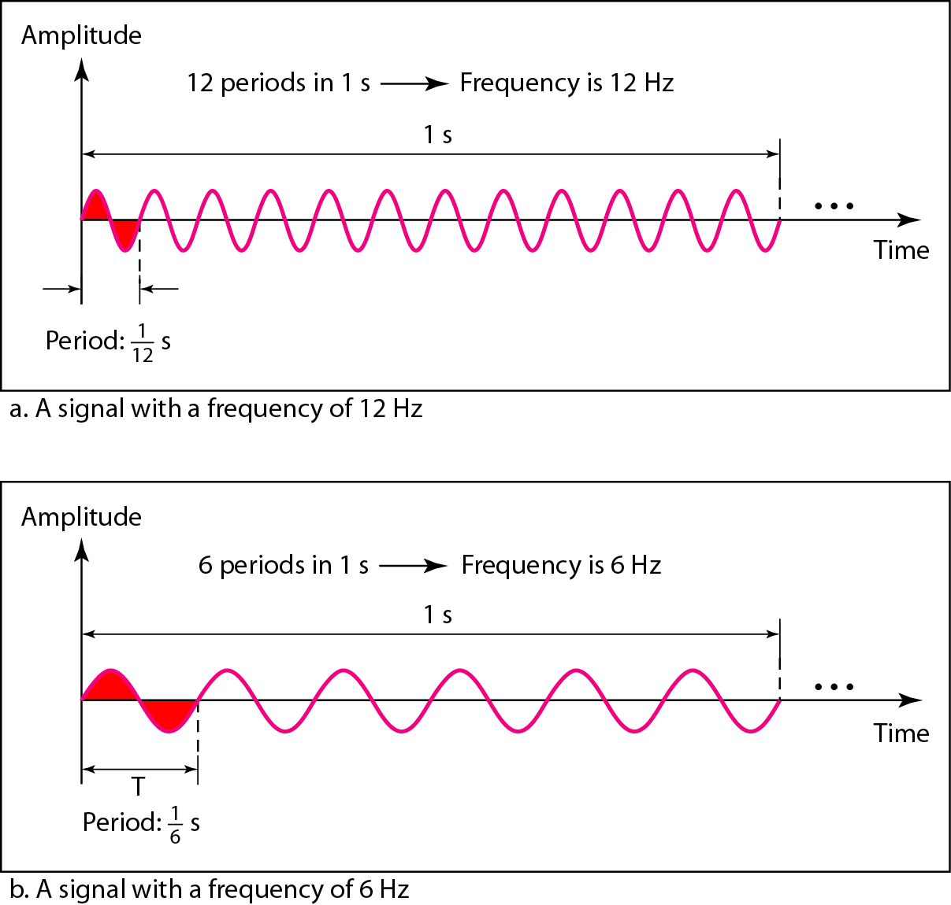
Figure 3.4 Two signals with the same amplitude and phase, but different frequencies

Slide 13
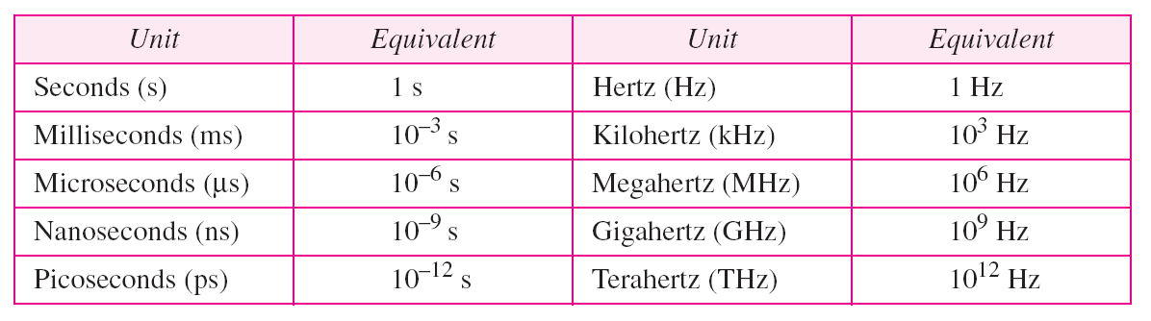
Table 3.1 Units of period and frequency

Slide 14
Example 3.3
The power we use at home has a frequency of 60 Hz. The period of this sine wave can be determined as follows:

Slide 15
Example 3.5
The period of a signal is 100 ms. What is its frequency in kilohertz?
Solution
First we change 100 ms to seconds, and then we calculate the frequency from the period (1 Hz = 10⁻³ kHz).

Slide 16
Note
Frequency is the rate of change with respect to time. Change in a short span of time
means high frequency. Change over a long span of time means low frequency.

Slide 17
Note
If a signal does not change at all, its frequency is zero.
If a signal changes instantaneously, its frequency is infinite.

Slide 18
Note
Phase describes the position of the waveform relative to time 0.

Slide 19
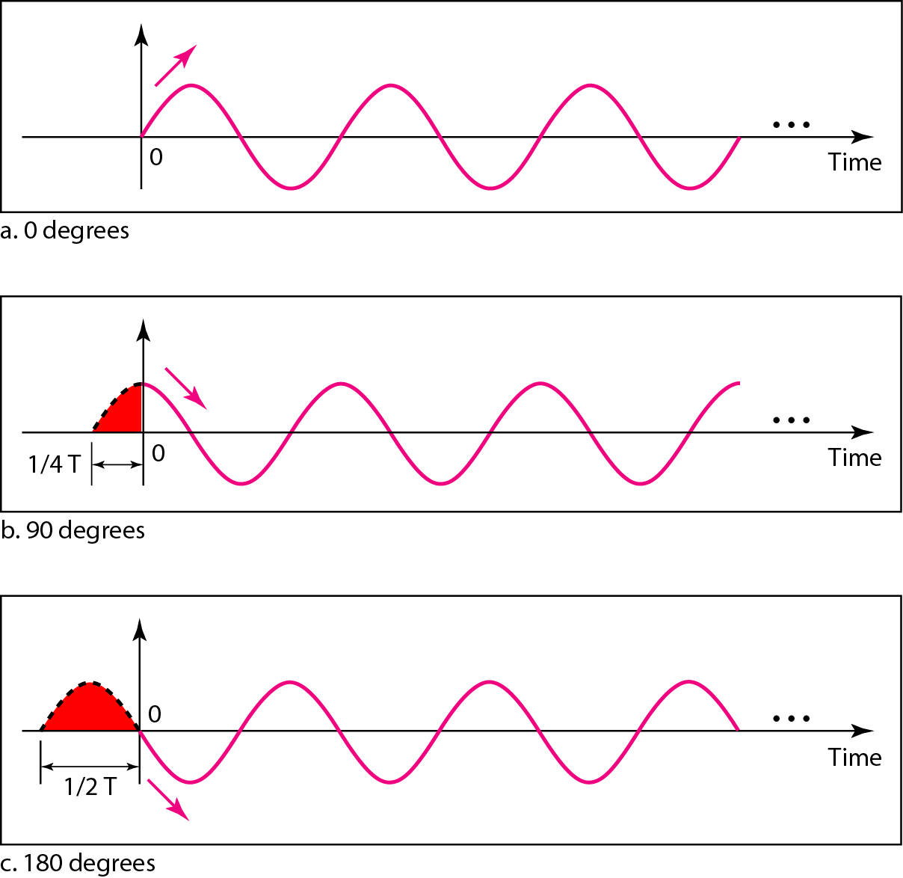
Figure 3.5 Three sine waves with the same amplitude and frequency, but different phases

Slide 20
Example 3.6
A sine wave is offset 1/6 cycle with respect to time 0. What is its phase in degrees and radians?
Solution
We know that 1 complete cycle is 360°. Therefore, 1/6 cycle is

Slide 21
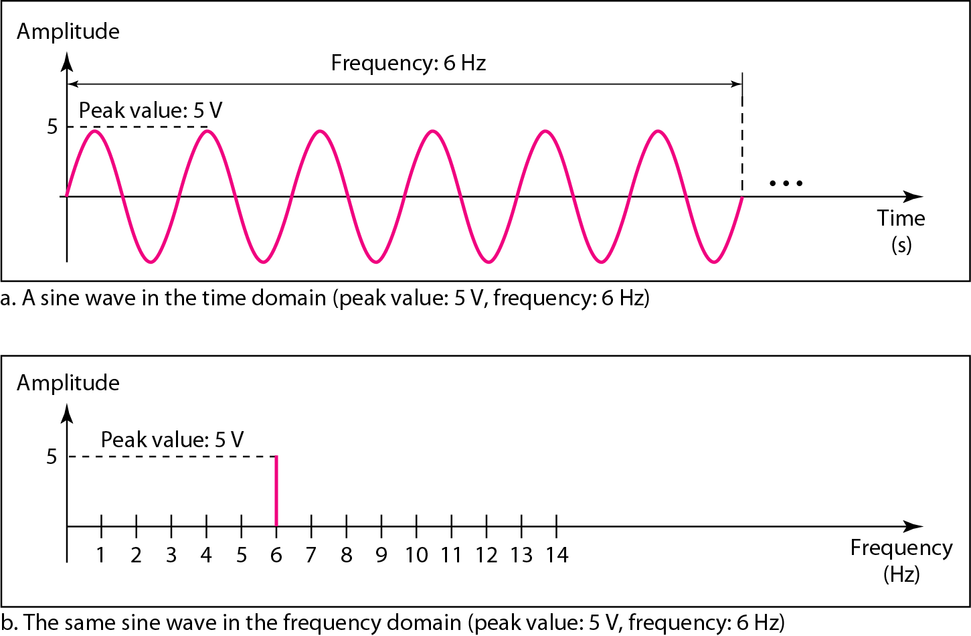
Figure 3.7 The time-domain and frequency-domain plots of a sine wave

Slide 22
Example 3.7
The frequency domain is more compact and useful when we are dealing with more than one sine wave. For example, Figure 3.8 shows three sine waves, each with different amplitude and frequency. All can be represented by three spikes in the frequency domain.

Slide 23
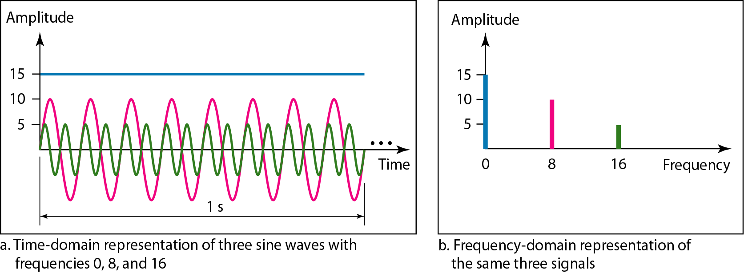
Figure 3.8 The time domain and frequency domain of three sine waves

Slide 24
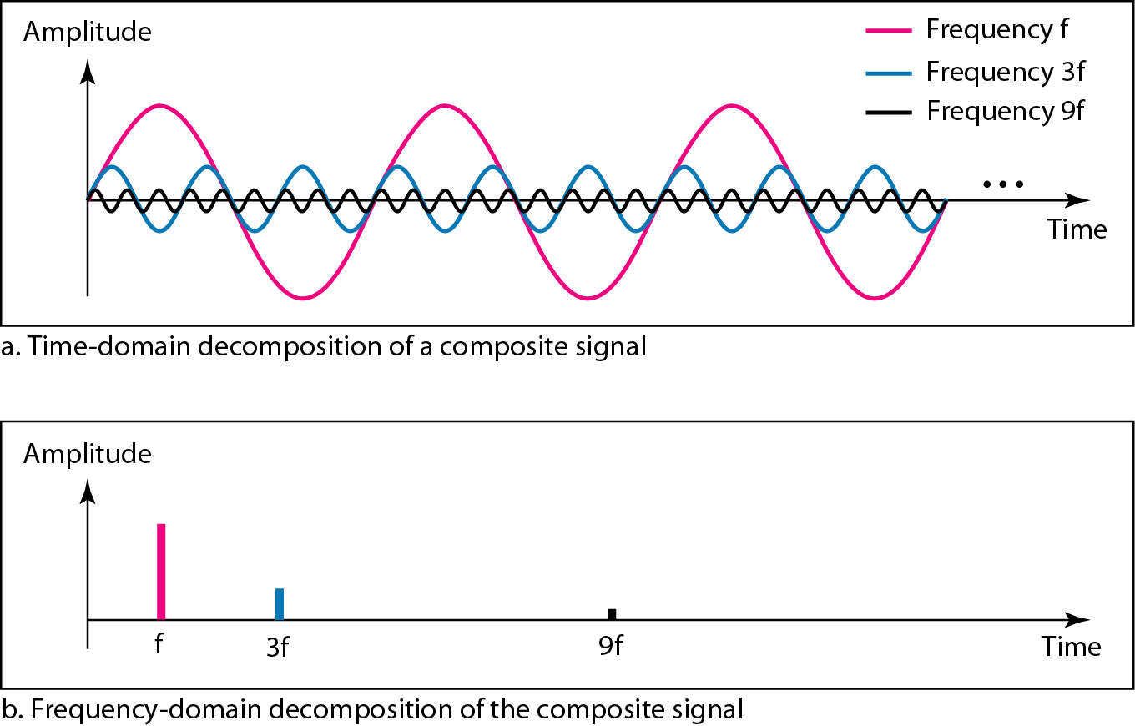
Figure 3.10 Decomposition of a composite periodic signal in the time and frequency domains

Slide 25
Note
A single-frequency sine wave is not useful in data communications;
we need to send a composite signal, a signal made of many simple sine waves.

Slide 26
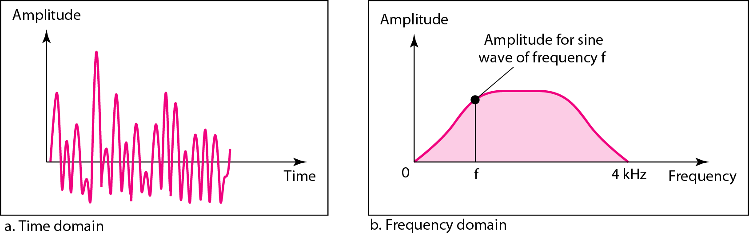
Figure 3.11 The time and frequency domains of a nonperiodic signal, such
someone speaking into a microphone

Slide 27
Note
The bandwidth of a composite signal is the difference between the
highest and the lowest frequencies contained in that signal.

Slide 28
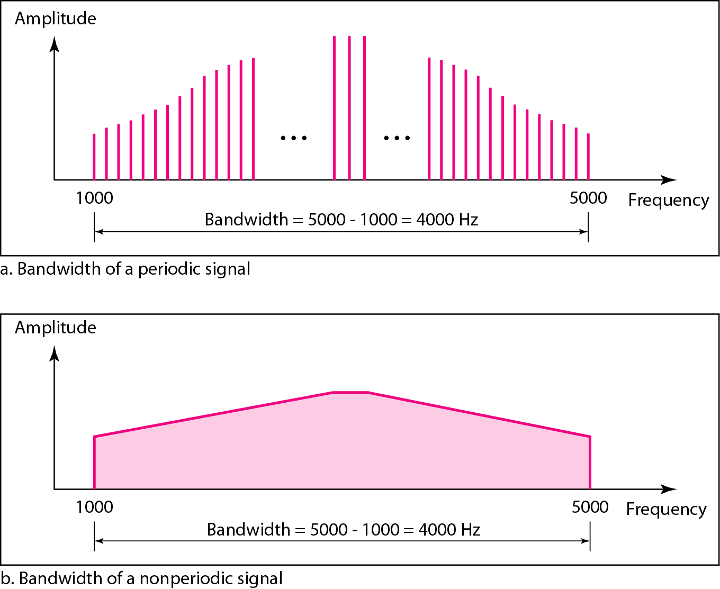
Figure 3.12 The bandwidth of periodic and nonperiodic composite signals
Note: each
frequency is
identifiable
Note:
frequencies
are all over
the place

Slide 29
Example 3.10
If a periodic signal is decomposed into five sine waves with frequencies of 100, 300, 500, 700, and 900 Hz, what is its bandwidth? Draw the spectrum (range of frequencies), assuming all components have a maximum amplitude of 10 V.

Slide 30
Example 3.10 (continued)
Solution
Let f_{h} be the highest frequency, f_{l} the lowest frequency, and B the bandwidth. Then
The spectrum has only five spikes, at 100, 300, 500, 700, and 900 Hz (see Figure 3.13).

Slide 31
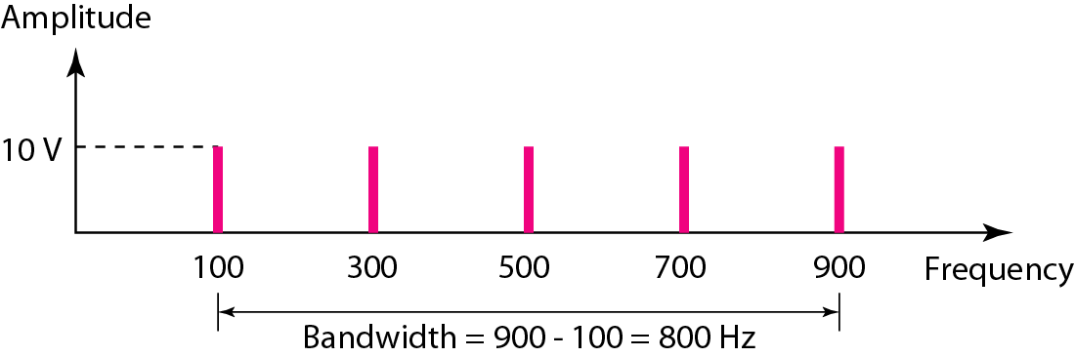
Figure 3.13 The bandwidth for Example 3.10

Slide 32
Example 3.12
A nonperiodic composite signal has a bandwidth of 200 kHz, with a middle frequency of 140 kHz and peak amplitude of 20 V. The two extreme frequencies have an amplitude of 0. Draw the frequency domain of the signal.
Solution
The lowest frequency must be at 40 kHz and the highest at 240 kHz. Figure 3.15 shows the frequency domain and the bandwidth.

Slide 33
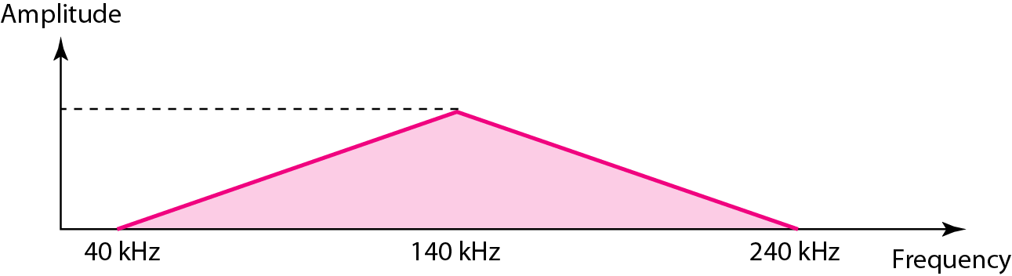
Figure 3.15 The bandwidth for Example 3.12

Slide 34
3-3 DIGITAL SIGNALS
In addition to being represented by an analog signal, information can also be represented by a digital signal. For example, a 1 can be encoded as a positive voltage and a 0 as zero voltage. A digital signal can have more than two levels. In this case, we can send more than 1 bit for each level.
Topics discussed in this section:
Bit Rate Bit Length Digital Signal as a Composite Analog Signal
Application Layer

Slide 35
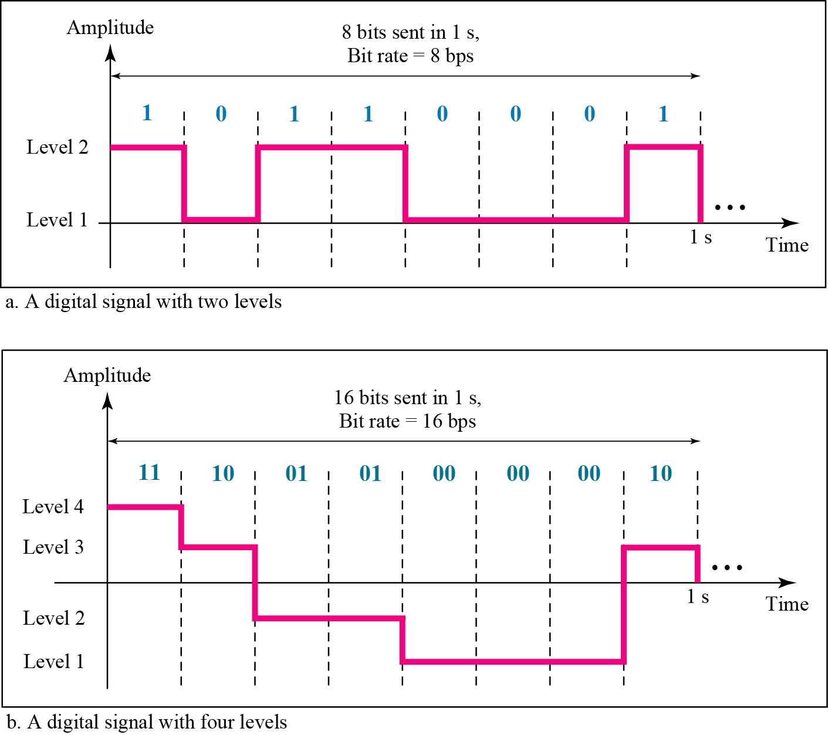
Figure 3.16 Two digital signals: one with two signal levels and the other with four signal levels

Slide 36
Example 3.16
A digital signal has eight levels. How many bits are needed per level? We calculate the number of bits from the formula
Each signal level is represented by 3 bits.

Slide 37
Example 3.17
What about a digital signal with 16 levels?
How many bits are needed per level?
What about 32 levels? 64 levels? 128 levels?
What about 9 levels??
2? = 9?
3.17 bits
However, this answer is not realistic.

Slide 38
Example 3.18
Assume we need to download text documents at the rate of 100 pages per second. What is the required bit rate of the channel?
Solution
A page is an average of 24 lines with 80 characters in each line. If we assume that one character requires 8 bits, the bit rate is

Slide 39
Example 3.19
A digitized voice channel, as we will see in Chapter 4, is made by digitizing a 4-kHz bandwidth analog voice signal. We need to sample the signal at twice the highest frequency (two samples per hertz). We assume that each sample requires 8 bits. What is the required bit rate?
Solution
The bit rate can be calculated as

Slide 40
Example 3.20
What is the bit rate for high-definition TV (HDTV)?
Solution
HDTV uses digital signals to broadcast high quality video signals. The HDTV screen is normally a ratio of 16 : 9. There are 1920 by 1080 pixels per screen, and the screen is renewed 30 times per second. Twenty-four bits represents one color pixel.
The TV stations reduce this rate to 20 to 40 Mbps through compression.

Slide 41
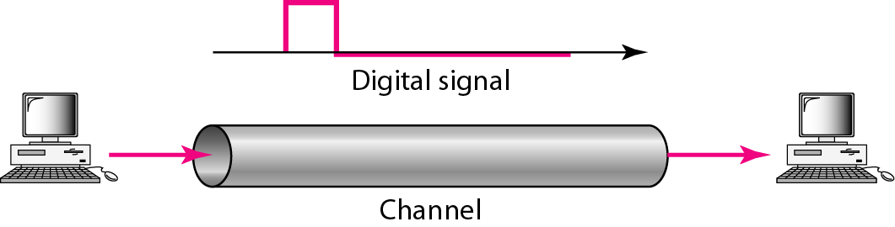
Figure 3.18 Baseband transmission
Digital transmission on a wire typically “consumes” the entire channel
and is labeled baseband signaling.
A digital signal is a composite analog signal with infinite bandwidth.
The LAN is a common example of baseband signaling.

Slide 42
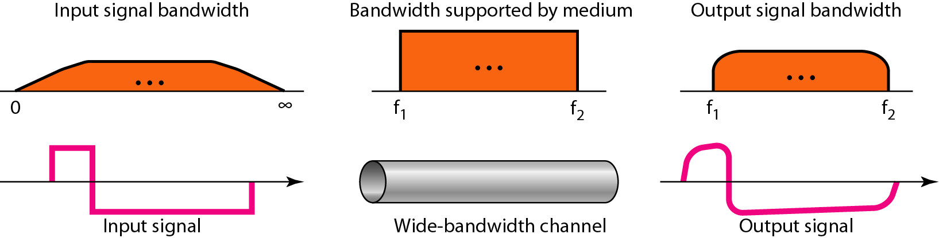
Figure 3.20 Baseband transmission using a dedicated medium
This is ideal.
This is what we get.
Still readable however.

Slide 43
Fourier Analysis
Interestingly, digital signals are combinations of analog signals
Fourier Analysis – any composite signal is a combination of simple sine waves with different frequencies and amplitudes
These simple sine waves are also called harmonics

Slide 44
Fourier Analysis
Square wave: (4A/ Pi)sin(2 Pi ft) + (4A/3 Pi)sin(2 Pi 3ft) + (4A/5 Pi)sin(2 Pi 5ft)…
Sawtooth: (2A/ Pi ) x [sin(2 Pi ft) – (1/2)sin(2 Pi 2ft) + (1/3)sin(2 Pi 3ft) – (1/4)sin(2 Pi 4ft) …
www.falstad.com/fourier

Slide 45
Note
In baseband transmission, the required bandwidth is proportional to the bit rate;
if we need to send bits faster, we need more bandwidth.

Slide 46
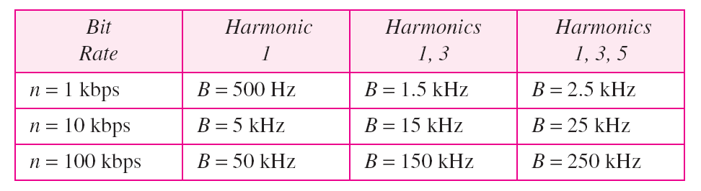
Bandwidth (B) = 3N/2
where N= Bit Rate
Table 3.2 Bandwidth requirements
Bandwidth (B) = 5N/2
where N= Bit Rate

Slide 47
Example 3.22
What is the required bandwidth of a low-pass channel if we need to send 1 Mbps by using baseband transmission?
Solution
The answer depends on the accuracy desired.
a. The minimum bandwidth, is B = bit rate /2, or 500 kHz.
b. A better solution is to use the first and the third harmonics with B = 3 × 500 kHz = 1.5 MHz.
c. Still a better solution is to use the first, third, and fifth harmonics with B = 5 × 500 kHz = 2.5 MHz.

Slide 48
Example 3.22
We have a low-pass channel with bandwidth 100 kHz. What is the maximum bit rate of this channel?
Solution
The maximum bit rate can be achieved if we use the first harmonic. The bit rate is 2 times the available bandwidth, or 200 kbps.

Slide 49
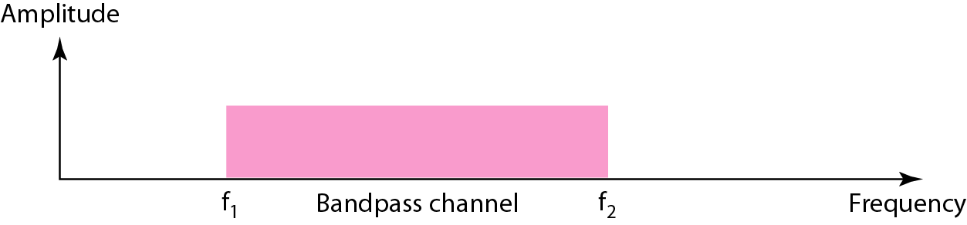
Figure 3.23 Bandwidth of a bandpass channel

Slide 50
Note
If the available channel is a bandpass channel, we cannot send the digital signal directly to the channel; we need to convert the digital signal to an analog signal before transmission.

Slide 51
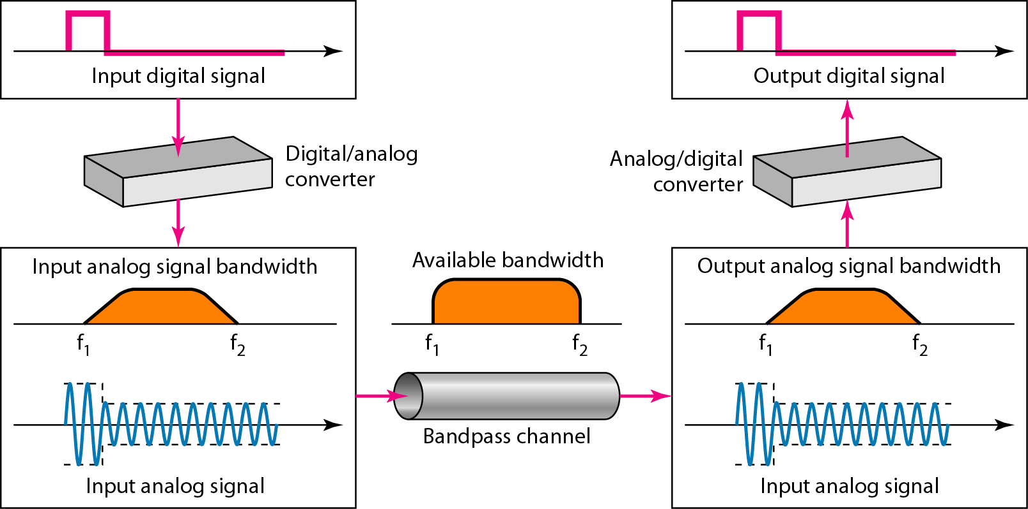
Figure 3.24 Modulation of a digital signal for transmission on a bandpass channel

Slide 52
3-4 TRANSMISSION IMPAIRMENT
Signals travel through transmission media, which are not perfect. The imperfection causes signal impairment. This means that the signal at the beginning of the medium is not the same as the signal at the end of the medium. What is sent is not what is received. Three causes of impairment are attenuation, distortion, and noise.
Topics discussed in this section:
Attenuation Distortion Noise

Slide 53
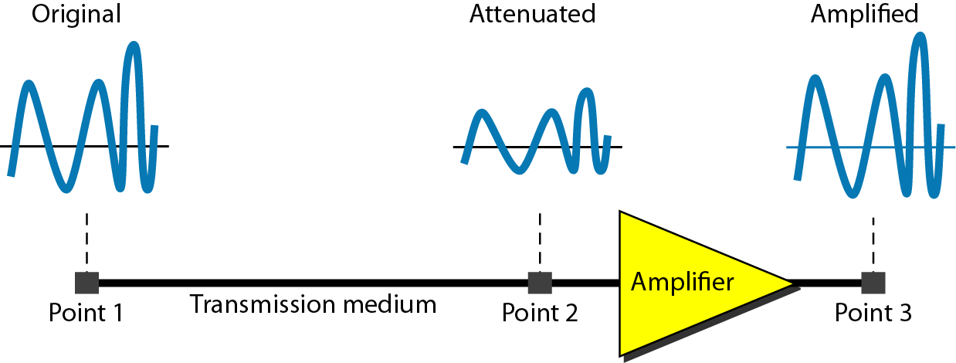
Figure 3.26 Attenuation (the first impairment)
Attenuation means a loss of energy.
When a signal, simple or composite, travels through a medium, it loses some of its energy in overcoming the resistance of the medium. To compensate for this loss, amplifiers are used to amplify the signal.

Slide 54
Decibels
Signal strength is measured in decibels (dB)
dB is a relative measure of loss (or gain). Decibel measures the relative strengths of two signals or one signal at two different points.
N_{dB} = 10 x log₁₀ (P2 / P1)
P2 = ending power level in watts
P1 = beginning power level in watts
Example: P1 = 10 watts, P2 = 5 watts
Even easier – remember ½ rule
Losses and gains are additive
Note that-”The decibel is negative if a signal is attenuated and positive if a signal is amplified.”

Slide 55
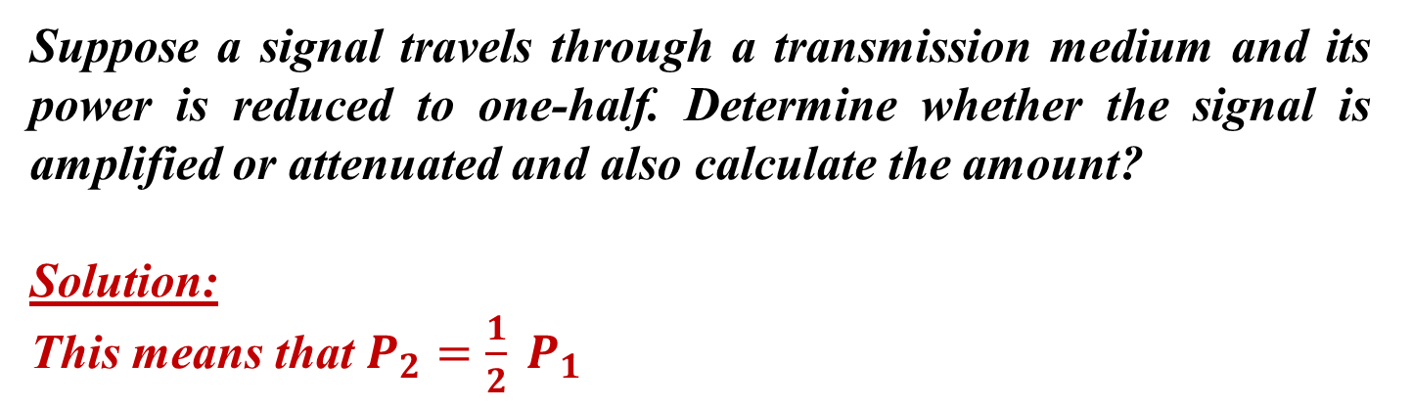

Example 3.26
As the result shows –ve sign, so attenuation (loss) of power = 3dB.
A loss of 3dB (-3dB) is equivalent to losing one-half the power.

Slide 56
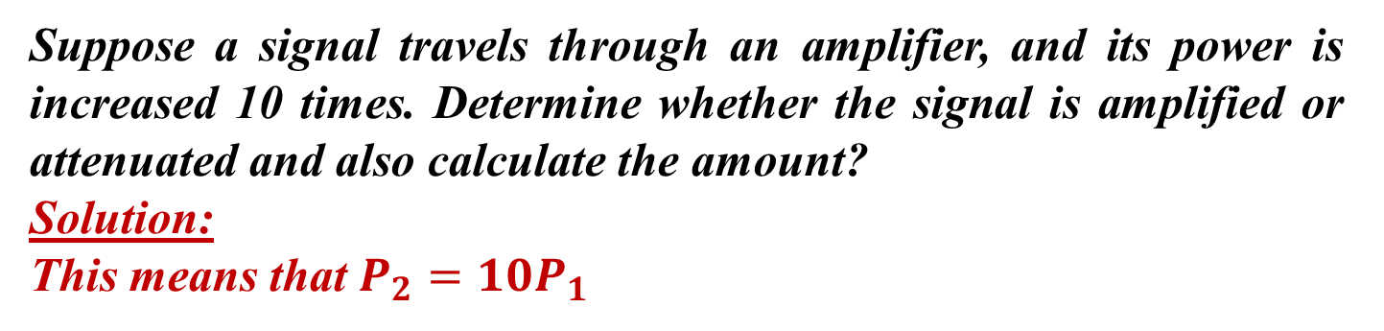

Example 3.27
As the result shows +ve sign, so amplification (gain) of power = 10 dB.

Slide 57
Signal to Noise Ratio (SNR or S/N)
Signal to noise ratio shows the ratio of signal power to noise power
Power often expressed in watts
S/N = signal power/noise power
Just a simple ratio

Slide 58
Signal to Noise Ratio_{dB} (SNR_{dB} or S/N_{dB})
Signal to noise ratio_{dB} shows the ratio of signal power to noise power in decibels
S/N_{dB} = 10 log₁₀ (signal power/noise power)
Example 1: Signal power = 1000 watts, noise power = 20 mw
Example 2: Signal power = 100 w, noise power = 0.000002w

Slide 59
Signal to Noise Ratio_{dB}
What if you know the S/N_{db} but want to know the signal power level?
For example, you are given that S/N_{db} = 85. What is the signal power level?

Slide 60

Example 3.28
One reason that engineers use the decibel to measure the changes in the strength of a signal is that decibel numbers can be added (or subtracted) when we are measuring several points (cascading) instead of just two. In Figure 3.27 a signal travels from point 1 to point 4. In this case, the decibel value can be calculated as

Slide 61
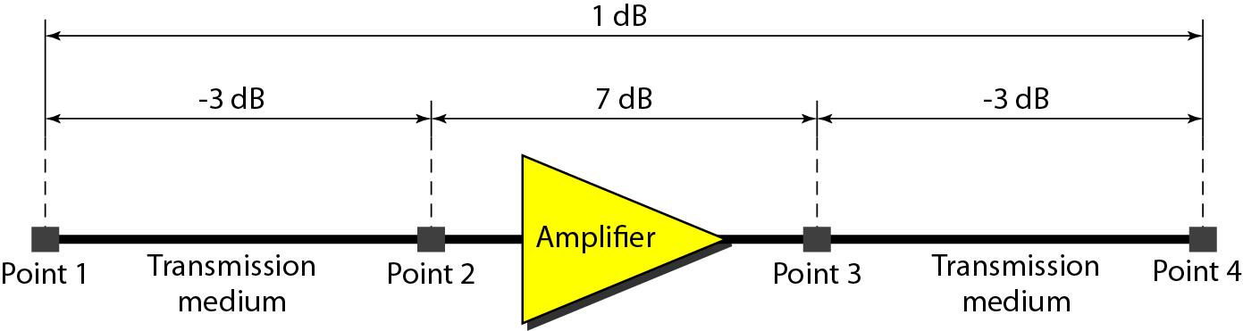
Figure 3.27 Decibels for Example 3.28

Slide 62
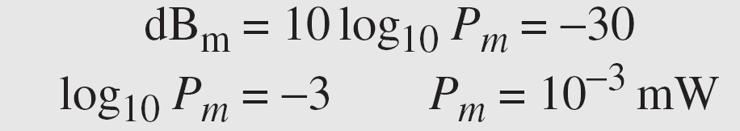
Example 3.29
Sometimes the decibel is used to measure signal power in milliwatts. In this case, it is referred to as dB_{m} and is calculated as dB_{m} = 10 log10 P_{m} , where P_{m} is the power in milliwatts. Calculate the power of a signal with dB_{m} = −30.
Solution
We can calculate the power in the signal as

Slide 63
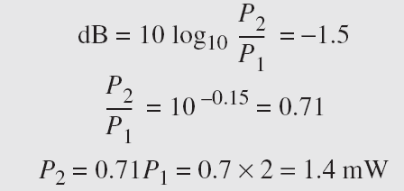
Example 3.30
The loss in a cable is usually defined in decibels per kilometer (dB/km). If the signal at the beginning of a cable with −0.3 dB/km has a power of 2 mW, what is the power of the signal at 5 km?
Solution
The loss in the cable in decibels is 5 × (−0.3) = −1.5 dB. We can calculate the power as

Slide 64
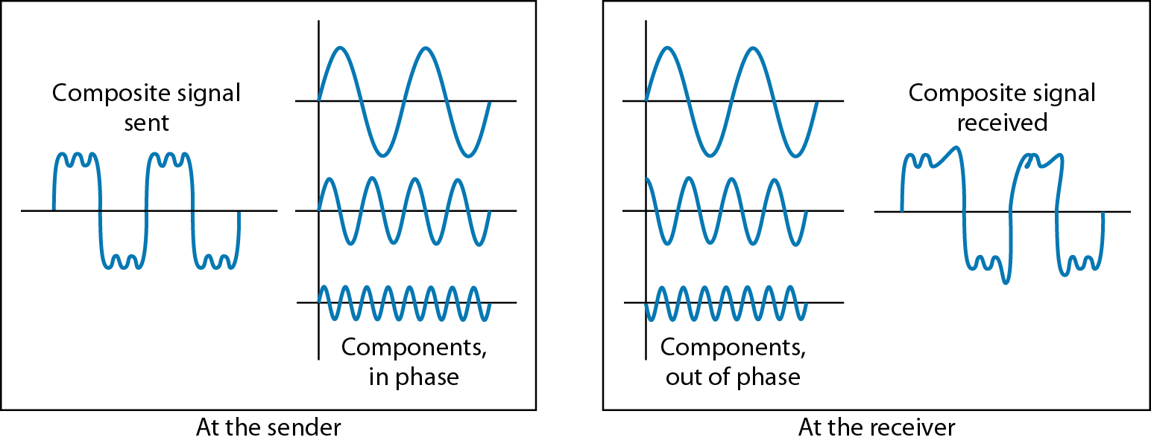
Figure 3.28 Distortion (the second impairment)

Slide 65
Distortion (Continued)
Distortion:
Distortion means that the signal changes its shape or form.
It can occur in composite signal made of different frequencies.
Each frequency has its own propagation speed through a medium and therefore its own delay in arriving at the final destination.
Delay changes the phase, therefore signals are distorted.

Slide 66
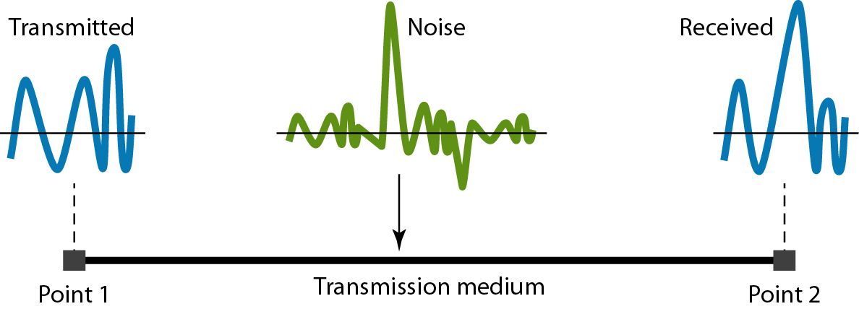
Figure 3.29 Noise (the third impairment)

Slide 67
Noise (Continued)
It is another cause of impairment.
Several types of noise such as thermal noise, induced noise, crosstalk noise, impulse noise may corrupt the signal.

Slide 68
Types of Noise
White Noise:
It is also called thermal noise or Gaussian noise. It is a continuous type of noise. It is always present to some degree and it dependent on the temperature of the medium. As temperature increases, level of noise increases. It can be significantly reduced but never be eliminated. It can be removed if signal passes through a regenerator before noise overwhelms original signal or passing the noisy signal through filters.
Impulse Noise:
It is a non-continuous noise and occur randomly. The noise is analog burst of energy. It can interfere both with analog and digital signals and often the original signal can’t be removed.

Slide 69
Types of Noise (Continued)
Crosstalk:
It is unwanted coupling between two different signal paths. This coupling can be electrical or electromagnetic. High humidity and wet weather increases the possibility of crosstalk..
Echo:
It is reflective feedback of transmitted signal as the signal moves through a medium. This occurs most often at junctions where wires are connected or at open end.

Slide 70
Example 3.31
The power of a signal is 10 mW and the power of the noise is 1 μW; what are the values of SNR and SNR_{dB} ?
Solution
The values of SNR and SNRdB can be calculated as follows:

Slide 71
Example 3.32
The values of SNR and SNRdB for a noiseless channel are
We can never achieve this ratio in real life; it is an ideal.

Slide 72
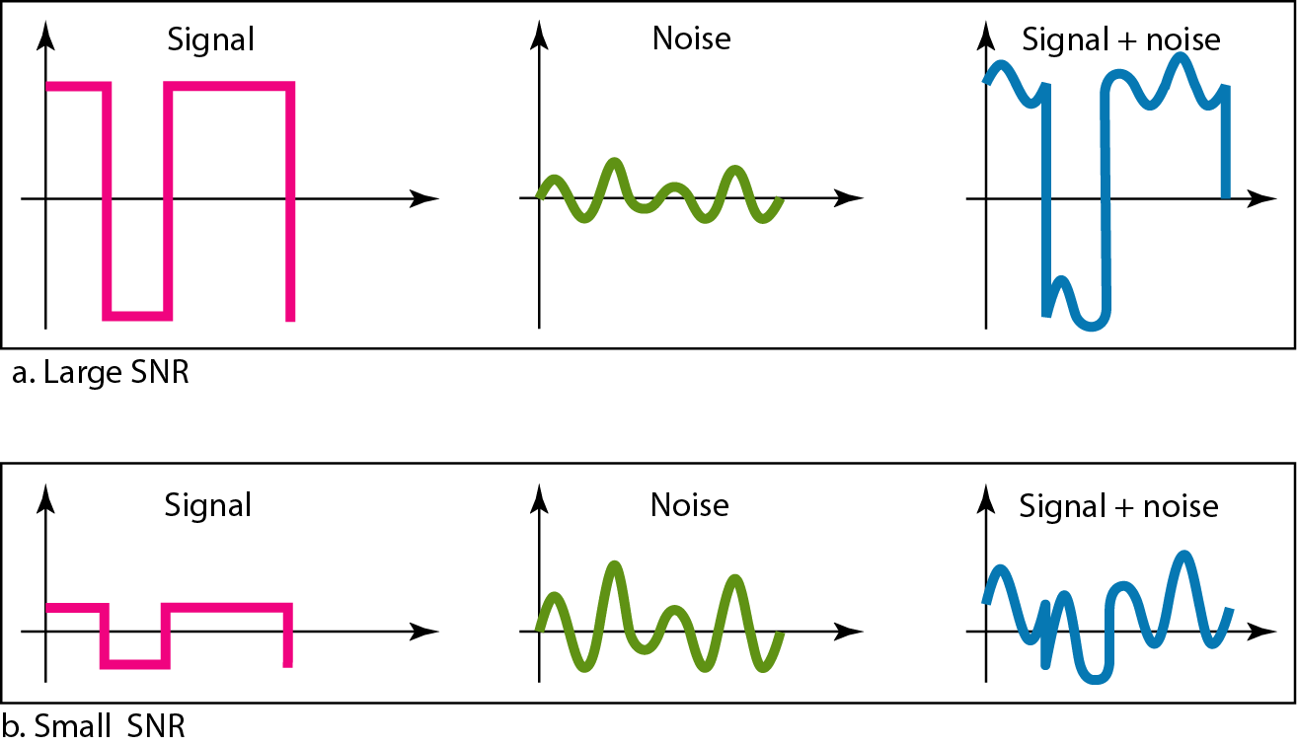
Figure 3.30 Two cases of SNR: a high SNR and a low SNR

Slide 73
3-5 DATA RATE LIMITS
A very important consideration in data communications is how fast we can send data, in bits per second, over a channel. Data rate depends on three factors:
1. The bandwidth available
2. The level of the signals we use
3. The quality of the channel (the level of noise)
Topics discussed in this section:
Noiseless Channel: Nyquist Bit Rate Noisy Channel: Shannon Capacity Using Both Limits

Slide 74
Note
Increasing the levels of a signal may reduce the reliability of the system.

Slide 75
Channel Capacity
Data rate
In bits per second
Rate at which data can be communicated
Bandwidth
In cycles per second of Hertz
Constrained by transmitter and medium
Baud rate
Frequency with which the components change

Slide 76
BPS vs. Baud
Data rate rarely the same as baud rate
Examples:
TDC 361

Slide 77
Channel Capacity
Nyquist
Maximum data rate of a noiseless channel =
2 * F * log₂(L) bps
Where F = frequency
L = the number of discrete levels
Example: F = 4000 Hz, L = 2

Slide 78
Example 3.34
Consider a noiseless channel with a bandwidth of 3000 Hz transmitting a signal with two signal levels. The maximum bit rate can be calculated as

Slide 79
Example 3.35
Consider the same noiseless channel transmitting a signal with four signal levels (for each level, we send 2 bits). The maximum bit rate can be calculated as

Slide 80
Example 3.36
We need to send 265 kbps over a noiseless channel with a bandwidth of 20 kHz. How many signal levels do we need?
Solution
We can use the Nyquist formula as shown:
Since this result is not a power of 2, we need to either increase the number of levels or reduce the bit rate. If we have 128 levels, the bit rate is 280 kbps. If we have 64 levels, the bit rate is 240 kbps.

Slide 81
Channel Capacity
Shannon (which includes noise)
Maximum data rate (in bps) = B x log₂(1 + S/N)
B = bandwidth, or frequency
S = signal power in watts
N = noise power in watts (S/N = SNR)
Example: B = 3400 Hz, S = 0.2 w, N = 0.0002 w
Max data rate = 3400 x log₂(1 + 1000)
= 3400 x 9.97
= 33898 bps

Slide 82
Example 3.37
Consider an extremely noisy channel in which the value of the signal-to-noise ratio is almost zero. In other words, the noise is so strong that the signal is faint. For this channel the capacity C is calculated as
This means that the capacity of this channel is zero regardless of the bandwidth. In other words, we cannot receive any data through this channel.

Slide 83
Example 3.38
We can calculate the theoretical highest bit rate of a regular telephone line. A telephone line normally has a bandwidth of 3000. The signal-to-noise ratio is usually 3162. For this channel the capacity is calculated as
This means that the highest bit rate for a telephone line is 34.860 kbps. If we want to send data faster than this, we can either increase the bandwidth of the line or improve the signal-to-noise ratio.

Slide 84
Example 3.39
The signal-to-noise ratio is often given in decibels. Assume that SNR_{dB} = 36 and the channel bandwidth is 2 MHz. The theoretical channel capacity can be calculated as

Slide 85
Example 3.41
We have a channel with a 1-MHz bandwidth. The SNR for this channel is 63. What are the appropriate bit rate and signal level?
Solution
First, we use the Shannon formula to find the upper limit.

Slide 86
Example 3.41 (continued)
The Shannon formula gives us 6 Mbps, the upper limit. For better performance we choose something lower, 4 Mbps, for example. Then we use the Nyquist formula to find the number of signal levels.

Slide 87
Note
The Shannon capacity gives us the upper limit; the Nyquist formula tells us how many signal levels we need.

Slide 88
Note
In networking, we use the term bandwidth in two contexts.
❏ The first, bandwidth in hertz, refers to the range of frequencies in a composite signal or the range of frequencies that a channel can pass.
❏ The second, bandwidth in bits per second, refers to the speed of bit transmission in a channel or link.

Slide 89
Example 3.42
As the bandwidth increases, so too can the data rate.
Stated another way, to transmit a high data rate, we need a wide bandwidth.
OR
We need to use a signaling technique that has a high number of signal levels.
The bandwidth of a subscriber line is 4 kHz for voice or data. The bandwidth of this line for data transmission
can be up to 56,000 bps using a sophisticated modem to change the digital signal to analog.

Slide 90
Example 3.43
If the telephone company improves the quality of the line and increases the bandwidth to 8 kHz, we can send 112,000 bps by using the same technology as mentioned in Example 3.42.

Slide 91
Performance
Throughput:
When used in the context of communication networks, such as Ethernet or packet radio, throughput or network throughput is the rate of successful message delivery over a communication channel.
Throughput is usually measured in bits per second (bit/s or bps), and sometimes in data packets per second (p/s or pps) or data packets per time slot.
Jitter
Jitter, in networking, refers to small intermittent delays during data transfers. It can be caused by a number of factors including network congestion, collisions, and signal interference. Technically, jitter is the variation in latency — the delay between when a signal is transmitted and when it is received. All networks experience some amount of latency,
It is a problem if different packets of data encounter different delays and the application using the data at the receiver site is time sensitive.

Slide 92
Performance(continued)
Bandwidth
Bandwidth describes the maximum data transfer rate of a network or Internet connection. It measures how much data can be sent over a specific connection in a given amount of time. For example, a gigabit Ethernet connection has a bandwidth of 1,000 Mbps (125 megabytes per second). An Internet connection via cable modem may provide 25 Mbps of bandwidth.
While bandwidth is used to describe network speeds, it does not measure how fast bits of data move from one location to another. Since data packets travel over electronic or fiber optic cables, the speed of each bit transferred is negligible. Instead, bandwidth measures how much data can flow through a specific connection at one time.

Slide 93
Performance(continued)
Latency:
Latency= propagation time + transmission time + queuing time + processing delay
Processing Time:
Propagation time= Distance/ (Propagation speed)
Transmission Time:
Propagation time= (Message Size)/ Bandwidth.
Queuing Time:
The time needed for each intermediate or end device to hold the message before it can be processed. It depends on the load imposed on the network.

Slide 94
Performance(continued)
Processing Delay:
Processing delay is the time it takes router to process the packet header.
Transmission Time:
Propagation time= (Message Size)/ Bandwidth.
Queuing Time:
The time needed for each intermediate or end device to hold the message before it can be processed. It depends on the load imposed on the network.
Processing Delay:
Processing delay is the time it takes router to process the packet header.

Slide 95
Review Questions
What is a composite signal?
How do you calculate a dB?
How do you calculate signal to noise ratio?
How do you read/create a frequency domain representation?
What is a dc component?

Slide 96
Review Questions
How do you use the Nyquist formula?
4000 Hz, 8 signal levels, data rate?
50,000 bps data rate, 4000 Hz, how many signal levels?
How do you use the Shannon formula?
8000 Hz, signal power = 20w, noise power = 0.002w, what is the data rate?
5000 Hz, signal power = 50w, data rate = 20000bps, what is the possible noise power?

