Slide 1

Humberto “Bert” Bello
20+ years of Architecture and Engineering practice delivering customer-facing digital experiences, integration, security and enterprise scale modernization.
15+ years leading global engineering teams in agile environments with end-to-end delivery accountability.
GDPR, HIPAA, SOX, SOC,
Hands-on experience in Gen AI and Agentic patterns, event-driven architectures, legacy platform modernization , cloud-native engineering (AWS, GCP, Azure), security and UI/UX standards.
Authorized for work in the United States without sponsorship. (US Citizen)

Slide 2
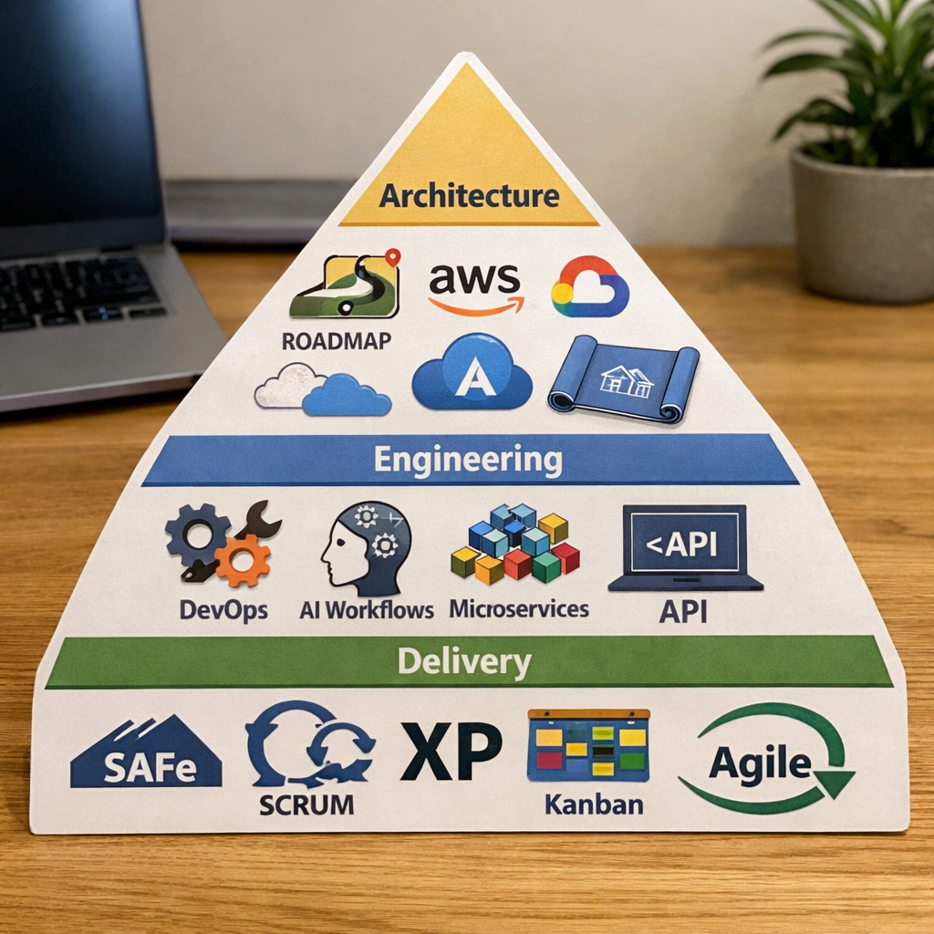
Professional Skills

Slide 3
Selected Experience
Scaled engineering teams from 8 → 20 across 3 countries; ran 34 sprints and 3 PI Plannings (EFX). Lead product roadmap and governance partnering with Stakeholders and supporting organizations: Architecture Team, InfoSec, Engineering.
Implemented API mgmt and produced security guardrails for microservices controlling surgical devices (K8s, Istio, Apigee, Spring Boot, Kafka).
Built a RAG engine (LangChain, Python, React, Azure OpenAI, Zilliz) for Leasing Contract Management productivity. Produced a serverless version for AWS (Bedrock, Lambda, Amazon OpenSearch, S3)
Modernized, re-built and standardized the middleware and portal that handled the Mobile Wireless service provisioning at the largest MVNO in the USA, scaling from $6M Subscriber to $19M and eight (8) different brands.
FISERV: Provided solution architecture and design to event processing requirements for a real time payment network, produced integrating with OpenBanking Customer APIs.
5th3rd bank: Technical leader, designed & implemented integration and service layer to support personal Banking Mobile Wallet of 2.4 million monthly mobile banking users. (AWS + Microservices + Event Streaming)

Slide 4

Selected clients & Employers

