Slide 1
Quantitative Analysis of BGP Route Leaks
Benjamin Wijchers Benno Overeinder

Slide 2
The Problem With Route Leaks
Route leaks are not route hijacks (in my definition)
route hijack: originate prefixes you do not “own”
route leaks: forward BGP announcements you shouldn’t according policies
Route leaks not easy to detect
Potential security risk
examples Belarusian and Iceland traffic misdirection

Slide 3
Business Relations and Route Leaks
ASes have business relationship
Client pays provider
Provider provides transit
Peers share client routes
Routing should reflect business relations
But in practice not always the case
Route leak

Slide 4
The Valley Free Rule
Relations between ASes:
Customer-provider
Peer-peer
Siblings
Valley Free Rule:
C2P(*) – P2P (1|0) – P2C (*)

Slide 5
The Valley Free Rule

Slide 6
Origins of Route Leaks
Misconfiguration
Malicious
Man in the middle
Intentional
Indirect peering
IXP
Research / Educational
Complex relations
Find characteristics for categorizing

Slide 7
Why Analyse Them?
Counter-measures planned
part of ongoing IETF SIDR WG activities
discussions in the context of BGPSEC
Traffic routes incorrectly causing:
ASes paying for transit of other ASes clients
Potentially slower connections
Potential hijacking of data (mitm)
Not much statistics available

Slide 8
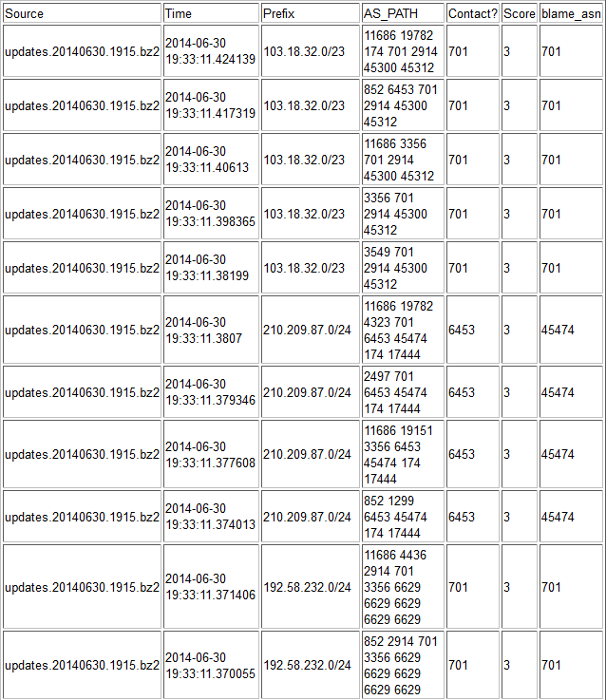
Previous Work
Jared Mauch
Detection without relation data
Not much statistics
List of route leaks
General counts

Slide 9
Detecting Valleys
Relations between ASes
Non-disclosure agreement
Inferred relations
BGP data dumps to investigate
RIPE Remote Route Collector
RouteViews
ASPATH attribute
Shows path of ASes traversed

Slide 10
Relation Inferences
Lixin Gao
Valley free rule
Ricardo Oliveira et al (UCLA)
Every non-tier-1 AS is (indirect) client (or peer) of tier-1
Matthew Lucky et al (CAIDA)
C2P to reach global connectivity
Peering clique at top of topology
No cycles of C2P links
CAIDA chosen for project
Validation of relations
No valley freeness used in inference

Slide 11
Methodology
CAIDA relationship data
Combined with siblings data
BGP MRT files from
RIPE RIS RRC00
Routeviews WIDE
Routeviews Oregon
Custom BGPdump
Detecting valleys

Slide 12
Methodology (2)
All valleys in database with
violation type
e.g. P2C-C2P
AS Leak triplet
leaked from, leaker and receiver
duration
check updates for same AS & prefix

Slide 13
About the results
Current results from 1 month from RIPE, Oregon and WIDE
~4% of routes investigated valley
Over 36 000 000 valley announces detected

Slide 14
Distribution of Violation Types
Top left area are no real valleys
P2P-P2P occurs most frequently
Notes:
17,6 % siblings

Slide 15
Distribution of Durations
Peaks at <2 seconds and 17-32 seconds
Default MRAI Cisco: 30 seconds
Probably unintentional

Slide 16
Most Frequent Leak Triplets
Duration > 1 minute
~12% of valleys found in top 10
Next challenge
categorize in classes

Slide 17
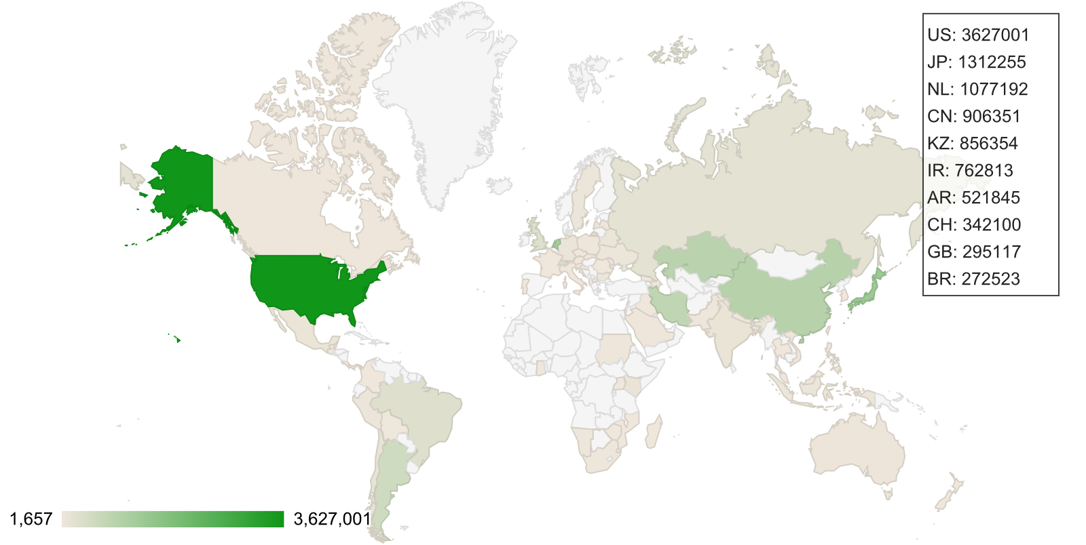
Geography of Most Frequent Leaks

Slide 18
Top Leaks Further Investigated
WIDE appears to provide transit for peer APNIC
APAN, WIDE and APNIC are all research ASes
who commonly have “special” relationships
Likely intentional behaviour

Slide 19
Top Leaks Further Investigated
Both AS12880 and AS48159 from Iran
possible merge -> sibling
cannot say for certain with data available
WHOIS AS12880 no mention of AS48159
WHOIS AS48159 mentions AS12880 as default route

Slide 20
Top Leaks Further Investigated
Different policies IPv4 and IPv6
mp-import: afi ipv6.unicast from AS6939 action pref=150; accept ANY
mp-import: afi ipv4.unicast from AS6939 action pref=150; accept AS-HURRICANE

Slide 21
Conclusion
Most route leaks are peer routes propagated to other peers
~65% valleys are very short-lived (< minute)
but ~6% very persistent (> day)
About 12% AS triplets reoccur frequently in found route leaks
most of them “special” relations
not enough knowledge to define others

Slide 22
Future Work
Broader date range
monthly reports, history with less storage
Separate relation data IPv4/IPv6
RPSL data usage for automatic detection of complex relations

Slide 23
Questions
Acknowledgments
Jared Mauch
Stella Vouteva

