Slide 1
From the original kMC to kmc3d
The Li plating rate as a worked example: same mechanism, physical units, statistics
Sweep of the plating exchange rate k0 (+-50 %) in the Li-metal half cell: 9 values x 10 seeds x 140 cycles
Carlos Guerrero Navarro
Department of Chemical Engineering, Texas A&M University
Supervisor: Dr. Perla B. Balbuena | Battery500
Draft v1, October 2026. Ageing sweeps (A_SEI = 100 and 10) running on GRACE; their slides are placeholders.
Notes:
Objetivo de la charla: cerrar el uso del motor original con el barrido de plating como ejemplo y mostrar que el motor nuevo hace lo mismo con unidades reales y estadistica.

Slide 2
CONTEXT
What was asked, and what this talk answers
The request
What we had
What is new
Vary the plating prefactor by +-50 % around the reference and quantify its effect on SEI formation, dead Li and efficiency.
Two sweeps with the original C++ engine (k_p 1e-4 to 0.025 and 0.0006 to 0.0015): one trajectory per value, model units, no error bars, a 'reference' with no physical meaning.
Same lattice, same mechanism, same rules. Four kinetic constants replaced by referenced values. k0 is now j0 in mA/cm2, time is seconds, the box has a current density. 10 seeds per value.
Part 1. The original engine as the antecedent: what the two earlier sweeps showed and why the efficiency behaved as it did.
Part 2. Same engine, physical constants: how every number was put in real units (the hardest part, so it gets three slides).
Part 3. The +-50 % sweep at real rates: current, side reactions, SEI, bound Li, efficiency, sensitivity with p-values.
Part 4. Bridge between the two: one model, two regimes (per-event chemistry vs accumulated ageing). Ageing sweeps in progress.
Part 5. Limits, decisions needed, and where this goes (the full Li-S cell).
2
Notes:
Resumen del guion. Insistir en que no hay dos modelos sino uno con dos juegos de constantes.

Slide 3
PART 1 · ORIGINAL ENGINE
Antecedent: the original engine and the two k_p sweeps
 | Wide sweep (deck 1) | Narrow sweep (deck 2)
k_p values | 1e-4 to 0.025 (three shown) | 0.0006 to 0.0015, ten values
Trajectories per value | 1 | 1
Cycles | 140 | 140
Units of k_p | model units (MOBILITY / DECOMPOSITION) | model units; 'no direct conversion to a current'
Main finding | below the reference the system is SEI-dominated; plating saturates above 0.025 | salt breakdown -15 to -17 %, SEI thickness minimum near 0.0009, CE +1.6 points
Average CE | falls after ~100 cycles at low k_p | 92.3 to 94.3 %
Dead Li | cumulative 'plating through SEI' up to 1600 events | buried Li increases, no simple ordering
Both decks used the same lattice, mechanism and cycling protocol that kmc3d reproduces byte for byte.
Their value: they showed the ageing mechanism of the model (SEI accumulates, Li gets bound, CE falls) and which reactions respond to k_p.
Their limit: without seeds the +-50 % differences (a few percent) are inside the trajectory noise, and nothing could be compared with an experimental current.
3
Notes:
Reconocer el trabajo previo (con Brandy). Lo que faltaba: repeticiones y unidades.

Slide 4
PART 1 · ORIGINAL ENGINE
Why the original efficiency started below 100 % and fell after ~100 cycles
charge half-cycle (50 events) | plating | plating on SEI | FSI | SFO | SOL | SOL2
cycle 1 (validation run, k0 1e-4 : 1e-4) | 23 | 2 | 21 | 2 | 3 | 0
cycle 50 | 4 | 7 | 5 | 14 | 1 | 20
A small third effect: Li surface diffusion jumps (1 to 3 per discharge half) consumed part of the 50-event budget, so slightly less Li was stripped than plated.
Both processes exist in kmc3d; what changes is their rate, and now the rate is referenced.
Process 1: per-event chemistry
Process 2: accumulation
With the salt constant equal to the plating constant, the salt wins the electron lottery as often as Li from cycle 1. At k_p = 1e-3 (production) about one electron in twelve went to the SEI every cycle: that is the 92 to 94 % average. Not ageing, a fixed split.
SEI piles up ~500 times faster than at real rates. By ~100 cycles the surface is covered, Li next to SEI is bound (cannot strip) and the stripping half delivers less than the plating half: the CE falls. Real mechanism, compressed time axis.
4
Notes:
Numeros tomados del Data2Excel de la corrida original de referencia. La CE menor a 100 desde el ciclo 1 es el reparto de electrones, no envejecimiento.

Slide 5
PART 2 · PHYSICAL CONSTANTS
Same engine, same mechanism: what is identical and what changed
Identical (validated byte for byte)
constant | original | kmc3d (physical) | source
plating / stripping | k_p 1e-3 (model) | Butler-Volmer, k0 = 74 s^-1 per site = j0 29.8 mA/cm2, alpha 0.5, eta +-30 mV | Boyle 2020 (j0); eta working choice [P]
FSI, SFO, SOL | 1e-4, 1e-6, 2e-6 | 1.118, 0.0112, 0.0147 s^-1 per adjacent site | anchored to CE 99.8 % (Yu 2022), original ratios kept
SOL2 (F5DEE on Li2O) | kT/h, Ea 0.364 eV | anchored to SOL, Ea 0.364 eV as relative attenuation | Tan 2024 (barrier)
Li accounting | infinite foil | finite anode + shared Li+ pool, li_total constant | conservation check every half
Lattice: 10 x 10 x 30 cubes of 4.0 A, 16 sites per cube, Li slab of 20 A in the centre, electrolyte LiFSI / F5DEE on both faces.
Species: Li, FSI, SOL, ETH and the fragments F, O, N, S, SFO, F5D.
Reaction network: FSI reduction, SFO step, F5DEE reduction (SOL), F5DEE on Li2O (SOL2), F5D.
Pair energies of MOBILITY.in (group values, never modified).
Protocol: charge at 4.4 V and discharge at 2.8 V, each half closed by a 50-event budget. 140 cycles.
kmc3d run with the original inputs reproduces the original event sequence exactly.
Everything else in the engine is untouched. The sweep itself is only a set of input decks: no engine change.
5
Notes:
Frase clave: mismo motor, mismo mecanismo, mismo conteo; solo cambian cuatro constantes y cada una tiene referencia.

Slide 6
PART 2 · PHYSICAL CONSTANTS
Units, step 1: from a measured exchange current to a rate per site
j0 = 29.8 mA/cm2
x A_site = (2.0 A)^2 = 4e-16 cm2
/ e = 1.602e-19 C
k0 = 74 s^-1 per site
x exp(alpha eta / kT) = 1.79
k_plate = 133 s^-1 per growth site
>
>
>
>
>
exchange current density of Li in LiFSI / ether (Boyle et al. 2020, Table 1)
area of one surface site of the lattice
one electron per Li
bv_k0_site in PARAMETERS.in
Butler-Volmer at eta = 30 mV, alpha 0.5, 298 K
the number the kMC uses in the event lottery
The sweep moves k0 between 37 and 111 s^-1 per site, i.e. j0 between 15 and 45 mA/cm2: the range that separates a regular from a good electrolyte in Boyle's table. +-50 % is a comparison between electrolytes, not an arbitrary knob.
In Butler-Volmer k0 is the exchange rate: it sets plating AND stripping. 'Plating faster at fixed electrolyte' would be a sweep of the overpotential eta instead (same tool, --param eta_charge).
What is still a working choice: eta = +-30 mV, tagged [P] until the group's Li||Cu polarisation data fixes it.
6
Notes:
Esta es la lamina del 'como se pusieron las unidades'. Recorrer la cadena de izquierda a derecha.

Slide 7
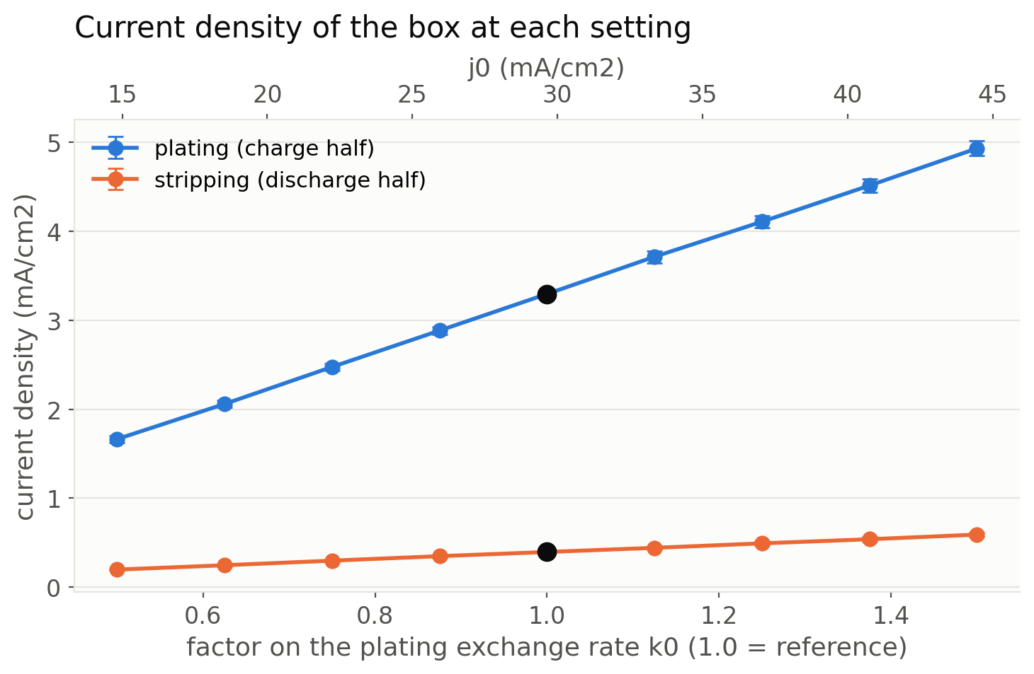
PART 2 · PHYSICAL CONSTANTS
Units, step 2: the kMC clock gives the box a real current density
Gillespie clock: dt = -ln(u) / W. With rates in 1/s the time is in seconds. In the original it was also 'seconds', but of a clock whose rates were relative numbers.
Charge half at the reference: 50 Li plated in 0.0078 s over 2 x (40 A)^2 = 3.2e-13 cm2 gives j = 50 e / (dt A) = 3.3 mA/cm2. Nobody typed that number in; it falls out of the model and sits in the experimental window (0.2 to 5 mA/cm2 in Zhang 2024).
It scales exactly with k0 (1.66, 3.30, 4.93 mA/cm2): expected, and the proof that the unit chain is consistent.
Stripping is slower (0.2 to 0.6 mA/cm2): only the least-coordinated Li strip at full rate, the rest are attenuated by the pair energies of MOBILITY.in. Model physics, not an error.
F01. Current density of the 4 x 4 nm box, both faces, from the kMC clock. 10 seeds, error bars = sd.
7
Notes:
El numero 3.3 mA/cm2 depende del sobrepotencial de 30 mV (pendiente). Decirlo antes de que lo pregunten.

Slide 8
PART 2 · PHYSICAL CONSTANTS
Units, step 3: side reactions anchored to the measured efficiency
The anchor
How it was done
FSI and F5DEE reduction on Li are barrierless (Tan 2024), so their bare rates would consume the electrolyte at once; the effective rate is SEI-limited (Boyle 2020). We anchor the family to an observable: CE = 99.8 % for LiFSI / F5DEE (Yu 2022) means 2 Li lost per 1000 plated.
Measured in the model: 2.7 fragments per primary event and 2.1 Li ionised (bound) per fragment. Solved for the family (FSI : SFO : SOL ratios of the original kept) so that Li bound per Li plated = 0.002. Result: FSI 1.118, SFO 0.0112, SOL 0.0147 s^-1 per adjacent site.
Consequence at real rates
Honest caveat
Side reactions are rare: 0.24 per 1000 plating events at the reference, 1 or 2 salt reductions in 110 cycles of a 4 x 4 nm box, 3 SEI sites, 5 bound Li. Thickness in A is real (lattice 4.0 A) but a visible SEI needs either many real cycles or a declared acceleration factor A_SEI.
In this half cell the bound Li per 1000 plated comes out 0.8, not 2: the anchoring was made on the full-cell geometry and the ratio depends on growth sites vs salt contacts. The sweep (relative changes) is unaffected; a per-geometry re-anchoring is a decision for the group.
8
Notes:
La diferencia 0.8 contra 2 es geometria, no error; decision pendiente.

Slide 9
PART 3 · SWEEP AT REAL RATES
Sweep design: nine values, ten seeds, two regimes
sweep | base case | k0 factors | seeds | cycles | regime | status
A | anode_physical (A_SEI = 1) | 0.5 to 1.5 in steps of 0.125 (9) | 10 | 140 (window 10 to 110) | per-event chemistry | done, 90 runs
B | anode_physical_A100 | 0.5, 0.75, 1, 1.25, 1.5 | 5 | 500 | accelerated ageing | running
C | anode_physical_A10 | 0.5, 1, 1.5 | 5 | 3000 | slow ageing, 1/A test | running
Everything the ledger records per half-cycle is kept: events of every type (plating, stripping, FSI, SFO, SOL, SOL2, F5D, surface diffusion), SEI sites and composition, Li bound to SEI, roughness, kMC time. The last xyz frame gives buried Li, film extent and porosity.
Half-cycles close by an event budget, so CE_cycle (stripped / plated) is fixed by the budget while Li is available. The CE that carries the physics is plating / (plating + side reactions); CE_cycle becomes informative only when the anode starts to fail (sweeps B and C).
Statistics: per value mean +- sd over seeds; across values a linear fit (% change per +50 %), a power-law exponent, p-values and a Welch test lowest vs highest.
Common random numbers: the same seeds are used at every k0, so trajectories are identical until the first side event differs. This reduces the noise of the differences.
9
Notes:
Explicar el truco de las semillas comunes y por que la CE del presupuesto no sirve en el regimen 1.

Slide 10
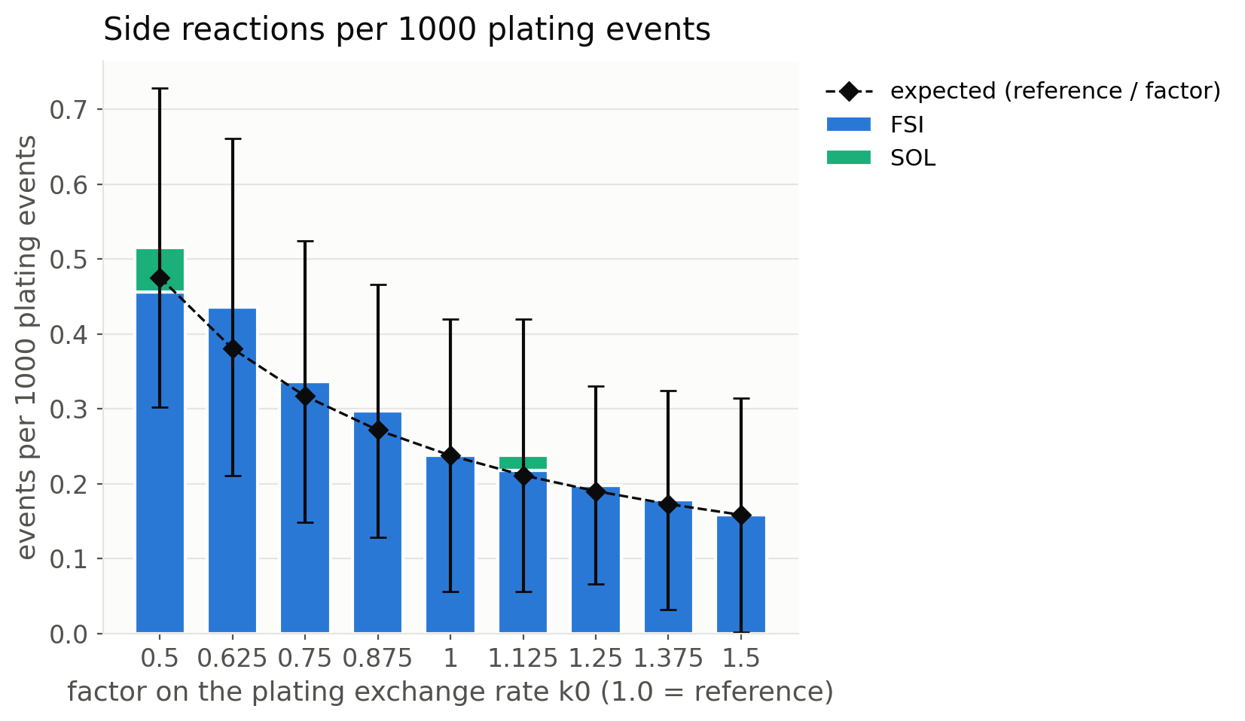
PART 3 · SWEEP AT REAL RATES
Result 1: side reactions per 1000 plating events scale as 1 / k0
0.52, 0.24 and 0.16 events per 1000 plating at k0 x 0.5, 1 and 1.5. Power-law exponent -1.08 +- 0.04: the electron lottery exactly as expected when side reactions only compete with plating.
Only the salt channel (FSI) fires. Solvent reduction ~0, SFO and SOL2 zero at real rates in 110 cycles.
Raw counts behind the normalised bars, per run (110 cycles, ~5500 Li plated): FSI 2.6, 1.5, 0.8 events at the three k0; the original had hundreds. Same counting, constants thousands of times smaller.
Significance: p = 7e-8 across 90 runs; Welch lowest vs highest p = 6e-4. Within one value the seed-to-seed sd is as large as the mean (Poisson statistics of 1 or 2 events), which is why one trajectory per value could never show +-50 %.
F02. Stacked by channel; black diamonds = reference / factor. Window cycles 10 to 110, 10 seeds per value.
10
Notes:
Lamina central. El exponente -1 es la prueba de que es competencia pura.

Slide 11
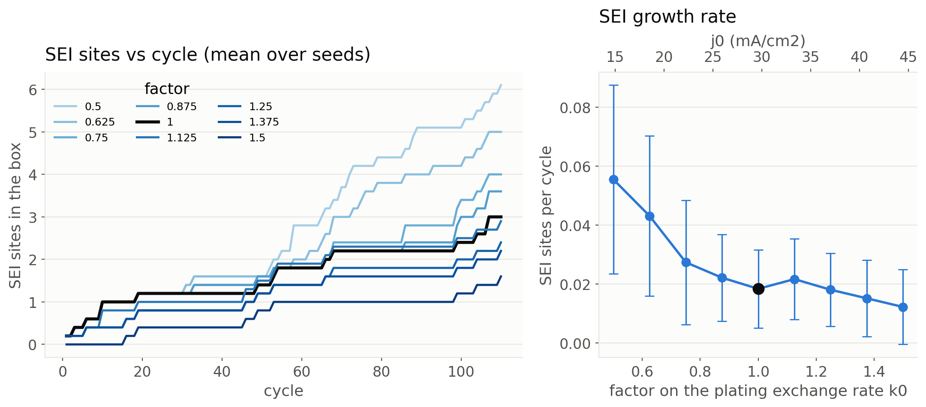
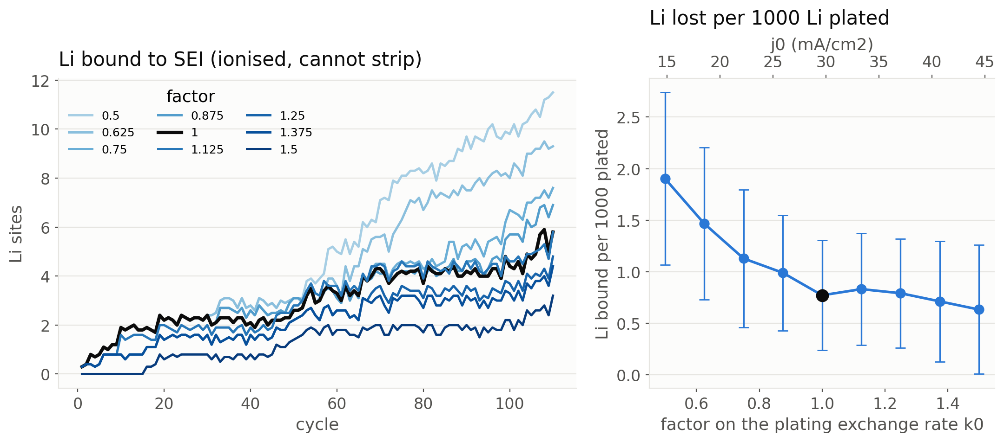
PART 3 · SWEEP AT REAL RATES
Result 2: SEI growth and Li bound to SEI follow the same law
SEI growth 0.056, 0.018, 0.012 sites per cycle (exponent -1.27 +- 0.12). Three SEI sites after 110 cycles at the reference: at real rates the SEI of a 4 nm patch is a few sites, consistent with the scale analysis (one box cycle moves half an atomic layer).
Li bound to SEI (ionised, cannot strip; the model's proxy for dead Li): 1.9, 0.77, 0.63 per 1000 plated (exponent -0.95 +- 0.08). It is the quantity that transfers to a real anode: Li lost per Li plated at a given current.
Composition is 50 % inorganic (F) and 50 % organic (SFO, F5D) at every k0: k0 changes how much SEI, not what it is made of.
11
Notes:
F03 arriba (SEI contra ciclo y tasa), F06 abajo (litio ligado contra ciclo y perdida por 1000 depositados).

Slide 12
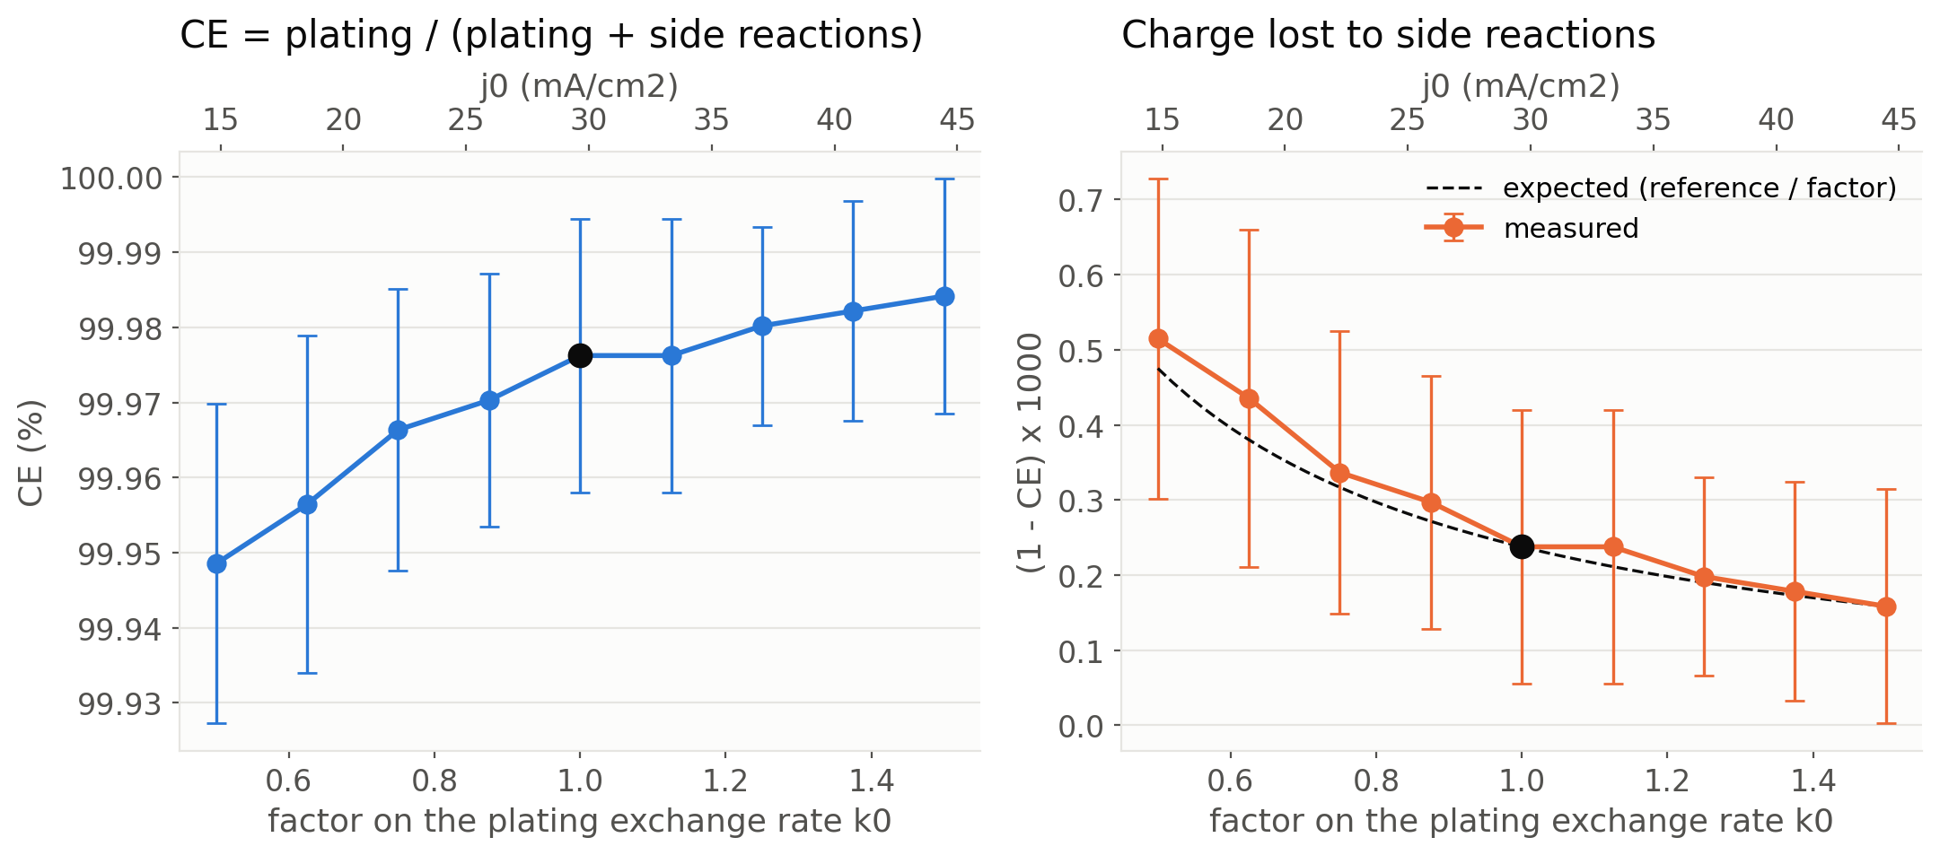
PART 3 · SWEEP AT REAL RATES
Result 3: coulombic efficiency in the chemistry regime
99.95 % at k0 x 0.5, 99.976 % at the reference, 99.984 % at x 1.5. Flat with cycling: at real rates nothing ages in 110 cycles, which is what Li||Cu experiments with this electrolyte show (99.8 % flat for hundreds of cycles).
The original's 92 % and its fall at ~100 cycles are not contradicted: they belong to the accelerated regime (next part).
Absolute differences are small (0.03 points over the sweep) but resolved: 90 runs, p = 7e-8.
F07. CE = plating / (plating + side reactions); right: charge lost per thousand with the 1 / factor expectation.
Note on definitions: with half-cycles closed by an event budget, CE_cycle = stripped / plated is 1.00 by construction while strippable Li exists (it even reads 1.02 when one of the 50 charge events was a salt reduction). It only becomes a failure indicator when the anode cannot deliver, which is what sweeps B and C look at.
12
Notes:
Insistir: dos definiciones de CE, cada una sirve en un regimen.

Slide 13
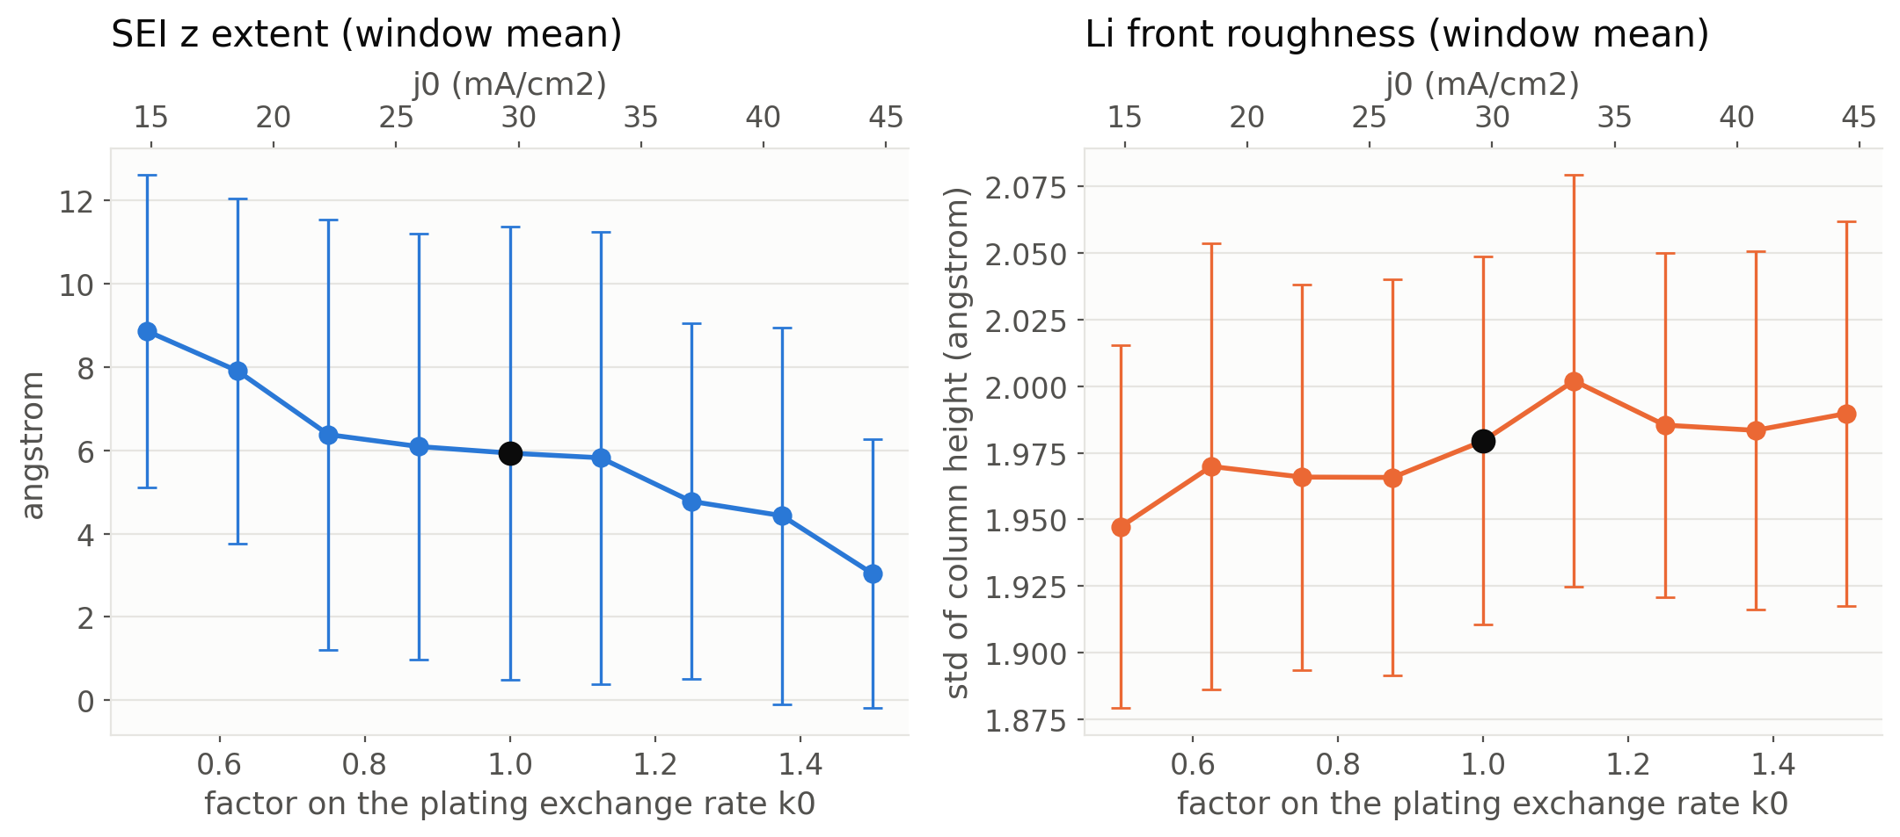
PART 3 · SWEEP AT REAL RATES
Result 4: what does NOT change, and why that is a result
Roughness, buried Li (zero in all 90 runs), SEI composition and the porosity profile are insensitive to k0.
Reason: at fixed overpotential k0 only scales the clock and the competition with side reactions; the plating site is chosen at random among growth sites, and Li surface diffusion never fires (0 events in 90 runs).
In the original k_p DID change morphology because it competed with surface diffusion at comparable rates (0.001 vs 0.56). In the physical case plating is 133 s^-1 per site while LiSurface kept its model value 0.56: the one anode rate still in model units.
Decision for the group: calibrate Li surface diffusion (DFT barriers 0.04 to 0.15 eV on Li faces, Jackle and Gross 2014, 2018; 0.1 to 0.3 eV on LiF, Li2O, Li2CO3, Ozhabes et al. 2015) and handle the time-scale gap (10^10 hops per plated atom) with a relaxed-surface rule rather than brute force.
F05. SEI z extent and Li front roughness vs k0. Roughness 1.95 to 1.99 A across the sweep (p = 0.10).
13
Notes:
Decir con claridad: este barrido es de quimica, no de morfologia. La difusion superficial es la decision pendiente mas importante para morfologia.

Slide 14
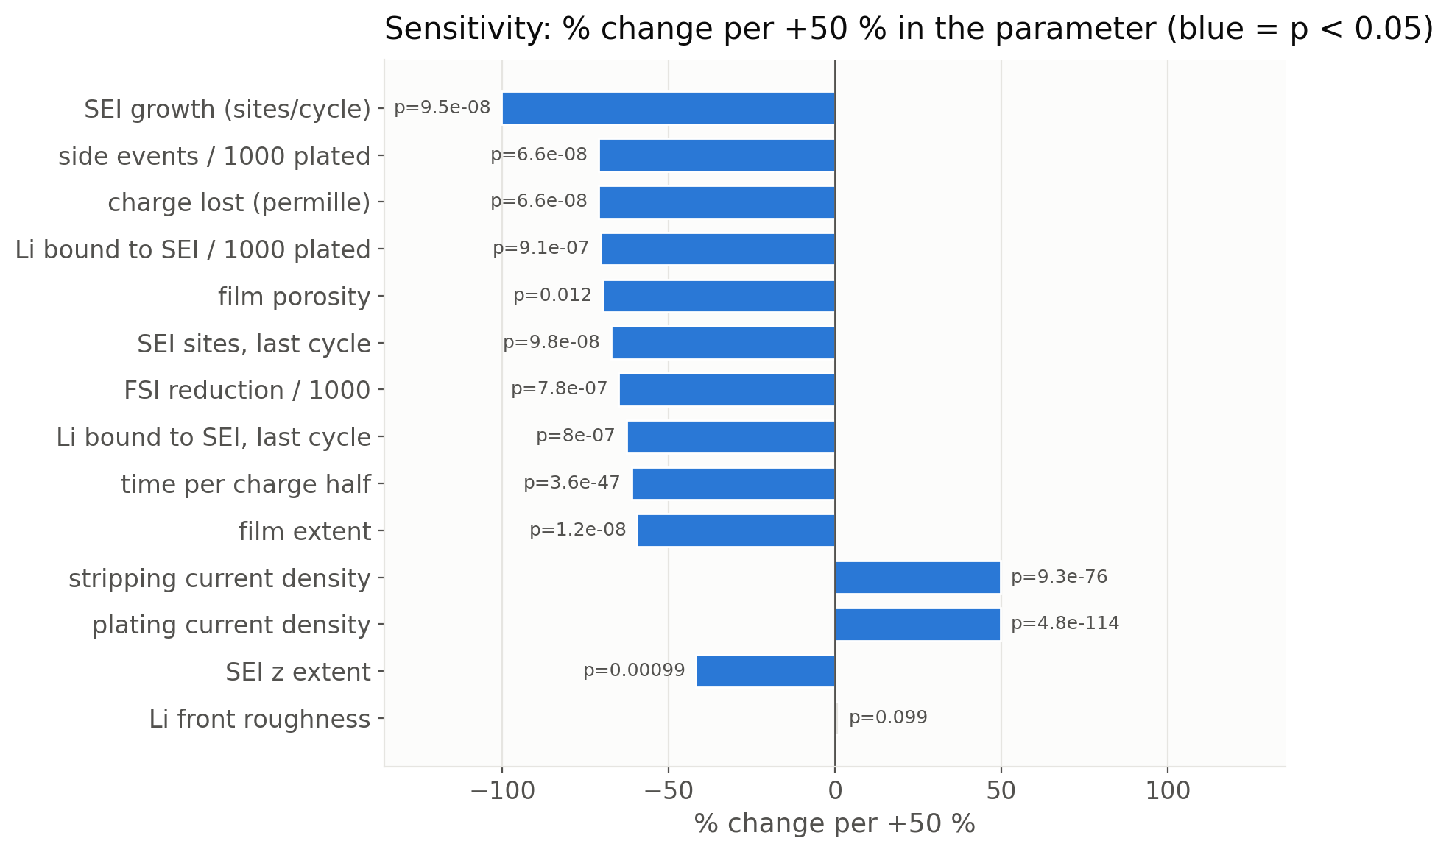
PART 3 · SWEEP AT REAL RATES
Sensitivity ranking with significance
metric | exponent n (metric ~ k0^n) | p
plating current density | +0.99 +- 0.00 | <1e-100
time per charge half | -0.99 +- 0.00 | 4e-47
side events / 1000 plated | -1.08 +- 0.04 | 7e-8
SEI sites, last cycle | -1.11 +- 0.08 | 1e-7
Li bound / 1000 plated | -0.95 +- 0.08 | 9e-7
SEI growth rate | -1.27 +- 0.12 | 9e-8
Li front roughness | ~0 | 0.10
SEI inorganic fraction | ~0 | 0.39
Two families: things that scale with k0 by construction (current, time) and things that scale as 1/k0 because they compete with plating (everything parasitic). Nothing in between.
F11. % change per +50 % in k0 from a linear fit over 90 runs; blue = p < 0.05. Replaces the single-trajectory 'normalised dynamic range' of the earlier decks.
14
Notes:
La tabla de exponentes es la version con estadistica del ranking de las laminas anteriores.

Slide 15
PART 4 · ORIGINAL vs PHYSICAL
Bridge: one model, two speeds of the parasitic chemistry
per cycle, reference setting | original (k_p 1e-3) | kmc3d physical (k0 = 74 s^-1)
plating events | ~45 (budget shared with side reactions) | 50 (budget)
salt reductions | several per cycle | 0.014 (1 to 2 per 110 cycles)
SEI atoms after 100 to 140 cycles | ~600 | 3
Li lost per Li plated | ~0.08 | 0.0008 (anchor 0.002)
CE in the first 100 cycles | 92 to 94 %, then falls | 99.98 %, flat
surface diffusion events | ~250 in 140 cycles | 0
time per cycle | model units | 0.08 s
current density | not defined | 3.3 mA/cm2 (charge), 0.4 (discharge)
implicit acceleration of the SEI chemistry | ~500 to 8000 x (depends on the anchor) | 1 x (A_SEI declared when needed)
Regime 1, per-event chemistry: what the physical sweep measures. Small numbers, real units, error bars matter. Answers 'what does k0 do to the chemistry'.
Regime 2, accumulation: what the original decks showed. Needs a thick SEI, which at real rates takes thousands of box cycles; the original got there by having the constants accelerated, kmc3d gets there with an explicit A_SEI.
Both are true at once: the original shows the mechanism of the fall, the physical engine shows the correct rate. The ageing sweeps (B, C) connect them.
15
Notes:
Lamina puente. Original = regimen acelerado con unidades del modelo; nuevo = regimen fisico con A_SEI explicito.

Slide 16
PART 4 · ORIGINAL vs PHYSICAL
Ageing sweeps B (A_SEI = 100) and C (A_SEI = 10): in progress
Sweep B: accelerated, 500 cycles
Sweep C: slow, 3000 cycles
anode_physical_A100, k0 x 0.5 to 1.5, 5 seeds, end_half_when_idle 10 so the discharge half ends when the anode cannot deliver and CE_cycle can fall gracefully. Expected: anode failure around cycle 300 at the reference, earlier at low k0.
anode_physical_A10, k0 x 0.5, 1, 1.5, 5 seeds. Expected failure around cycle 3000. If cycles-to-failure scale as 1/A between B and C, the acceleration factor only compresses the cycle axis; if not, SEI growth is autocatalytic (SOL2 on Li2O) and that is a result too.
Placeholder for F12 (CE per cycle and cycles to failure vs k0), F03/F06 of the accelerated runs, buried Li and its first-shell composition (what surrounds the inactive Li), SEI thickness and porosity profiles. Figures are produced by the same analysis script, so they will have the same look as Part 3.
16
Notes:
Rellenar cuando terminen las corridas en GRACE (B: horas; C: 1 a 2 dias).

Slide 17
PART 4 · ORIGINAL vs PHYSICAL
How to read 'cycles to failure' of a 4 nm box
What a box cycle is
What transfers
Half cell vs full cell
50 Li plated on 2 x 100 surface sites: half an atomic layer per cycle. A real 1 mAh/cm2 cycle moves ~5000 layers. One box cycle is ~1/4000 of a real cycle in charge passed, before any A_SEI.
Li lost per Li plated at a given current (and its 1/k0 law). For a real anode of thickness T and areal capacity Q per cycle, life = T / (loss per cycle), with loss per cycle = (Li lost per Li plated) x Q. The box number of cycles does not transfer; the ratio does.
What the box measures is exactly a Li||Cu experiment: the anode alone. A full cell adds polysulfide shuttle and CEI losses, so its life is shorter. The half-cell result is the anode upper bound, which is how it is reported experimentally.
Statement to use: 'at 3.3 mA/cm2 and j0 = 30 mA/cm2 the model loses 0.8 Li per 1000 plated, doubling when j0 halves', not 'the anode dies at cycle N'.
17
Notes:
Evitar la trampa de 'ciclos de la caja = ciclos reales'.

Slide 18
PART 5 · LIMITS AND OUTLOOK
Limits of the present engine and decisions needed
item | status | what it would take
Li surface diffusion | model value 0.56 (never fires at physical plating rates) | DFT barrier + relaxed-surface rule (opt-in engine change, validated byte for byte)
overpotential eta = +-30 mV | working choice [P] | group's Li||Cu polarisation data
side-reaction anchoring | made on the full-cell geometry (0.8 vs 2 per 1000 here) | re-anchor per geometry, or anchor on a geometry-independent quantity
Li transport through the SEI (option 2a) | absent: Li next to SEI cannot strip | advisor decision; removes the 'death by bound Li' artefact that any thick SEI triggers
no electrolyte transport | CE can only improve with k0 | out of scope for a lattice kMC; state it
event-budget protocol | CE_cycle fixed while Li is available | CC-CV protocol in the full cell (planned)
18
Notes:
Lista honesta. La difusion superficial y 2a son las dos que mas importan para morfologia y envejecimiento.

Slide 19
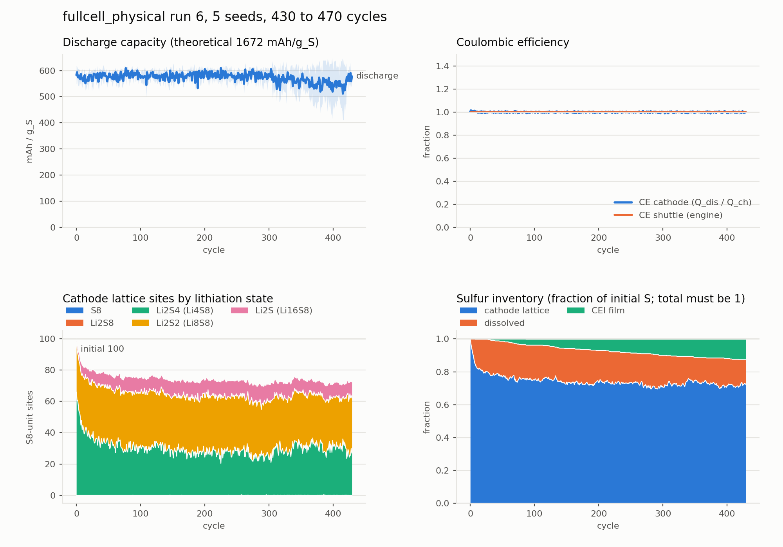
PART 5 · LIMITS AND OUTLOOK
Where this goes: the same engine already runs the full Li-S cell
Li anode, shared electrolyte, S8-unit cathode, dissolved polysulfides, shuttle and CEI, exact Li and S conservation.
570 to 600 mAh/g_S stable to cycle 430, CE 1.00, SEI ~1 site per cycle, CEI 12 % of the sulfur, 15 % dissolved.
The plating sweep is the first sensitivity test of this engine; the same tool sweeps any cathode constant (--param decomp:cat_S8_red) to decide which ones deserve DFT refinement.
Open on the cathode side: never returns to S8 (passivation mask), constant voltage within a half, no carbon host, no Li2S nucleation.
fullcell_physical run 6: 5 seeds, 430 to 470 cycles (30 h limit), same anode constants as the sweep.
19
Notes:
Cierre: el barrido no es un ejercicio aislado sino la primera prueba de sensibilidad del motor que se usara en la celda completa.

Slide 20
SUMMARY
Conclusions
The original engine and kmc3d are one model. kmc3d reproduces the original byte for byte; the physical case changes four referenced constants and the Li accounting.
The plating rate now has units: k0 = 74 s^-1 per site = j0 29.8 mA/cm2; the box runs at 3.3 mA/cm2; +-50 % spans j0 from 15 to 45 mA/cm2, the spread between electrolytes.
At real rates, everything parasitic scales as 1/k0 (exponent -1.08 +- 0.04): side reactions, SEI growth, Li bound to SEI, charge lost. Current and time scale as k0. Morphology does not move. All with 90 runs and p < 1e-6.
The original's 92 % efficiency and its fall after ~100 cycles are the same mechanism in an accelerated regime; the physical engine makes the acceleration explicit (A_SEI). The ageing sweeps B and C will put that regime in physical units too.
Decisions for the group: Li surface diffusion, overpotential, per-geometry anchoring, Li transport through the SEI (2a).
From here: the full Li-S cell with the same constants, and the sweep tool for every other parameter.
20
Notes:
Terminar con la decision: cerrar el original como antecedente y pasar al nuevo motor.

