Slide 1
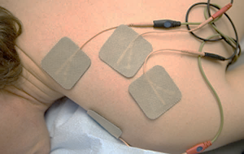
SMART TENS Project
Smart - Transcutaneous electrical nerve stimulation - Project
Project Team DX MX & CO (LATAM)
Laura Frias
Amin Espinoza
Omar Aviles
Raul Guerrero
Roberto Cervantes
Walter Novoa

Slide 2
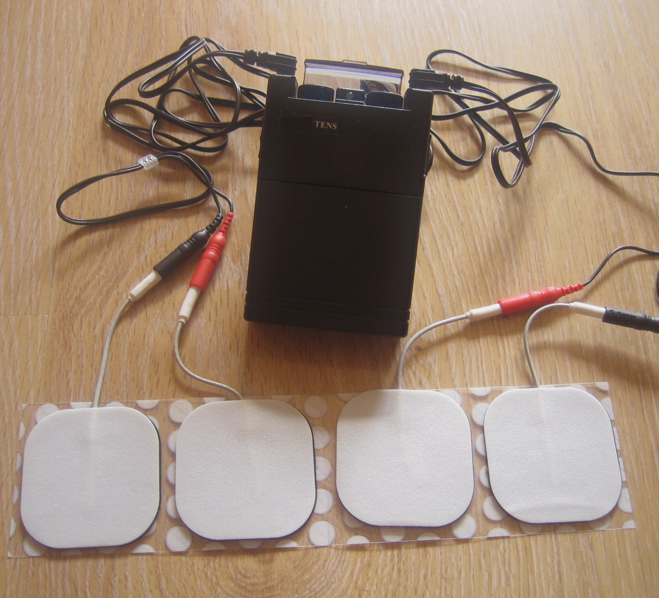
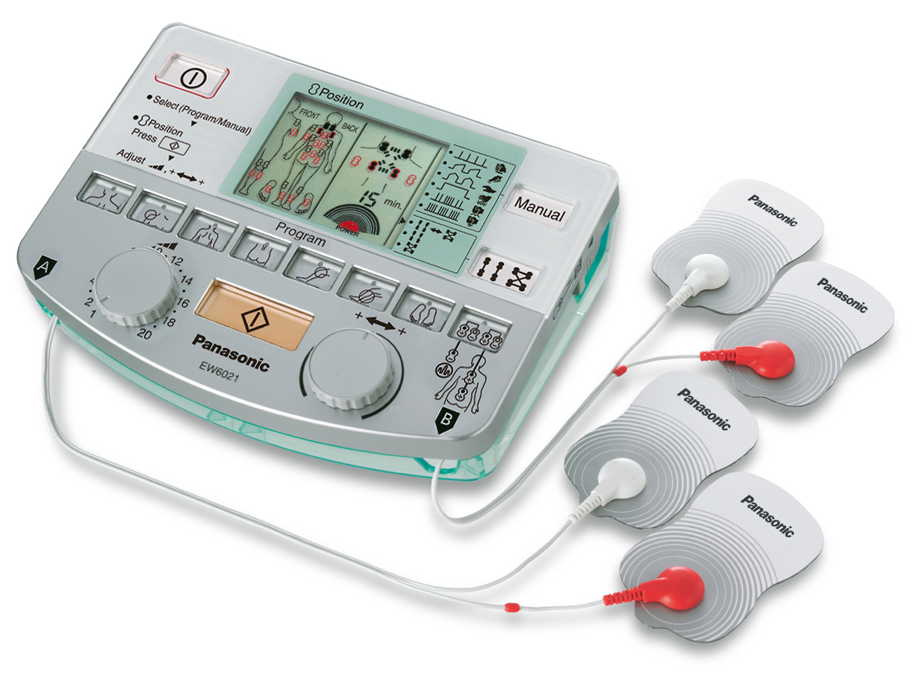
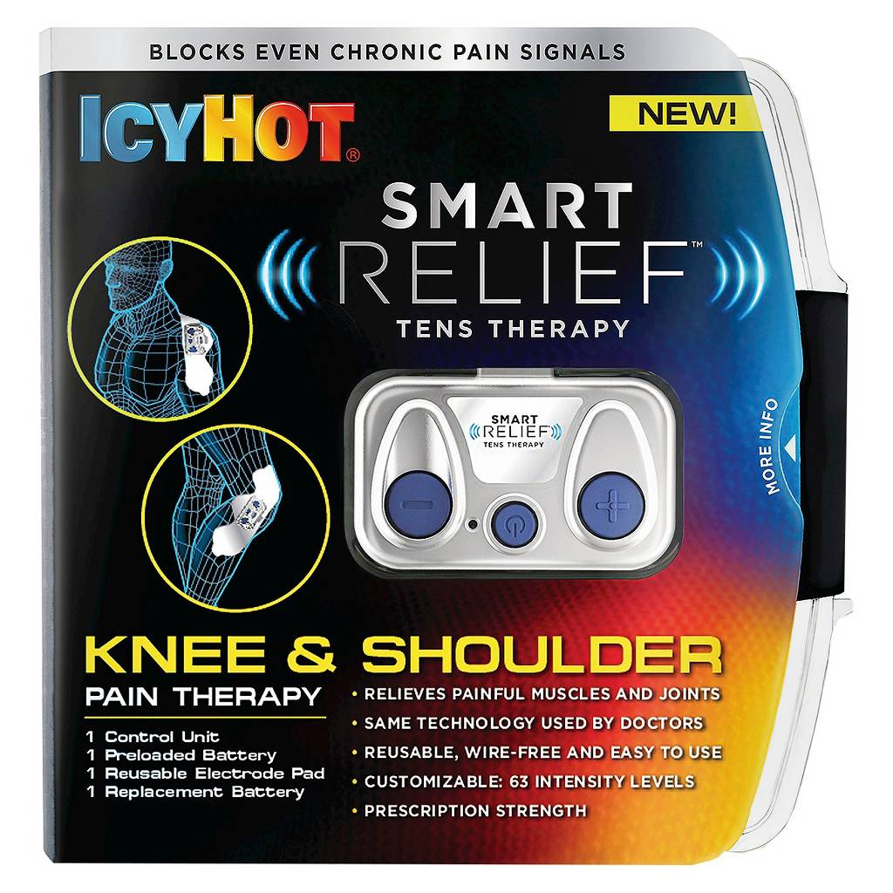
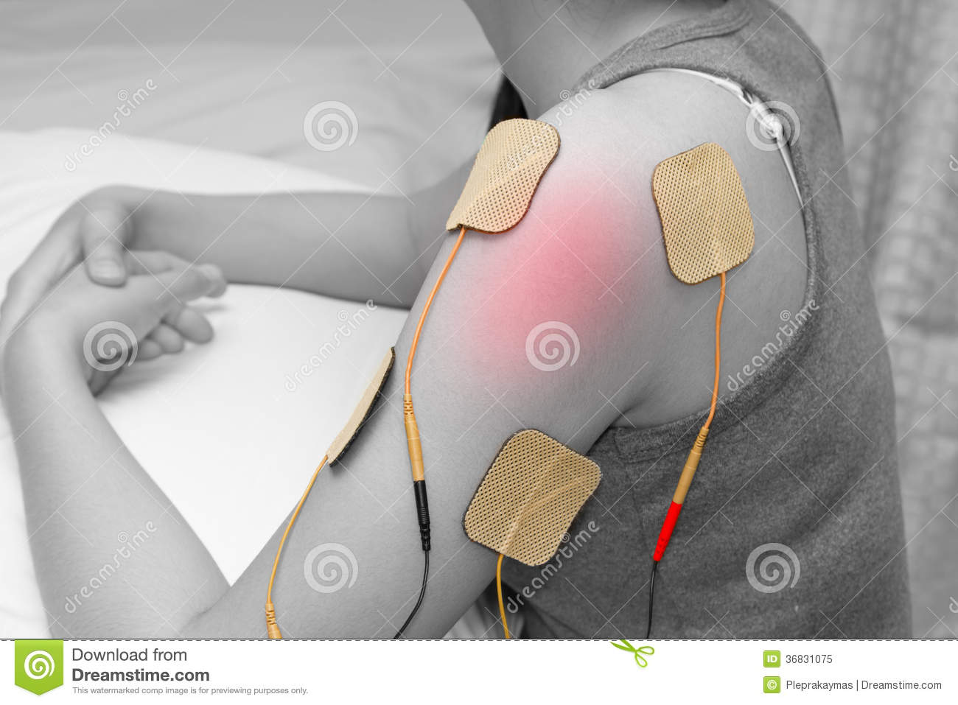
Traditional body pain treatment doesn’t have the effectivity of TENS therapy but current TENS system doesn’t deliver real time results to validate therapy effectiveness.
Notes:
https://en.wikipedia.org/wiki/Transcutaneous_electrical_nerve_stimulation#Medical_uses

Slide 3
Solution Architecture Diagram V1.0
Web API on Azure
(Micro service)
Notification Email
(Office Group Connectors)
Prediction Process and Service
(Azure ML)
Xamarin App (Forms.Droid)
Trigger message (Microservice)
Power BI Dashboard Embedded on
Web App
IoT Device (IoT TENS Device)
Azure Storage Service
SMART TENS Bot

Slide 4
DEMO

Slide 5
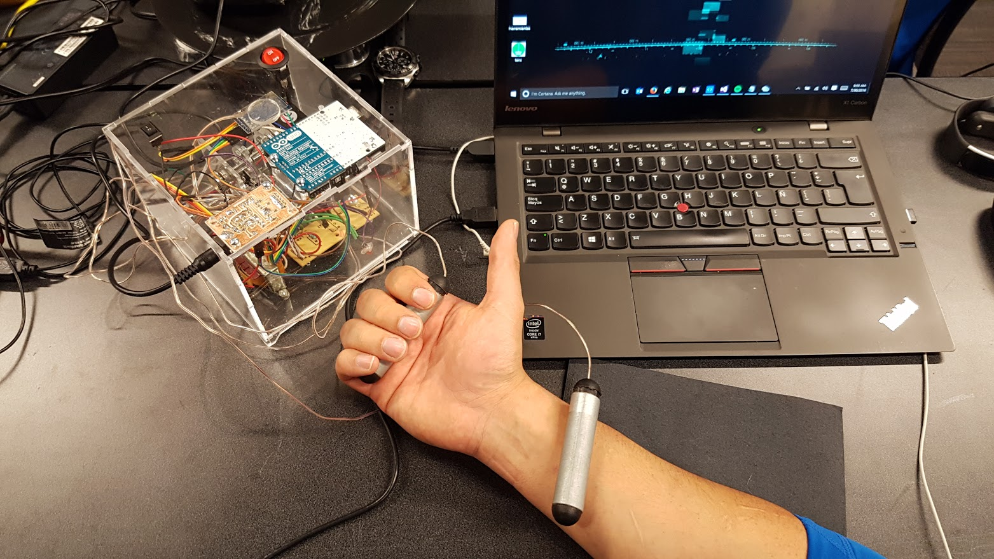
Come and test our project and relieve your pains

Slide 6
Q&A

Slide 7
Solution Architecture Diagram V2.0
Xamarin App (Forms.Droid)
Web API on Azure (Microservice)
Trigger message (Microservice)
Prediction Process and Service
(Azure ML)
IoT Device (IoT TENS Device)
Azure Storage Service
Power BI Dashboard Embedded on
Web App
People Monitoring
(MS Band 2.0)
Notification Email
(Office Group Connectors)
SMART TENS Bot

