Slide 1
Emploid.app
An application that helps users meet relevant job posts in a blink

Slide 2

Motivation
Practice AWS Big Data and Machine Learning
Deploy something useful
Duplicated job posts, too much to read
Job search services do not offer precise job offers
Competition for jobs ~100 per

Slide 3
Architecture
MVP 1 – Low cost cloud infrastructure
  S3
  EC2, ECS
  ML models in Python
MVP 2 – High availability cloud infrastructure
  S3
  SageMaker
  Real time feedback (behavioural)

Slide 4
Implementation
Datahen – provider for crawlers
  Terms of services
Convert résumés to vectors
  PDFs, DOCXs
Create the recommendations
  Cross the user profiles with the posts headlines
Update recommendations
  MVP2 – behavioural remapping

Slide 5
Implementation
Job postings: moving window
Databases on S3
  6 different “databases”, mostly CSV
  Save while possible
  DynamoDB, ElasticSearch or Redshift?
  EC2 or ECS?
  Front-end JSON API

Slide 6

Expected result
Provide the user a list of links to apply in a blink
Welcome, John
Please select your keywords
#Accounting, #CPA,
#harbour, #port, #junior
Please select the cities where
You would like to work
Toronto, Mississauga
Position Title
#Backend #Downtown
#Toronto #Javascript
#Presales#Architecture
Selected posts
Company Name
Company Name1
Position1
Linkedin
Go!
Company Name2
Position2
Glassdoor
Go!
Company Name3
Position3
Indeed
Go!
Upload resume
Active résumé
none
Username Surname
Username Surname
FINISH

Slide 7
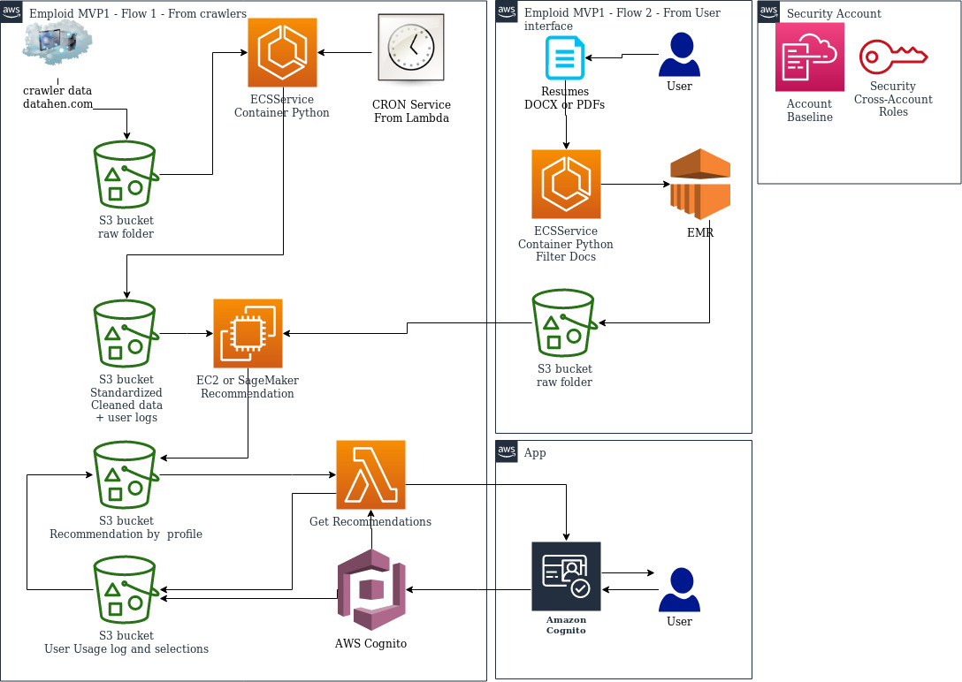
Implementation - MVP1

Slide 8
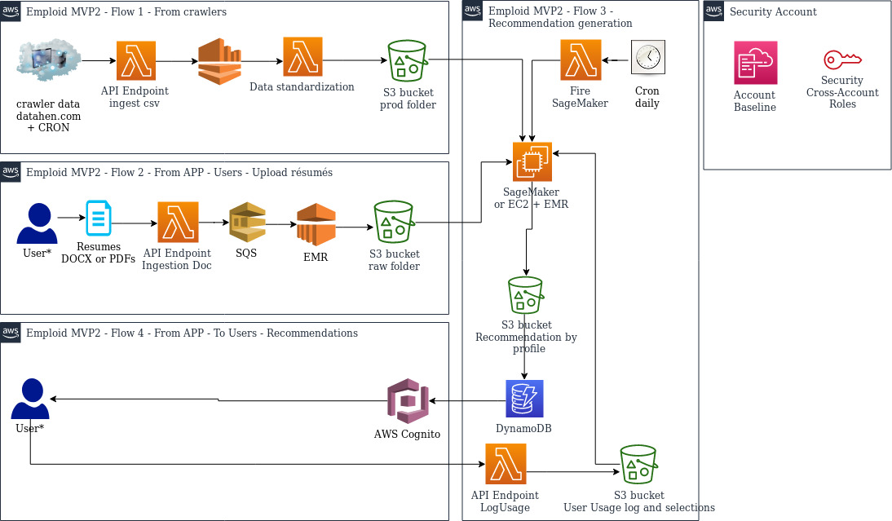
Implementation - MVP2

Slide 9
Data format – CSV, JSON

Slide 10
Questions?

