Slide 1
Programming III
Centennial College
Week#5 Winter 2019
Topic: Introduction to XAML & WPF

Slide 2
Desktop Application Platforms
UWP, WPF and Windows Forms provide managed runtime environments, Windows Runtime for UWP, and .NET for WPF and Windows Form
UWP: Use XAML markup to separate presentation from business logic. It is suitable for desktop apps that require a sophisticated UI, styles customization and graphics-intensive scenarios; has built-in support for the Fluent Design system; can be used to create desktop apps, but also support platform for Xbox, HoloLens, etc.
WPF: the preferred technology for Windows desktop apps that require UI complexity, styles customization, and graphics-intensive scenarios for the desktop. WPF also takes advantage of XAML views
WinForm: the first UI technology in the .NET Framework for building desktop apps. It is still a good fit for many business desktop apps. Windows Forms is easier to use and lighter weight than WPF for simple scenarios. Windows Forms does not use XAML, so later, if the app needs to Windows Phone or Windows Store, the app needs a complete re-write of the UI

Slide 3
Windows Presentation Foundation(WPF)
Is part of .NET Framework and was first introduced by Microsoft as part of .NET 3.0
An new graphical display system for Windows
The core of WPF is a resolution-independent and vector-based rendering engine that is built to take advantage of modern graphics hardware
Empowers rich-media (e.g., video) applications
Provides a clear separation between the UI (XAML) and business logic
Influenced by modern display technologies such as HTML, CSS and Flash

Slide 4
WPF Key Features
A -> Anywhere execution (XMAL)
UI designed in WPF can be used for Browser based apps
B -> Data Bindings
C -> Common Look and Feel (Styles)
D -> Declarative programming
E -> Expression Blend and Animation
F -> Faster execution (Hardware Rendering)
WPF internally uses DirectX which performs Hardware rendering whereas WinForm uses GDI (Graphical Data Interface) which performs software rendering
G -> Graphic Independency (DIP)
WPF works on DIP (Device Independent Pixel) 1 DIP=1/96 th of Inch. It basically relates itself directly with the size of screen. In other words, it is resolution independent.

Slide 5
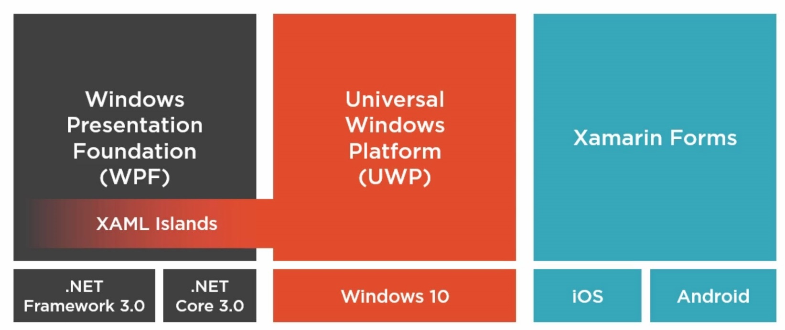
Extensible Application Markup Language (XAML)
XML-based declarative language
A declarative language says “what”
An imperative language says “how”
Is used to describe UI elements

Slide 6
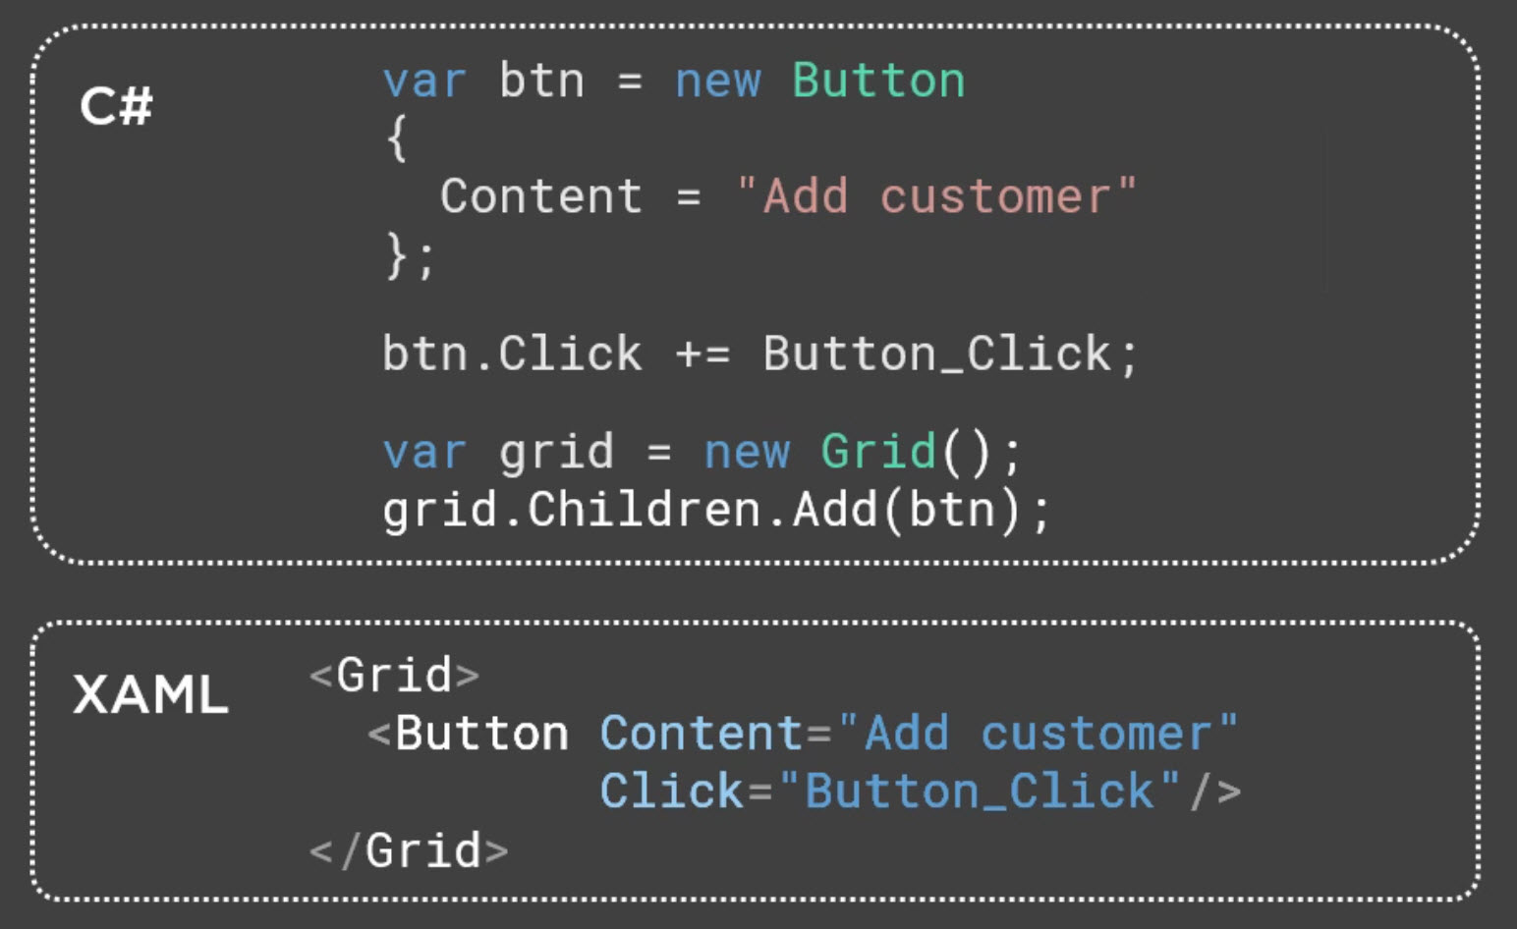
Create User Interface with XAML

Slide 7
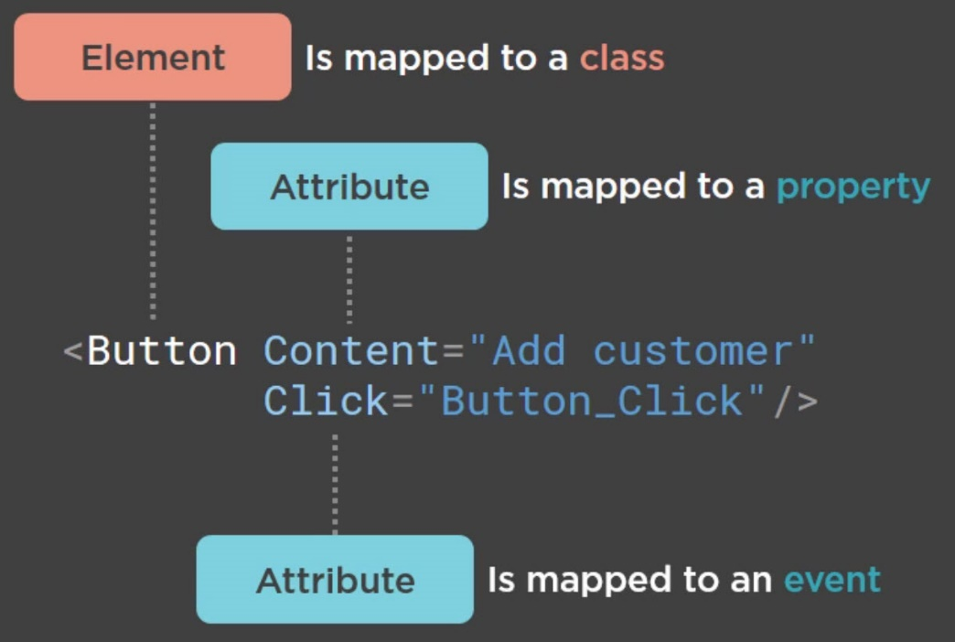
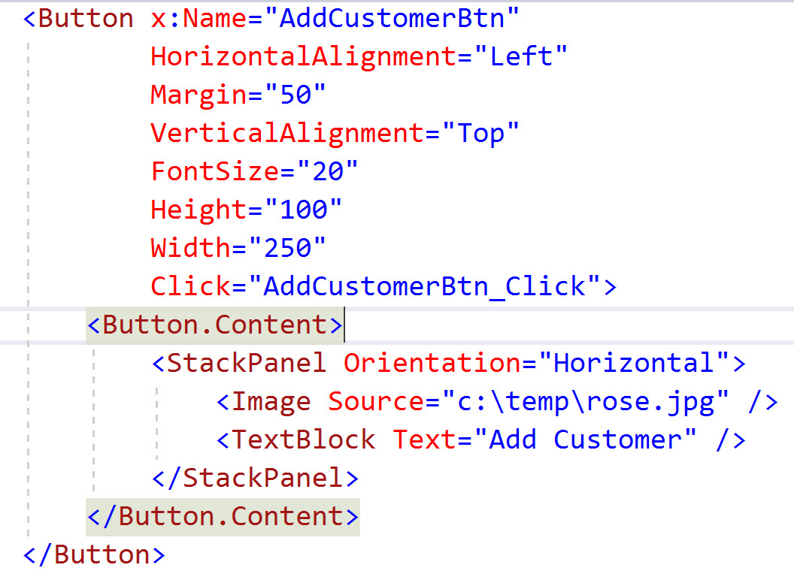
Work with Elements and Attributes
Property elements

Slide 8
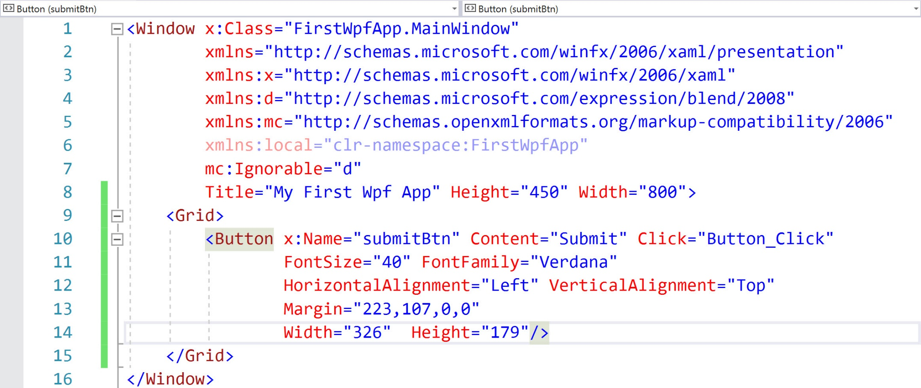
An XAML Example of WPF App

Slide 9
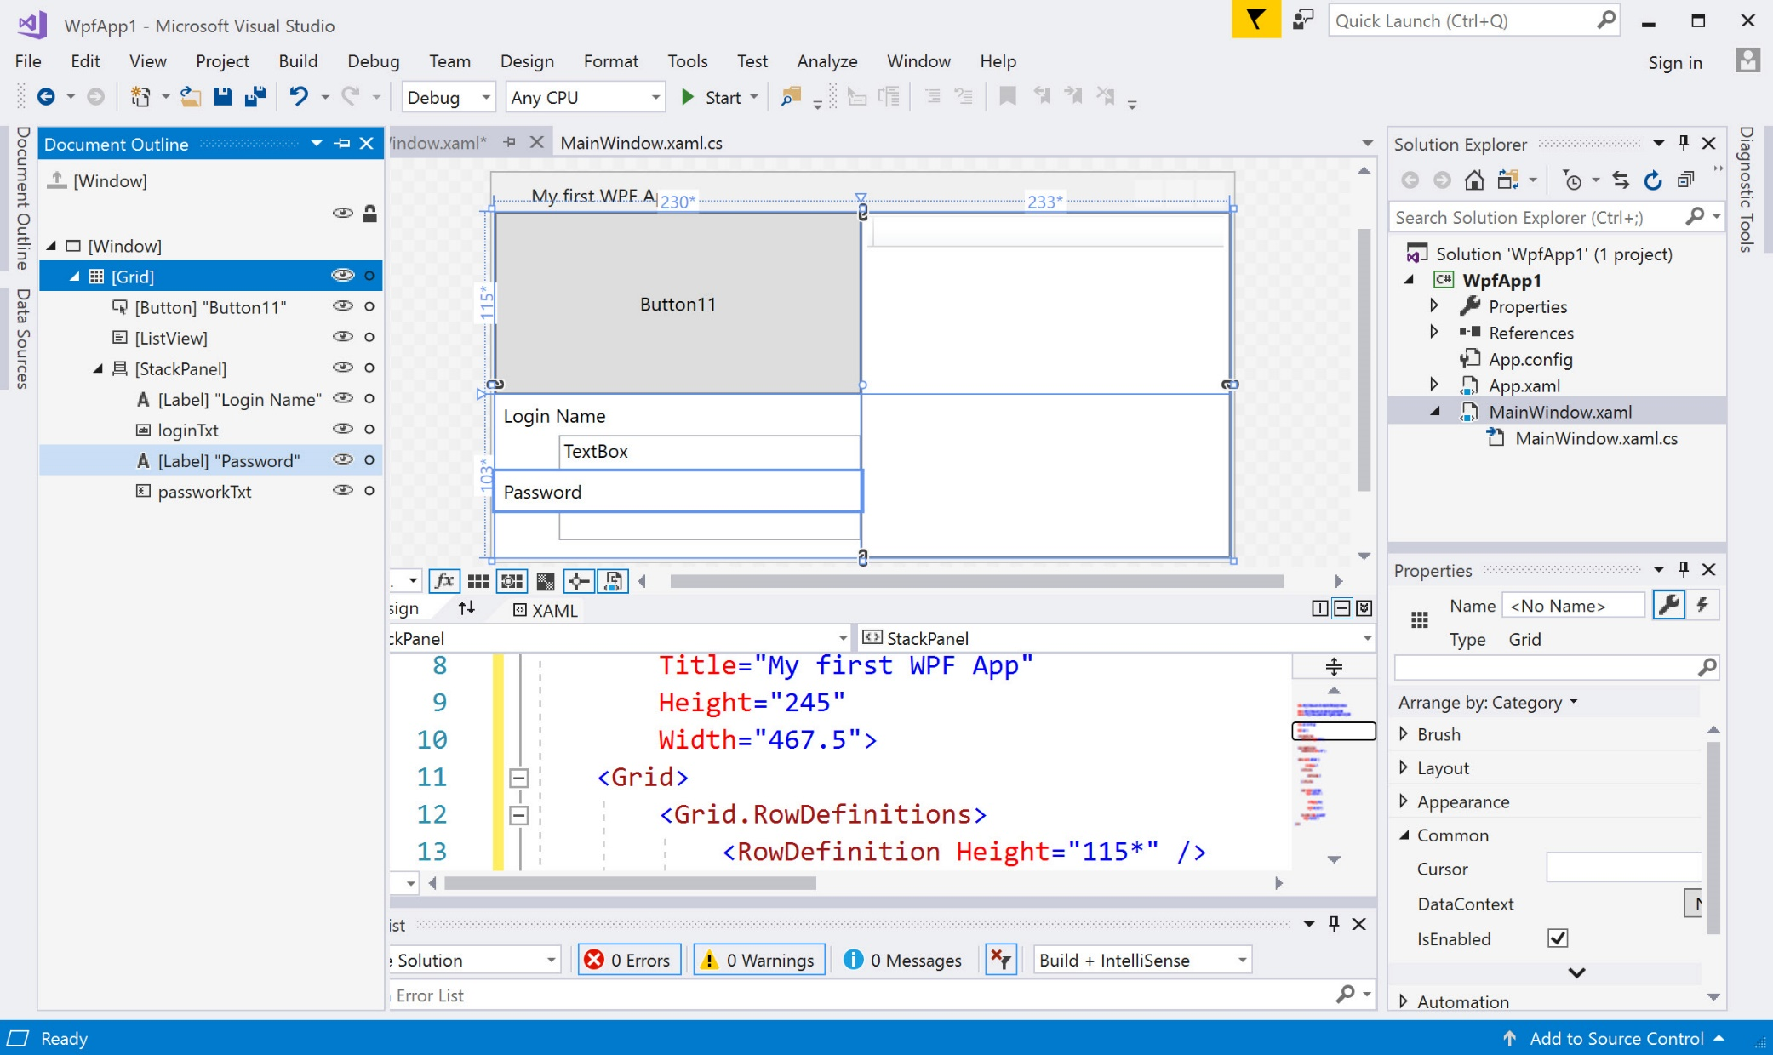
Take a closer look at XMAL

Slide 10
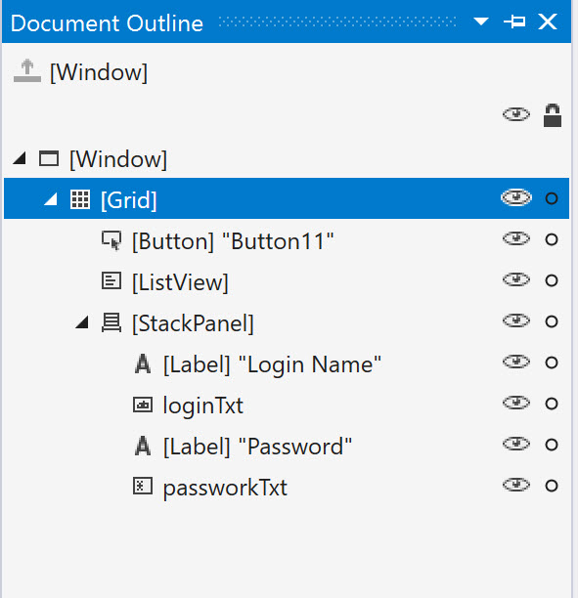
Routed Events
The .NET event model is extended by routing event for XAML-based applications where elements forms a hierarchy (i.e., tree)
With routed events, an event is routed through the hierarchy of elements. E.g., if a routed event is fired from a control (e.g., button), the event can be handled with the button itself, then it routes up to all its ancestors controls where it can be handled as well. This is called bubbling: events bubble up through the control hierarchy
Tunneling events go in the direction opposite of bubbling

Slide 11
Styles of XAML
Instead of defining the look and feel with every element, UI designers can define styles and add to resources

Slide 12
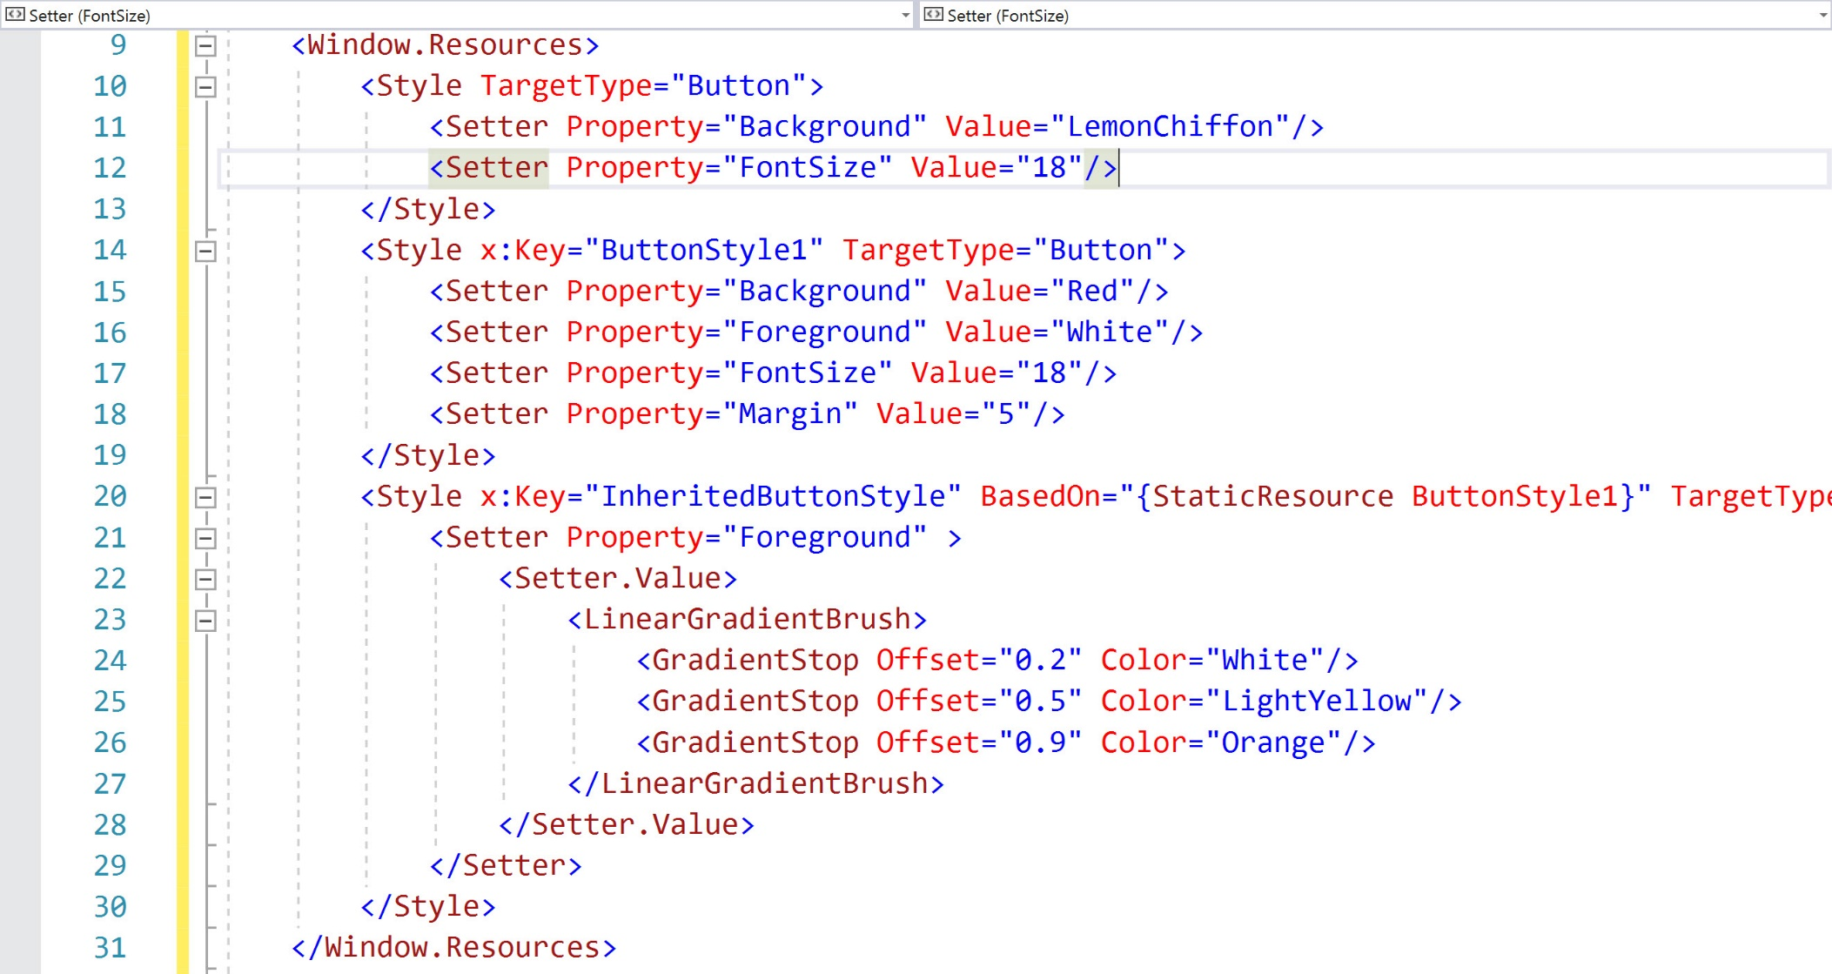
Style Example

Slide 13
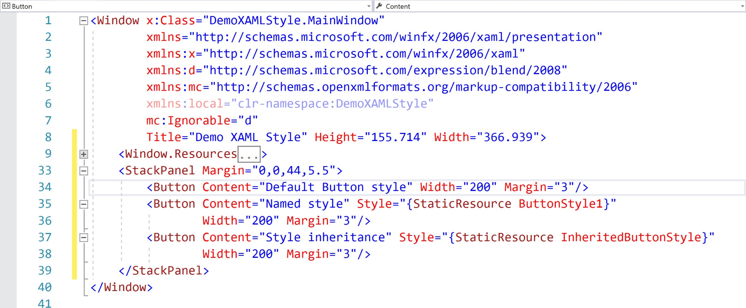
Style Example(Con’t)

Slide 14
Resource Dictionary
Resource dictionary enables style sharing between multiple applications.

Slide 15
Controls of WPF(1/2)
Simple controls
Those controls that don’t have a content property
E.g., TextBox, RichTextBox, Calendar, DatePicker, Passwordbox, ScrollBar, ProgressBar, Slider, etc.
Content controls
Those controls that have a content property
E.g., Button, Label, Frame, ListBoxItem, StatusBarItem, ScrollViewer, ToolTip, UserControl, Window, NavigationWindow, etc.
Headered Content Control
Content controls with a header
E.g., Expander, GroupBox, TabItem

Slide 16
Controls of WPF(2/2)
Items controls
The ItemControl class contains a list of items that can be accessed with the Items property
E.g., DataGrid, TreeView, ListBoxComboBoxTabControl, StatusBar, Menu and ContextMenu
Headered Items Controls
HeaderedItemControl is the base class of controls that include items but also have a header
E.g., MenuItem, TreeViewItem, ToolBar, etc.

Slide 17
Layout Containers (1/2)
A layout container needs to do two main tasks: measure and arrange; Measuring is to define the preferred sizes, while arrange is to position the children accordingly
Canvas
Defines an area within which you can explicitly position child elements by coordinates relative to the Canvas area
DockPanel
Defines an area within which you can arrange child elements either horizontally or vertically, relative to each other
Grid
Defines a flexible grid area consisting of columns and rows

Slide 18
Layout Containers (2/2)
StackPanel
Arranges child element into a single line that can be oriented horizontally or vertically
WrapPanel
Positions child elements in sequential position from left to right, breaking content to the next line at the edge of the containing box. Subsequent ordering happens sequentially from top to bottom or right to left, depending on the value of the Orientation property

Slide 19
WPF Advantages
Benefit of the separation between the UI and business logic
Development and maintenance costs are reduced as appearance-specific markup is not tightly coupled with behavior-specific code
Development is more efficient as designers can design app’s appearance while developers focus on the app’s behavior
Globalization and localization for WPF apps is simplified

Slide 20
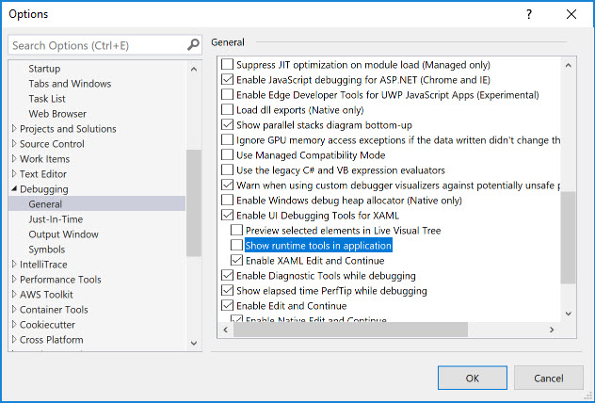
Turn off Runtime Debug Tool in App

Slide 21
References
http://www.wpf-tutorial.com/data-binding/hello-bound-world/
http://www.c-sharpcorner.com/article/abc-of-wpf/
https://docs.microsoft.com/en-us/dotnet/framework/wpf/controls/panels-overview
https://docs.microsoft.com/en-us/dotnet/api/system.collections.objectmodel.observablecollection-1?view=netframework-4.7.2

