Slide 1
Programming III
Centennial College
Week#5 2020 Winter
Topic: WPF Data Binding

Slide 2
Data Binding Overview
Data binding is the process to establish a connection between the app UI and the data it displays
When the underlying data has been changed, the UI elements that are bound to the data reflect changes automatically
On the hand, when the data in UI element (e.g., TextBox) has been changed, the underlying data will be automatically updated to reflect the change
Reduce code/maintenance effort
Facilitates Developer-Designer workflow
Allow designers work on XAML isolation
Is an extremely important concept with XAML-based apps
Is one of the most powerful XAML platform features

Slide 3


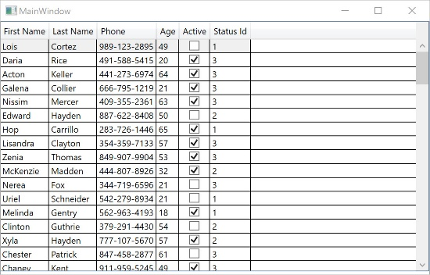
Data Access vs Data Binding
Data access
DB
Data source object
Data binding
Data source object

Slide 4
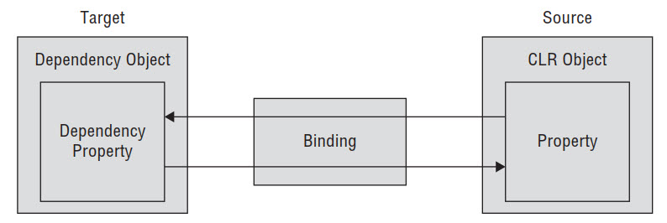
Basic Data Binding Concepts
Each binding has 4 components
A binding target object
A target property
A binding source
A path to the value in the binding source to use

Slide 5
Binding Source
The binding source object refers to the object that you obtain data from
Bindings use the element DataContext by default
Can directly indicate the source object by using one of following three ways
ElementName
Obtain object reference for some other named element within the visual tree
RelativeSource
Obtain object reference from a type/position in the element hierarchy relative to the current element
Source
Obtain object reference from a Resource object

Slide 6
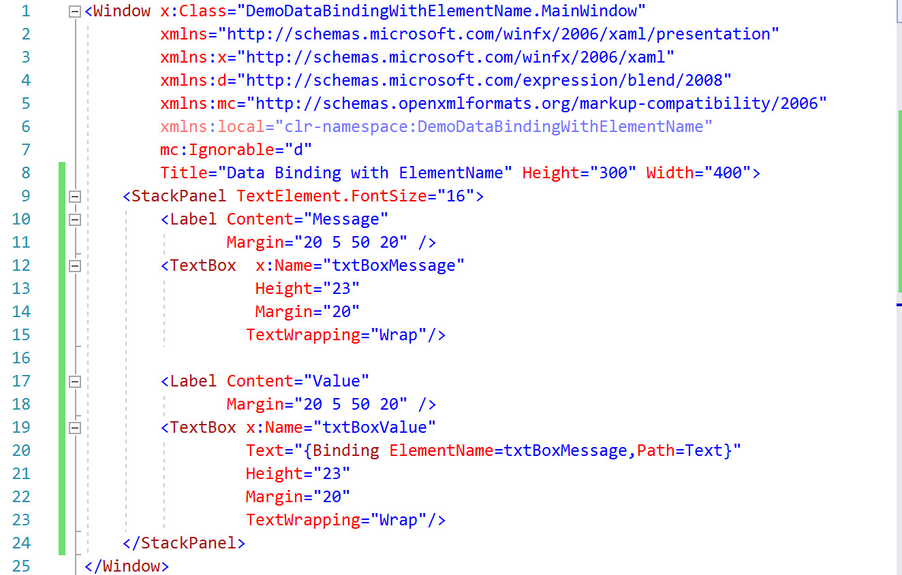
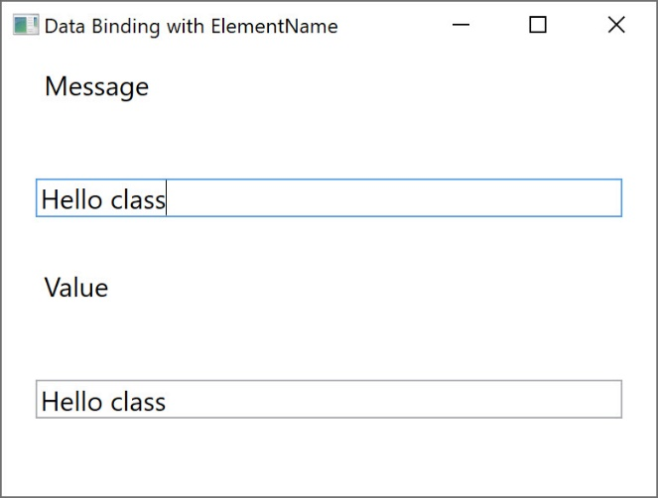
Data Binding With ElementName

Slide 7
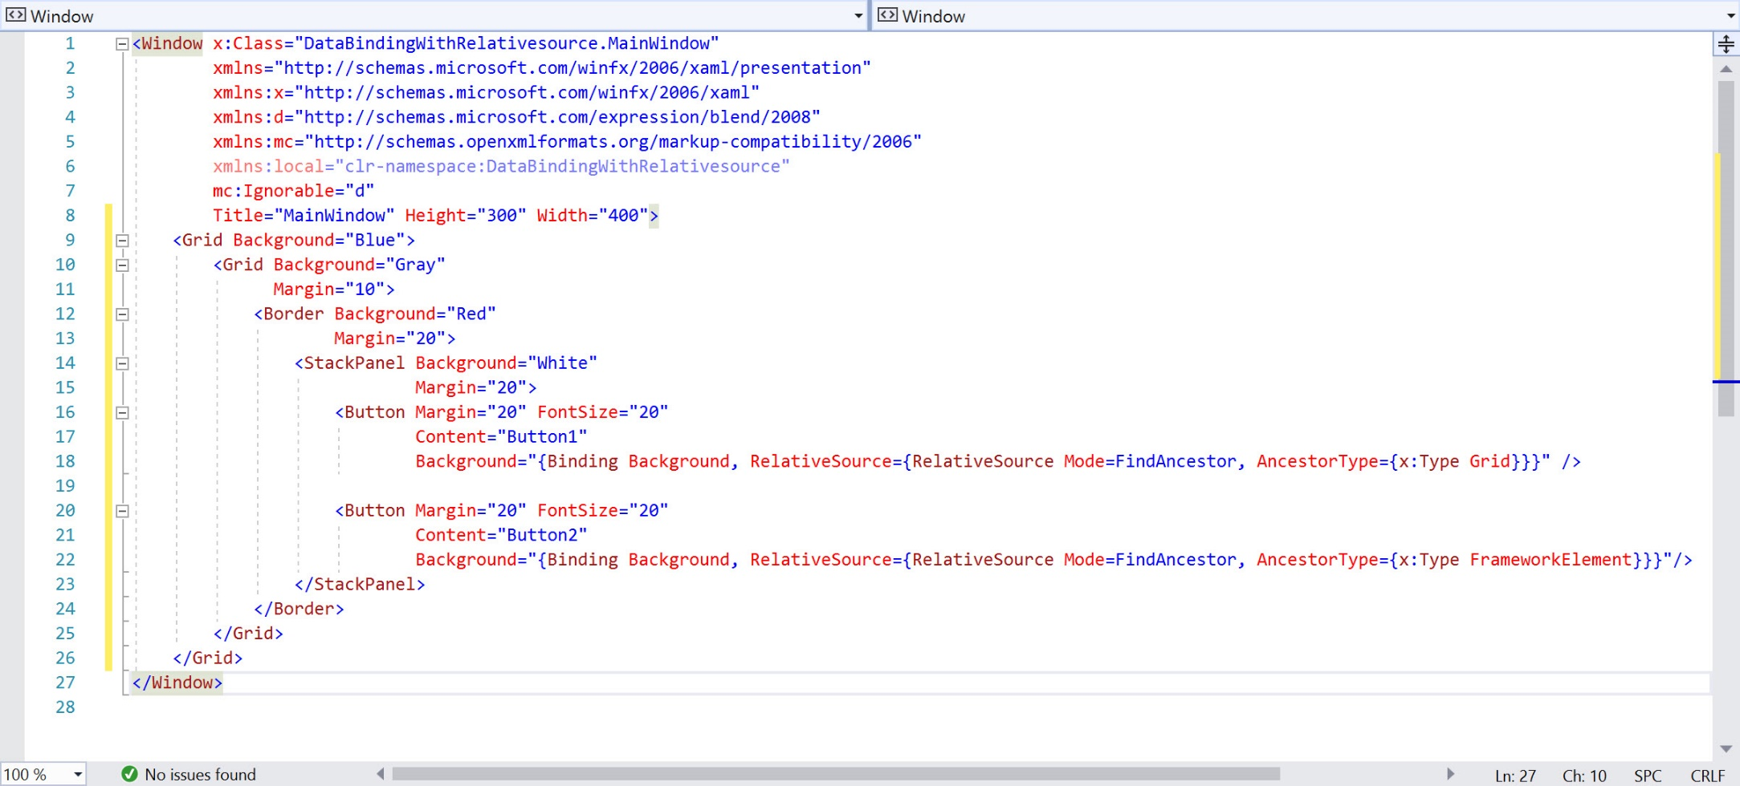
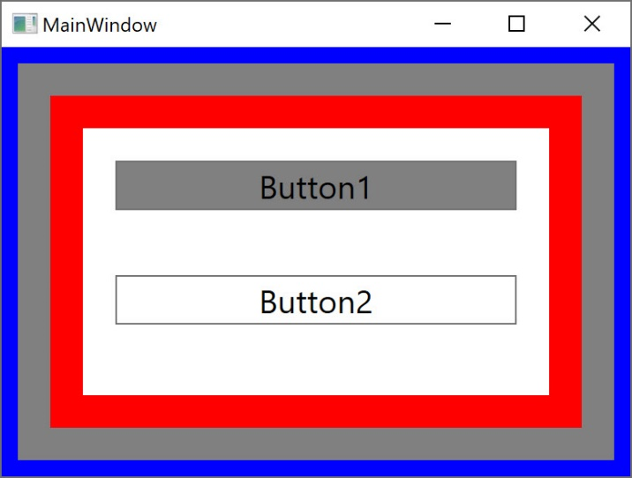
Data Binding With RelativeSource

Slide 8
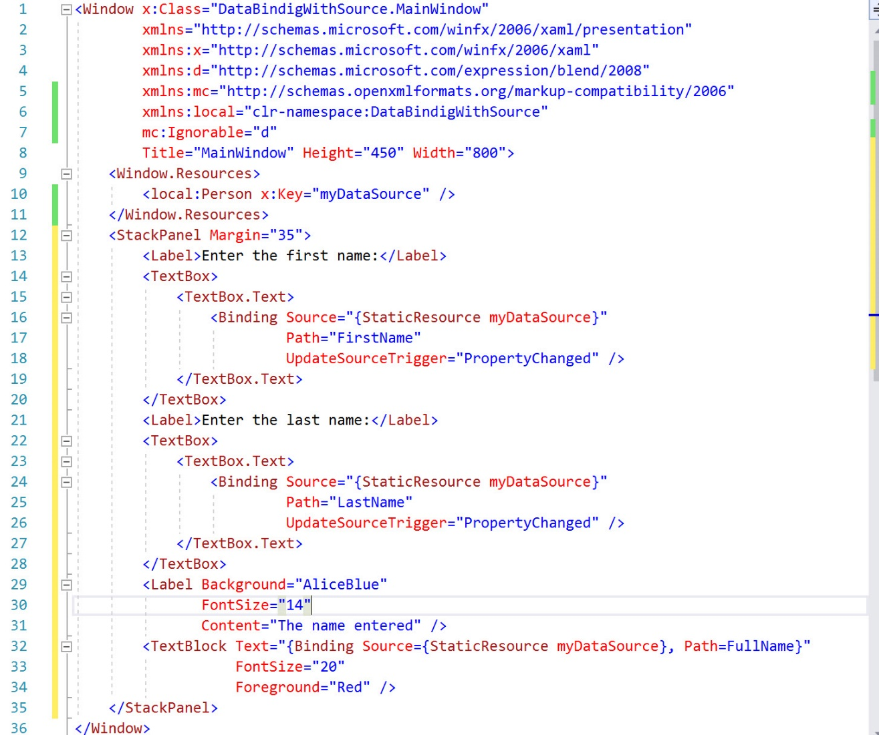
Data Binding With Source

Slide 9
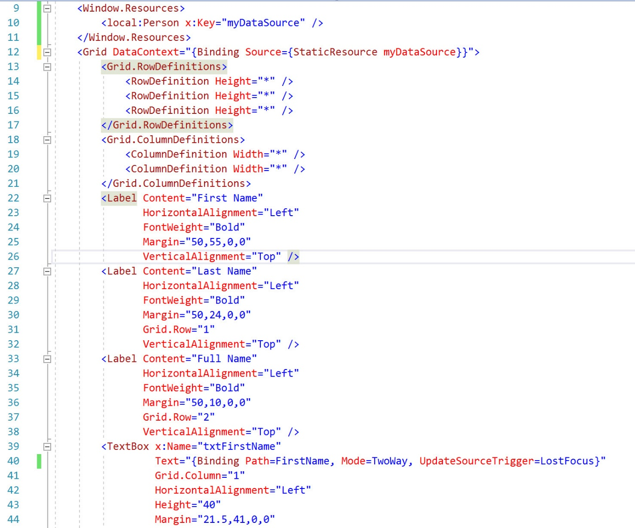
Data Binding With DataContext

Slide 10
Data Binding Mode
Data Binding supports several binding mode between the target and source
Binding Mode | Description
One-time | Binding goes from the source to the target and occurs only once when the app is started or the data context changes
One-way | Binding goes from the source to the target. This is useful for read-only data, because it is not possible to change the data from UI. To get updates to the UI, the source must implement the interface INotifyPropertyChanged
Two-way | The user can make changes to the data from the UI. Binding occurs in both directions. The source needs to implement read/write properties so that changes can be updated from the UI to the source
One-way-to-source | If the target property changes, the source object is updated

Slide 11
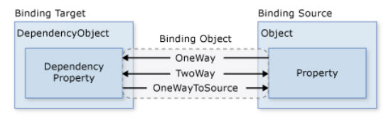
Data Binding Mode(con’t)
https://docs.microsoft.com/en-us/dotnet/desktop-wpf/data/data-binding-overview

Slide 12
INotifyPropertyChanged Interface
The interface is in System.ComponentModel
In order to facilitate two-way binding, the underlying class must implement INotifyPropertyChanged
If a class implements INotifyPropertyChanged, it will raise a property changed event to notify UI when its property changes

Slide 13
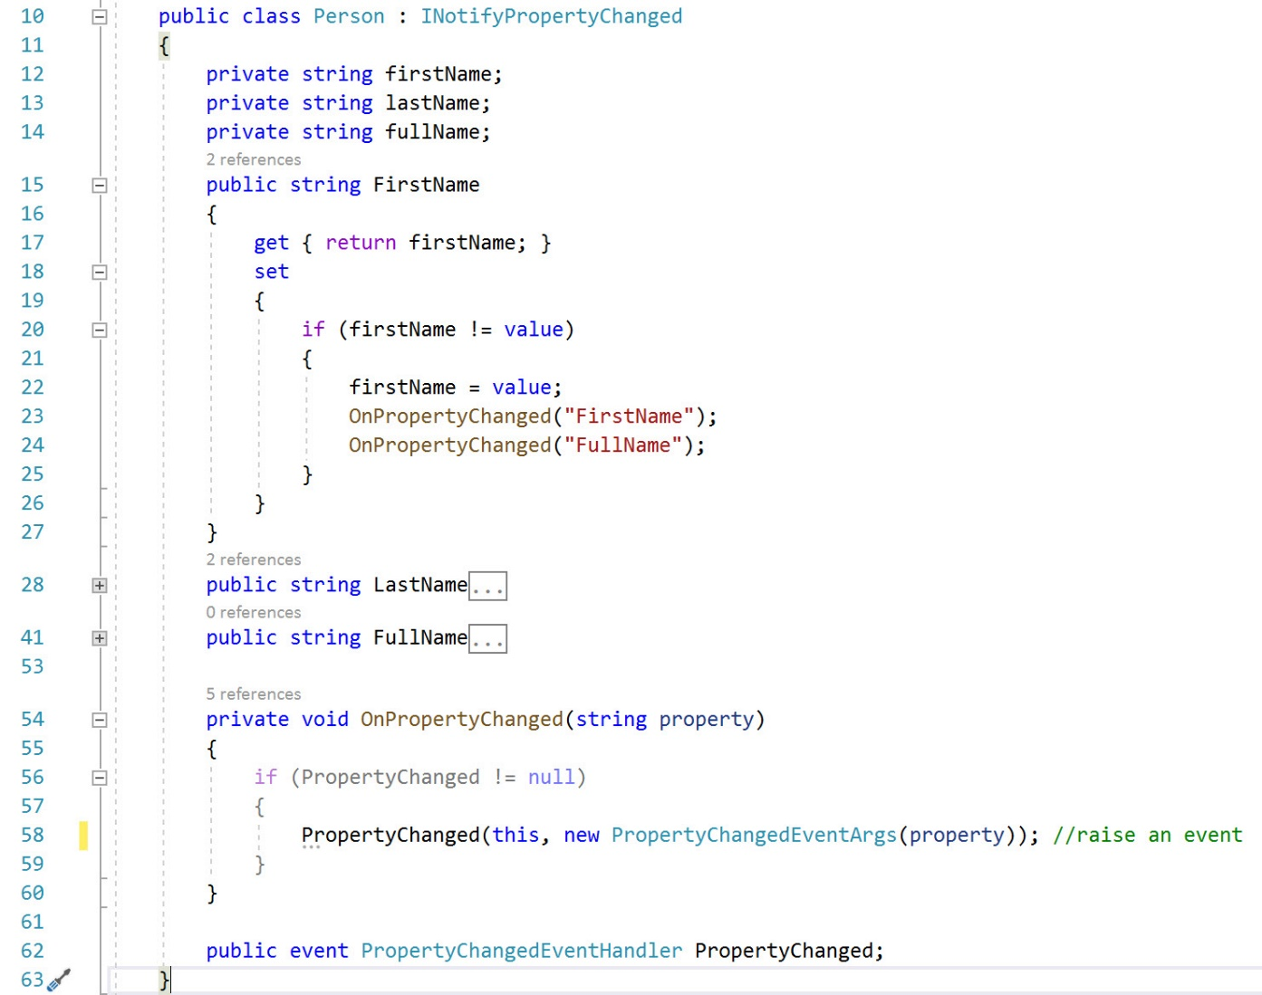
An Example of implementation

Slide 14
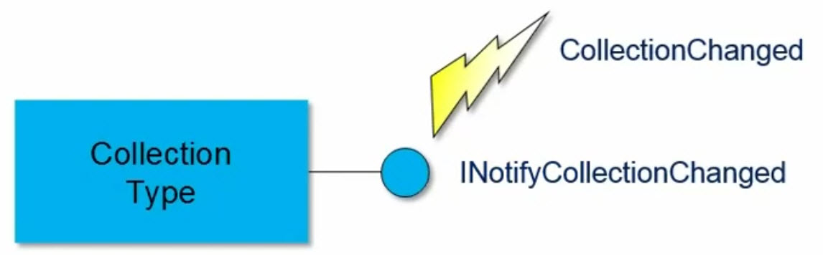
ObservableCollection<T>
Collection changed only fires for add/remove/replace/clear
Not for individual object change
ObservableCollection<T> predefines class for this
In general, any modifiable collection you are going to bind to should be ObserverableCollection<T>

Slide 15
DataGrid
It is used to display and edit data using rows and columns
ItemSource property is the key to data binding
By default, the AutoGenerateColumns property of DataGrid is true, therefore all public properties of the underlying class are represented as columns of the DataGrid; set this property to false if you do not wish to generate automatic columns
Set Column Width and Row Height by setting property RowHeight and ColumnWidth
Set Grid Lines Visibility and Header Visibility, e.g., GridLinesVisibility="Vertical" HeadersVisibility="All"

Slide 16
DataGrid (Con’t)
Background property is used to set the background color of the DataGrid
The RowBackground and AlternativeRowBackground properties are used to set the background color of rows and alternative of the DataGrid
The BorderBrush and BorderThickness properties are used to set the color and width of the border
IsReadOnly property is used to make a DataGrid read only
CanUserSortColumns property is used to enable (by default) or disable to sort column
HorizontalScrollBarVisibility and VerticalScrollBarVisibility properties of type ScrollBarVisibility enumeration control the horizontal and vertical scrollbars of the DataGrid. It has four values - Auto, Disabled, Hidden, and Visible

Slide 17
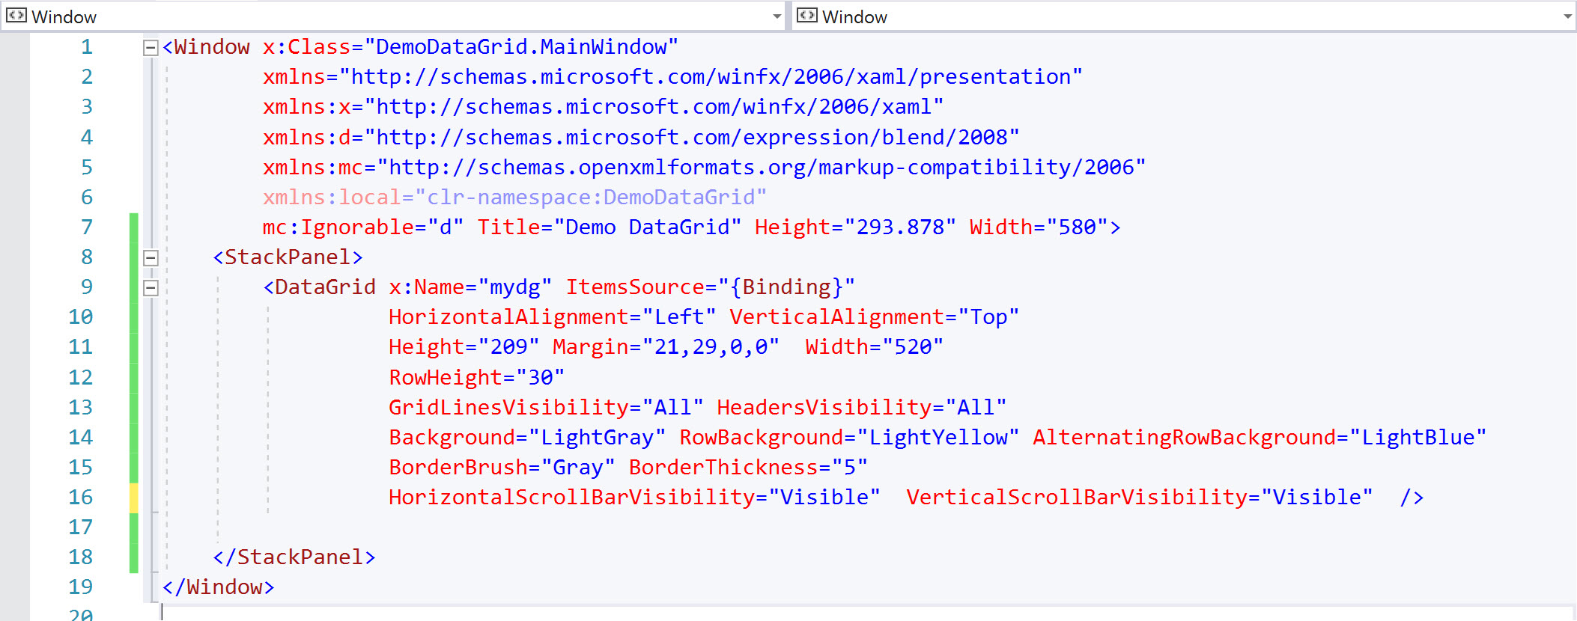
Example of DataGrid

Slide 18
References
https://docs.microsoft.com/en-us/dotnet/api/system.windows.data.binding?view=netframework-4.8
https://docs.microsoft.com/en-us/dotnet/desktop-wpf/data/data-binding-overview

