Slide 1
Programming III
Centennial College
Week#6 2020 Winter
Topic: More on Data Binding

Slide 2
Twoway Data Binding Triggers
Can get it immediately on bound property change
Binding.UpdateSourceTrigger
Default
Explicit: updates the binding source only when you call UpdateSource()
LostFocus
PropertyChanged
Default and LostFocus mean the same thing for most controls
DataGrid
Default: row lost focus
LostFocus: cell lost focus

Slide 3
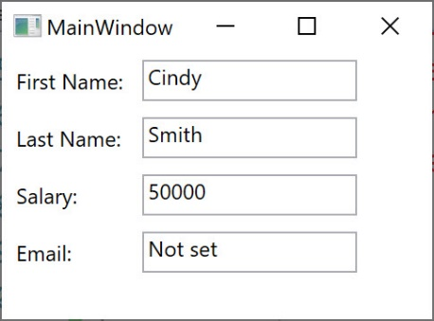
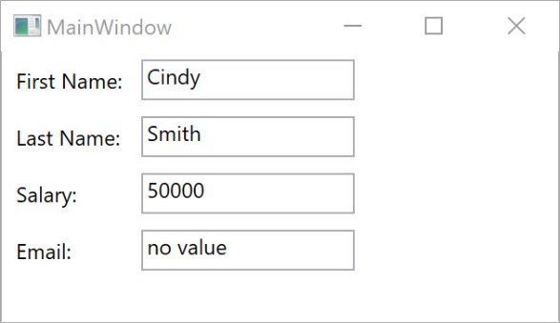
Fallback Values
TargetNullValue
Alternate value to use when some property can be found but it’s value is null
FallbackValue
Used when the source property cannot be found

Slide 4
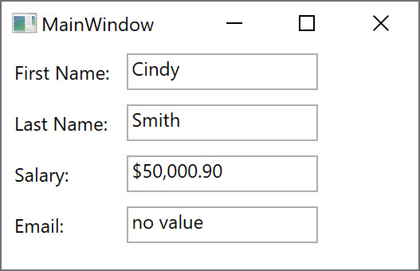
StringFormat
The StringFormat property is to format the output string by calling String.Format()

Slide 5
Converters
Allow bound value present slightly differently
Can transform data value flowing in each direction
Change data value
Change data type
IValueConverter
Convert: from source to target
ConvertBack: from target to source
Only matters for two way data binding
Create class that implements IValueConverter
Create Instance in Resources
Set Converter property on Binding through StaticResource

Slide 6
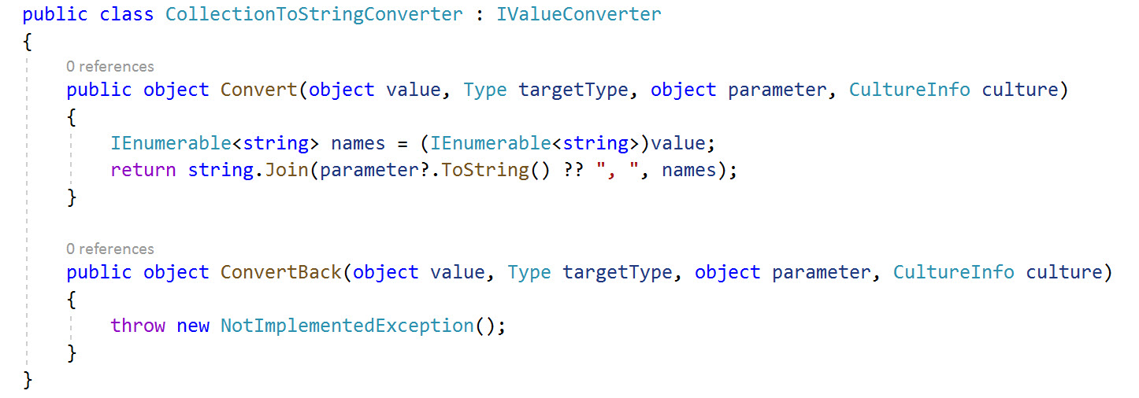
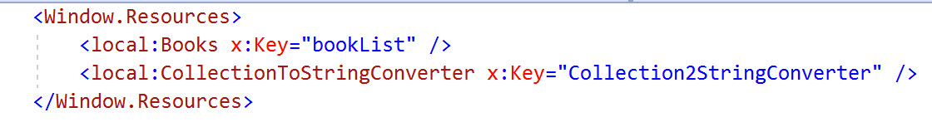
Converter Example

Slide 7
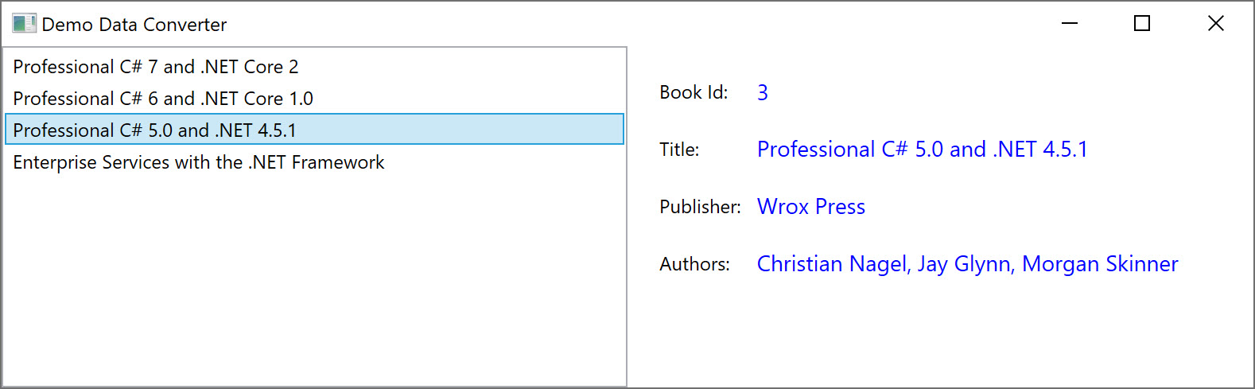
Converter Example (Con’t)
This is also a master-detail example. More specifically, there is a ListBox, which is an ItemsControl. Based on user selection, more details about the selected item will be displayed.
Both ItemsControl and ContentControl bind to the same source, the collection object (i.e., bookList). IsSynchronizedWithCurrentItem property of ItemsControl must set to true to ensure that the selected item is always set as the CurrentItem
If the ItemsControl gets data from a CollectionViewSource, it synchronizes selection and currency automatically

Slide 8
DataTemplate Overview
Describes how bound data is displayed
Can be applied to ContentControls & ItemsControls
ContentControls: Button, Label, ListBoxItem, StatusBarItem…
ItemsControls: DataGrid, ListView, TreeView, ListBoxComboBoxTabControl, StatusBar, Menu…
Can be defined as a Resource with an x:Key and referred by using StaticResource or DynamicaResource
ContentControl.ContentTemplate
ItemsControl.ItemTemplate
Is used to render the data-bound object(s)

Slide 9
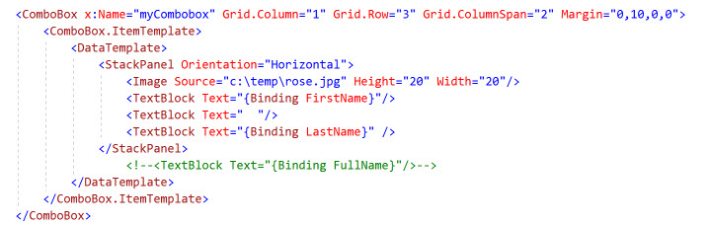
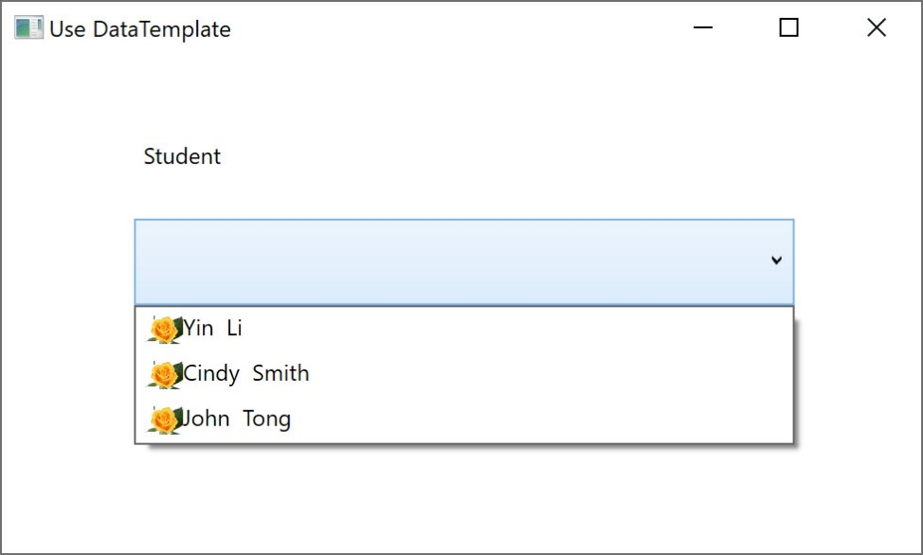
Example of DataTemplate

Slide 10
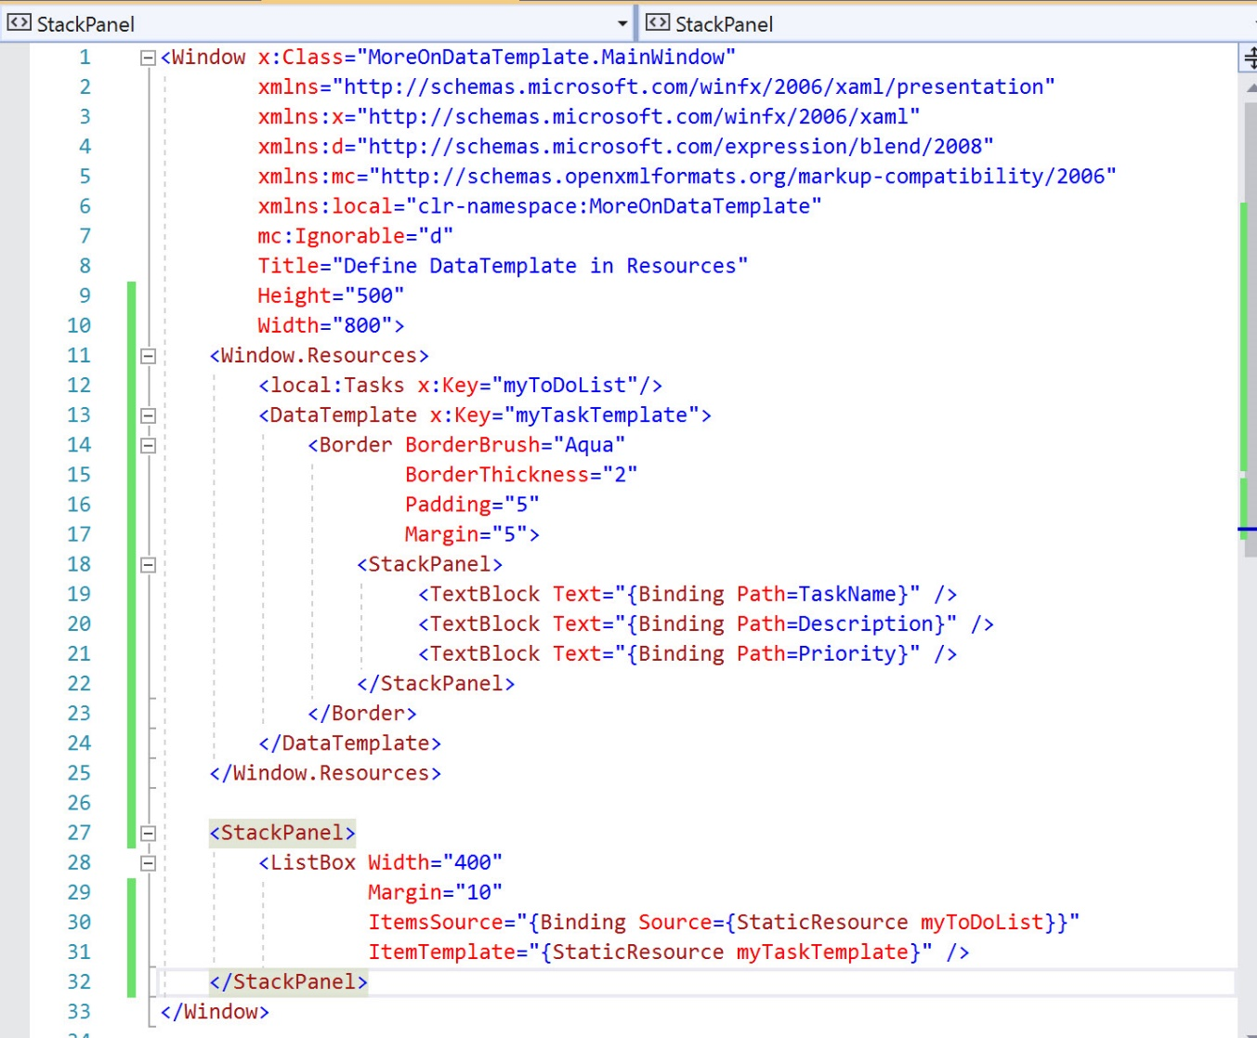
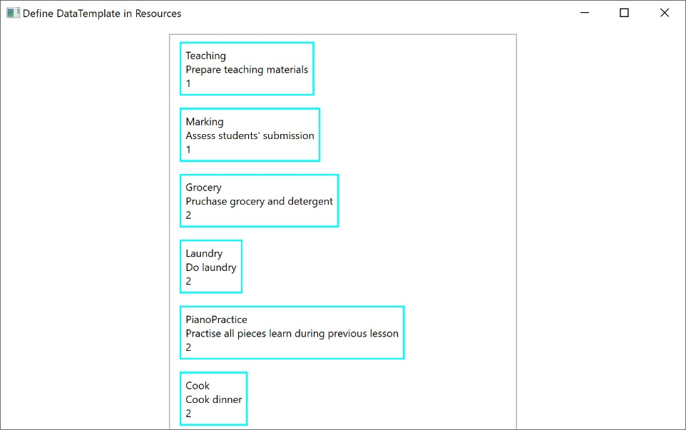
Define DataTemplate as Resource

Slide 11
References
https://docs.microsoft.com/en-us/dotnet/api/system.windows.data.binding?view=netframework-4.8
https://docs.microsoft.com/en-us/dotnet/desktop-wpf/data/data-binding-overview
https://docs.microsoft.com/en-us/dotnet/framework/wpf/data/data-templating-overview
https://docs.microsoft.com/en-us/dotnet/framework/wpf/data/how-to-bind-to-a-collection-and-display-information-based-on-selection#example
https://www.c-sharpcorner.com/UploadFile/mahesh/datagrid-in-wpf/
https://docs.microsoft.com/en-us/dotnet/framework/wpf/controls/datagrid

