Slide 1
Programming III
Centennial College
Week#6 2020 Winter
Topic: WPF Dependency Property and WPF User Control

Slide 2
Agenda
WPF Dependency Property
WPF User Control

Slide 3
Common Language Runtime (CLR) property
A CLR property is read directly from the member of the object or class. Get() and Set() of the class are used to retrieve and store the values of the property

Slide 4
WPF Dependency Property
The value of a Dependency Property is not stored in a field of the object, but in a dictionary of keys and values provided by the base class DependencyObject. The key of an entry is the name of the property and the value is the value
DependencyObject class is the immediate base class of many important UI-related classes, such as UIElement, Geometry, FrameworkTemplate, Style, and ResourceDictionary

Slide 5
Terms Used with Dependency Property
Dependency Property
A property that is backed by a DependencyProperty
Dependency property identifier
A DependencyProperty instance which is obtained as a return value when registering a dependency property, then stored as a static member of a class
CLR “wrapper”
The actual get and set implementations for the property

Slide 6
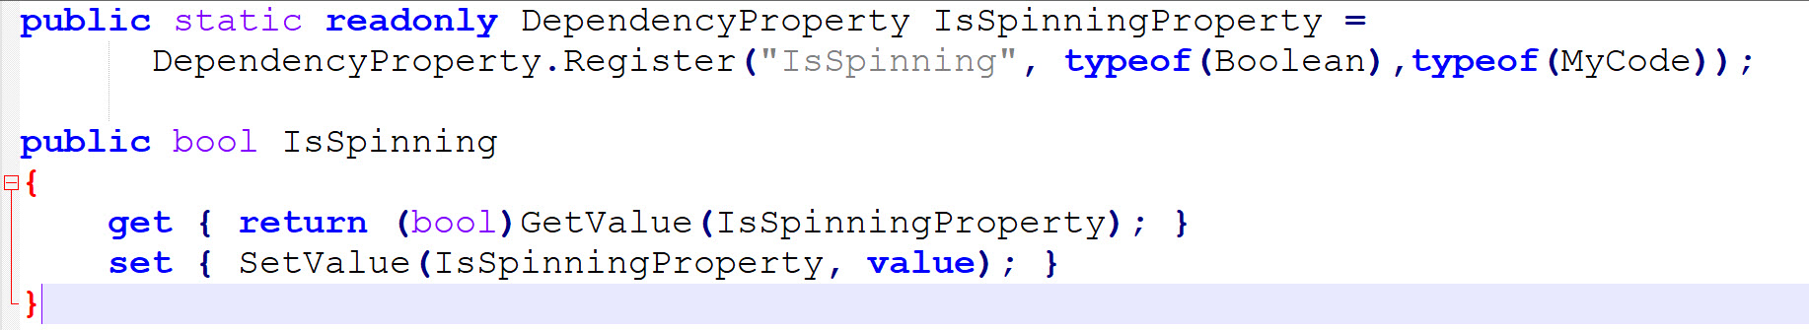
Example of DependencyProperty
The following snippet code defines a dependency property IsSpinning, and shows the relationship of the DependencyProperty identifier to the property that it backs
Please note that the name of the field is always the name of the property with the suffix Property appended

Slide 7
WPF User Control
The custom controls extend one of the WPF control base classes and provide additional functionality through code so all the added logic and representation must be implemented inside the code
While a WPF UserControl is an aggregation of other controls

Slide 8
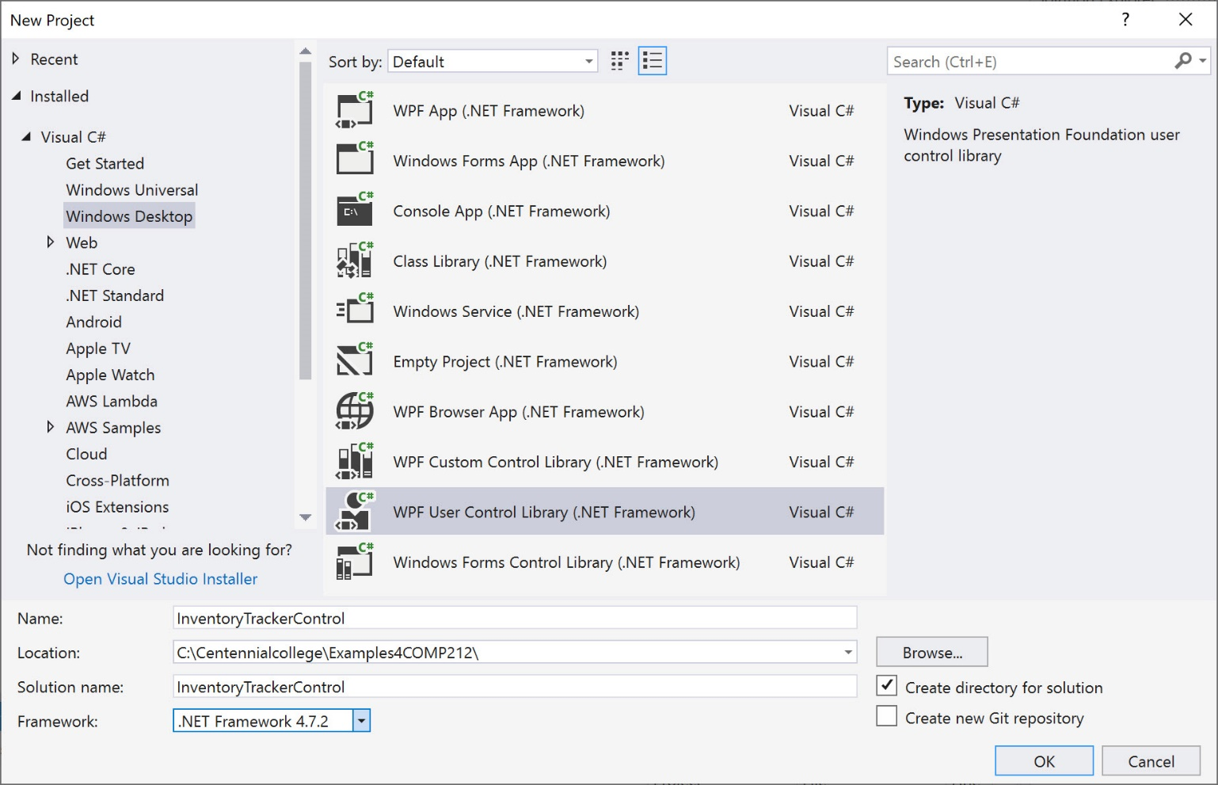
InventoryTrackerControl (1/3)

Slide 9
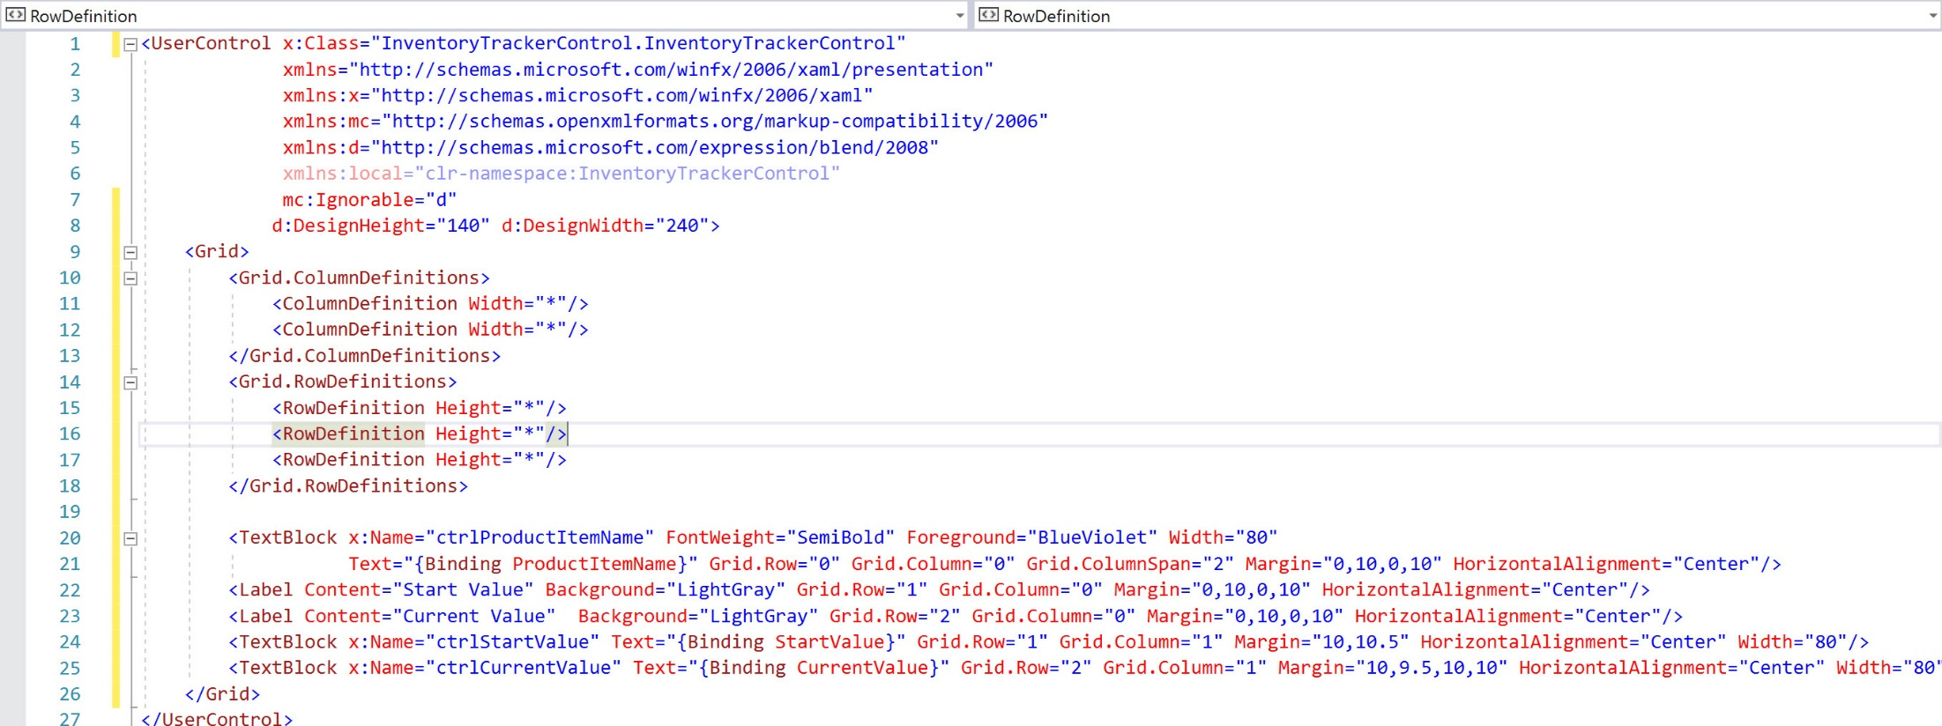
InventoryTrackerControl (2/3)

Slide 10
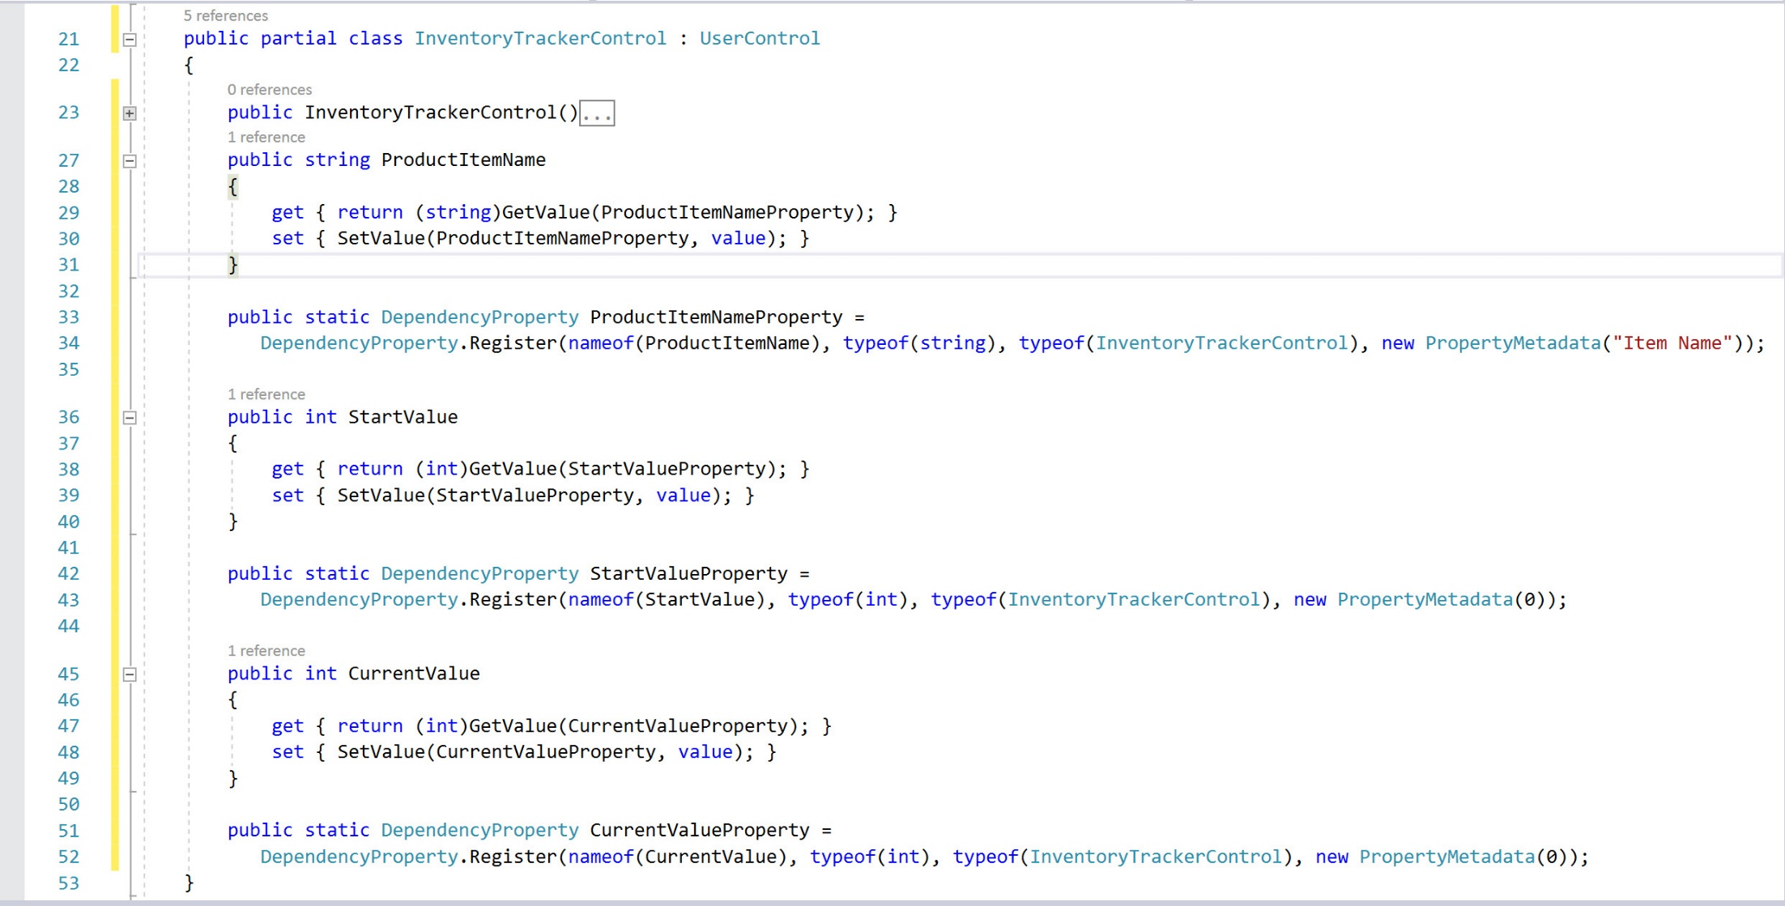
InventoryTrackerControl (3/3)

Slide 11
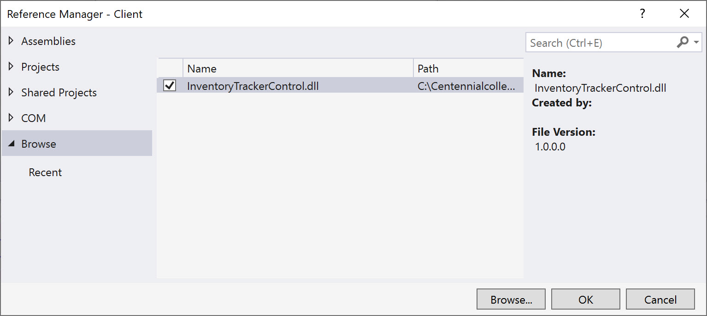
Consume InventoryTrackerControl(1)
Add reference to the Client project
InventoryTrackerControl is listed in the ToolBox

Slide 12
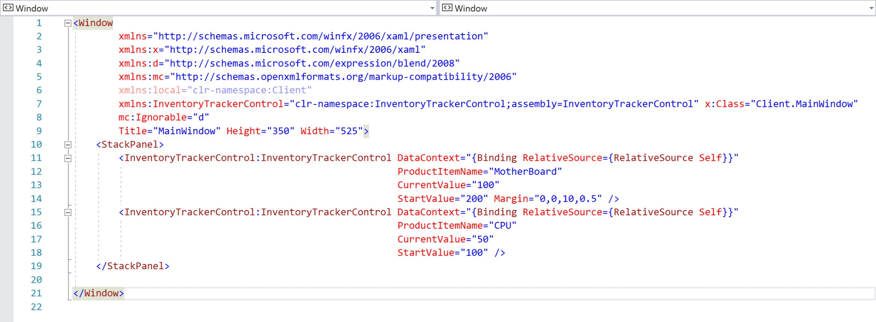
Consume InventoryTrackerControl(2)

Slide 13
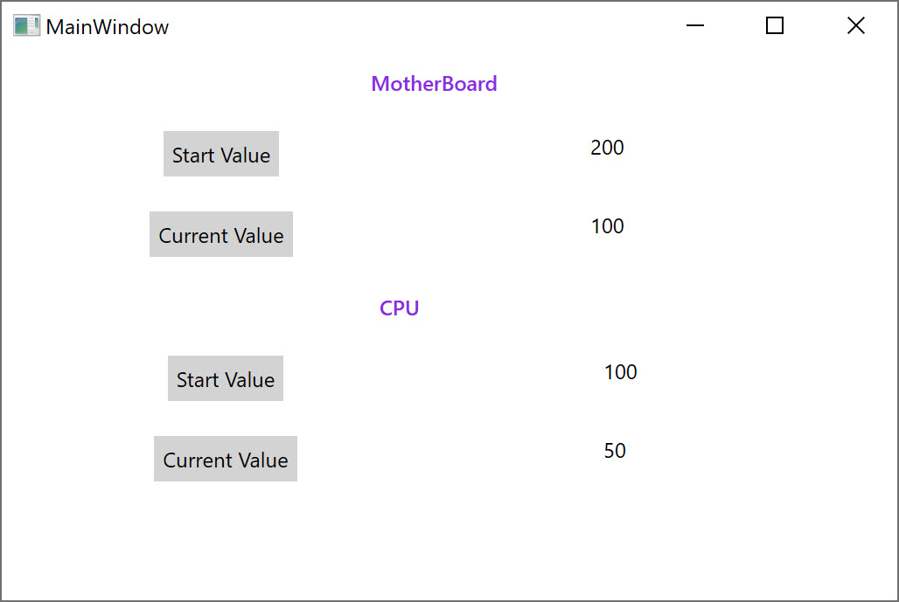
Consume InventoryTrackerControl(2)

Slide 14
References
https://docs.microsoft.com/en-us/dotnet/framework/wpf/advanced/dependency-properties-overview

