Slide 1
Programming III
Centennial College
2020 WINTER
Topic: Introduction to ADO.NET

Slide 2
Objectives
Upon completion, the learner will understand
ADO.NET Architecture
.NET Data Providers
DataSet

Slide 3
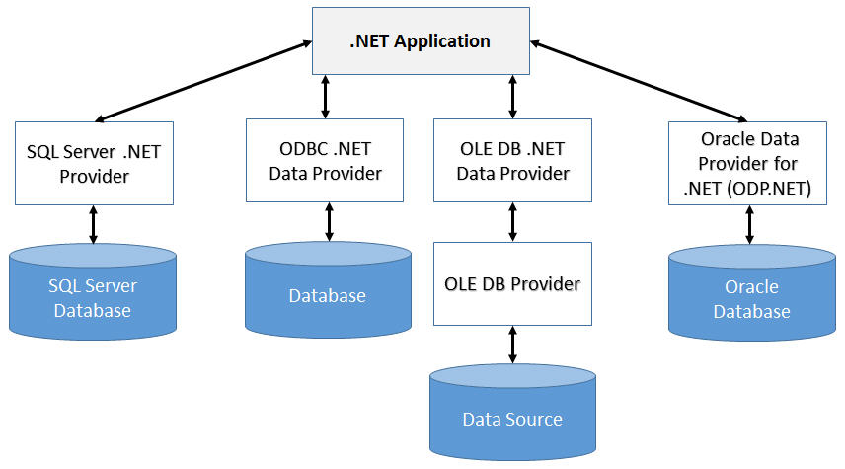
ADO.NET
ADO.NET(ActiveX Data Objects) provides consistent access to data sources such as SQL Server and XML, and data sources exposed through OLE DB and ODBC.
Whenever possible, use provider specific driver, e.g.,
Connector/Net is a
fully-managed ADO.NET
driver for MySQL

Slide 4
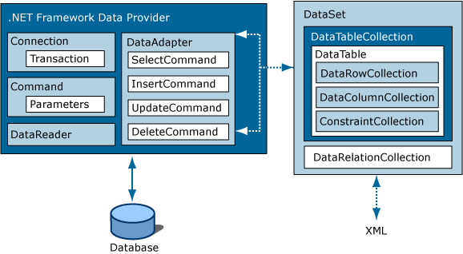
ADO.NET Architecture
The two main components of ADO.NET for accessing and manipulating data are the .NET Framework data providers and the DataSet.

Slide 5
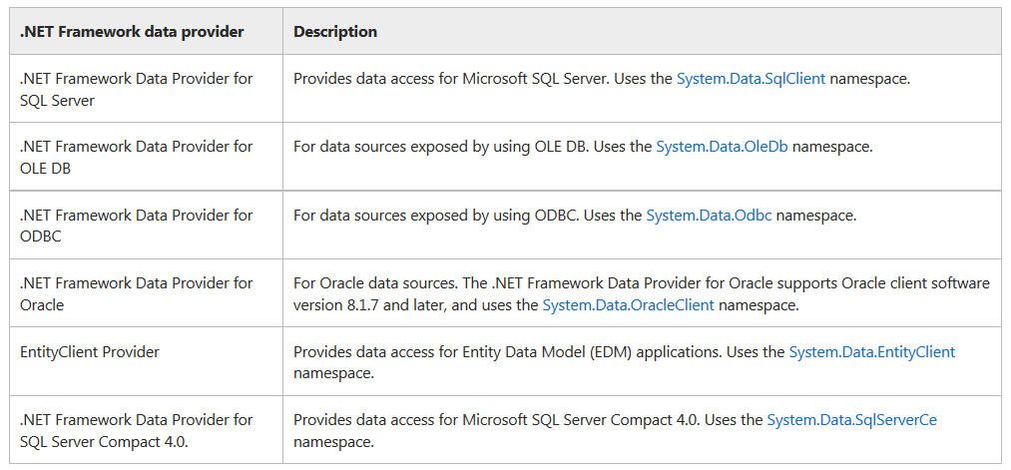
.NET Framework data providers(1/4)
From https://msdn.microsoft.com/en-us/library/a6cd7c08%28v=vs.110%29.aspx

Slide 6
.NET Framework data providers(2/4)
A .NET Framework data provider is used for connecting to a database, executing commands, and retrieving results.
Those results can either be processed directly, placed in a DataSet in order to be exposed to the user as needed, combined with data from multiple sources, or remoted between tiers.
.NET Framework data providers are lightweight, creating a minimal layer between the data source and code, increasing performance without sacrificing functionality.

Slide 7
.NET Framework data providers(3/4)
The .NET Framework Data Providers are components that have been explicitly designed for data manipulation and fast, forward-only, read-only access to data.
Consists of the following classes
Connection
Command
DataReader
DataAdapter

Slide 8
.NET Framework data providers(4/4)
The Connection object provides connectivity to a data source.
The Command object enables access to database commands to return data, modify data, run stored procedures, and send or retrieve parameter information.
The DataReader provides a high-performance stream of data from the data source.
The DataAdapter provides the bridge between the DataSet object and the data source.
The DataAdapter uses Command objects to execute SQL commands to load the DataSet with data and reconcile changes that were made to the data in the DataSet back to the data source.

Slide 9
Object-Relational Mappers(ORM)
ORM maps OO concepts to Relational DB concepts
To read/update data, ADO.NET can be used by using SqlCommand, SqlDataReader, SqlDataAdapter and DataSet. In this case, the developers have to manually write and execute SQL queries; convert data from database’s format into objects, properities, and collections, etc.

Slide 10
Three Commonly Used ORMs in ASP.NET
ADO.NET Entity Framework
The main ORM that Microsoft provides for the .NET Framework
For new development where you're not constrained by a legacy data access approach, Microsoft recommends the Entity Framework
LINQ to SQL
A legacy ORM that Microsoft provides
Nhibernate(here) is an open source ORM for the .NET framework

Slide 11
LINQ(Language Integrated Query)
Be a part of .NET Framework
Allows to perform queries (i.e., select, filter, group, and transform data) without leaving the comfort of the C# language
LINQ extensions allow to use same query expressions with different data sources
LINQ to Objects to query collections of in-memory objects
LINQ to Dataset performs the same feat with the in-memory Dataset
LINQ to Entities to query database without writing data access code
LINQ to XML allows to read an XML file without using .NET’s specialized XML classes

Slide 12
Entity Framework
Entity framework is a data access framework provided by Microsoft that helps to establish a relation between objects and data structure in the application
It is built over traditional ADO.NET and acts as a wrapper over ADO.NET and is an enhancement over ADO.NET that provides the data access in a more automated way by reducing a developer’s effort to struggle with connections, data readers or dataset

Slide 13
References
.NET Documentation

