Slide 1
How do we progress from machine learning to deep learning?
by yin see
ys

Slide 2
Key Issues in Machine Learning
Machine learning (ML) faces several significant challenges that can hinder its effectiveness and application. Here are the primary issues:
Data Quality and Quantity: The effectiveness of ML algorithms heavily relies on the quality and quantity of training data. Common problems include inadequate, noisy, or uncleadata, which can lead to inaccurate predictions and model performance issues.
Overfitting and Underfitting:
Overfitting occurs when a model learns the training data too well, including noise and outliers, leading to poor generalization on unseen data​​
Underfitting happens when a model is too simple to capture the underlying patterns in the data, resulting in poor performance even on training data

Slide 3
3. Bias and Fairness: Models trained on biased datasets can produce skewed outcomes, leading to ethical concerns, particularly in sensitive applications like hiring or lending
.Addressing bias involves careful dataset curation and ongoing monitoring.
4.Lack of Interpretability: Many ML models function as "black boxes," making it difficult for users to understand how decisions are made. This lack of transparency can reduce trust in ML applications
5.Talent Shortage: There is a significant gap between the demand for skilled ML professionals and the available talent pool. This shortage affects project timelines and quality

Slide 4
6.Scalability Issues: As datasets grow larger, scaling models to handle increased complexity becomes challenging. Efficient strategies for distributed computing and parallel processing are essential for managing extensive datasets
7. Slow Implementation and Results: The time-consuming nature of data preparation, model training, and evaluation can delay deployment, impacting business agility

Slide 5
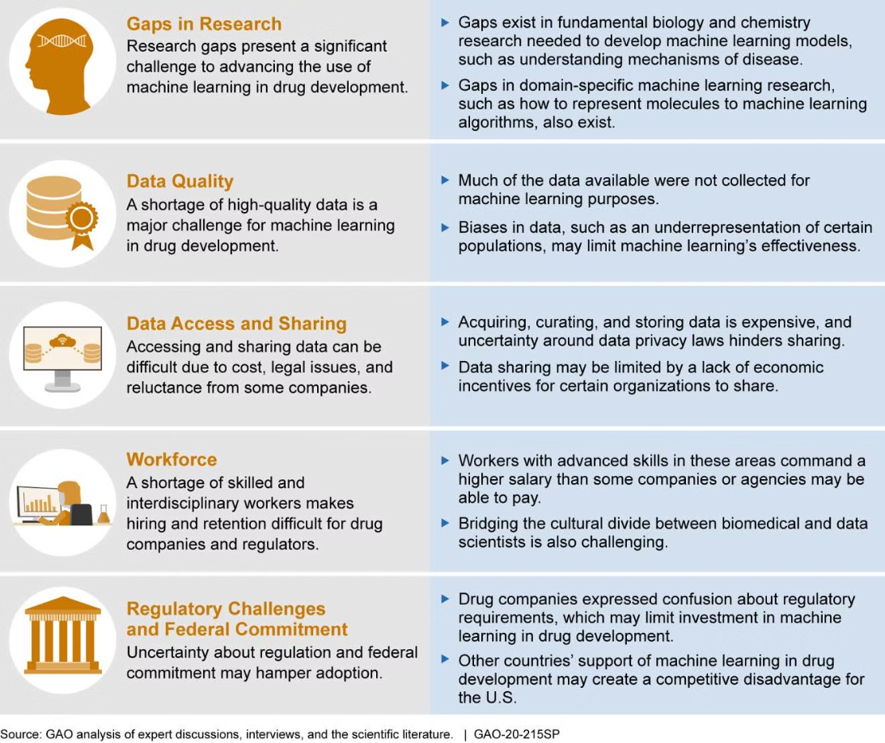

Slide 6
Progressing from Machine Learning to Deep Learning
Transitioning from traditional machine learning to deep learning involves several key steps:
Understanding Neural Networks: Deep learning is fundamentally based on neural networks, which require a solid understanding of their architecture, such as layers, neurons, activation functions, and backpropagation.
Data Requirements: Deep learning typically demands larger datasets compared to traditional ML methods due to its complexity. Collecting and curating high-quality data is crucial for training effective models.
Computational Resources: Deep learning models often require significant computational power, including GPUs or TPUs, for efficient training due to their complexity and size.
Feature Engineering vs. End-to-End Learning: Traditional ML often relies on manual feature extraction, while deep learning can automatically learn features from raw data. Understanding this shift is essential for effectively applying deep learning techniques.
Experimentation with Architectures: Familiarize yourself with different deep learning architectures (e.g., CNNs for image processing, RNNs for sequential data) to determine which is best suited for your specific problem.
Model Evaluation: Develop skills in evaluating deep learning models using appropriate metrics (e.g., accuracy, precision, recall) and techniques (e.g., cross-validation) to ensure robust performance.

Slide 7
By addressing these issues in machine learning and understanding the transition to deep learning, practitioners can enhance their capabilities and improve the performance of their models across various applications.

