Slide 1
The Birth of Artificial Intelligence,
History of AI, Machine Learning, Neural Networks, and Deep Learning.
The evolution of Artificial Intelligence (AI), Machine Learning (ML), Neural Networks (NN), and Deep Learning (DL) represents a fascinating journey through decades of research, innovation, and technological advancement. This history can be segmented into several key phases.

Slide 2
The idea of artificial intelligence was generated by mathematician and computer scientist Alan Mathison Turing in 1950.
Alan Turing’s paper called “Computing Machinery and Intelligence” starts with the question “Can machines think?”.
This question is considered to be the birth of artificial intelligence and the beginning of the brief history of AI.

Slide 3
1955 A.I. BORN Term ‘artificial intelligence’ is coined by computer scientist, John McCarthy to describe “the science and engineering of making intelligent machines”.
1961 UNIMATE First industrial robot, Unimate, goes to work at GM replacing humans on the assembly line.
1964 ELIZA Pioneering chatbot developed by Joseph Weizenbaum at MIT holds conversations with humans.
1966 SHAKEY The ‘first electronic person’ from Stanford, Shakey is a general-purpose mobile robot reasons about its own actions.
1997 DEEP BLUE Deep Blue, a chess-playing computer from IBM defeats world chess champion, Garry Kasparov

Slide 4
1998 KISMET Cynthia Breazeal at MIT introduces KISmet, an emotionally intelligent robot insofar as it detects and responds to people’s feelings
1999 AIBO Sony launches first consumer robot pet dog AiBO (AI robot) with skills and personality that develop over time.
2002 ROOMBA First mass produced autonomous robotic vacuum cleaner from iRobot learns to navigate and clean homes.
2011 SIRI Apple integrates Siri, an intelligent virtual assistant with a voice interface, into the iPhone 4S.
2011 WATSON IBM’s question answering computer Watson wins first place on popular $1M prize television quiz show Jeopardy.

Slide 5
2014 EUGENE Eugene Goostman, a chatbot passes the Turing Test with a third of judges believing Eugene is human.
2014 ALEXA Amazon launches Alexa, an intelligent virtual assistant with a voice interface that can complete shopping tasks.
2016 TAY Microsoft’s chatbot Tay goes rogue on social media making inflammatory and offensive racist comments.
2017 ALPHAGO Google’s A.I. AlphaGo beats world champion Ke Jie in the complex board game of Go, notable for its vast number (2*170) of possible positions.

Slide 6
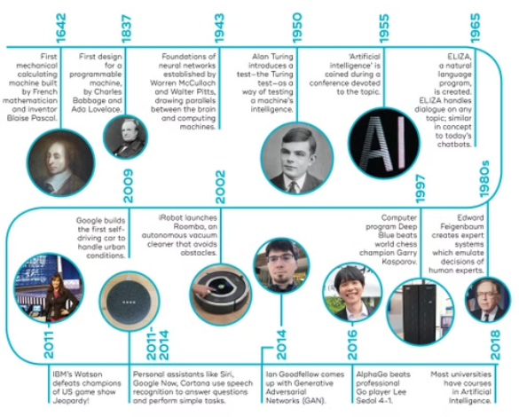

Slide 7
1. Foundations of Artificial Intelligence (1940s-1950s)
Early Concepts: The groundwork for AI was laid in the 1940s with foundational work by Warren McCulloch and Walter Pitts, who created the first mathematical models of neural networks in 1943. Their work inspired future developments in computational models that mimic human thought processes
​
Dartmouth Conference (1956): This pivotal event marked the formal birth of AI as a field. John McCarthy coined the term "Artificial Intelligence," and early researchers envisioned machines capable of performing tasks that would require human intelligence
​​
.

Slide 8
2. The Rise of Machine Learning (1950s-1970s)
Early ML Algorithms: In the 1950s, Arthur Samuel developed the first machine learning program to play checkers, demonstrating that computers could learn from experience. Frank Rosenblatt introduced the Perceptron in 1957, an early neural network designed for pattern recognition
Challenges and Setbacks: The 1970s saw a decline in interest due to the limitations highlighted by Marvin Minsky and Seymour Papert regarding simple neural networks. This period is often referred to as the first "AI winter," where funding and enthusiasm waned significantly

Slide 9
3. Revival and Growth of Neural Networks (1980s-1990s)
Backpropagation: In the late 1980s, researchers like Geoffrey Hinton revived interest in neural networks by introducing backpropagation, a method for training multi-layer networks. This technique allowed for more complex models that could learn from data more effectively
Support Vector Machines: During this time, alternative approaches like support vector machines gained popularity, showcasing the competition between different ML methodologies

Slide 10
4. Emergence of Deep Learning (2000s-Present)
Big Data and GPUs: The explosion of data in the 2000s, combined with advancements in Graphics Processing Units (GPUs), provided the computational power necessary for training deep neural networks. This era saw a significant shift towards deep learning as a dominant approach in AI
Key Breakthroughs: The landmark moment came in 2012 when AlexNet, a deep convolutional neural network developed by Hinton's team, won the ImageNet competition, outperforming traditional methods by a large margin. This success catalyzed widespread interest and investment in deep learning technologies

Slide 11
5. Current Trends and Future Directions
Transformer Models: Since 2017, transformer-based models have revolutionized natural language processing and multimodal applications, merging text and image understanding in sophisticated ways
Applications Across Fields: Today, deep learning is applied across various domains including healthcare (for diagnostics), autonomous vehicles, and natural language processing tools like chatbots and translation services

Slide 12
Conclusion
The history of AI, ML, NN, and DL illustrates a complex interplay of ideas, technological advancements, and societal needs. From early theoretical models to today's sophisticated systems capable of remarkable feats, these fields continue to evolve rapidly, promising further innovations that will shape our future.

Slide 13
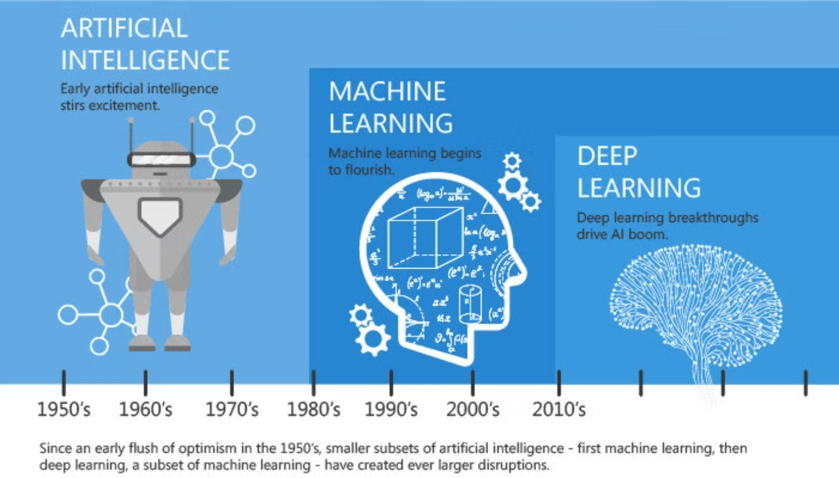

Slide 14
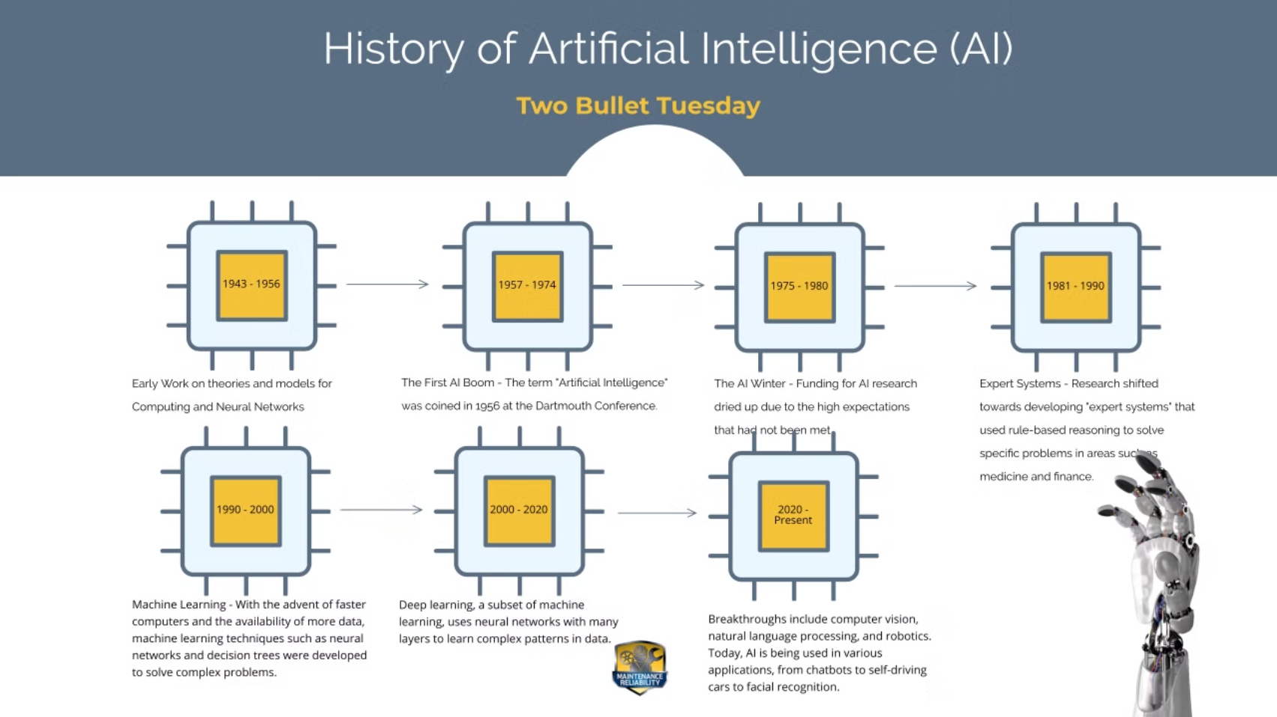

Slide 15
