Slide 1
Understand the Differences and connections between Research problems and Applications in Machine learning, Artificial Neural Networks, and Deep Learning
by yin see
ys

Slide 2
The fields of machine learning (ML), artificial neural networks (ANNs), and deep learning (DL) are interconnected yet distinct, particularly when discussing research problems and real-world applications.
This overview will elucidate their differences and connections.

Slide 3
. Definitions and Scope
Machine Learning (ML): A subset of artificial intelligence that enables systems to learn from data and improve over time without explicit programming. ML encompasses various techniques, including supervised learning, unsupervised learning, and reinforcement learning
Artificial Neural Networks (ANNs): A type of ML model inspired by the human brain's structure. ANNs consist of interconnected nodes (neurons) that process data in layers. They are foundational for many DL applications
Deep Learning (DL): A specialized area within ML that uses multi-layered ANNs to analyze complex data patterns. DL excels in tasks like image and speech recognition due to its ability to learn hierarchical representations of data

Slide 4
2. Research Problems
Research problems in these domains often focus on improving algorithms, enhancing model accuracy, and addressing challenges such as:
Data Quality: Ensuring high-quality training datasets is crucial for effective ML models. Issues like noise, bias, and imbalanced classes can significantly impact model performance
Model Interpretability: Understanding how models make decisions is vital, especially in sensitive areas like healthcare. Research is ongoing to develop techniques for better interpretability of complex models
Algorithm Efficiency: Many research initiatives aim to create more efficient algorithms that require less computational power while maintaining or improving accuracy

Slide 5
3. Applications
The application of ML, ANNs, and DL spans numerous industries, each with unique challenges:
Healthcare: Applications include predicting patient outcomes and diagnosing diseases through image analysis. However, adapting these models to real-world scenarios requires significant engineering work beyond mere application of existing methods
Finance: ML is used for fraud detection, algorithmic trading, and risk assessment. The dynamic nature of financial data presents unique challenges for model training and evaluation
Agriculture: Techniques like predictive analytics enhance crop yield predictions and optimize resource usage. However, the agricultural context requires tailored models that consider local conditions

Slide 6
4. Connections Between Research Problems and Applications
The interplay between research problems and applications is critical:
Benchmarking: Many research efforts focus on creating benchmark datasets that reflect real-world complexities. However, reliance on overly simplistic benchmarks can lead to models that perform poorly in practical scenarios
Feedback Loop: Real-world applications often highlight shortcomings in existing research methodologies, prompting new research questions. For instance, issues faced in deploying ML models in healthcare can lead to advancements in interpretability techniques or data handling strategies
Collaborative Efforts: Successful applications often stem from collaboration between researchers and industry practitioners who understand specific domain challenges. This partnership helps ensure that research addresses practical needs effectively

Slide 7
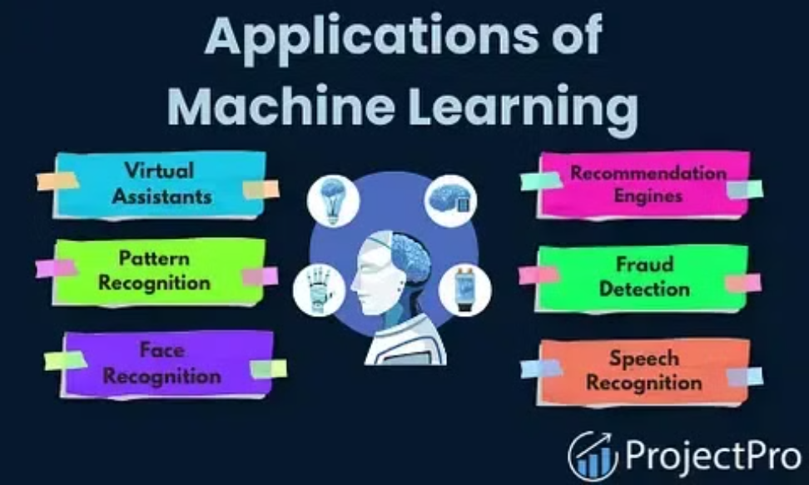

Slide 8
