Slide 1

Distributed Systems
Lecture 14: Time in Distributed Systems
Prof. Dr.-Ing. Christoph König

Slide 2
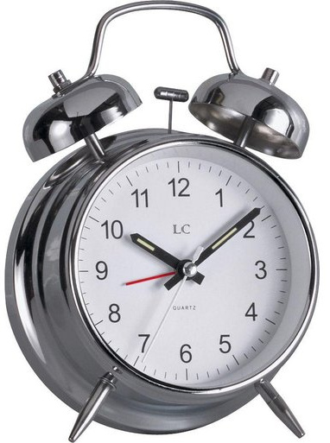
Outline
Challenges in distributed systems
  Consistency
  Concurrency
Physical and logical time
  … and how to distribute it
Time synchronization
  Skew and drift
  Cristian's algorithm
  Berkeley algorithm
  NTP and PTP
Logical clocks
  Relations
  Lamport clock
  Vector clock

Slide 3
Synchronization and drift
Goal: All hosts should have the same time
Challenges
  Clocks can have different start times
    t_{clock_a} != t_{clock_b}
    Called skew
  Clocks can run at different speeds
    Called drift
    Ideal: dC/dt = 1
Drift example
  Let p = the maximum deviation
  e.g. given by the manufacturer, such
  that 1-p ≤ dC/dt ≤ 1+p
  Question: What is the maximum difference
  of two drifting clocks after ∆t time units?
  Answer: 2p∆t
Clock time C
Fast clock
Ideal clock
Slow clock
UTC t

Slide 4


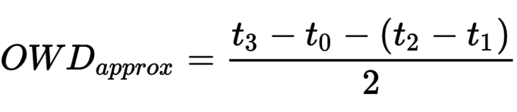
Message delays (cont’d)
How to get (and calculate) message delays?
Approximation
Question: What is the maximum error?
t₁
t₂
time
Server
t₀
t₃
time
Client
Notes:
Question: What is the maximum error?
Error:
The earliest point at which S(erver) could have placed the time in m_{t} was min after C(lient) dispatched m_{r-} The latest point at which it could have done this was min before m_{t} arrived at C(lient). The time by S(erver)’s clock when the reply message arrives is therefore in the range [ t + min , t + T_{round} – min ] . The width of this range is T_{round} – 2 * min , so the accuracy is ± T_{round} / 2 – min .
https://www.redhat.com/en/blog/combining-ptp-ntp-get-best-both-worlds
Error: (d2-d1)/2 (d2>>d1)
Max error: d1=0 => d2/2
https://visualmatheditor.equatheque.net/
OWD_{approx}=\frac{t_3-t_0-(t_2-t_1)}{2}

