Slide 1


SelfHelp
Technology Platform for Research
Dr. Simon Maurer and Stefan Kodzhabashev
11.10.2021, Bern

Slide 2
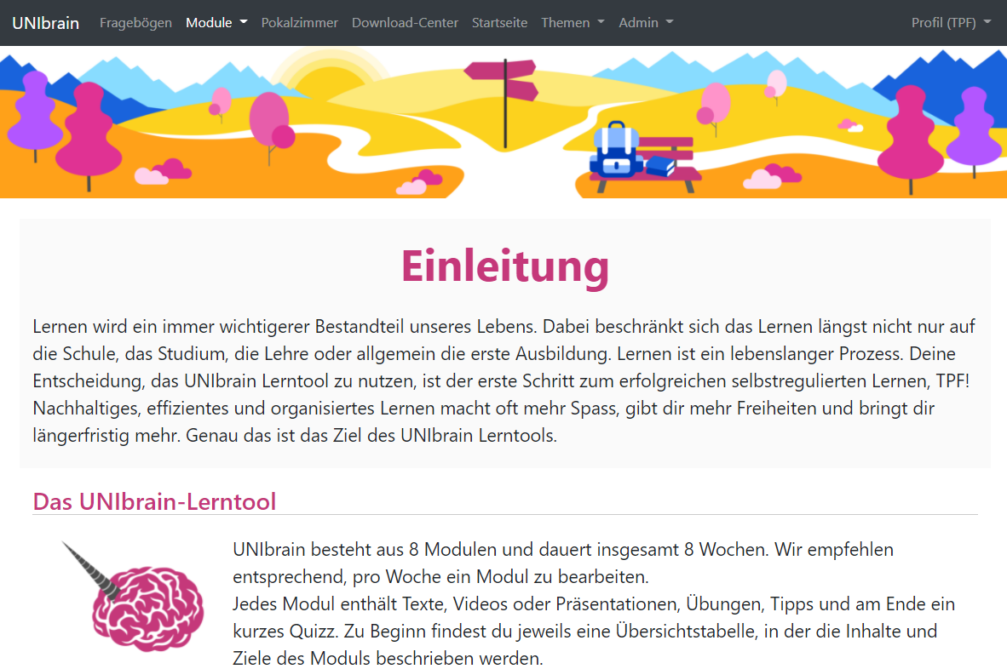
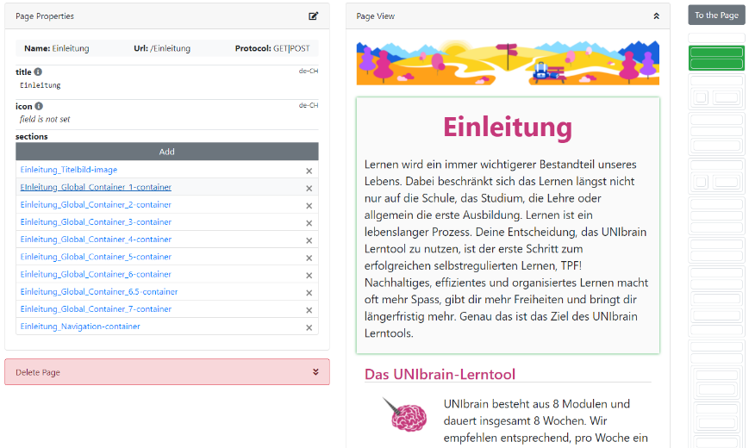
What is SelfHelp?
Started as a webpage for self-aided therapy project
Website building platform
OpenSource (MPL-2.0)
Notes:
Created by Simon, 4 years ago as a simple project requiring a web page for a self aided therapy. Then it expanded to a CMS tools designed for researchers.

Slide 3
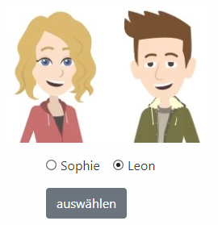
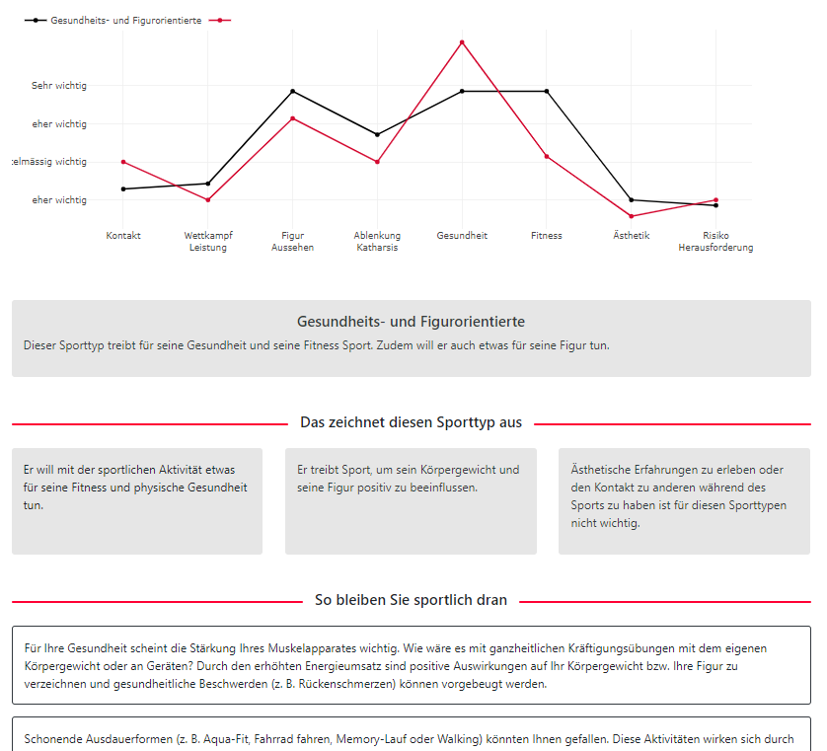
Why SelfHelp?
Tailored to research
Tight control over the data
No programming skills needed
Close support by the TPF Team
Notes:
Collected data dynamically change the view of the website. It can even trriger task as adding or removing permissions.
Sophie and Leon

Slide 4

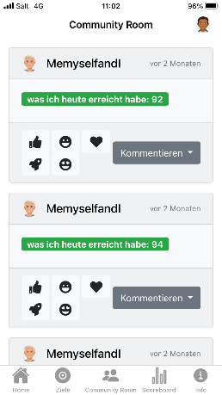
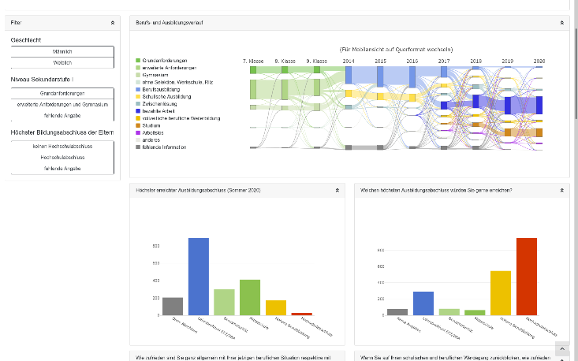
When to Use SelfHelp?
Information hub
Data collection
Data representation
User interaction
Mobile
Notes:
Load static data and represent it.
If you have any combination of these requirements, then SelfHelp will be the perfect tool for your project.
All these requirements are perfectly usable and rendered on mobile page but we further offer an option for a native android or iOS app that you can design, manage and change content without needs to contact any IT and you don’t need any programming skills at all.

Slide 5
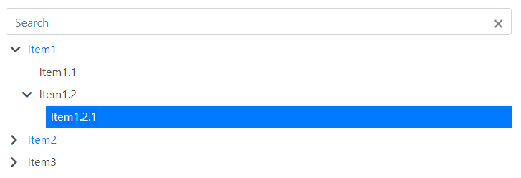
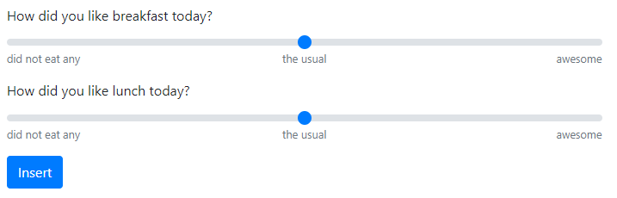
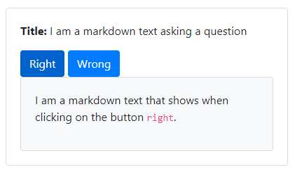
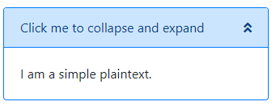
How to Use SelfHelp?
Building blocks
Group & user management
Qualtrics integration
Experiment scheduling
Notes:
Build the content using the components that we developed for you. We add new components with the new updates and we improve some of the already existing components.
Creates groups with different permissions and then assign the users to specific groups in order to present different information to the users.
Qualtrics is fully integrated and a survey can be loaded inside the webpage. Then the user does not need to move to another platform and come back to your study. All the data could be collected if needed and even more, the start or finish of a survey could trigger a task in selfhelp such as sending notification after specific time or assign the user to another group where he/she can have access to other pages. All these scheduling gives you the opportunity to design flexible and very customizable studies with multiple sessions.
With this experiment scheduling it is very easy to design a diary experiment for example. You can schedule notifications and add the user to a group where he/she can fill a questioner every night and send them reminders if they did not do it.

Slide 6
Wrap Up
Current applications:
PSY: 15
ISPW: 1
EDU: 3
External: 1
Future work:
Templates
REDCap integration
Mobile features

Slide 7
References
https://becccs.psy.unibe.ch
https://selfhelp1.psy.unibe.ch/unibrain
https://www.spw.unibe.ch/tpf_selfhelp
https://dab-data.edu.unibe.ch
https://selfhelp.psy.unibe.ch/sophie

Slide 8
Thank You
for your Attention
Technology Platform for Research
11.10.2021, B 201, Fabrikstrasse 8

