Slide 1


SelfHelp
Technology Platform for Research
Stefan Kodzhabashev
30.03.2026, Bern
Notes:
Today I want to show how SelfHelp has evolved since our 2021 presentation and why it now works as a platform for complete digital programs.

Slide 2

SelfHelp at the Faculty Meeting
We already presented SelfHelp here in 2021
Since then, the platform has evolved significantly
Today, SelfHelp is no longer just a website system
It is a platform for complete digital programs
Notes:
Some of you may remember that we presented SelfHelp here in 2021. Today I want to build on that and show how much the platform has changed since then.
The main message is simple. SelfHelp is no longer just a website system. It has grown into a platform for complete digital programs.

Slide 3
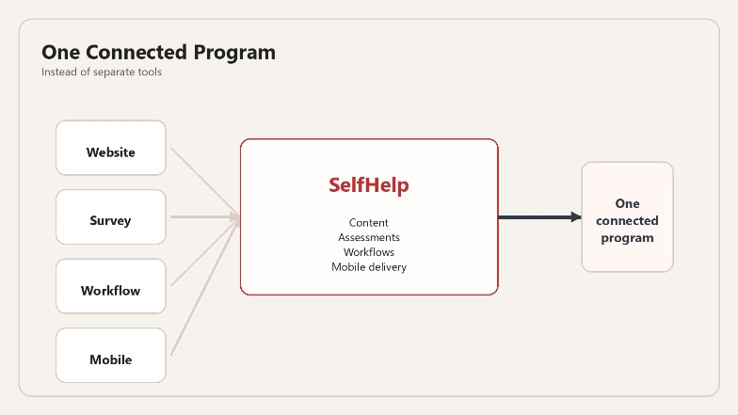
What SelfHelp Is
A modular platform for running digital programs
Brings content, assessments, workflows, and mobile delivery into one system
Reusable components make projects faster to build and easier to adapt
Can be hosted under university control
Notes:
If I had to explain SelfHelp in one sentence, I would call it a platform for running digital programs.
What makes it useful is that it brings together pieces that are often separate. Content, assessments, workflows, and mobile delivery can all live in the same system.
That makes projects easier to build, easier to adapt, and easier to manage over time. And because it can run under university control, it also fits settings where governance and data protection matter.

Slide 4
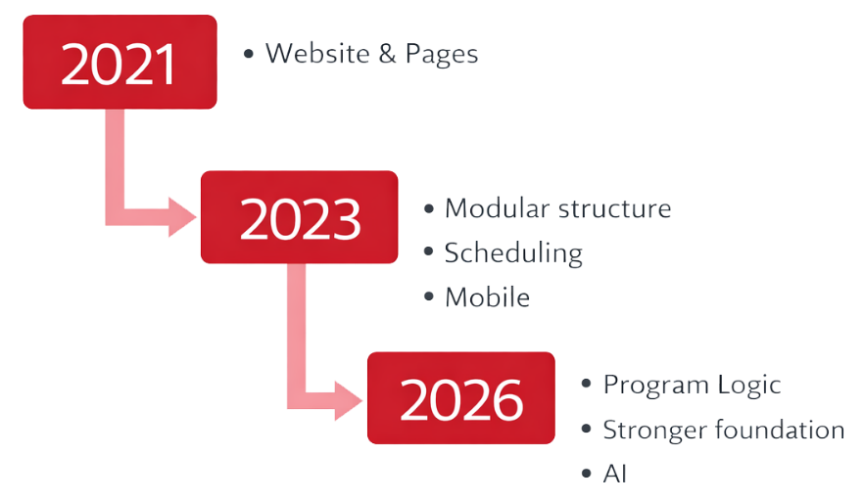
How SelfHelp Evolved
2021: positioned as a platform for self-help and research websites
2023: expanded toward modular pages, scheduling, and mobile integration
2024 to 2026: stronger data model, workflows, permissions, 2FA, and background processing
The newest step is AI: general LLM support and supervised therapy-style chat
The direction is clear: from content publishing toward structured digital program delivery
Notes:
The easiest way to understand the evolution is to look at what changed at each stage.
In 2021, SelfHelp was mainly presented as a platform for self-help and research websites. By 2023, it had become more modular and more practical to run, with better page structure, scheduling, and mobile integration.
Then from 2024 to 2026, a lot of the progress happened underneath the surface. The data model became stronger, workflows became more systematic, permissions became clearer, and two-factor authentication was added.
Once that base became stronger, it made sense to add AI in a more serious way. So the direction is clear. SelfHelp started as a content platform, and it is now growing into a platform for structured digital programs.

Slide 5
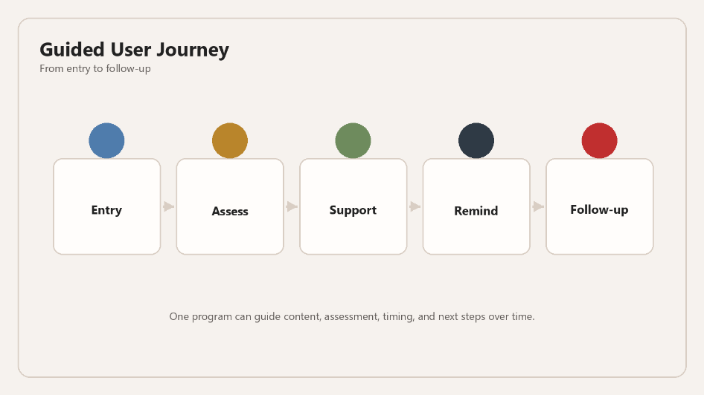
What Teams Can Do with It
Turn a concept into a guided journey from entry to follow-up
Run repeated assessments and collect richer inputs over time
Adapt content and timing by role, group, language, or user state
Automate reminders, tasks, and next steps as the program progresses
Notes:
What this means in practice is that a team can take an idea and turn it into a full user journey.
With SelfHelp, you can build a complete digital program: onboarding, content, structured assessments, reminders, and follow-up. That can all happen in one environment instead of being spread across disconnected tools.
People can move through the program step by step. The system can adjust content, timing, and next actions based on role, group, language, or what already happened before.
So the value is not only that SelfHelp can publish content. It can run a process over time.

Slide 6
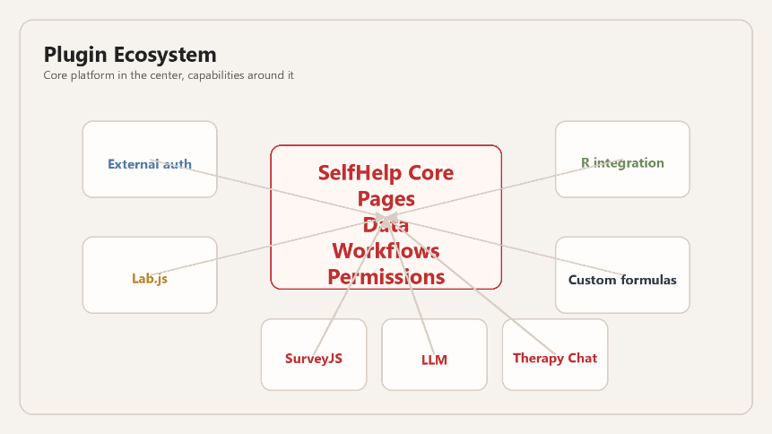
How SelfHelp Expands
SelfHelp grows by adding capabilities without breaking the core system
Core supporting plugins: external auth, Lab.js, R, and custom formulas
These plugins strengthen real academic and institutional workflows
Today I want to highlight 3 newer plugins that are especially visible and practical
Notes:
Another important part of the story is how SelfHelp grows.
It grows through plugins. That means new capabilities can be added without rebuilding the core platform every time.
Some of those plugins matter mainly in the background. External authentication helps with institutional access. Lab.js brings browser-based experiments into the same environment. R integration supports more advanced analysis. And custom formulas allow scoring and derived values directly in the system.
On top of that, there are also newer plugins that are much more visible from the user side. Those are the three I want to show next.

Slide 7
Featured Plugin 1: SurveyJS
Versioned survey creation, publishing, and scheduling
Autosave, edit mode, timing metadata, and dashboards
File upload, PDF export, and voice-record responses
Stronger data quality for repeated and longitudinal assessment
Notes:
SurveyJS is a good example of how SelfHelp has moved beyond simple forms.
The key point is not only that surveys can be created. The key point is that they can be managed properly inside the platform. They can be versioned, scheduled, edited later, and connected to dashboards.
That improves data quality and makes repeated assessment much easier to handle. It also makes the assessment layer more flexible, because responses can include files and voice recordings.
So SurveyJS makes SelfHelp a much stronger environment for structured data collection over time.

Slide 8
Featured Plugin 2: LLM
Controlled AI assistants inside SelfHelp pages
Text, file, image, and speech-to-text input
Conversation output or structured JSON output, including OpenAI-style structures
Prompt Lab for testing, replay, and evaluation before rollout
Notes:
The LLM plugin should not be understood as just a chatbot. It is better understood as a controlled and testable AI component.
It lets us place a purpose-built assistant inside a page, with a clear role and a clear context. A very important part of that is prompt management. Prompts can be versioned, tested, replayed, and improved before they are used in a real setting.
The plugin can also work with files, images, and voice input. And it can return either normal conversation or structured JSON output, including formats that fit OpenAI-style workflows.
That matters because it makes AI output easier to connect back into the platform in a controlled way. And right now, we are using the university's local LLM infrastructure, which means the interaction stays inside the university environment.

Slide 9
Featured Plugin 3: LLM Therapy Chat
AI-supported or human-only communication in the same framework
Therapist dashboard with alerts, notes, summaries, and drafts
Direct escalation from AI to human handling
Useful for both service delivery and controlled comparison studies
Notes:
The therapy chat plugin is probably the most distinctive part of the current platform.
The key idea is supervised communication. A user can interact with AI, but therapists remain present through their own dashboard. They can review conversations, step in directly, write notes, generate drafts, and manage risk status.
It is also important that this can run without AI. That means the same framework can support both AI-assisted and human-only communication.
That makes it interesting not only for service delivery, but also for research, because different communication models can be compared in the same environment.

Slide 10
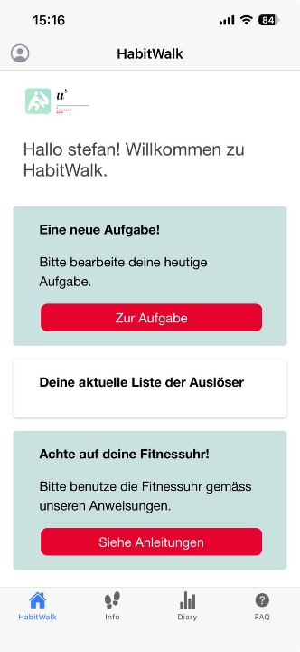
Mobile App
The same program logic can continue on mobile
Surveys, AI chat, therapy chat, notifications, camera, and microphone are already supported
This makes repeated real-world interaction much easier
SelfHelp becomes part of daily use, not only desktop use
Notes:
The mobile app matters because digital programs rarely stay on the desktop.
SelfHelp already has a mobile frontend that uses the same platform logic. Surveys, AI chat, therapy chat, notifications, camera input, and microphone input are already part of that picture.
That makes repeated interaction much easier in real life. People can respond, upload, reflect, or interact when it fits their day, not only when they are sitting at a computer.
So the same program can stay with the user across different situations, instead of being split across separate tools.

Slide 11
Alternatives
LimeSurvey is strong for surveys
JATOS and formr are strong for online studies
Moodle is strong for learning delivery
SelfHelp is strongest when everything needs to stay connected
Notes:
It is also useful to compare SelfHelp with other open and self-hosted tools.
LimeSurvey is very strong for surveys. JATOS and formr are strong for online studies. Moodle is strong for learning delivery.
SelfHelp is strongest in a different kind of case. It becomes most valuable when content, data collection, workflows, mobile use, permissions, and AI all need to stay connected in one locally controlled system.
So the point is not that it replaces every other tool. The point is that it connects more of the full program in one place.

Slide 12
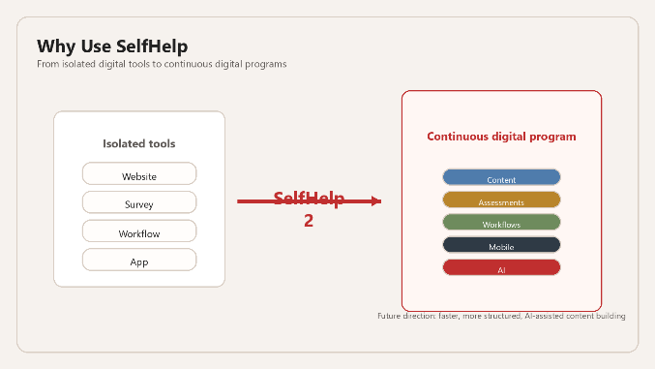
Why Use SelfHelp
One platform for complete digital programs
One structure across content, data, workflows, mobile, and AI
Local control plus flexibility for future development
SelfHelp 2 can make the platform even more structured and easier to extend
Notes:
To close, I would summarize it like this.
SelfHelp gives us one platform where content, assessments, workflows, mobile interaction, and AI can all be part of the same program. That is already useful today.
At the same time, SelfHelp 2 is already well underway. It is not just a redesign. The goal is to make the platform more structured, easier to extend, and faster to build with.
One especially promising next step is LLM-supported content creation. That could reduce the time spent building website structure by hand and give teams more time for the actual study design, content quality, and assessment logic.
And if you see value in this direction, especially in the local university AI infrastructure behind it, I would really encourage you to support ID with a short letter of support so that this local LLM service can become a permanent university service.
The main message I would leave you with is this: SelfHelp moves us from isolated digital tools to continuous digital programs.

Slide 13
Thank You
for your Attention
Technology Platform for Research
30.03.2026, Fabrikstrasse 8
Notes:
Thank you very much. I am happy to take questions.

