Slide 1
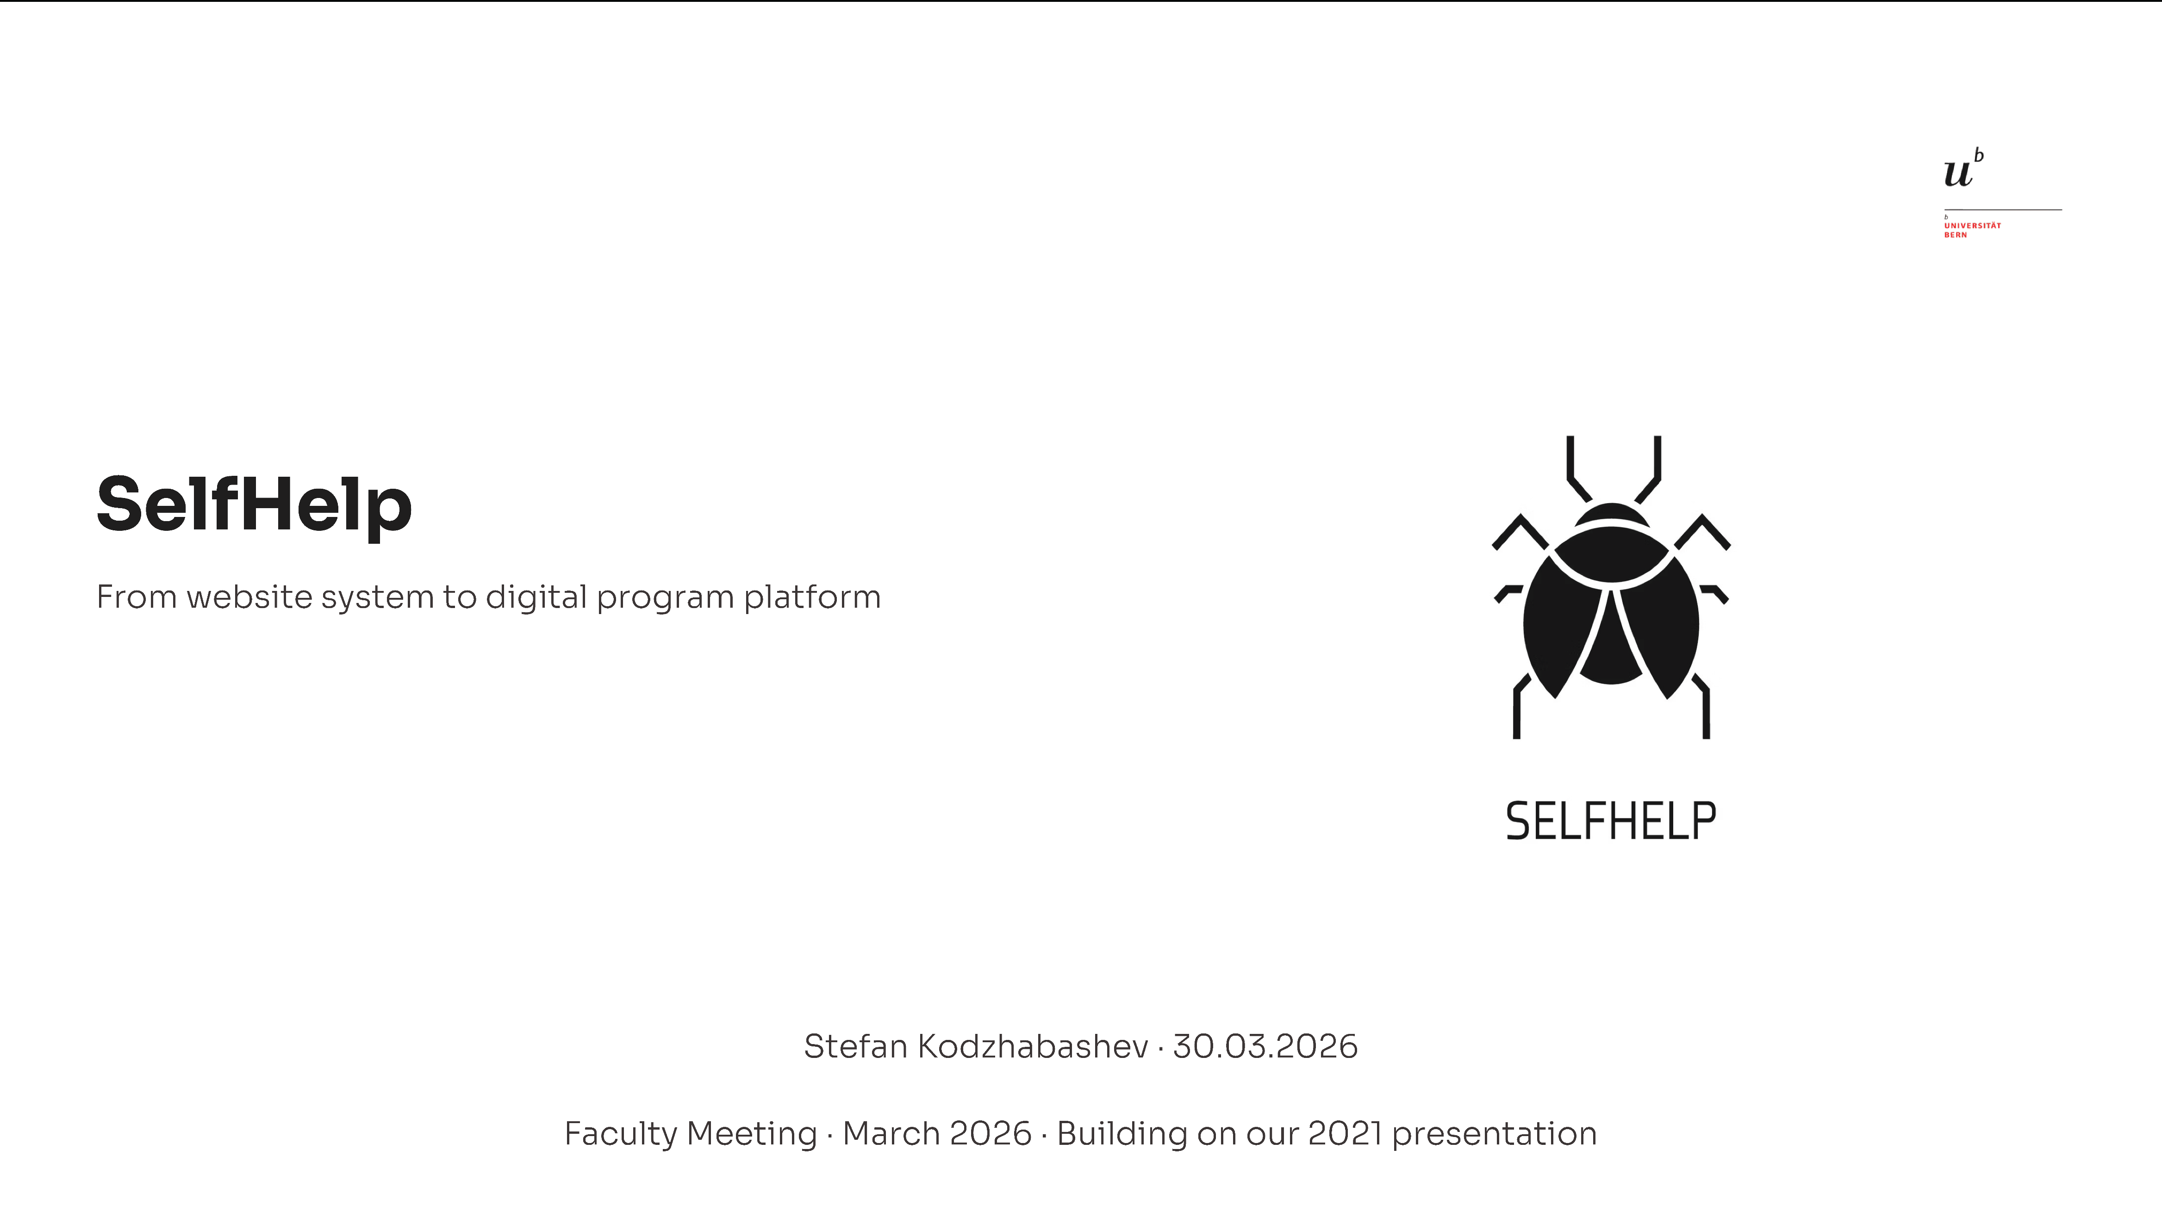
Notes:
Hallo everyone, for those who does not know me, my name is Stefan Kodzhabashev, I am research software engineer in TPF.
I am here to present Selfhelp. Some of you may remember that I already gave a presentation about it some years ago, I think it was in 2021.
At that time, the platform was much simpler. It was mainly a website builder. Today, I want to show you how it evolved, and what it is capable now.

Slide 2
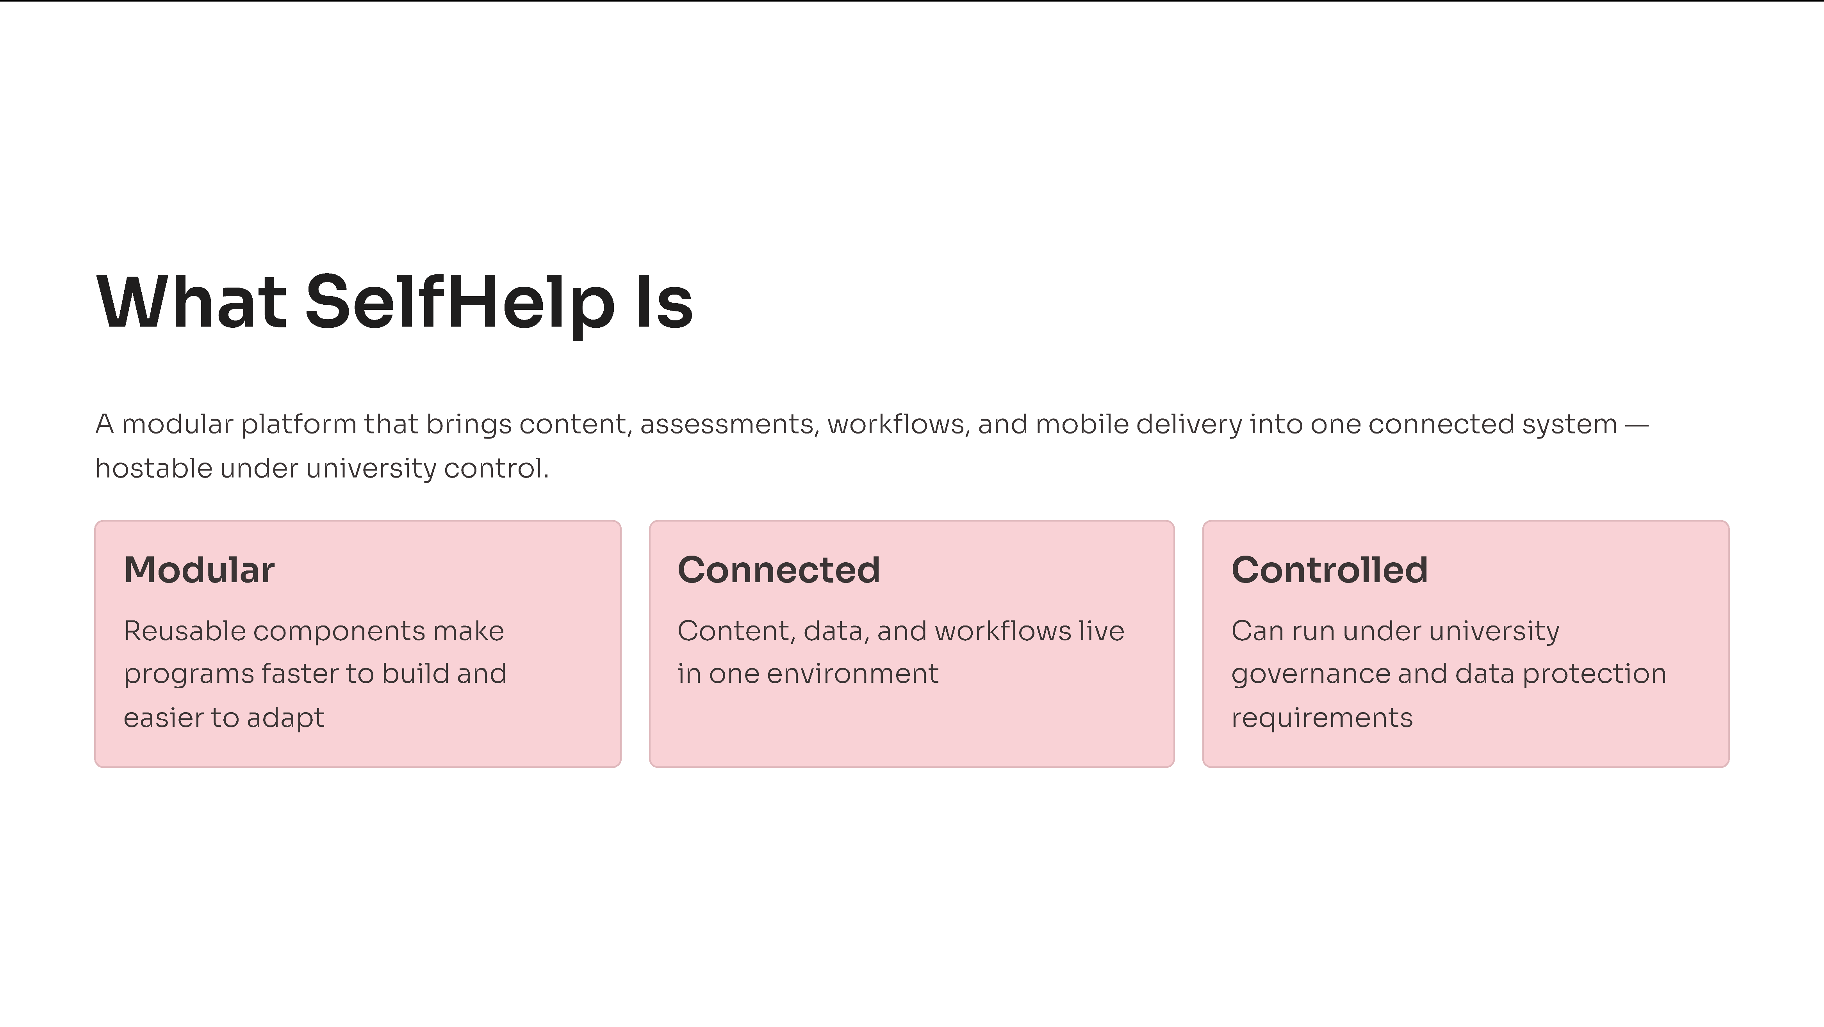
Notes:
So, what is SelfHelp today?
If you ask me to describe it with one sentence, I will say:
It is a platform that connects different digital tools into a single solution.
In many research projects or online interventions, systems are fragmented:
👉Data is stored in one place
👉Content is managed in another
👉Scheduling or randomization happens somewhere else
As a result, everything becomes distributed and harder to manage.
SelfHelp addresses this by bringing all these components together.
It connects:
👉Content
👉Data
👉Workflows
👉Communication
👉And even native mobile application
—all within one unified environment.
Another important aspect is that the system can be installed locally within the university infrastructure. This means that we have full control over the data and the system.
In summary: SelfHelp supports structured, long-term processes from start to finish

Slide 3
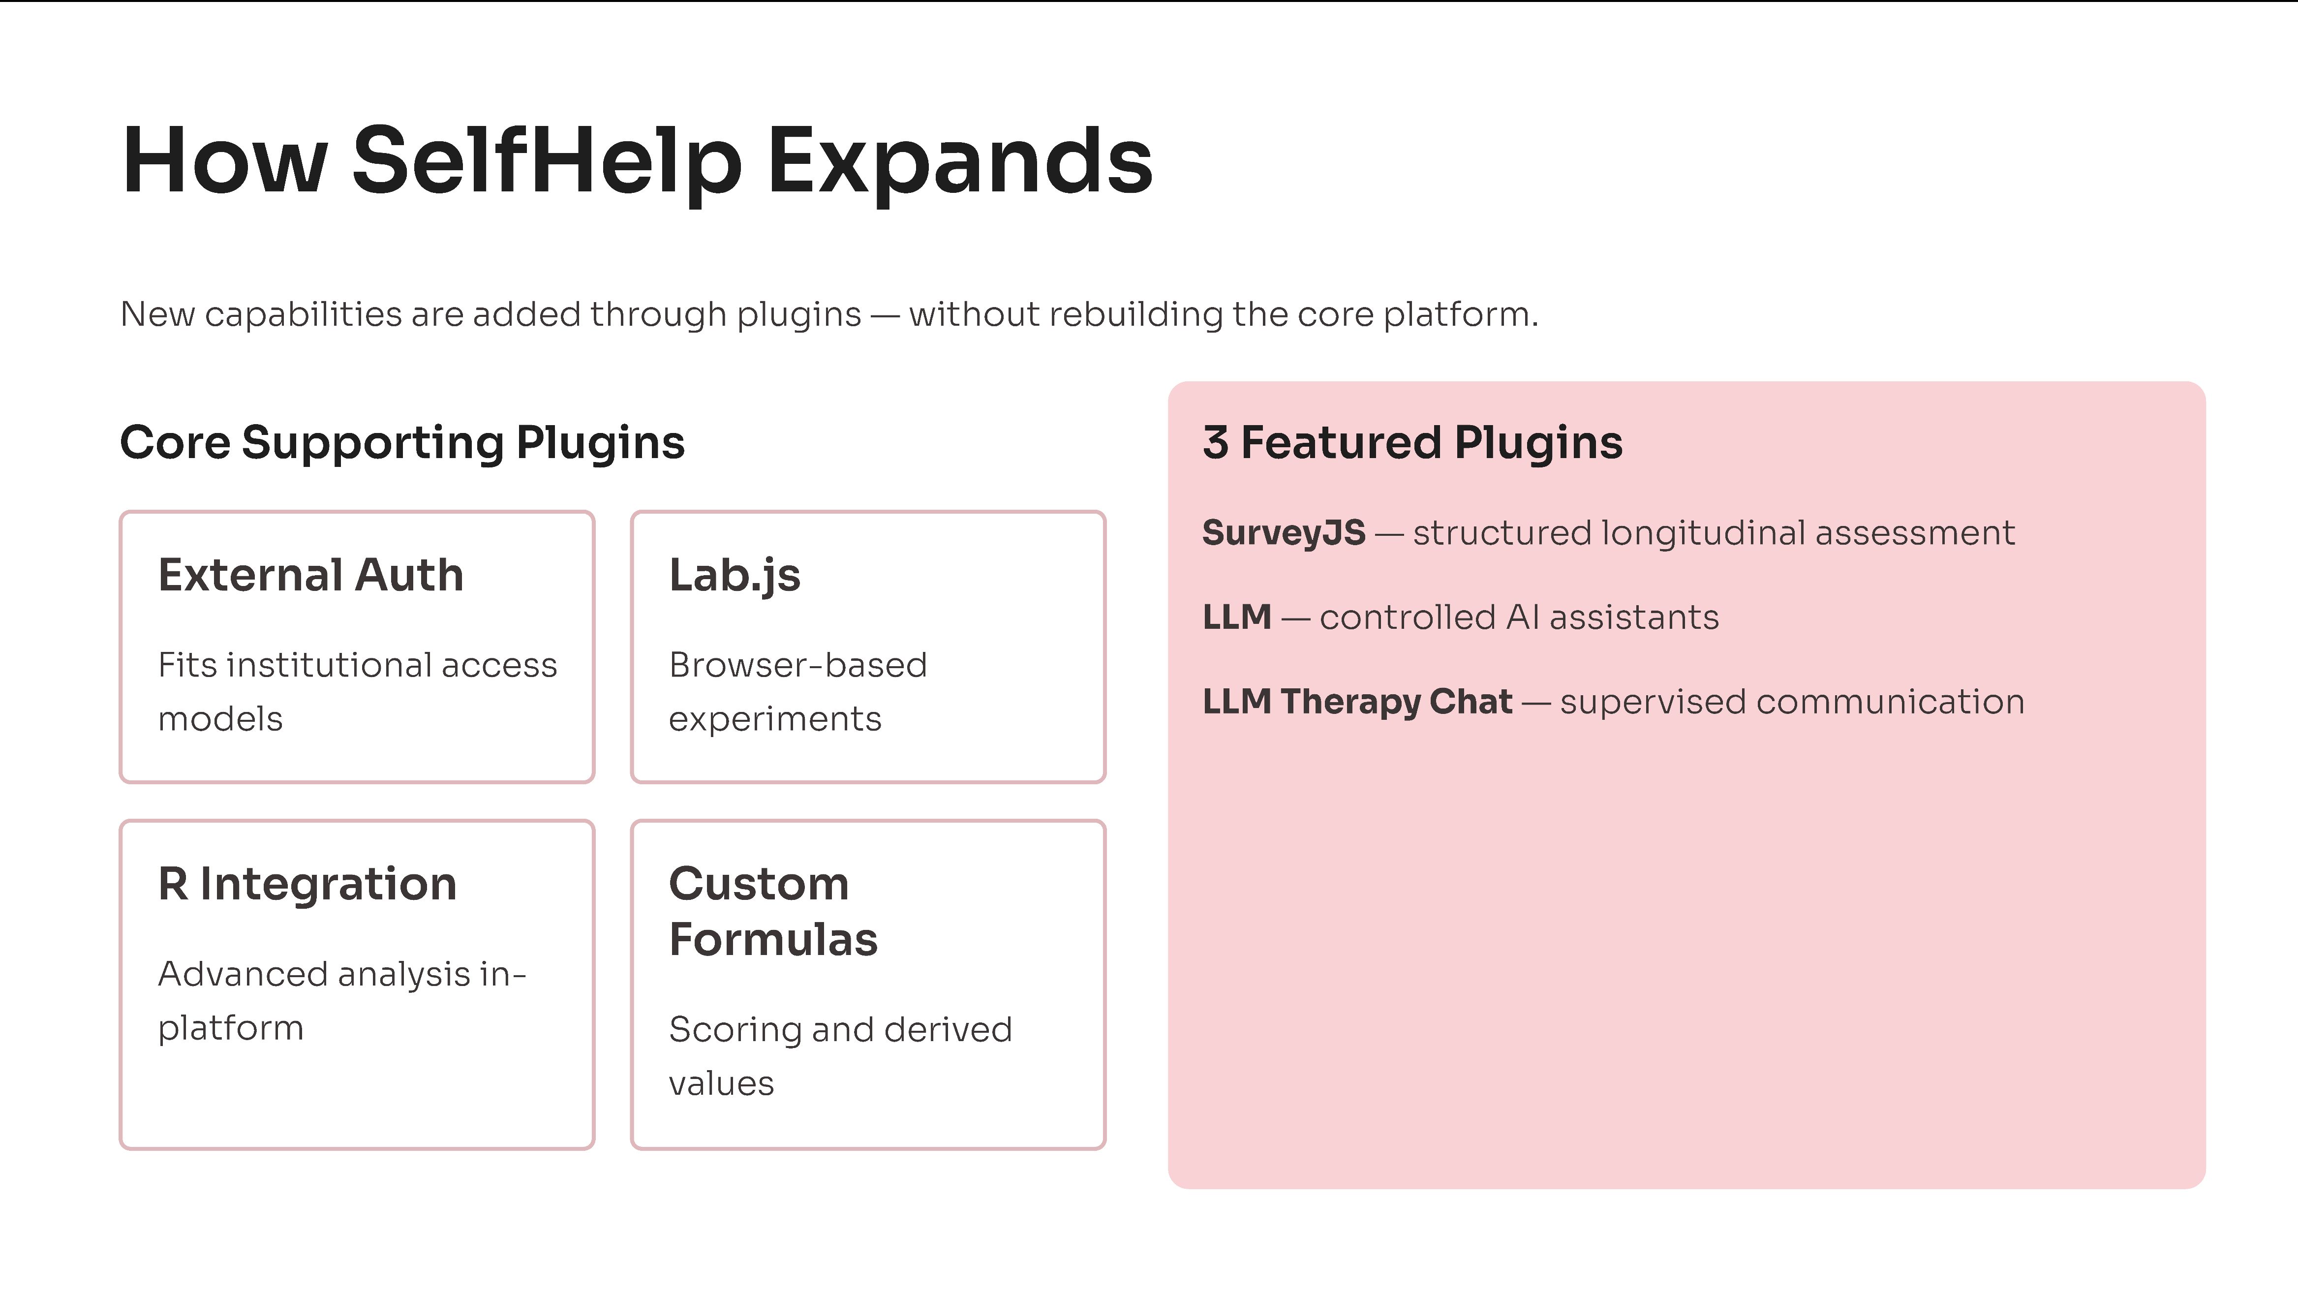
Notes:
The platform has grown a lot over the years.
So it became very important for us to keep it maintainable—and also lightweight when deployed on servers.
Not every project needs all features.
That’s why we introduced a plugin system.
The idea is simple: Any functionality that doesn’t belong to the core system is added as a plugin.
This has two main advantages.
👉First, from a development perspective, it keeps the code cleaner, better organized, and easier to maintain.
👉Second, from a deployment perspective, it keeps the system lightweight.
If a project doesn’t need certain features, they simply don’t have to be installed.
We already developed several plugins, for example:
👉External authentication
👉Lab.js integration
👉R integration
👉Custom formulas
👉API import and export
👉Plotly.js – library for graphs
In the next slides, I’ll focus on three specific plugins: SurveyJS, LLM, and the LLM Therapy Chat.

Slide 4
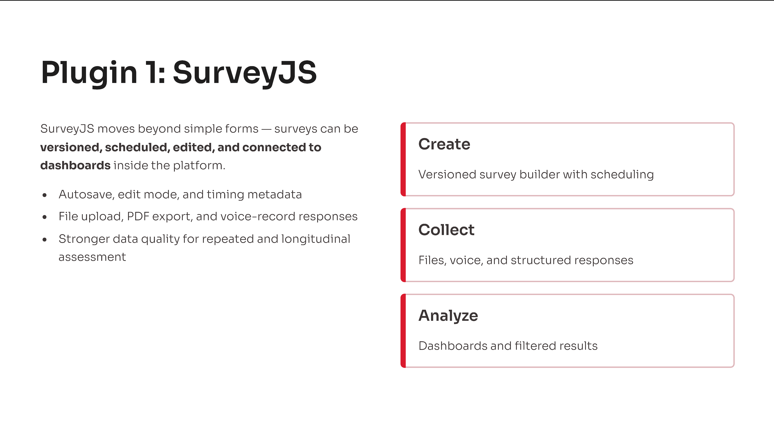
Notes:
The first plugin I want to talk about is SurveyJS. The idea is very simple: we can design and manage surveys directly inside our platform.
That means we can:
👉Create surveys
👉Store and version them
👉And publish them when they’re ready
Once published, these surveys can be used directly in the system—without relying on external tools.
All collected data is immediately available and can be reused across the platform. For example, we can:
👉Adapt future surveys dynamically
👉Show feedback to users
👉Or visualize results with graphs
We also have full control over how surveys are delivered.
We can define:
👉Whether a survey is shown once per user or maybe once per session
👉Time restrictions, like specific hours
👉Or expiration rules
In addition to the responses, we also collect detailed metadata.
So we don’t just see the final answers—we also know:
👉When the survey was started and completed
👉How much time was spent
👉And how users moved through it
This gives us much deeper insight into users behavior.
As you see we don’t just use surveys—we fully integrate them into the system.

Slide 5
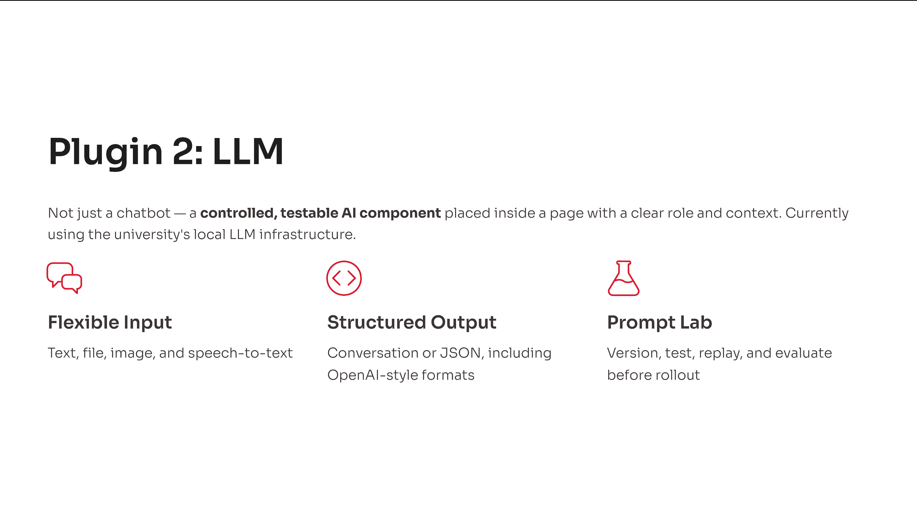
Notes:
The second plugin I want to present is the LLM plugin.
Here I want to show you how we actually use Large Language Models in SelfHelp.
Before I continue I want to point it out, that AI can be unpredictable… a bit random. So the key question is: how do we make it behave in a more controlled and reliable way?
This is where prompts and context come in.
A prompt is simply the instruction we give to the AI—it defines the task. For example: ‘Explain depression.’
But the prompt alone is not enough.
We also need context, which defines the situation or the audience.
For example, we could say:
👉“You are a professor teaching students”
👉Or: “You are a therapist talking to a patient”

Slide 6
Notes:
Even though the prompt stays the same, the result will be very different.
In one case, the explanation will be more academic. In the other, it will be simpler and more empathetic.
So in simple terms:
👉 The prompt defines what we want 👉 The context defines how it should be delivered
And together, they shape the final result.
To make this more reliable, we introduced a prompt & context management system.
With this system, we can:
👉Store and version prompts and contexts
👉Test them in a playground
👉Run them across different modules
👉Create datasets to evaluate responses
👉And continuously refine everything based on the results
This allows us to systematically improve how the AI behaves in our platform.
So in the end, this is not just a simple chatbot. It’s a controlled and evolving system for working with LLMs.

Slide 7
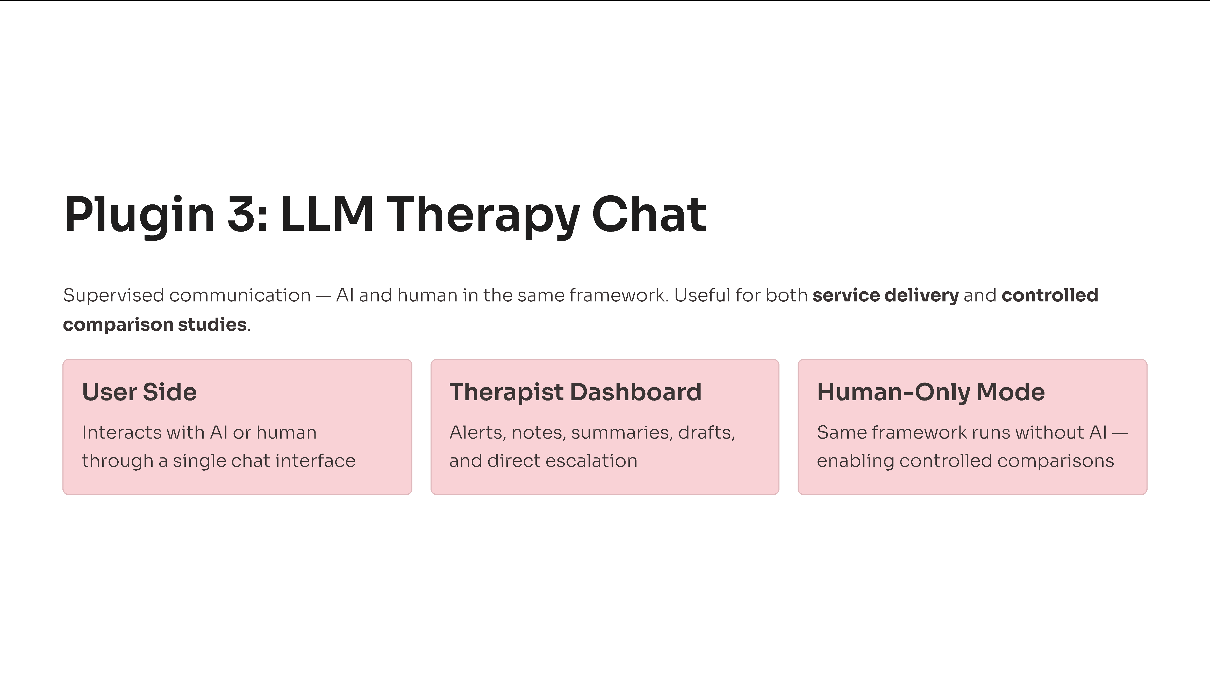
Notes:
The last plugin I want to show in more detail is the LLM therapy chat.
This plugin combines AI-supported communication with human supervision in a single framework.
From the user’s perspective, the experience is very simple. They interact through a chat interface and always know whether they are speaking with the AI or with a therapist.
👉If they message the AI, they get an immediate response
👉If they message the therapist, they wait for a human reply
On the professional side, we provide a dedicated therapist dashboard.
From there, therapists can:
👉 Monitor conversations in real time
👉 Receive alerts and notifications
👉 Communicate with the patient
👉 Use AI to improve the responses to the patients
👉 Create summaries and write notes for the patients (Here I want to relate to the previous slide where I explained the context.
These notes and summaries can be used as additional context for the AI, helping to improve the quality of the responses)
The same system can run in a human-only mode, which allows us to compare different communication setups in a controlled way—for example, AI-assisted versus fully human interaction.
So the key point is:
👉 This is not just a chat system 👉 It’s a structured communication environment with supervision, safety, and control.

Slide 8
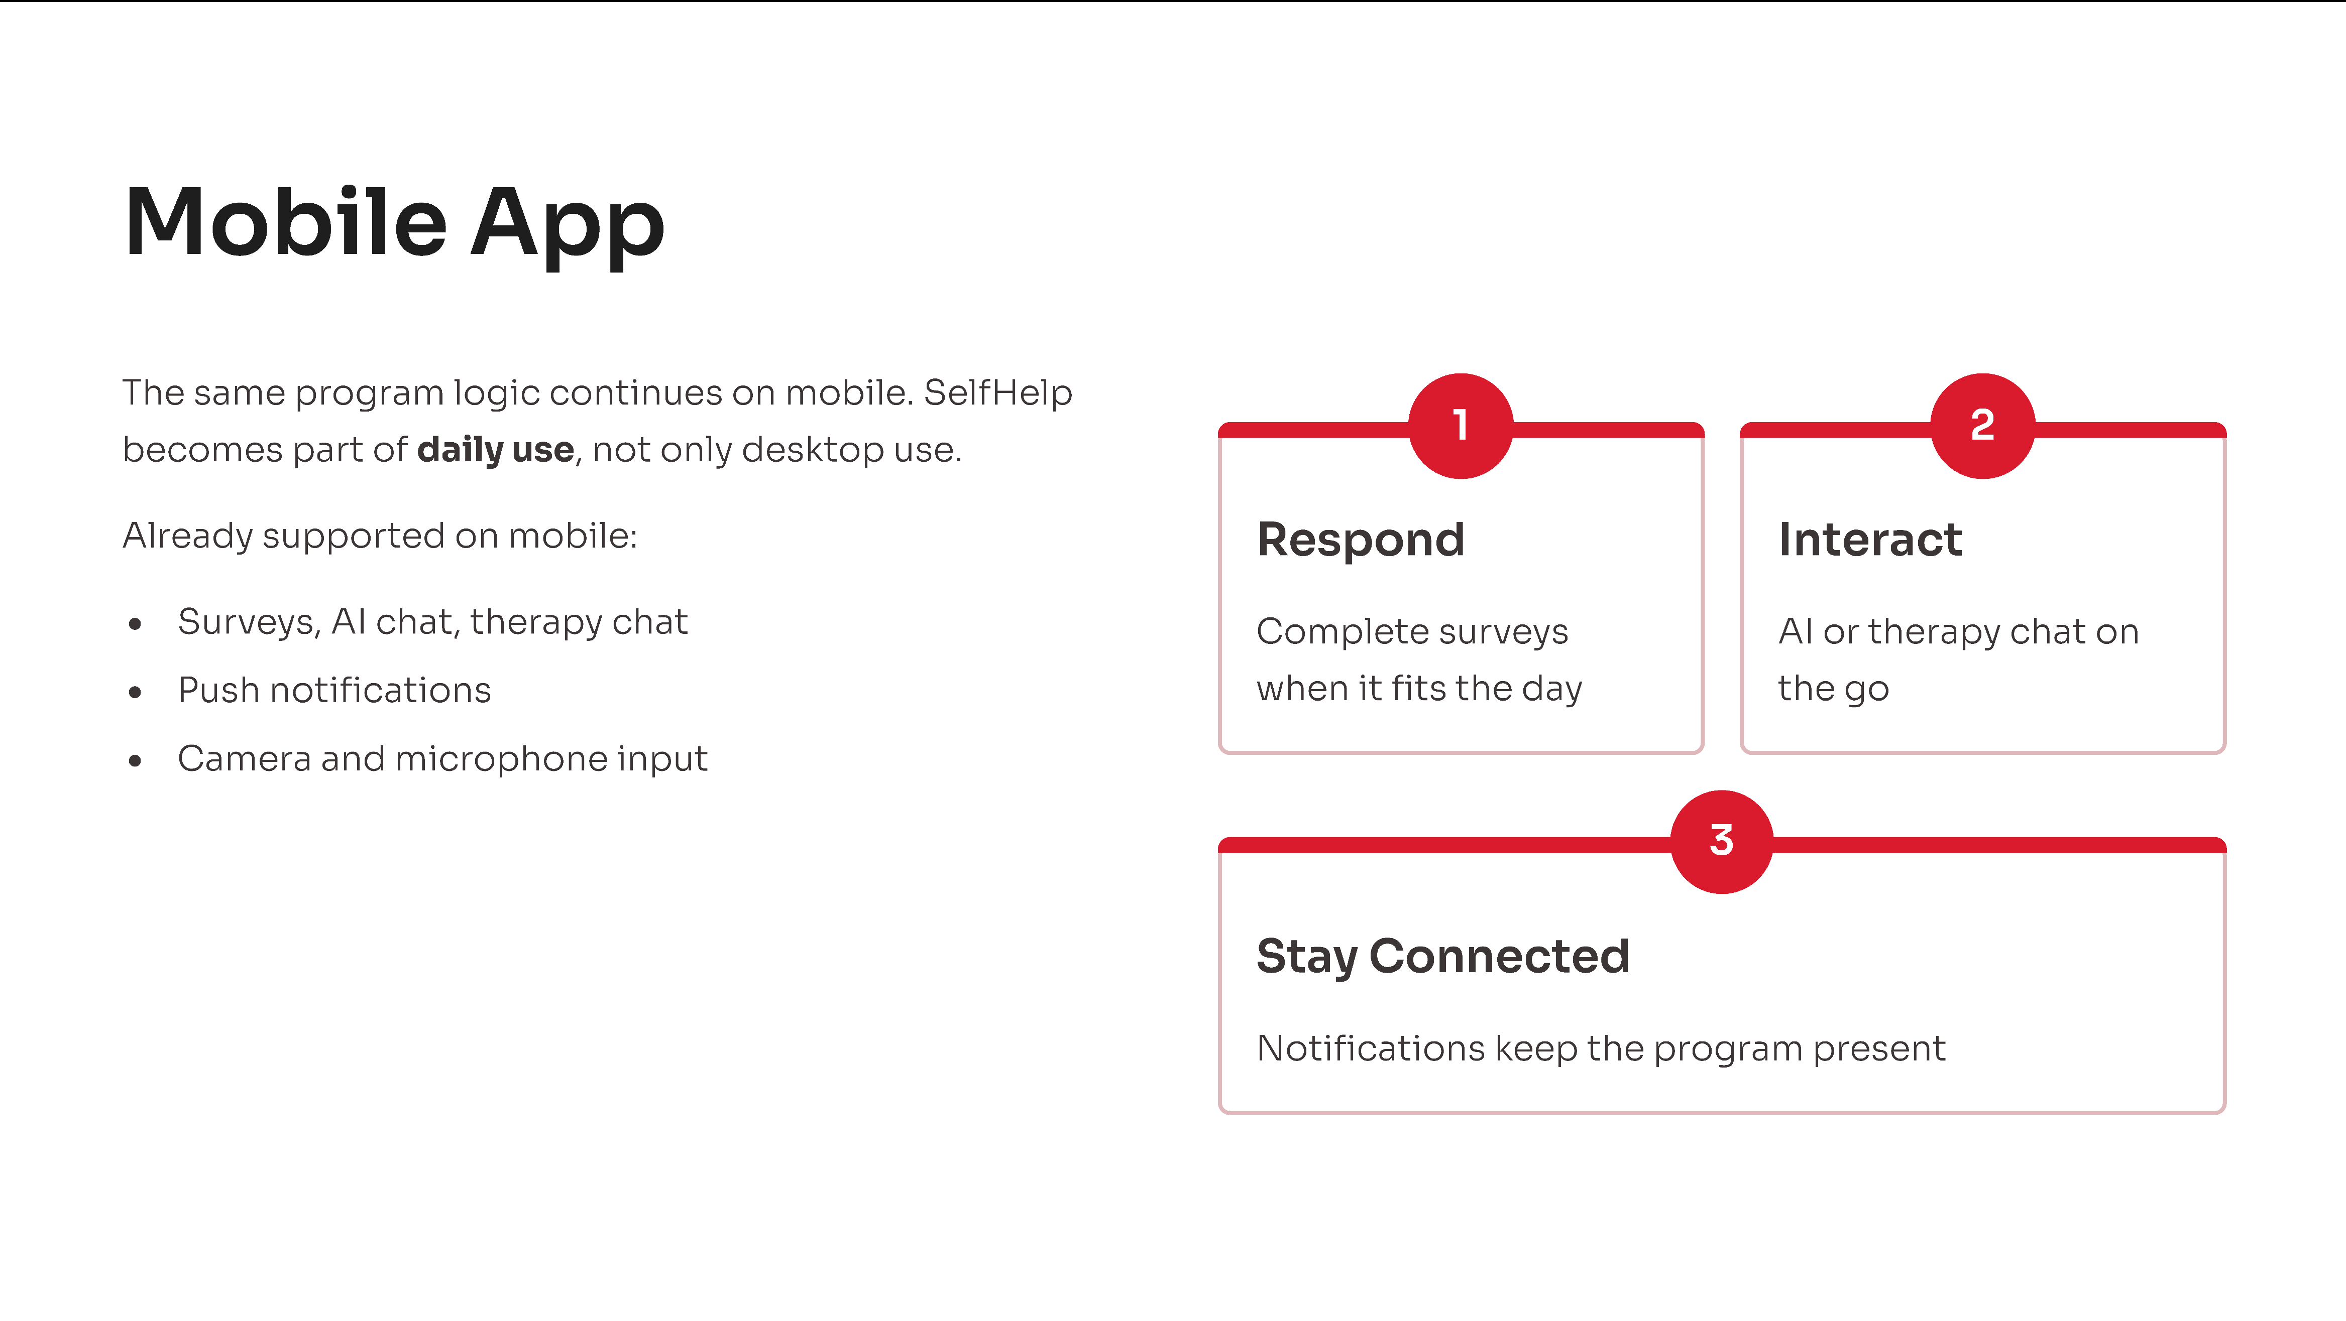
Notes:
Just to briefly mention — the platform also comes with a native mobile app.
Not every study works well on desktop or in the browser, and a mobile app can really boost engagement.
It makes it easier for users to participate and stay active.
And the best part is, everything you’ve already built for the web works seamlessly in the app too.

Slide 9
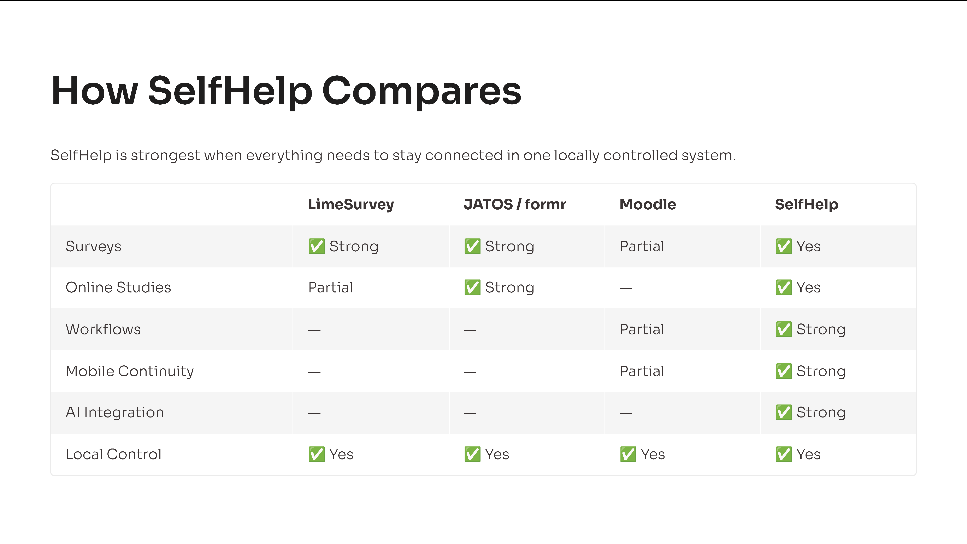
Notes:
If we compare SelfHelp to other systems, it’s important to be fair.
There are several strong open-source tools, such as LimeSurvey, JATOS, formr, or Moodle.
Each of these systems is excellent in its own area:
👉JATOS and formr are very strong for online studies
👉LimeSurvey is specialized in surveys
👉Moodle is designed for learning environments
What makes SelfHelp different is not that it replaces these tools.
The real strength lies in the connection between all components bringing them all within a single platform.
So if someone only needs one specific function, a specialized tool might be the better choice.
But if someone is looking for an integrated, end-to-end solution, then SelfHelp really stand outs.

Slide 10
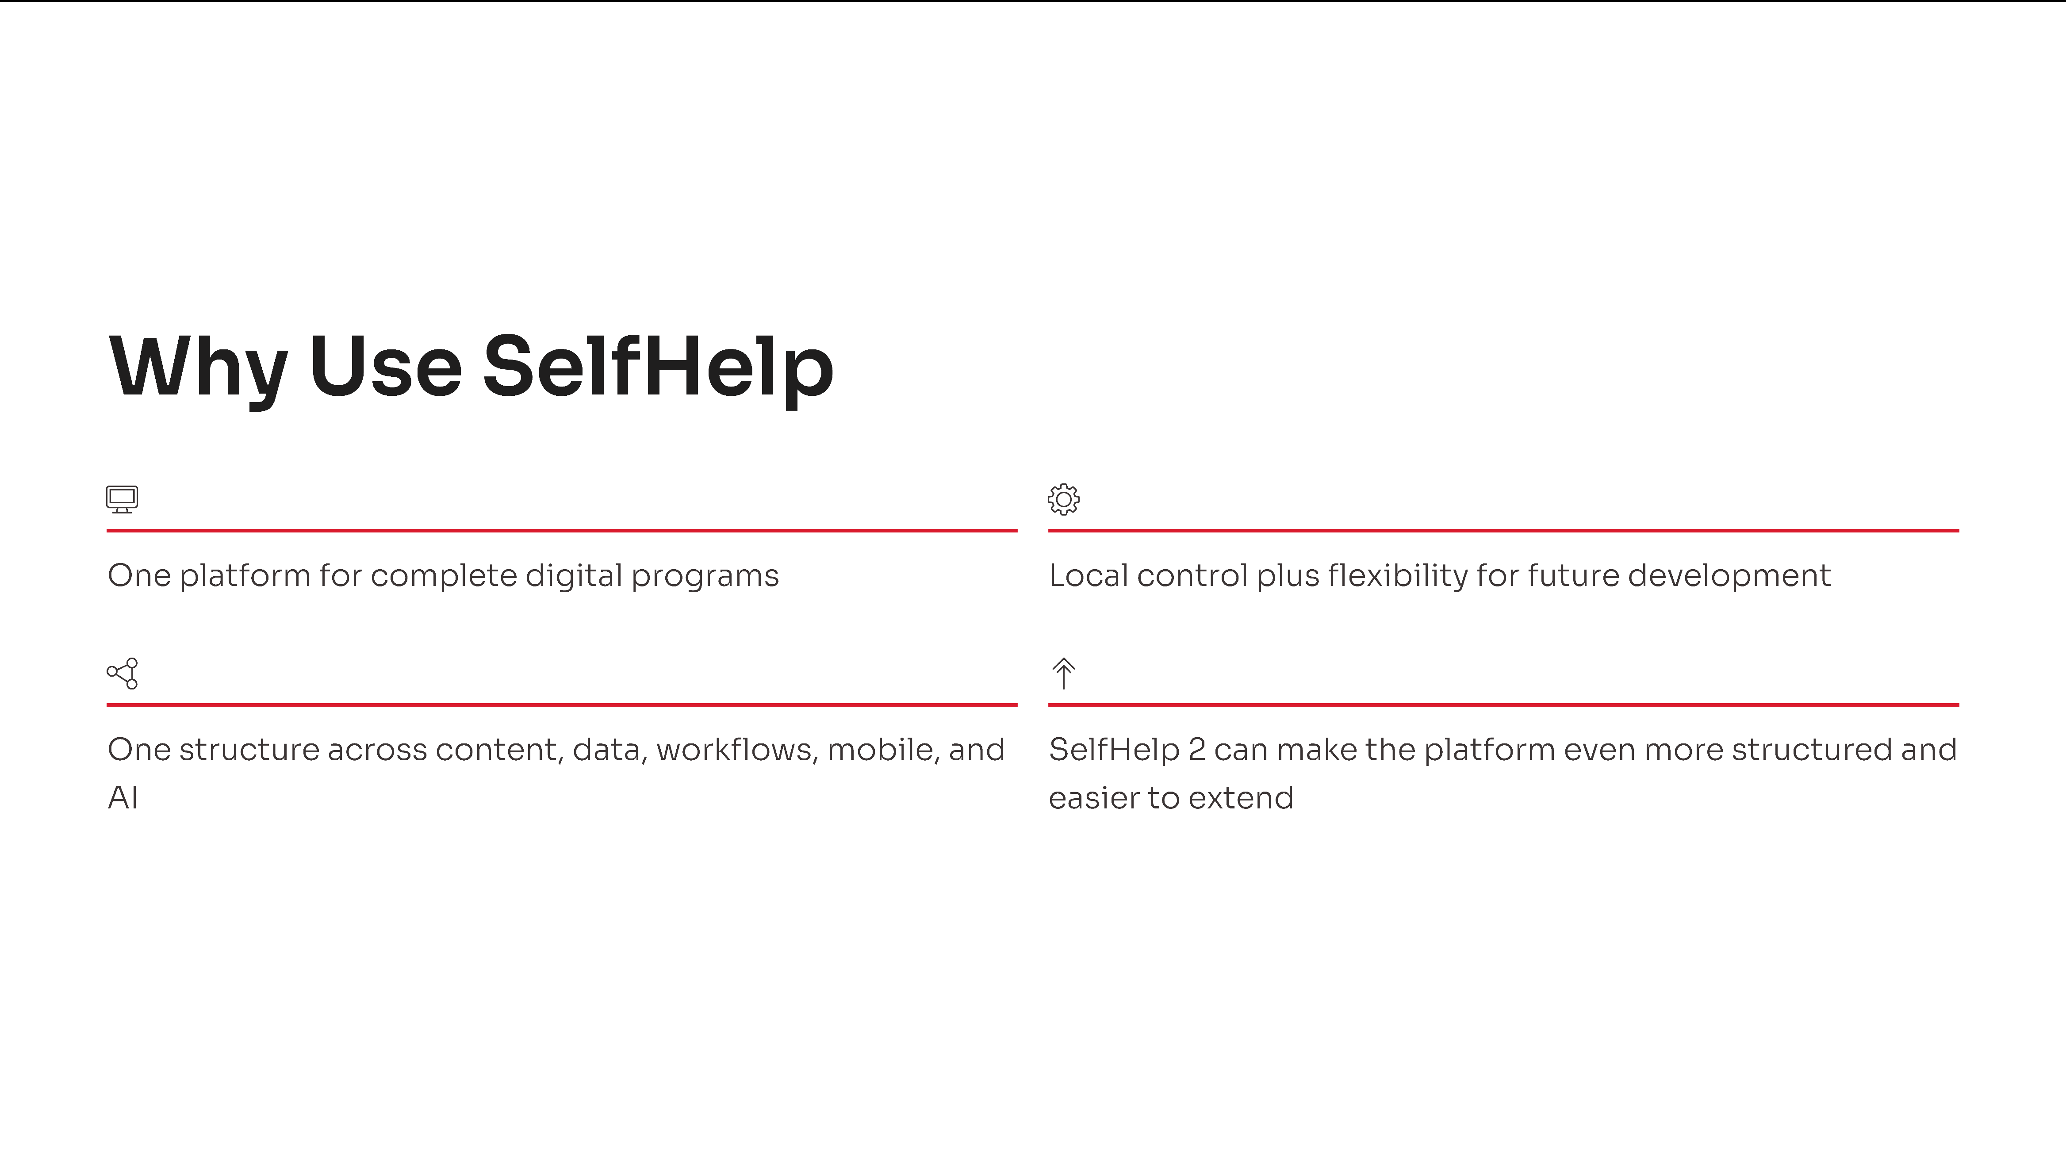
Notes:
So, why use SelfHelp?
The biggest reason is integration.
Instead of splitting your work across multiple tools, everything is combined in a single platform which can be installed locally in the University.
As we have seen, the platform is evolving, we’re continuously improving and maintaining it.
We are also developing SelfHelp 2, a completely redesigned version with the goal of making it simpler to use.
One particularly promising feature is AI-supported content creation.
This will allow teams to create content for web and mobile much faster.
And the time saved can be reinvested into what really matters for you as researchers:
👉Improving study quality
👉And refining study design
So the key message is:
👉 SelfHelp moves us away from isolated digital tools 👉 toward a single, integrated platform for research.

Slide 11

Notes:
Last but not least, I would like to thank Thomas Berger and his group, as well as Tina Hascher and her team, for the great collaboration on the LLM plugin implementations.
I would also like to highlight that all of this is made possible by the local LLM infrastructure, which is currently being developed by the Informatikdienste at the university.
And if you see value in this direction, I will really encourage you to support ID with a short letter of support so that this local LLM service can become a permanent university service.
Thank you very much for your attention.
I will be happy to answer questions, and also happy to talk afterwards if someone wants to discuss ideas in more detail.

