Slide 1
JAIL INFORMATION MANAGEMENT SYSTEM
Review Milestone
Test Plan Report Outline
Oct 21, 2015

Slide 2
Our Team
Joseph Comeau
Team manager
David Edwards
Testing
Mike Pasek
User interface
Eric McCoy
Development Activities
Erik Micklesen
Development Activities

Slide 3
Overview
The Jail Information Management System (JIMS) team is developing a replacement system for the sheriff’s department booking and inmate management systems. The major capabilities for this system include
Detention processing that includes the capture of booking information
Trust accounting that tracks inmate financial accounts
Property management that tracks inmate non-financial property that is being held by the jail until the inmate is released
Sentence calculation that computes the amount of time an inmate must serve and his/her release date.

Slide 4
What Are we testing
JIMS is a cloud hosted application
Browser based user interface
Primarily written in Python
Uses open source COTS products

Slide 5
Software Test Environment
Hardware:
Cloud Hosted Unix/Linux machines:
Maintenance should be minimal
Software:
HTML/CSS, Python, and JavaScript
PyUnit for automated unit testing
Selenium WebDriver for UI testing

Slide 6
Test Descriptions
JIMS system framework tests
Graph Based tests for ensuring proper navigation between pages
User input:
Test validity of the input entered by users
Equivalence partitioning / input validation
Correct data type
Valid format

Slide 7
Test Descriptions (cont)
User-interface/Demonstration tests:
Tests UI functionality via demonstration and Selenium
Login process
Page Navigation
User-maintained lists tests:
Comparison tests with pre-defined inputs and expected outputs
User-System interaction tests:
Usage based tests to ensure proper user-system interaction
Database functionality tests:
Tests database functionality
E.g. Data persistence & response time

Slide 8
Data Recording, Reduction, Analysis
Equivalence Class Partitioning –
Divide inputs into classes deemed equivalent for the purposes of finding errors
Example: Input Types
Text-Based data – name, appearance, comments, descriptions
Boolean data – medical conditions, sex
Numerical data – SSN, Department/Officer ID, weight, height, date/time
Unique data – addresses, license number, phone number, arrest charges

Slide 9
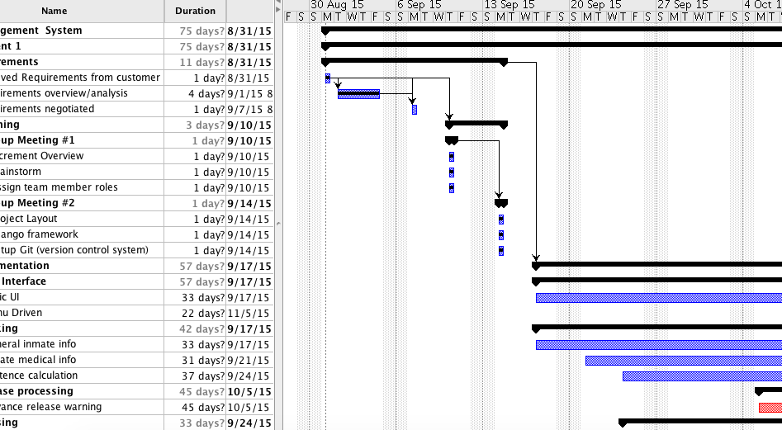
Schedule
Please see OpenProj for schedule details

Slide 10
JIMS
Please See OpenProj for schedule details
Source Code for JIMS can be found at
https://github.com/humdings/Jims-CS532

