Slide 1
JAIL INFORMATION MANAGEMENT SYSTEM
Review Milestone
Requirements Analysis and Project Plan Report Content
September 30, 2015

Slide 2
Our Team
Joseph Comeau
Team manager
David Edwards
Testing
Mike Pasek
User interface
Eric McCoy
Development Activities
Erik Micklesen
Development Activities

Slide 3
Overview
The Jail Information Management System (JIMS) team is developing a replacement system for the sheriff’s department booking and inmate management systems. The major capabilities for this system include
Detention processing that includes the capture of booking information
Trust accounting that tracks inmate financial accounts
Property management that tracks inmate non-financial property that is being held by the jail until the inmate is released
Sentence calculation that computes the amount of time an inmate must serve and his/her release date.

Slide 4


Development Environment
OS independent web framework:
Developers can work locally with their choice of OS
Windows / OS X / Linux
Programming Language(s)
Python backend (django)
JavaScript / HTML / CSS front end

Slide 5
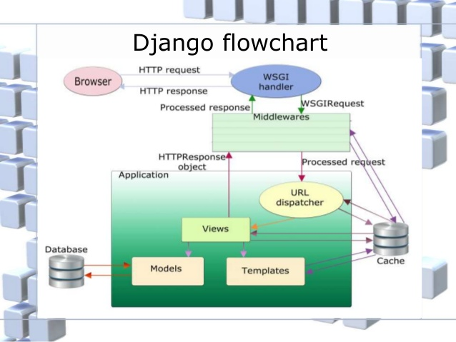
Application Architecture (5000 ft. view)

Slide 6
ICSM Common Case
Software-intensive application or system
software application/system that executes on one or more commercial hardware platforms. It can be a stand-alone software system or a constituent within one or more systems of systems.

Slide 7
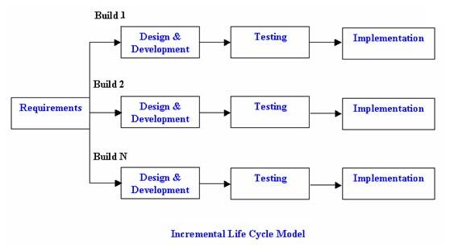
Life Cycle Model
Incremental Life Cycle Model

Slide 8
Process Methodology
Extreme Programming (XP)
Well suited for small teams working in close proximity
Responsive to changing customer requirements
Short development cycles with frequent releases
Promotes frequent communication between team members

Slide 9
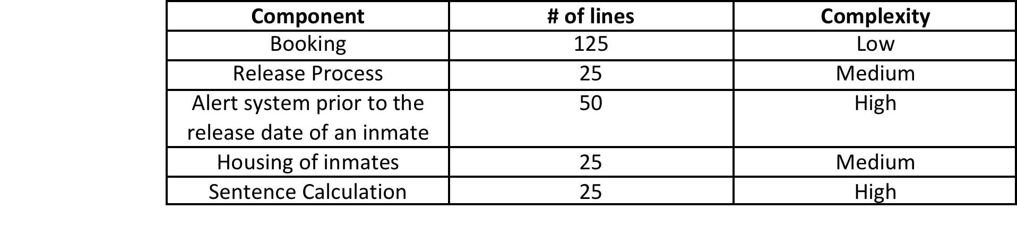
Software Size
Estimation method:
source lines of code (SLOC) via COCOMO II
New lines of code = 250
Reused lines of code = 10,000 (django)
Modified lines of code = 0
Total Equivalent Size = 250 SLOC
Component breakdown

Slide 10
Software Size (cont.)
Estimated labor hours required for the first increment will be ~ 3.2 months.
Requirements may have to be adjusted due to the fact that we are all part-time.

Slide 11
Requirements
High priority requirements for the first increment
Detention processing
43 items related to inmate data entry
Ex. Name, address, birth date, gang affiliations
Inmate release
5 items related to release date calculations
System and Performance
3 items related to system performance
Ex. System response time upon database data entry

Slide 12
Initial Requirements by Functional Area
Functional Area | Total # Requirements | High Priority | Medium Priority | Low Priority
System and Performance Requirements | 5 | 3 | 1 | 1
Framework | 1 | 0 | 1 | 0
Detention Processing Requirements | 67 | 43 | 23 | 1
Trust Accounting Requirements | 0 | 0 | 0 | 0
Inmate Property Requirements | 0 | 0 | 0 | 0
Inmate Release | 5 | 0 | 5 | 0
Diposition/Sentence Calculation Requirements | 0 | 0 | 0 | 0

Slide 13
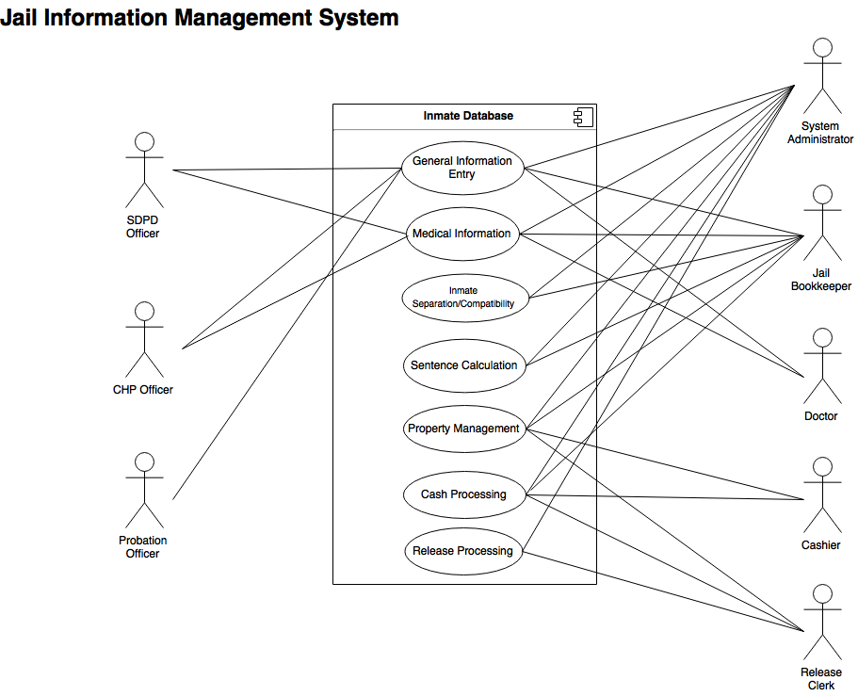
Unified Modeling Language Diagram

Slide 14
Risks
Time constraints:
The JIMS team is composed of full time college students, most of whom also have jobs
Familiarity Risk
Most team members are not familiar with Python and Django so the initial learning curve is steep
Complexity Risk
The sentencing/release date algorithm is complex and may need to be broken into multiple increments

Slide 15
JIMS
Source Code for JIMS can be found at
https://github.com/humdings/Jims-CS532

